Slide 1
Maven

Slide 2
Maven
Apache Maven is a build tool mainly for Java applications to help the developer at the whole process of a software project

Slide 3
What Maven Does?
Compilation of Source Code
Running Tests(unit tests and functional tests)
Packaging the results into JARs, WARs ,EARs etc.
Upload the packages to remote repos(Nexus, Artifactory)
Notes:
JAR- Java Archive file
WAR- Web Archive file
EAR- Enterprise Archive file

Slide 4
Installing Apache Maven
In windows:
The installation of Apache Maven is a simple process of extracting the archive and adding the bin folder with the mvn command to the PATH
mvn – version (Print the version of maven installed in your machine)
For other environment:
Please refer to the below link:
https://maven.apache.org/install.html

Slide 5
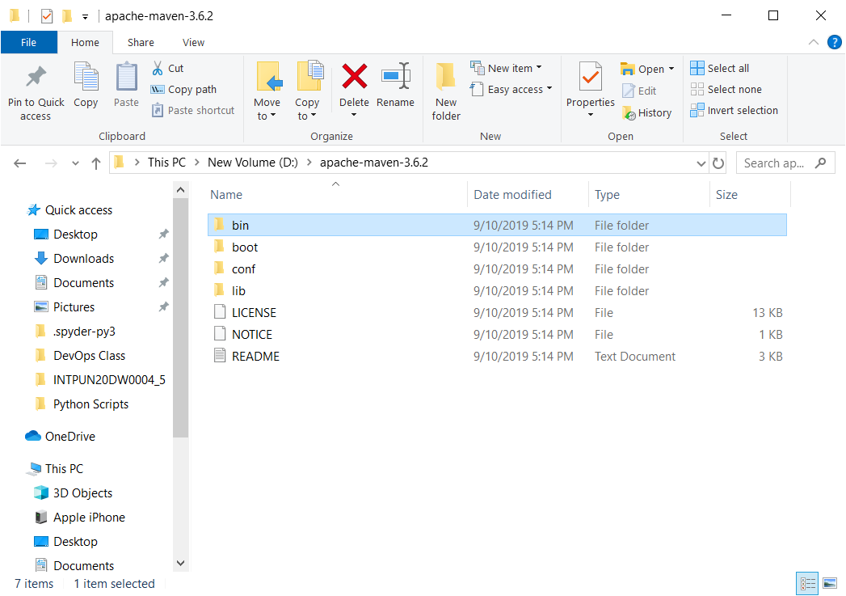
Apache Maven in Windows
Notes:
You can set the class in windows in environment variables

Slide 6
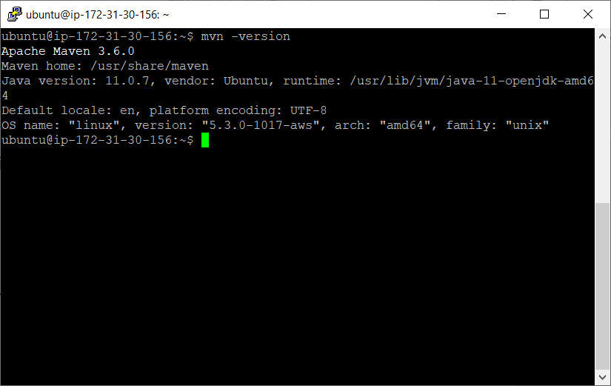
Apache Maven in Ubuntu

Slide 7
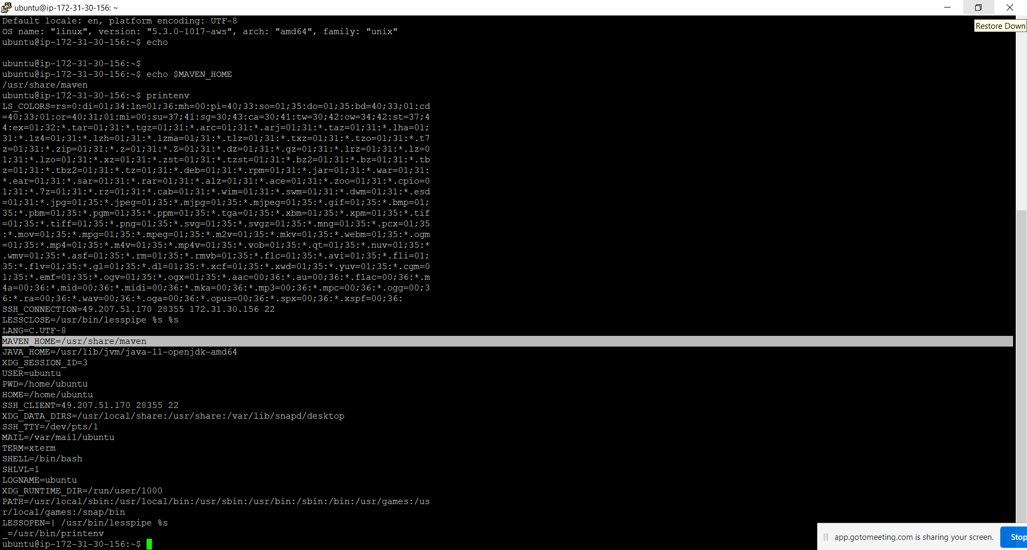
Apache Maven in Ubuntu
Notes:
Use printenv command to know the MAVEN_HOME in ubuntu
Or
echo $MAVEN_HOME

Slide 8
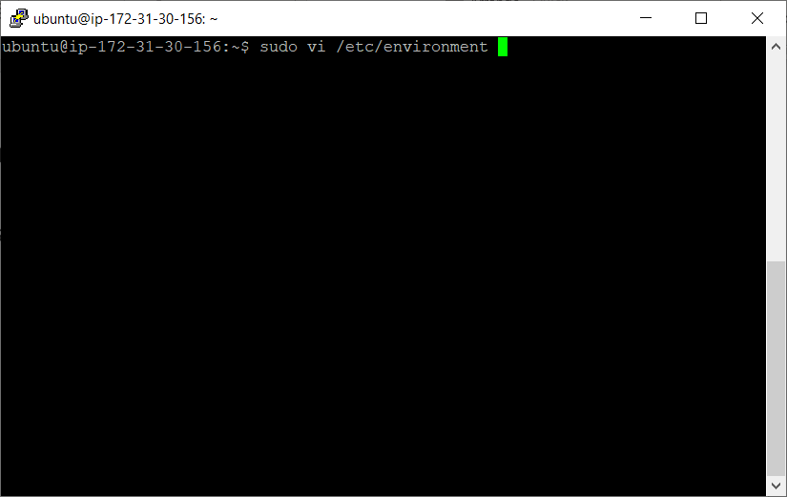
Apache Maven in Ubuntu
How to set MAVEN_HOME path in Ubuntu?
Edit /etc/environment file using vi editor or any other editor
$ sudo vi /etc/environment

Slide 9
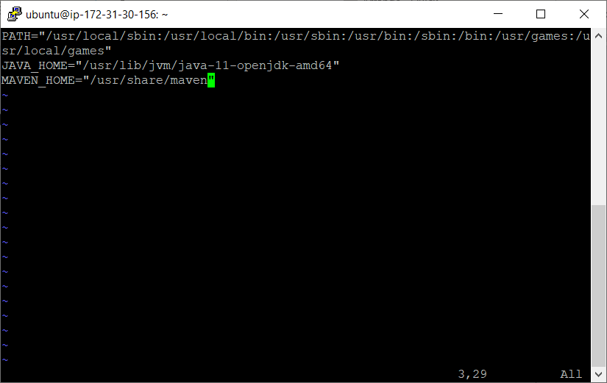
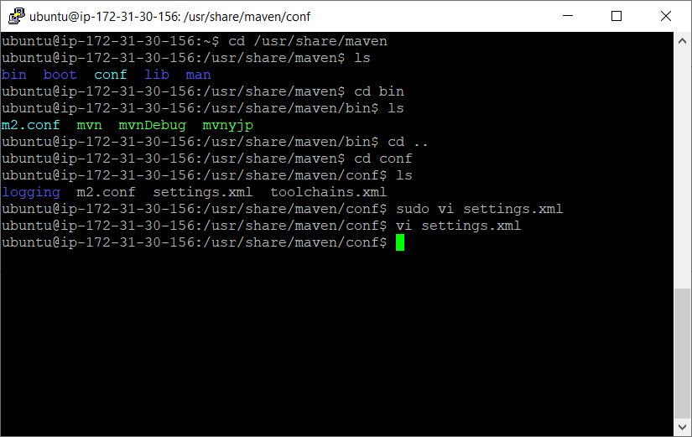
Apache Maven in Ubuntu
Enter JAVA_HOME and MAVEN_HOME at end of the file .
You need to set path of java and maven
Notes:
First Java should be installed otherwise you will get error when you try to execute the mvn –version command or any other mvn command

Slide 10
Maven Build Lifecycle
There are three built-in build life cycle
clean
default
site
A life cycle has multiple phases.
Notes:
Maven defines and follows conventions.
Right from the project structure to building steps, Maven provides conventions to follow.
If we follow those conventions, with minimal configuration we can easily get the build job done.

Slide 11
Maven Build Lifecycle .. contd
A life cycle has multiple phases
For example:
“default” lifecycle has following phases (listed only the important phases) :
compile — compiles the source code
test — executes unit test cases
package — bundles the compiled code (Ex: war / jar)
install — stores the built package in local Maven repository
deploy — store in remote repository for sharing

Slide 12
Maven Build Lifecycle
Example ...contd
For all the phases in previous slide, we just have to call one command:
mvn <phase> { Ex: mvn install }
$ mvn install
For the above command, starting from the first phase, all the phases are executed sequentially till the ‘install’ phase.
Notes:
For the above command, starting from the first phase, all the phases are executed sequentially till the ‘install’ phase.

Slide 13
Maven Build Lifecycle
A goal represents a specific task which contributes to the building and managing of a project. It may be bound to zero or more build phases.
A goal not bound to any build phase could be executed outside of the build lifecycle by direct invocation.
The order of execution depends on the order in which the goal(s) and the build phase(s) are invoked. For example, consider the command below.
The clean and package arguments are build phases while the dependency:copy-dependencies is a goal.
mvn clean dependency:copy-dependencies package
Notes:
Here the clean phase will be executed first, followed by the dependency:copy-dependencies goal, and finally package phase will be executed.

Slide 14
Maven Repository
Repository is where the build artifacts are stored.
Build artifacts means,
the dependent files (Ex: dependent jar files)
the build outcome (the package we build out of a project).
There are two types of repositories
Local
Remote

Slide 15
Local vs Remote Repository
Local maven repository(.m2) is in the user’s system.
It stores the copy of the dependent files that we use in our project as dependencies.
Remote maven repository is setup by a third party(nexus) to provide access and distribute dependent files.
Ex: repo.maven.apache.org from internet.
In settings.xml in mirror section you can find remote repository link
<mirror>
<id>planetmirror.com</id>
<name>PlanetMirror Australia</name>
<url>http://repo.maven.apache.org/maven2</url>
<mirrorOf>central</mirrorOf>
</mirror>

Slide 16
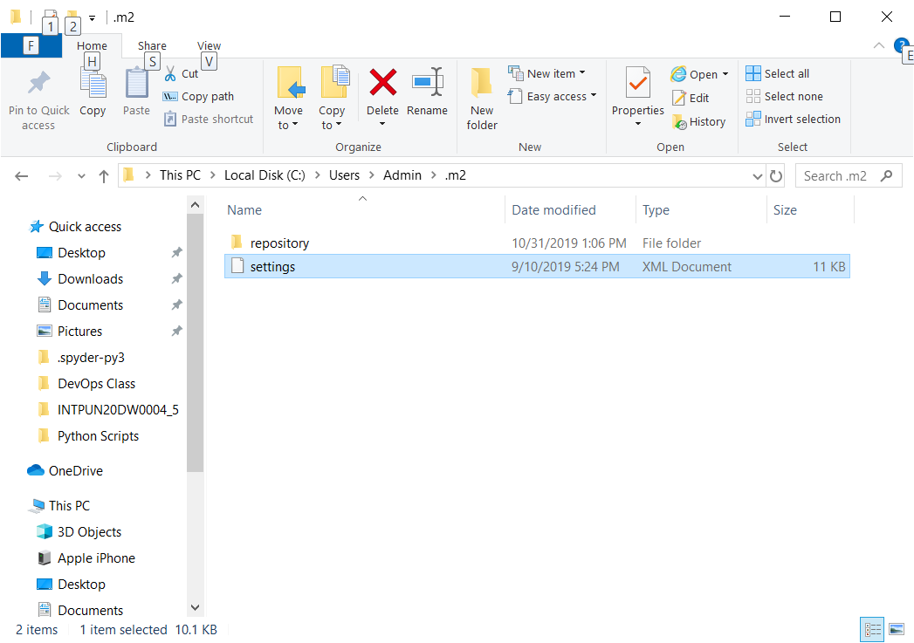
Local vs Remote Repository
.m2 folder in windows

Slide 17
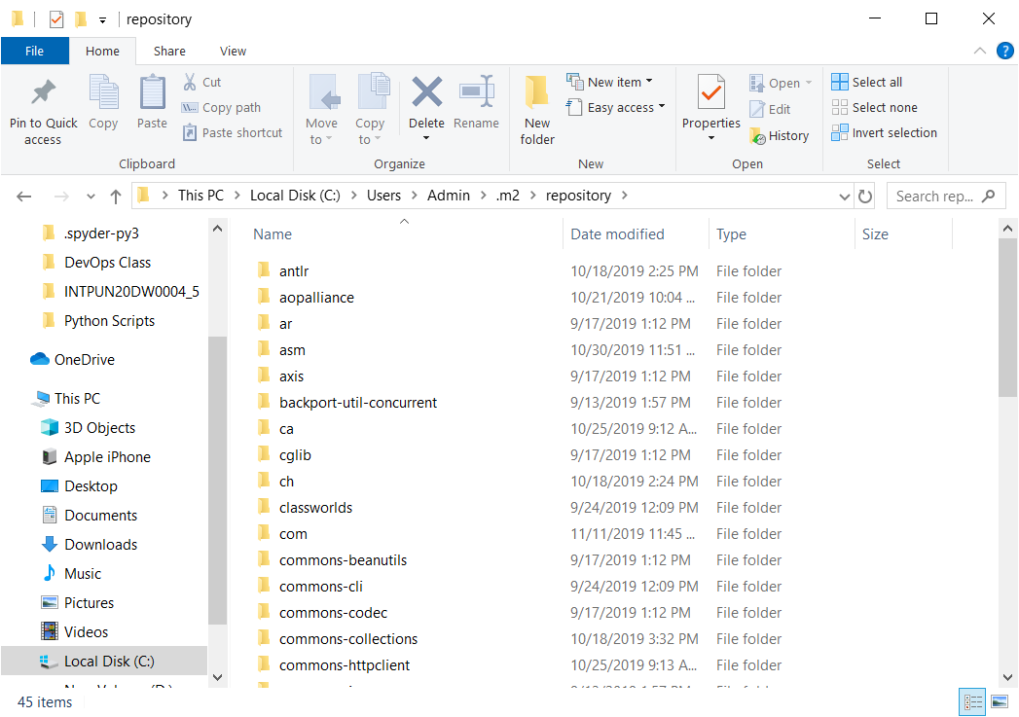
Local vs Remote Repository
.m2 folder in windows
Inside repository folder
Notes:
Repository folder will be occupied by the dependencies which will downloaded when we execute mvn command like mvn install

Slide 18
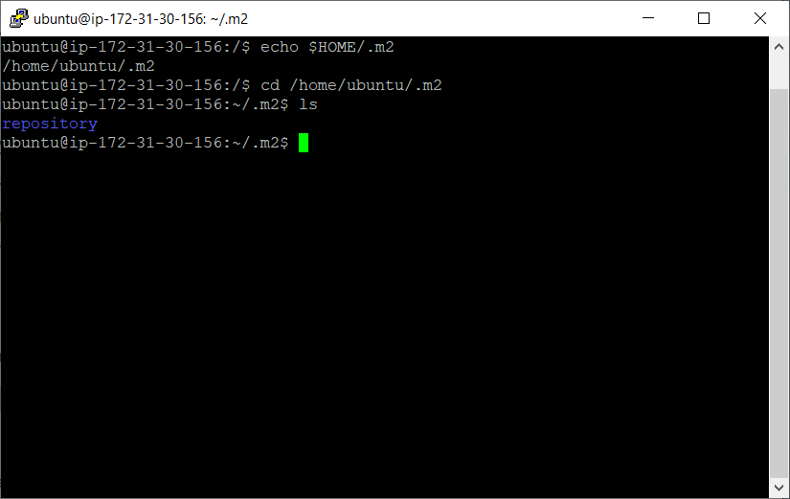
Local vs Remote Repository
.m2 folder in ubuntu

Slide 19
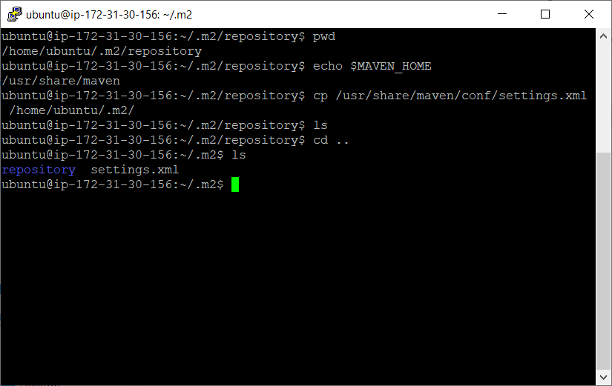
Local vs Remote Repository
Copy settings.xml to .m2 folder in Ubuntu

Slide 20
POM – Project Object Model
Fundamental unit of work in Maven.
Its an XML file that resides in the base directory of the project as pom.xml.
Has all the configuration settings for the project build.
Generally we define the project dependencies (Ex: dependent jar files for a project), maven plugins to execute and project description /version etc.

Slide 21
POM – Project Object Model
Simplest pom.xml should have 4 important information.
modelVersion-4.0.0 (POM version for Maven 2 and is always required)
groupId —will identify your project uniquely across all projects, ex:ebs.obill.webs, com.companyname.project
artifactId — is the name of the jar/war/ear without version(keeping in mind that it should be jar-name friendly)
version — if you distribute it then you can choose any typical version with numbers and dots (1.0, 1.1, 1.0.1, …)
<project>
<modelVersion>4.0.0</modelVersion>
<groupId>com.intuit.jsapp</groupId>
<artifactId>js-app</artifactId>
<version>1</version>
</project>

Slide 22
Maven Dependencies
There is an element available for declaring dependencies in project pom.xml
Used to define the dependencies that will be used by the project.
Maven will look for these dependencies when executing in the local maven repository.
If not found, then Maven will download those dependencies from the remote repository and store it in the local maven repository.

Slide 23
Maven Dependencies
Example: Declaring junit and log4j as project dependencies-
<dependencies>
<dependency>
<groupId>junit</groupId>
<artifactId>junit</artifactId>
<version>3.8.1</version>
<scope>test</scope>
</dependency>
<dependency>
<groupId>log4j</groupId>
<artifactId>log4j</artifactId>
<version>1.2.12</version>
<scope>compile</scope>
</dependency>
</dependencies>
Notes:
scope — describes under which context this dependency will be used.

Slide 24
Maven Plugins
All the execution in Maven is done by plugins.
A plugin is mapped to a phase and executed as part of it.
A phase is mapped to multiple goals.
Those goals are executed by a plugin.
We can directly invoke a specific goal while Maven execution.
A plugin configuration can be modified using the plugin declaration.

Slide 25
Maven Plugins
Example :
For Maven plugin is ‘compiler’, it compiles the java source code.
This compiler plugin has two goals
compiler:compile
compiler:testCompile
Using the configuration element, we can supply arguments to the plugin.

Slide 26
Maven Plugins
Example :
Using the configuration element, we can supply arguments to the plugin.
<build> <finalName>springexcelexport</finalName> <plugins> <plugin> <groupId>org.apache.maven.plugins</groupId> <artifactId>maven-war-plugin</artifactId> <version>2.2</version> </plugin> <plugin> <groupId>org.apache.maven.plugins</groupId> <artifactId>maven-surefire-plugin</artifactId> <version>2.16</version> <configuration> <skipTests>true</skipTests> </configuration> </plugin> </build>

Slide 27
Maven Project Structure
Following is a snap shot from a Maven project and it shows the project structure.
$ tree
.
├── pom.xml
└── src
├── main
│ └── java
│ └── com
│ └── demo
│ └── App.java
└── test
└── java
└── com
└── demo
└── AppTest.java
9 directories, 3 files
Notes:
Maven uses a convention for project folder structure.
If we follow that, we need not describe in our configuration setting, what is located where.
Maven knows from where to pick the source files, test cases etc.

Slide 28
First Maven Project
Let us create our first maven project.
Hope you have setup Maven already.
In Maven we have ‘Archetype’.
It is nothing by a template for projects.
Maven provides templates to start a project and using this we can quickly start a Maven project.
Execute the following command in cmd prompt,
agv$ mvn archetype:generate -DgroupId=com.beCloudReady.demo.java -DartifactId=com.js.demo.java -DarchetypeArtifactId=maven-archetype-quickstart -DinteractiveMode=false
Notes:
This will create a sample Maven project skeleton using we can start building the application.We will get a a pom.xml and let us use that to build the newly created Maven project. Go inside the newly created Maven project root and execute the command (this is where the pom.xml is available),

Slide 29
First Maven Project
Go inside the newly created Maven project root and execute the command (this is where the pom.xml is available),
mvn package
Now this will execute all the Maven phases till the ‘package’ phase. That is, Maven will compile, verify and build the jar file and put it in target folder under the project.

Slide 30
DEMO

