Slide 1

Attention Entrepreneurs, Predictors of Locations of Indian Restaurants in New York City
Kranthi Balusu

Slide 2
Investors need to know where to open restaurants
New York City's demographics show that it is a large and ethnically diverse metropolis
It is the largest city in the United States with a long history of international immigration
Indians are the largest South Asian group, comprising 2.4% of the city's population, among the largest in the US cities
Indian are highly popular in the united states and restaurants attract a diverse set of people, and not just Indian origin people.
This suggests factors other than just ethnicity of the people wouldn't dictate the presence of an Indian restaurant
Business Problem: Determine the variable that can predict the presence of Indian restaurants in NYC
Data savvy entrepreneurs will find location opportunities to open an Indian restaurant

Slide 3
Data Acquisition
Target data
No. of Indian restaurants in New York City boroughs and neighborhoods: Foursquare API
Parameter data
People of Indian Origin in New York City boroughs: https://www.baruch.cuny.edu/nycdata/population-geography/foreign-birthcountry.htm
General population statistic data: https://guides.newman.baruch.cuny.edu/nyc_data/nbhoods
No. of Chinese restaurants in New York City boroughs and neighborhoods: Foursquare API

Slide 4
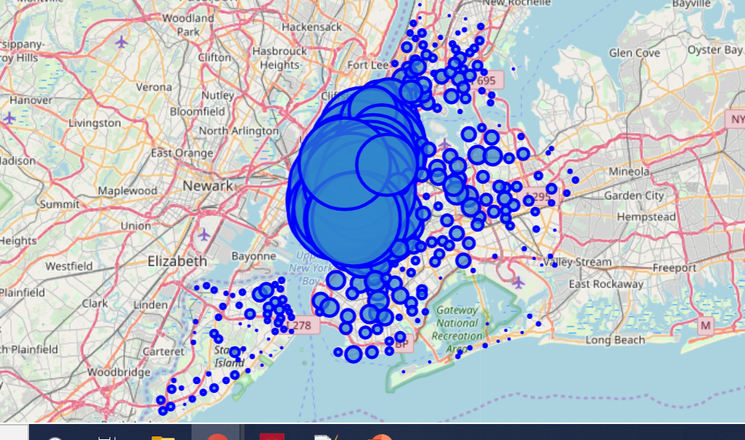
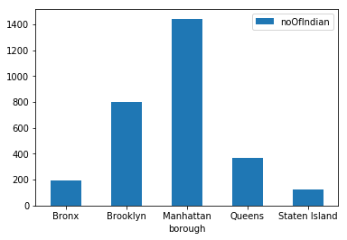
Indian restaurants in NYC: Neighborhoods and boroughs
No. of Indian restaurants
Borough
Most of the Indian restaurants are in Manhattan
Brooklyn and Queens have the next most numbers
Indian restaurants in New York City

Slide 5
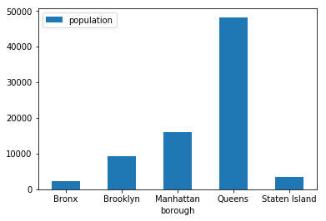
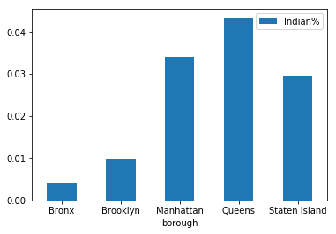
Indian origin people in NYC
Indian origin population
Most Indian origin people in NYC live in Queens
Much less no. of Indians live in other boroughs
Queens also contains the most no. of Indian origin people by fraction of the population; ~ 4% of the total population
The fraction of Indians in Manhattan and Staten Island is also large: >3% of the total population
Borough
% of Indian origin population
Borough

Slide 6
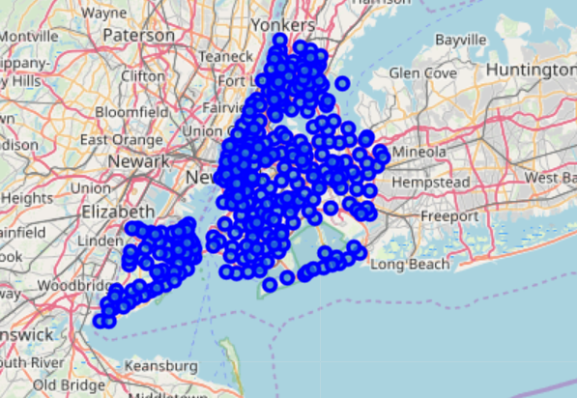
Chinese Restaurants in each NYC Neighborhood

Slide 7
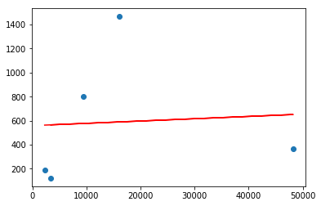
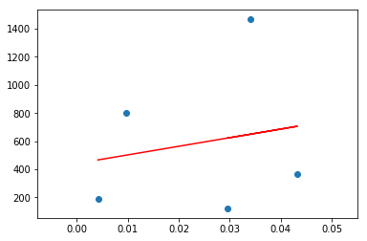
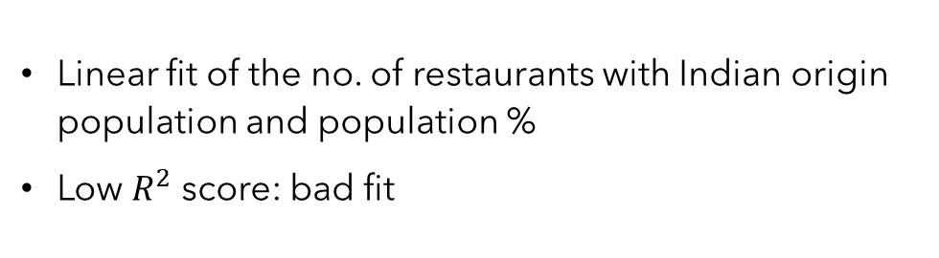


Correlation: with Indian origin population
No. of Indian restaurants
No. of Indian restaurants
Indian origin population
Indian origin population %
$R^{2}$value = 0.004239
$R^{2}$value = 0.03326
Linear fit of the no. of restaurants with Indian origin population and population %
Low $R^{2}$ score: bad fit
No correlation found with population of Indian origin people

Slide 8
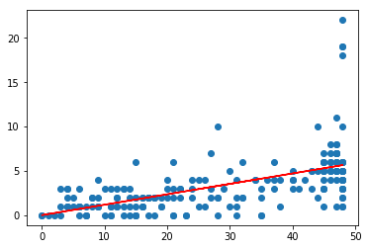

Correlation: with Chinese Restaurants
Linear fit
A better correlation is obtained
The neighborhoods below the linear line indicates low no. of Indian restaurants: An opportunity of entrepreneurs to open Indian restaurants.
No. of Indian restaurants
No. of Chinese restaurants
$R^{2}$value = 0.33520

Slide 9







Conclusion and Future Work
Indian origin population is not related to no. of Indian restaurants
No. of Indian restaurants is better correlated to no. of Chinese restaurants
Neighborhoods to open Indian restaurants in NYC are identified
Other demographic data and tourist information for city like NYC is very important for analysis in the future

