Slide 1


Lending Club Case Study
G. Kranthi Kiran
Nitin Kumar

Slide 2
Agenda
Problem Statement Understanding
Solution Flow Diagram
Solution
Data Preprocessing
Data Cleaning
EDA
Business Drivers and Recommendations
Appendix

Slide 3
Problem Statement Understanding
Dataset Given : Historical Loan Data
GOAL :
Identify profit-makers and loss-making sectors
Analyse the data and make business decisions which drives the business to make more profits and reduce losses
Assumption Made :
We are neglecting current loans and considering only Fully Paid and Charge Off loans

Slide 4
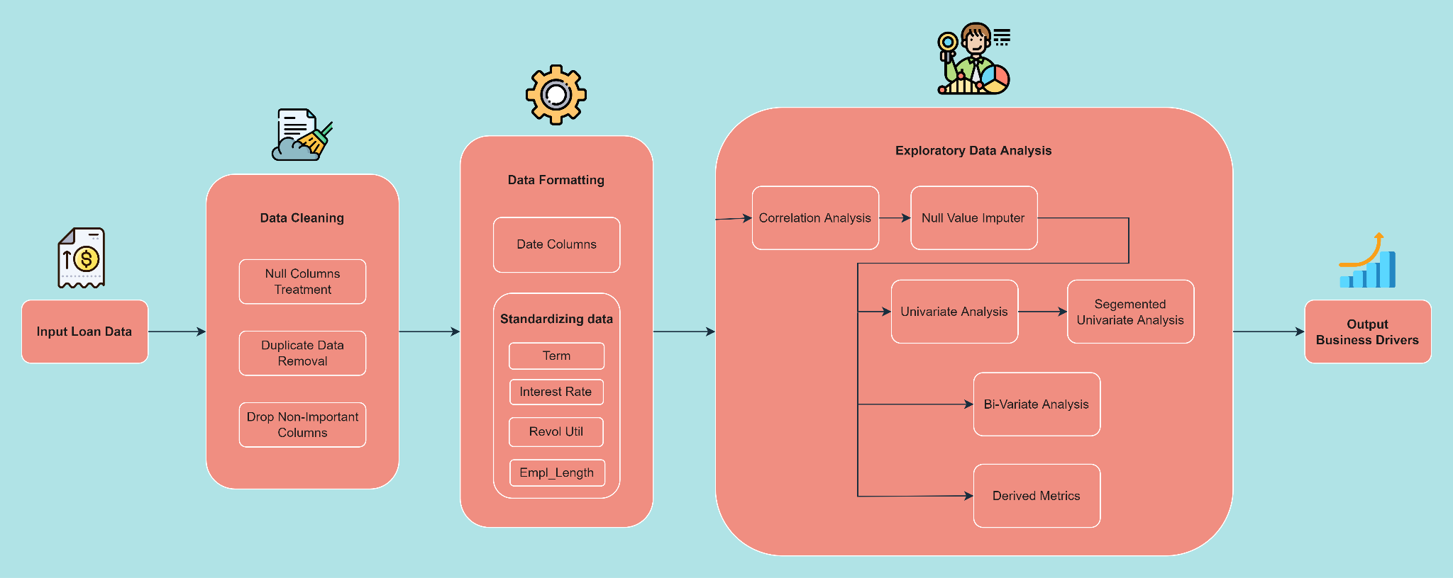
2. Solution Flow Diagram

Slide 5
3. Solution
Data Preprocessing
Data Cleaning
EDA

Slide 6
3.1 Data Preprocessing
Null Column Treatment
Removing columns with 100% null values
Removing duplicate rows
Removing columns which only have 1 unique value i.e has no information
Dropping Columns :
ID columns : fully unique columns
ZipCode : ZipCode contain partial information; lets drop that cause we can use addr_state instead of that
Last payment information : As we're analysing the behaviour of completed loans and charged off loans; there's no point of having last payment information
Post Loan Approval Features : We can't have this information before approving a loan which is our actual goal
Heavily Null Features : Have > 60% null values so isn't contributing a lot of information for our case study

Slide 7
3.2 Data Cleaning
Date Formatting : The columns which contained the date values are issue_d, earliest_cr_line :
Converted the dates into datetime from string data-type so that it helps to visualize data better
Derived features :
issue_d_month
issue_d_year
earliest_cr_line_month
Earliest_cr_line_year
Standardizing columns :
term : removed the keyword “months” and converted into integer data-type
int_rate : removed the “%” character and converted into float data-type
revol_util : removed the “%” character and converted into float data-type
emp_length : removed the keyword “years” and converted into integer data-type
< 1 year is converted to 0
+10 years is converted to 10

Slide 8
3.3 EDA
Correlation Analysis
Target Distribution
Null Value Imputing
Feature Distinction
Categorical Feature Analysis
Numerical Feature Analysis
Date Feature Analysis
Bi-Variate Analysis

Slide 9
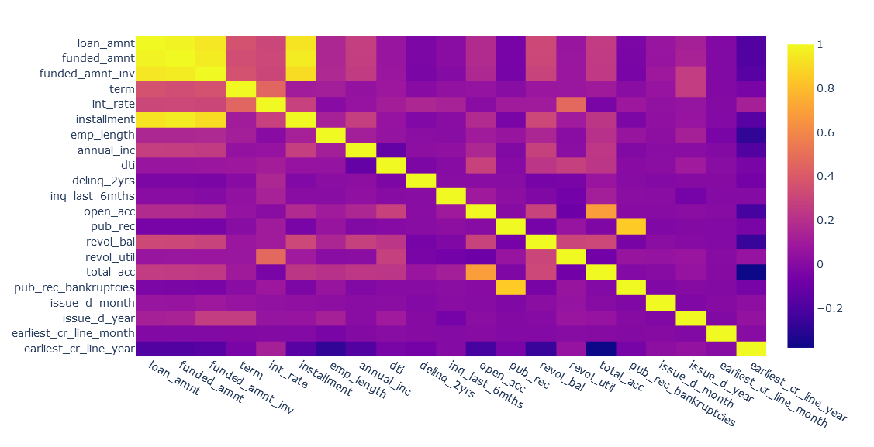
Correlation Analysis
'loan_amnt', 'funded_amnt', 'funded_amnt_inv' and 'installment' have huge correlation(>0.9) within each other
public records related fields i.e 'pub_rec' and 'pub_rec_bankrupcies' have correlation(0.84)
number of accounts fields i.e 'open_acc' and 'total_acc' have correlation(0.68)

Slide 10
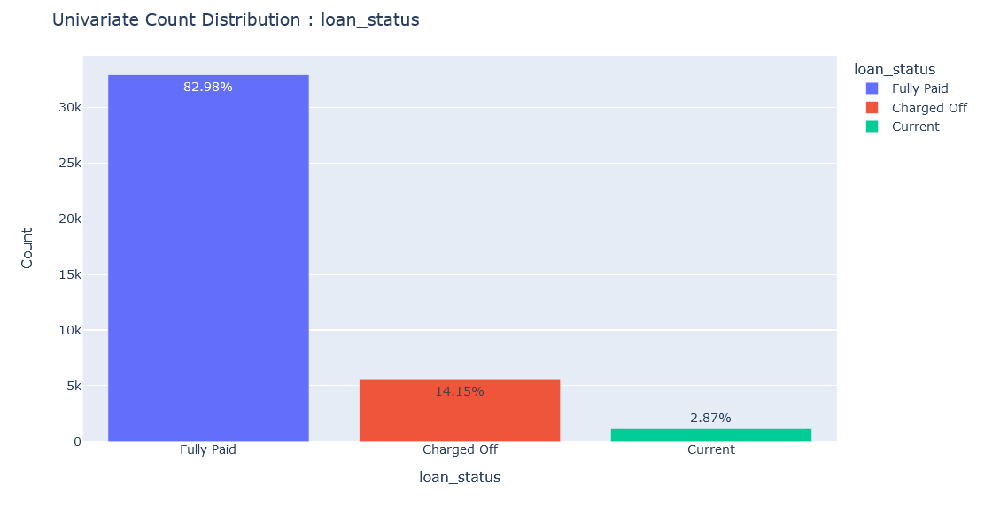
Target Distribution

Slide 11
Null Value Imputing
The following features have null values :
emp_title : filled with “NA”
title : filled with “NA”
pub_rec_bankruptcies : imputed with values of “pub_rec” values as both of them are heavily correlated
emp_length : filled with mode of emp_length i.e 10 years
revol_util : dropped the rows containing revol_util as null as they’re quite insignificant in number (~0.1%)

Slide 12
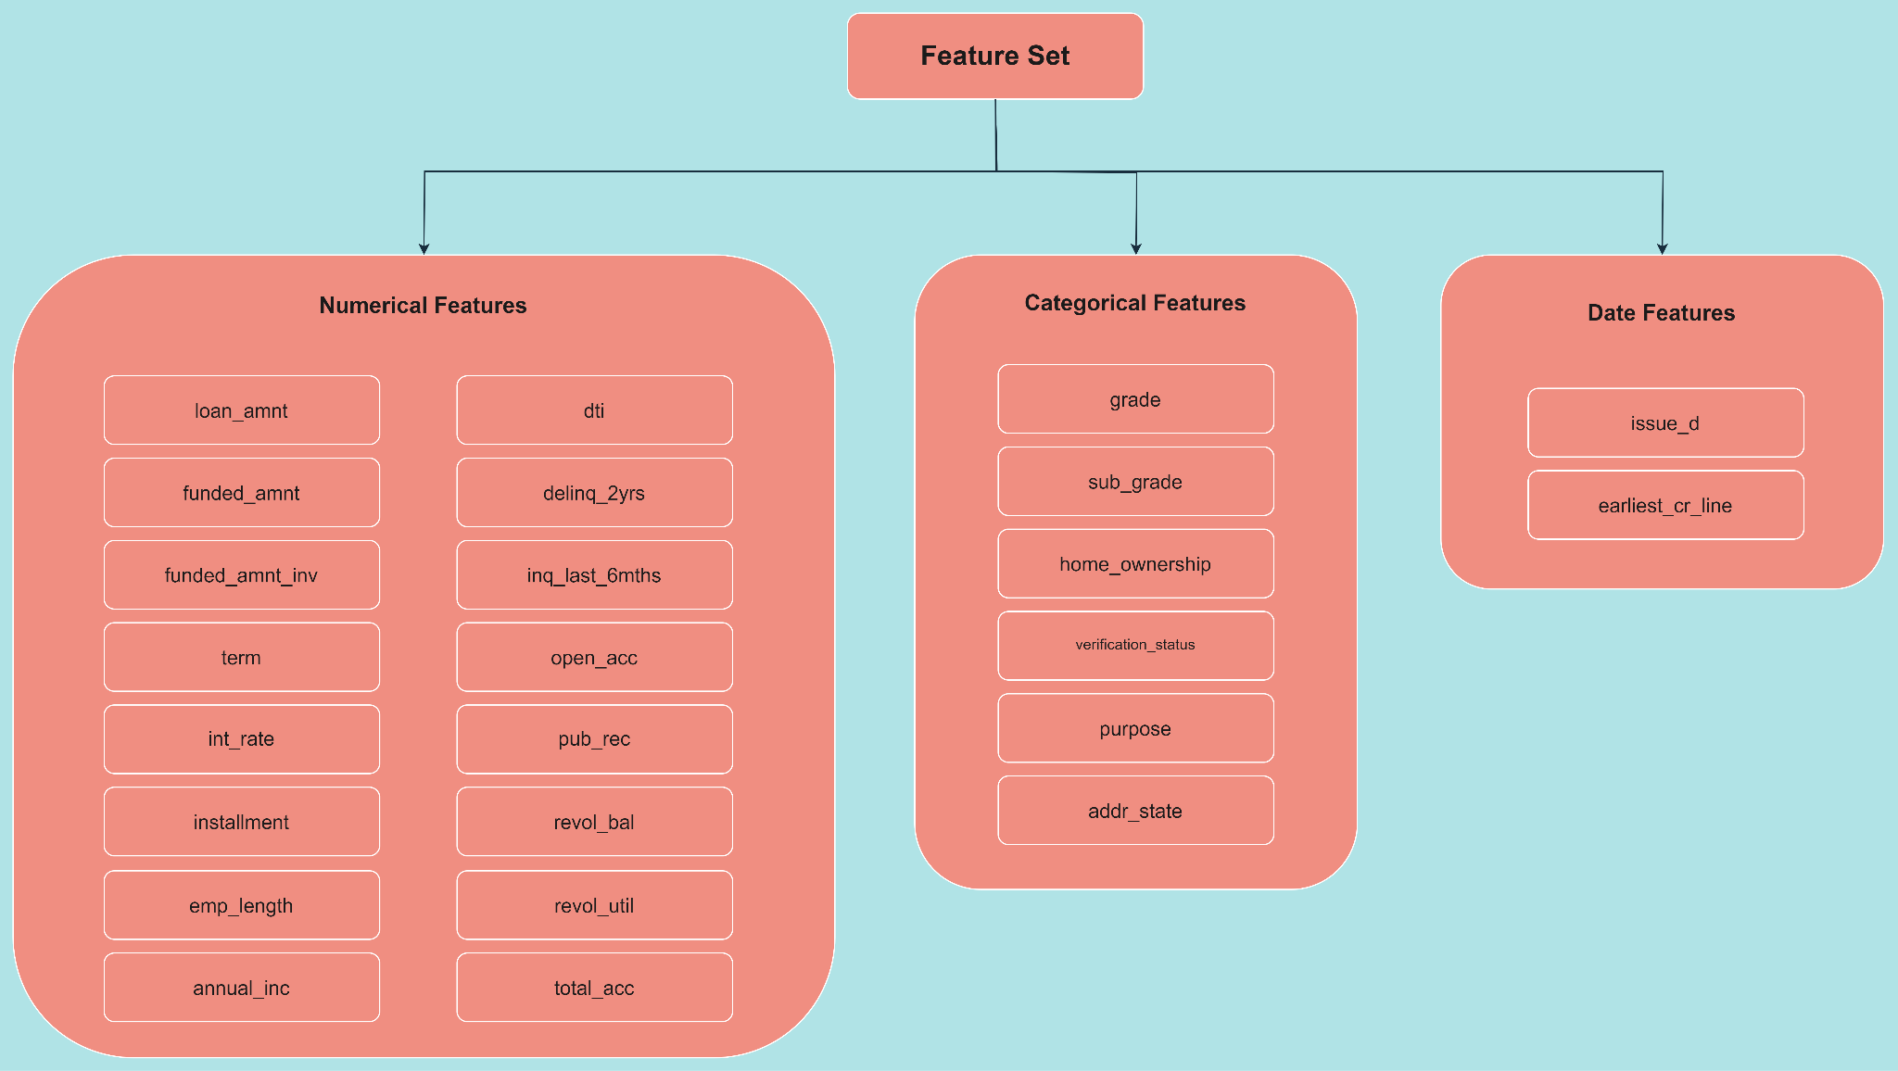
Features Distinction

Slide 13
EDA
Categorical Columns Analysis
The X Axis in the plots is sorted as :
higher “charged off percentage” to the left and lower percentage to the right

Slide 14
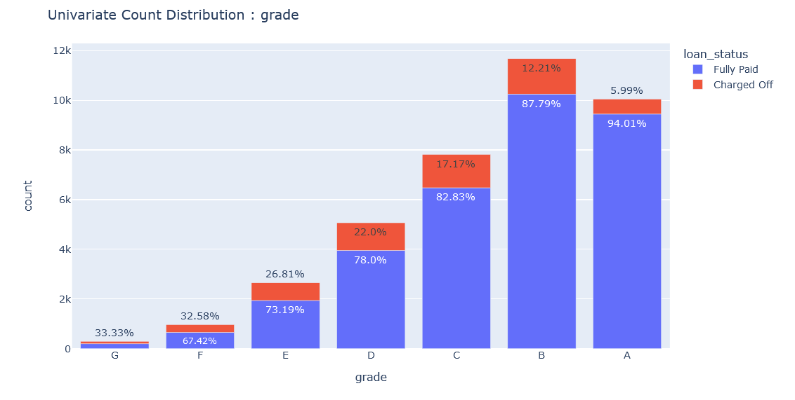
Grade
- lower grades i.e G, F, E, D have so much higher defaulting percentages
- the lowest "Charged Off" percentage comes from A Grade of only 6% defaulters

Slide 15
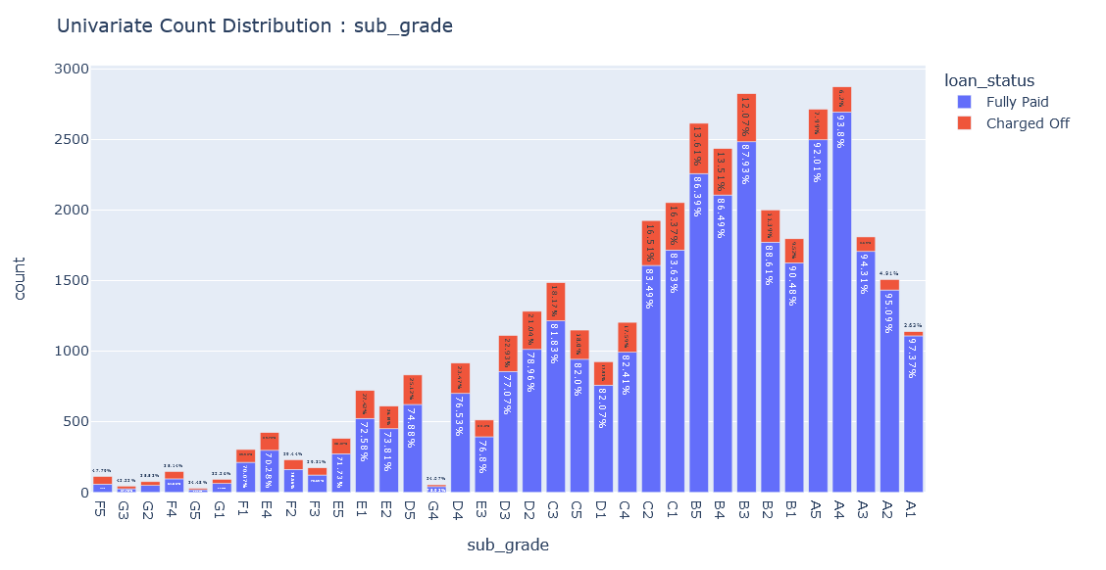
SubGrade
- The Grade "F5" is very very risky as it almost has ~50% of loan defaulting percentage
- The Grade "A1" is more than safe and has ~2% of loan defaulting percentage
- The right-most i.e safest bets for loan lending are very clear i.e A1, A2, .., B4, B5, etc so this means the internal grading algorithm of the lending club is very robust and reliable

Slide 16
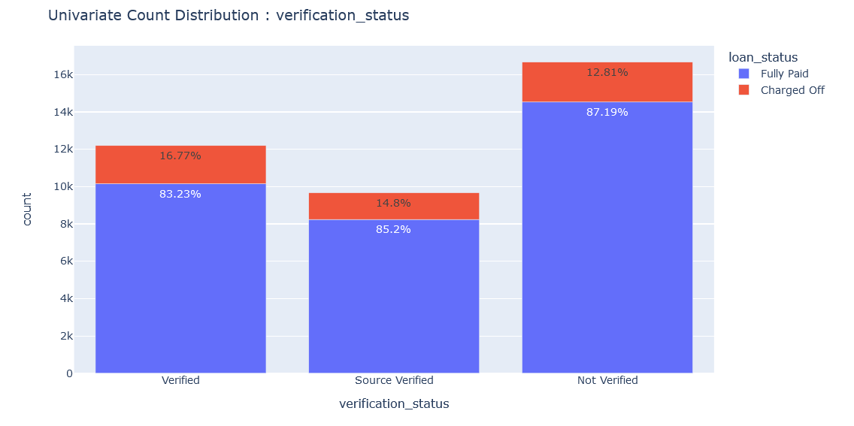
Verification Status
- Not Verified Customers have the least loan defaulting percentage i.e ~13% where as Verified Customers have 15-17%; which doesn't make sense

Slide 17
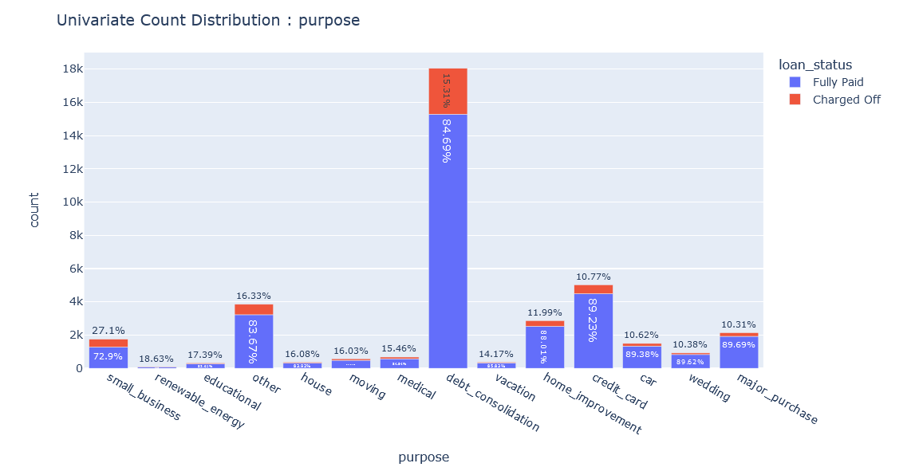
Purpose
- "small business" have the highest tendency of loan defaulting i.e ~27%
- Most of the loans have a purpose of "Debt Consolidation" which has a okay-ish default percentage i.e ~15% which the LC can live through
- "Major Purchase", "Wedding", "Car", "Credit Card" are the most safe bets as they have the least loan default percentage i.e 10-11%

Slide 18
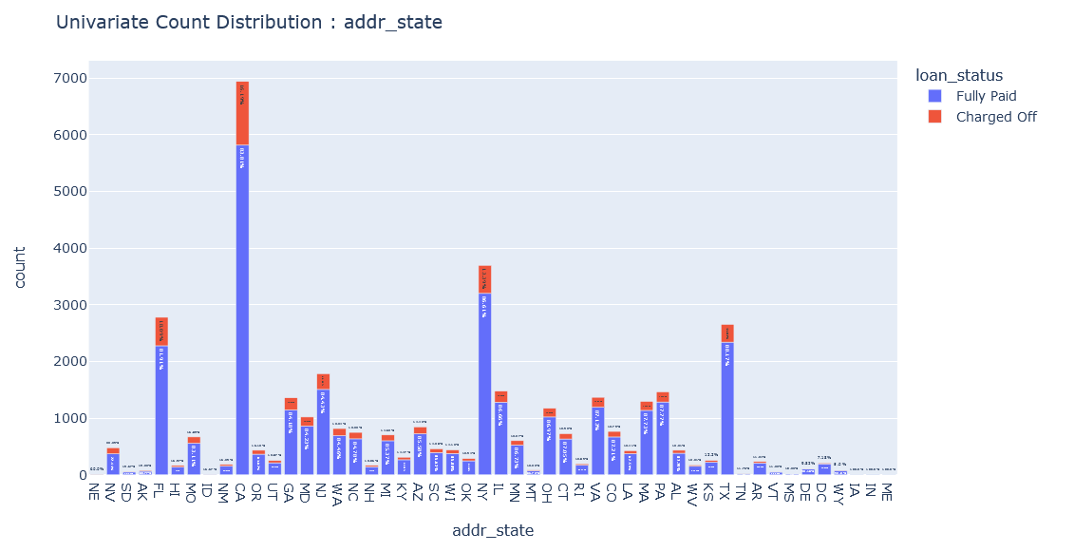
Address State
- Most loans are from CA i.e Canada which also has a higher default percentage i.e ~16.2% than normal
- FL i.e Florida is also a state where the loans are heavily taken and also has a higher default percentage i.e ~18%
- TX - Texas, PA - Pennsylvania are some good business making states i.e have go amount of loans taken and also repaid too i.e have lower default percentage <12%

Slide 19
EDA
Numerical Columns Analysis
Box Plot : shows a distribution of the loan status with respect to numerical column we're analysing
Distribution Plot : shows a distribution of the segmented numerical column
Yellow Trend Line (top-right of each slide): shows the loan default percentage trend line (the percentages are calculated for segmented numerical column)
NOTE : The percentage in trend-line is scaled up to show in the plot; you can see the actual percentage by hovering on the line

Slide 20
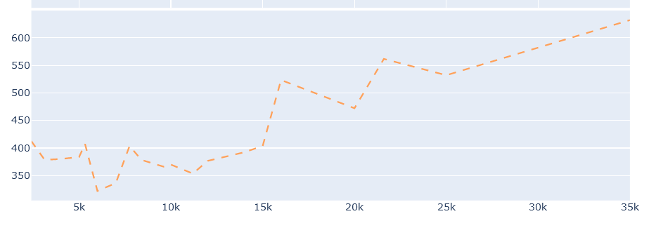
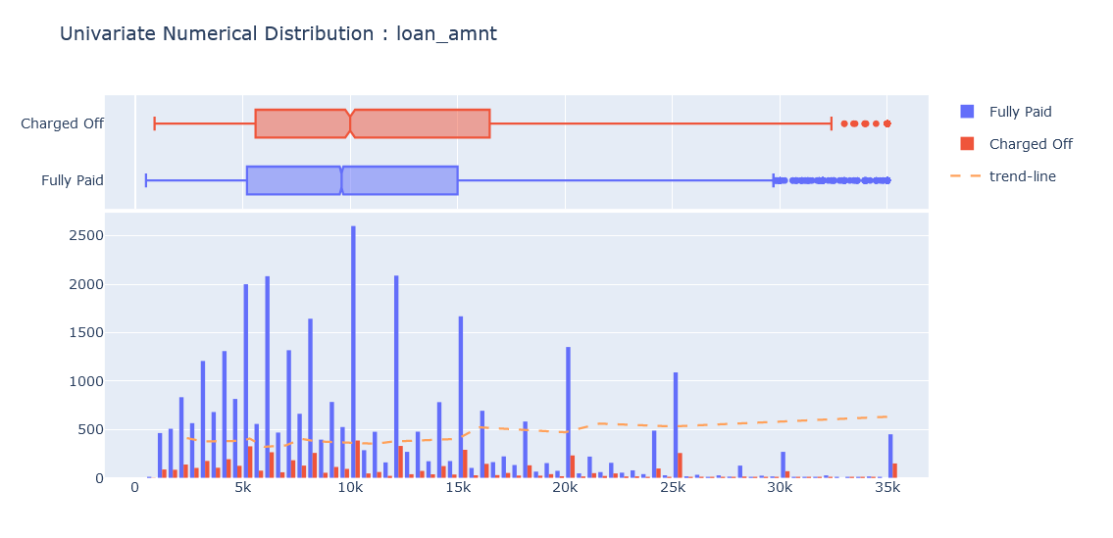
Loan Amount
- The loan defaulting percentages increases with Loan Amount taken i.e steadily upward sloped trend line
- The higher amount loans(> 20K) are having higher default rates (>17%)
- As the Funded Amount and Funded Amount Investor columns are heavily correlated with this column; they both also have similar trend lines

Slide 21
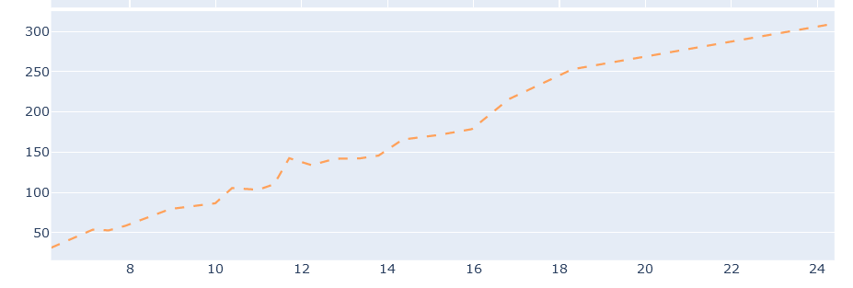
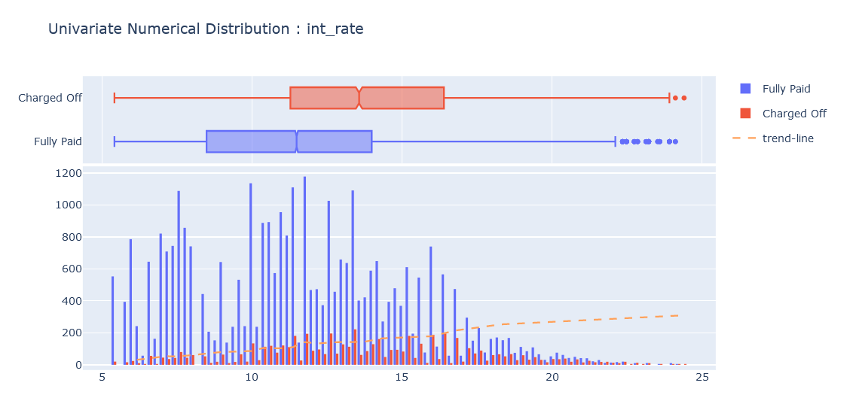
Interest Rates
- The loan defaulting percentages increases with the Interest Rates i.e steadily upward sloped trend line

Slide 22
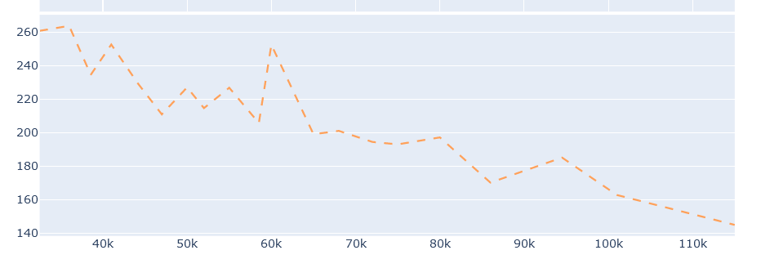
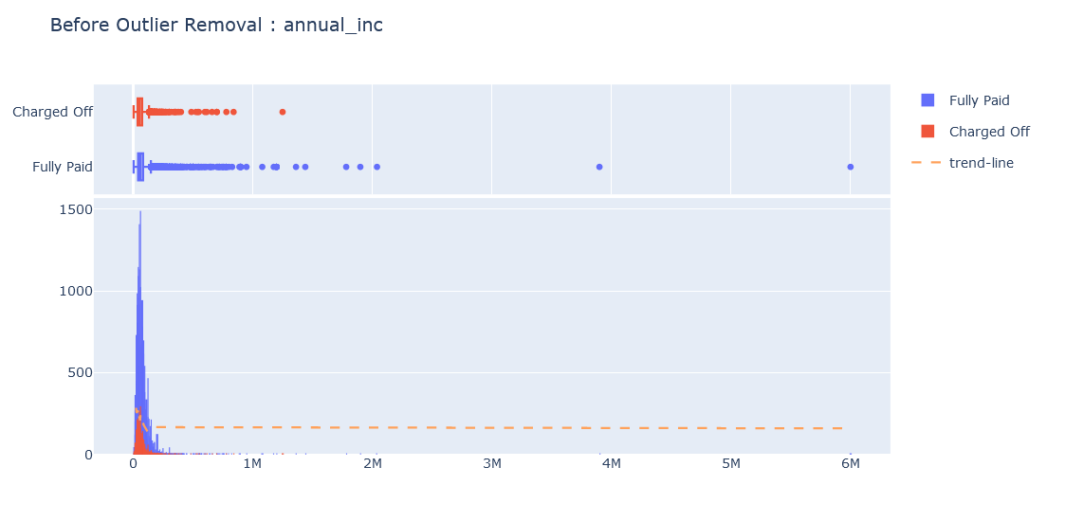
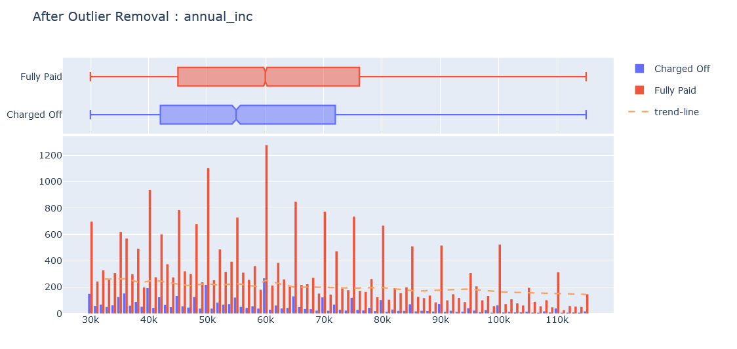
Annual Income
- Having a higher annual income the lower the default percentage i.e heavily downward sloped trend line
- Outliers on the right
- Outliers are removed by only taking data till the 95th percentile
- As the annual income increases the loan defaulting percentage drastically comes down

Slide 23
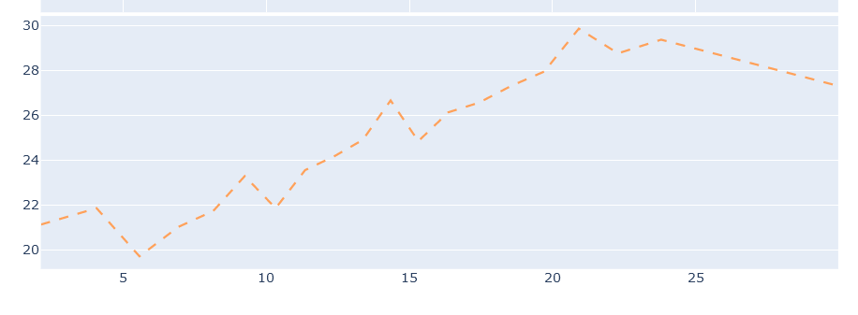
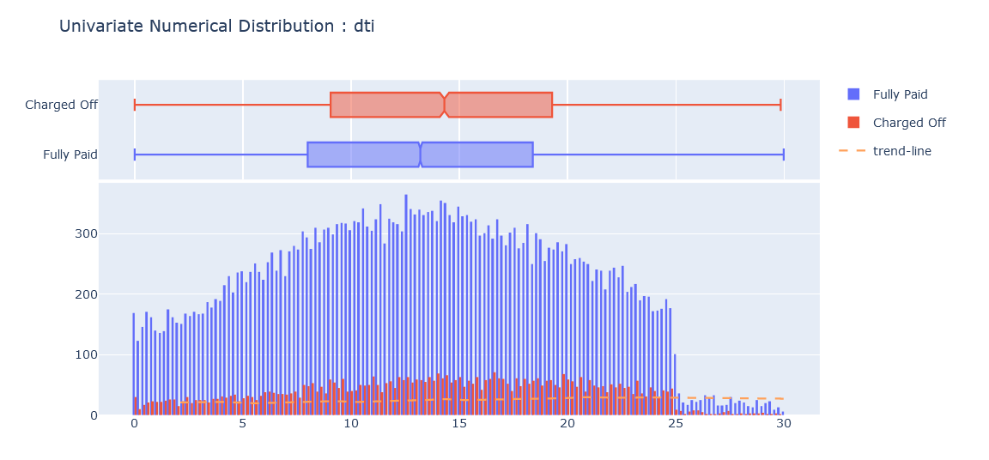
DTI
- The loan defaulting percentages increases with the DTI i.e steadily upward sloped trend line

Slide 24
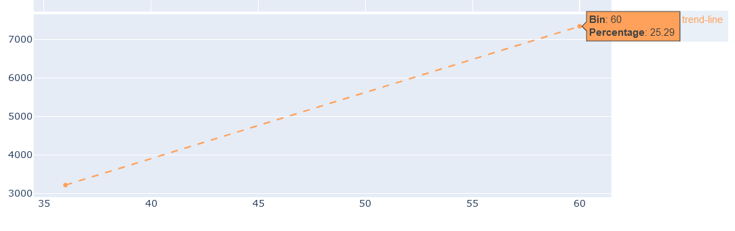
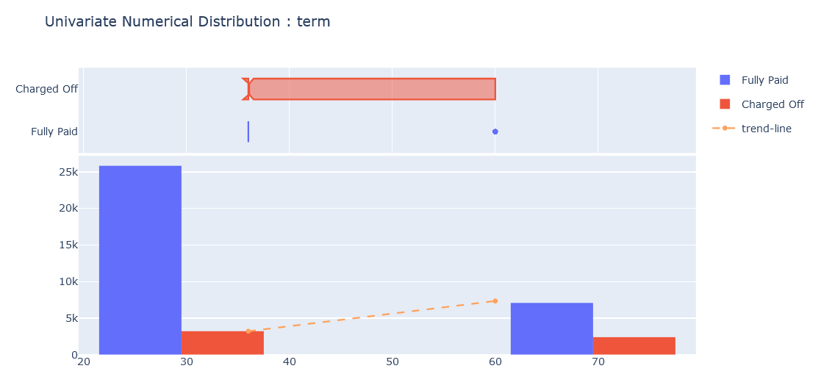
Term
- Longer loans(60 months) has a very high default percentage (25%) compared to 36 Months loan (11%)

Slide 25
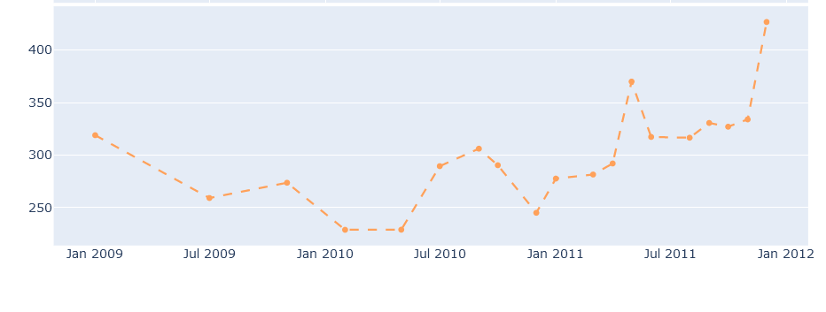
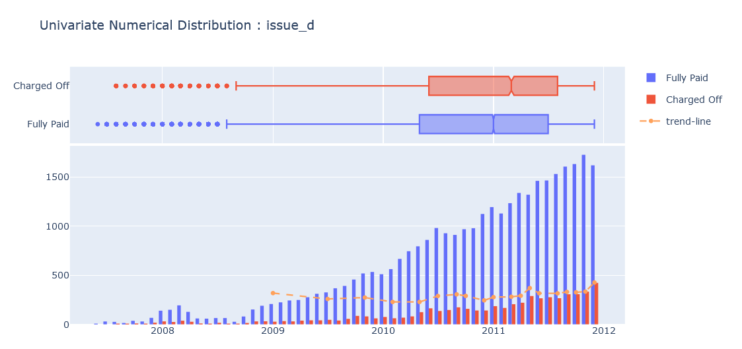
Issue Date
There's an increasing loan defaulting trend seen for the latest approved loans i.e starting from Jan 2011
- Can be an effect of Financial Crisis in 2011-2012 period in US, Canada

Slide 26
Bi-Variate Analysis

Slide 27
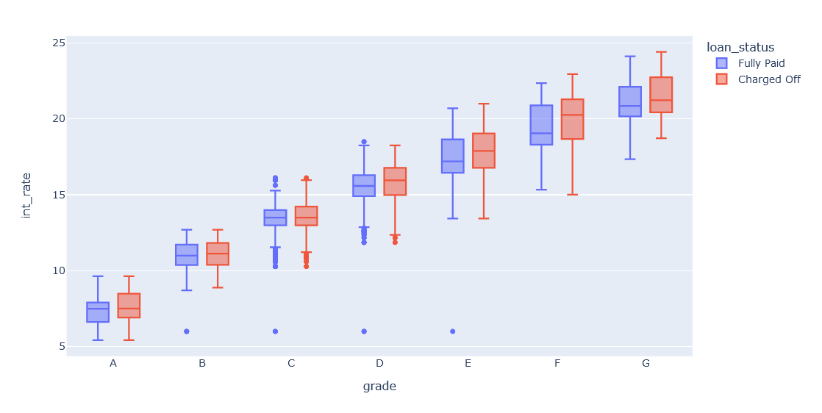
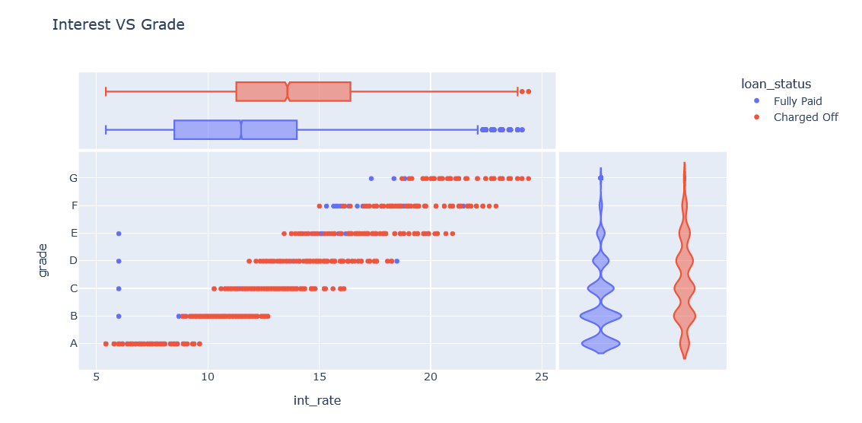
Interest vs Grade
It is clearly visible that as the grade increases the interest rates linearly increase too

Slide 28
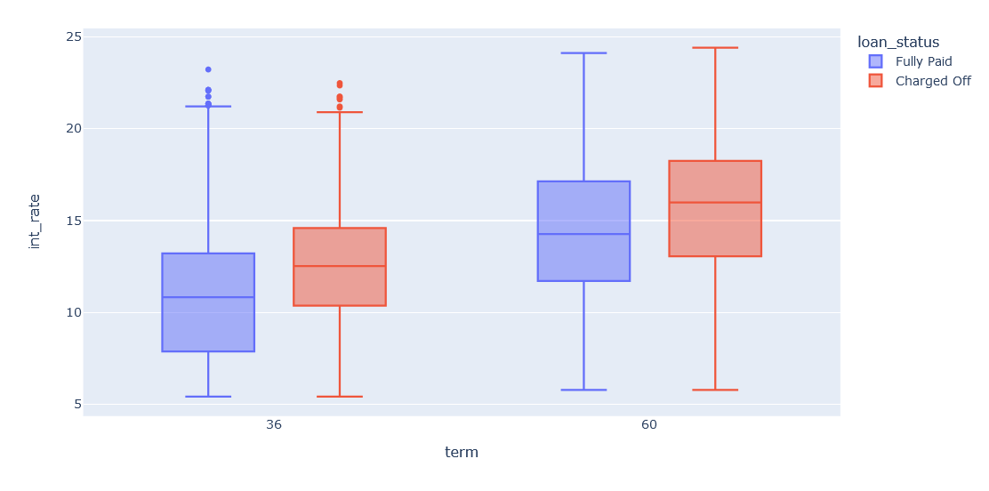
Term vs Interest Rate
Longer Termed Loans have higher interest rate margins

Slide 29
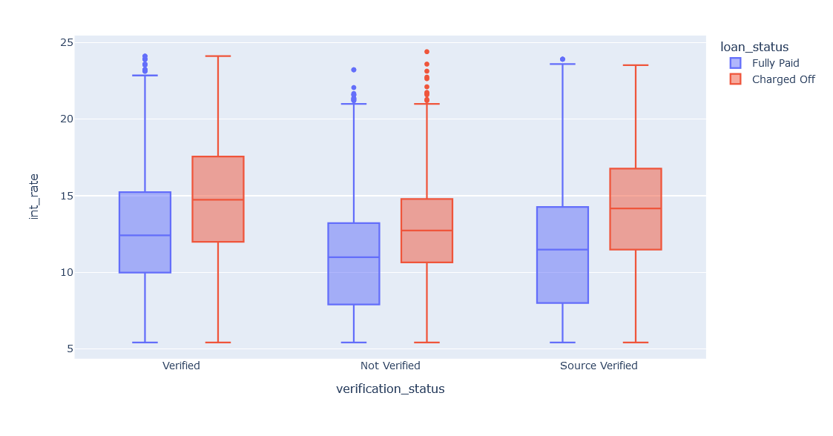
Verification Status vs Interest Rate
Why does "Verified" Sources of income have higher interest rate margins than "Not Verified" ones?

Slide 30
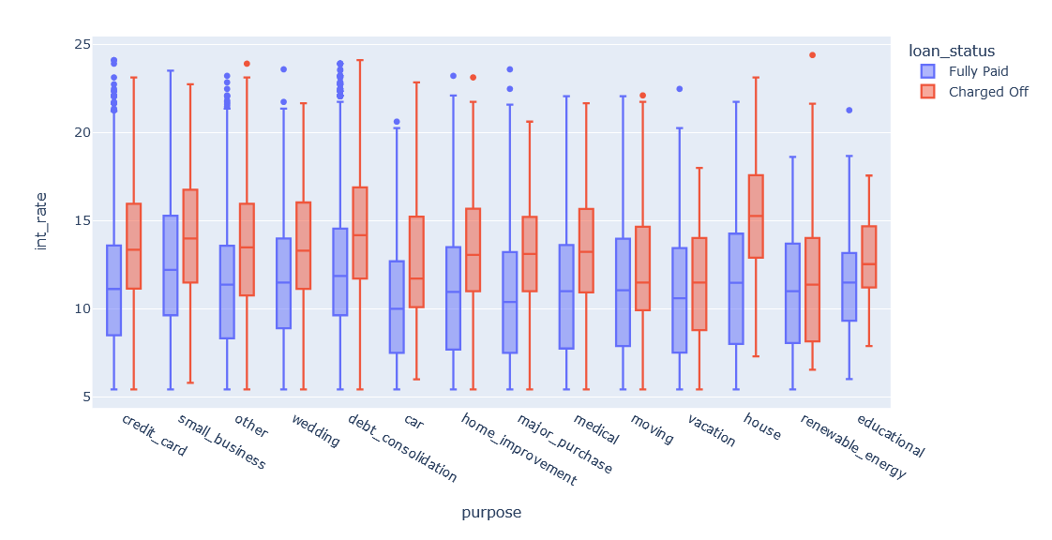
Purpose vs Interest Rate
Purpose = "House" has unusually high interest rates(mean: 15.5) for "Charged Off" applications
Purpose = "Small Business" have normal interest rate margins but we've already seen that it is the most riskiest sector of loan lending i.e these have the highest loan defaulting rates (27%)

Slide 31
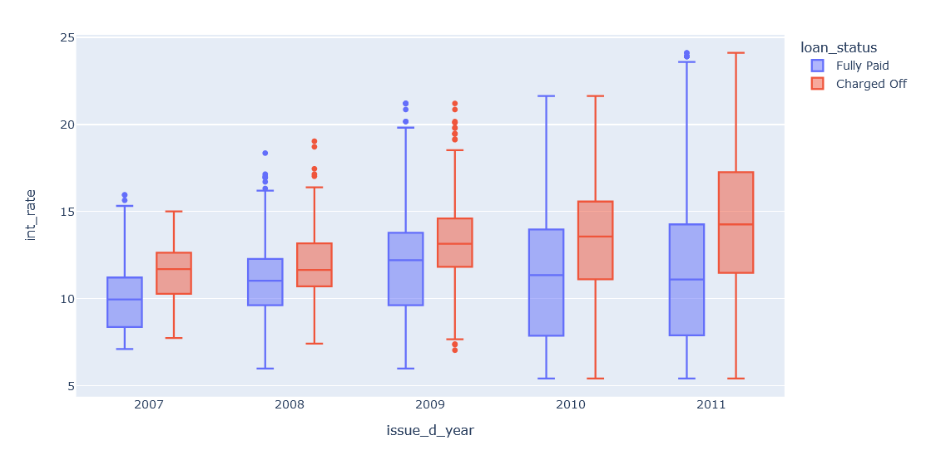
Issue Year vs Interest Rate
- 2008, 2009 have smaller boxes(quantiles) showing that the LC usually used to play very safe by giving loans on usual industry set interest rate (9-14%)
- But starting from 2010, the LC has lowered the profit margin (decrease in interest rate) with giving out loans at a lower interest rates (7-14%)
- The clear increase in interest rates for "Charged Off" loan applications is very clearly visible, example : in 2010: the 25% percentile of interest rate for "Fully Paid" applications was 7.88, whereas was 11.12 for "Charged Off" applications which is a very huge increase in interest rate

Slide 32
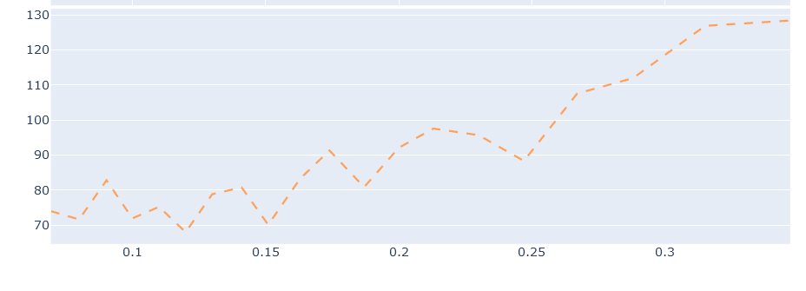
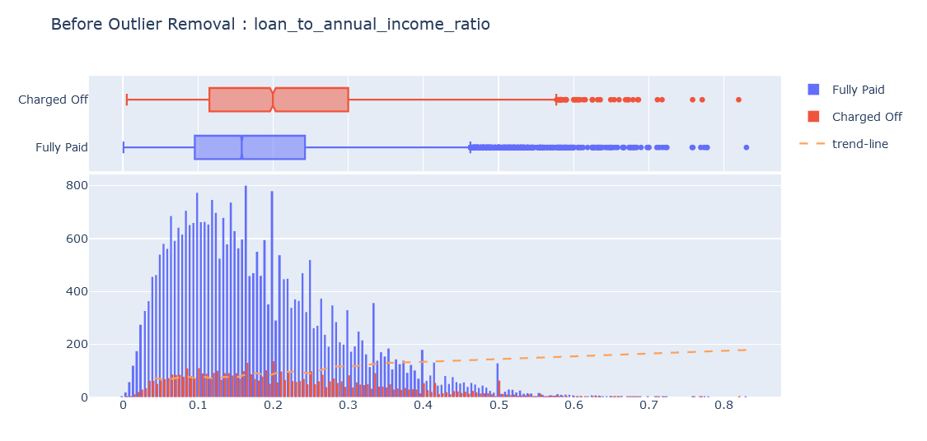
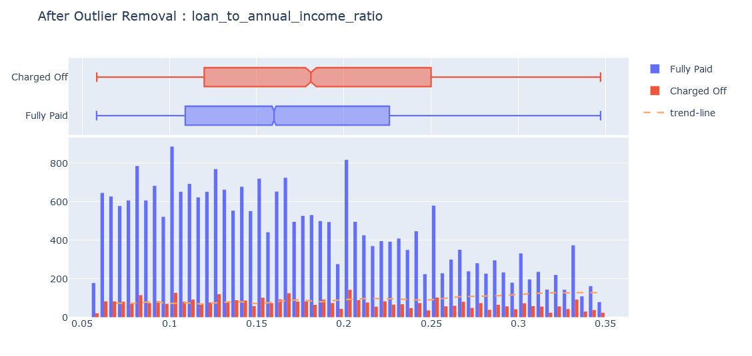
Loan Amount to Annual Income Ratio
We can clearly see in the plots that higher the ratio, higher the defaulting tendency

Slide 33
4. Business Drivers & Recommendation
01
OBSERVED : This derived ratio is directly proportional to the loan defaulting percentage
Loan Amount to Annual Income
Ratio
RECOMMENDATION : Interest Rates should also increase proportionally with this metric
02
OBSERVED : "Small Business" have normal interest rate margins but we've already seen that it is the most riskiest sector of loan lending i.e these have the highest loan defaulting rates (27%)
Purpose
RECOMMENDATION : Historically riskier sections should have higher interest rate margins and vice-versa
03
OBSERVED :
There's an increasing loan defaulting trend seen for the latest approved loans i.e starting from Jan 2011
Can be an effect of Financial Crisis in 2011-2012 period in US, Canada
Issue Date
RECOMMENDATION : Observing the current loan defaulting trend and global economic situation; the loans should be given at a higher rate than normal as we’ve got the highest loan-defaulting rates currently

Slide 34
4. Business Drivers & Recommendation
04
OBSERVED : Longer loans(60 months) has a very high default percentage (25%) compared to 36 Months loan (11%)
Loan Term
RECOMMENDATION : Longer Loans should have higher interest rates compared to shorter-term loans
05
OBSERVED : The loan defaulting percentages increases with the Interest Rates
Interest Rates
06
OBSERVED : As soon as there is a public derogatory record or a publicly recorded bankruptcy the loan default rates shoots up and also the interest rates shoot up
Public Image
RECOMMENDATION : Should have higher interest rates if the public image is not good because the loan-defaulting can go upto 33%(some cases) hence for such high risk -> set higher Interest Rate
07
Verification
OBSERVED : “Not Verified” customers have the least loan defaulting percentage i.e ~13% where as Verified Customers have 15-17%
RECOMMENDATION : Verification process should be looked into and corrected as we should be having lower risk for Verified Profiles and higher for Not Verified

Slide 35
END!

Slide 36
5. Appendix
Attaching all the other feature plots which we deemed weren’t as important.

Slide 37
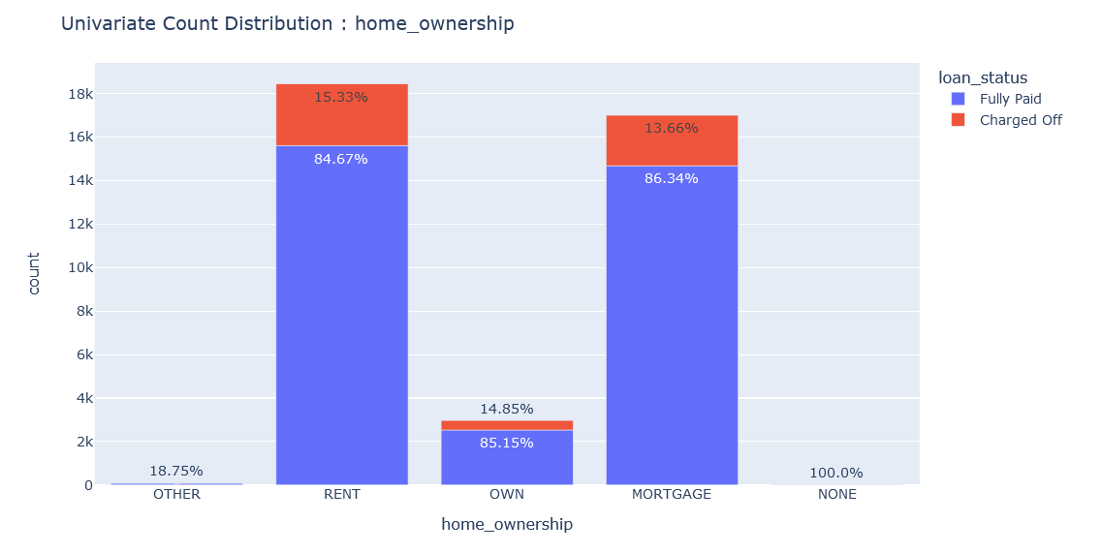
Home Ownership
- People who have own homes tend not to take loans as compared to people who are rented and on mortgage
- It doesn't matter who the loan is given to i.e Rented, Mortgaged, or Own Home; the loan defaulting percentage is almost ~15%

Slide 38
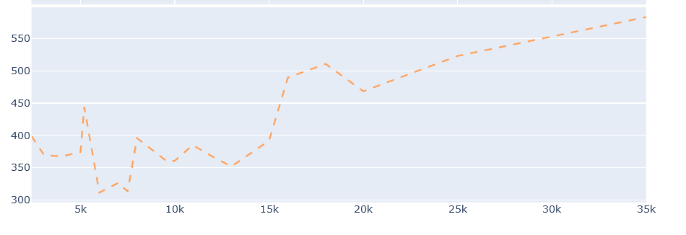

Funded Amount
- Similar trend line as Loan Amount i.e higher amount loans(> 20K) are having higher default rates (>17%)

Slide 39
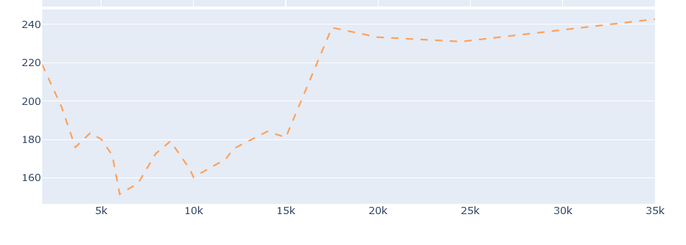
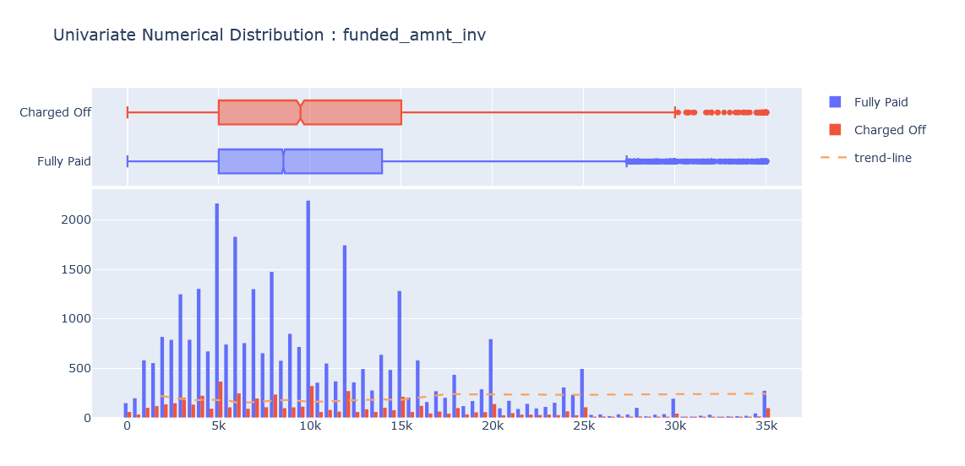
Funded Amount Investor
- Similar trend line as Loan Amount i.e higher amount loans(> 20K) are having higher default rates (>17%)

Slide 40
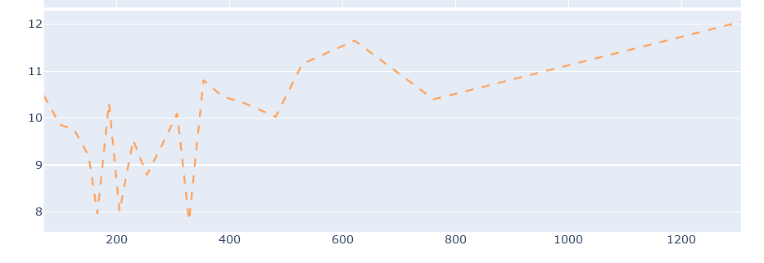
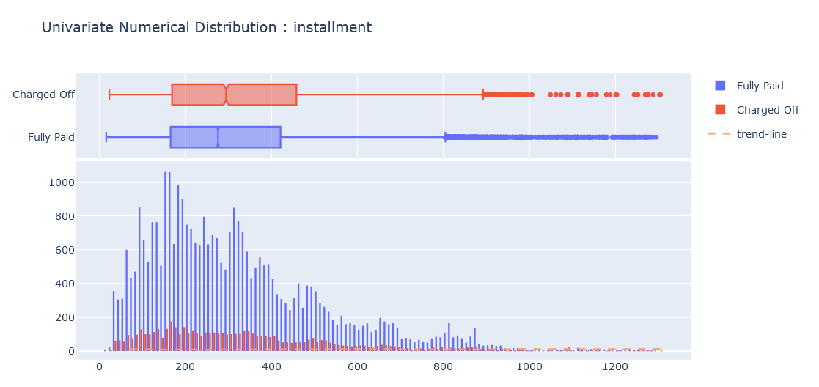
Installment Amount
- outliers on the right i.e having many total accounts
- Actions : Perform an outlier removal

Slide 41
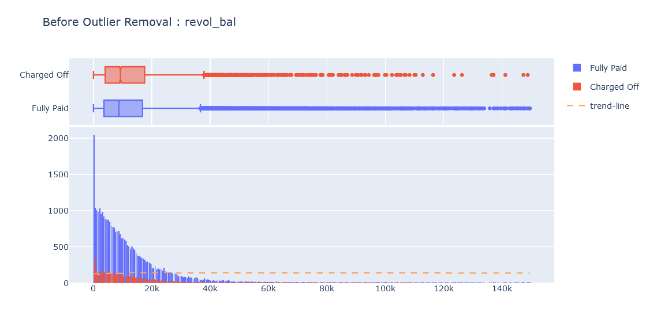
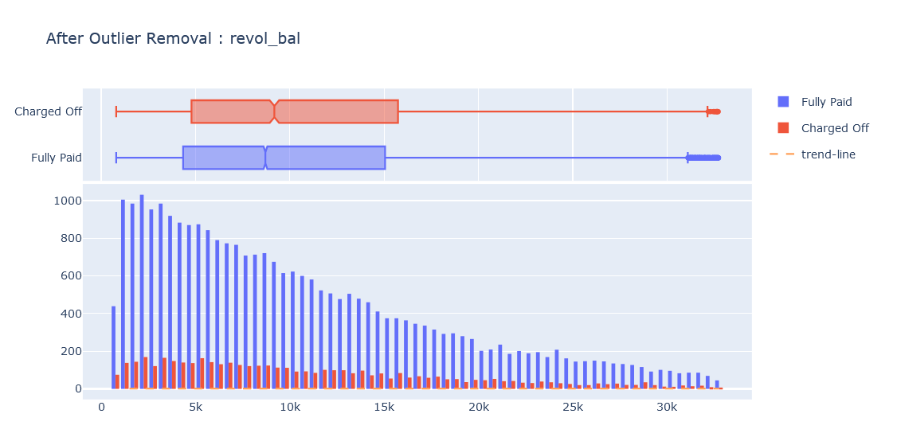
Revolving Balance
- outliers on the right i.e having many total accounts
- Actions : Perform an outlier removal
- As the revolving balance increases the loan defaulting percentage goes up too

Slide 42
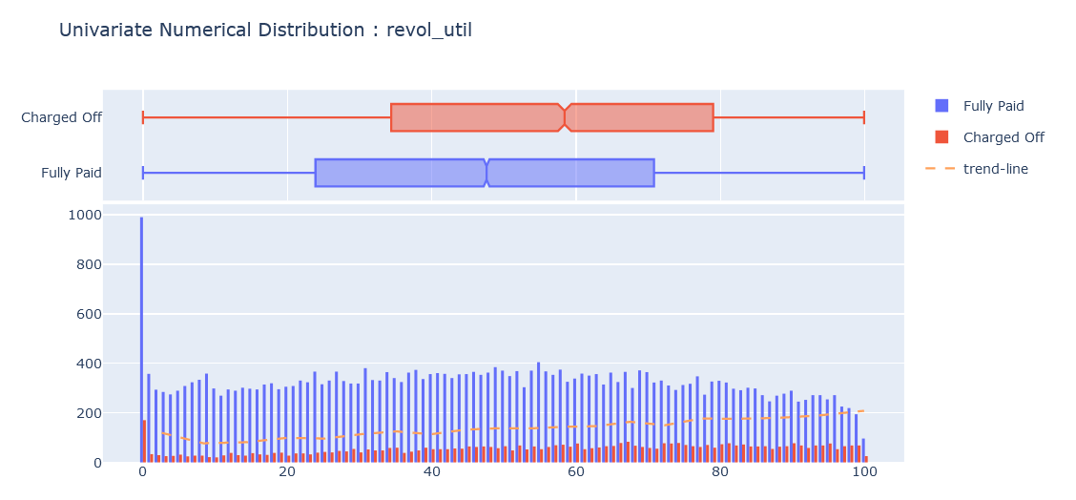
Revolving Utilization Rate
- The loan defaulting percentages increases with the Revolving Utilization i.e heavily sloped upward trend line

Slide 43
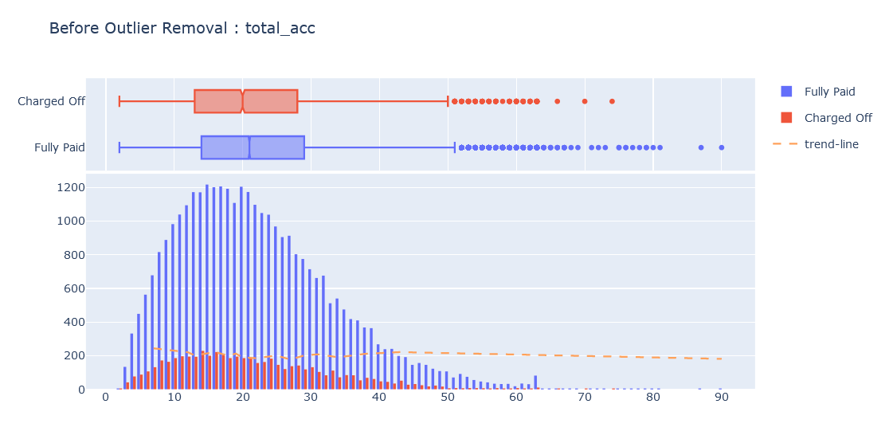
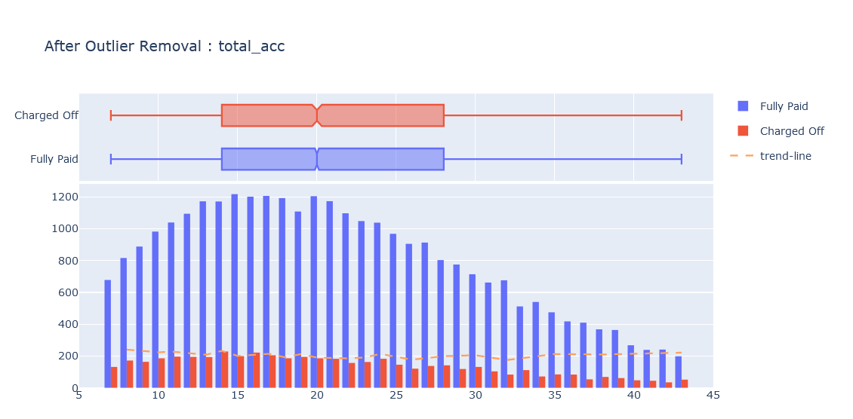
Total Accounts
- outliers on the right i.e having many total accounts
- Actions : Perform an outlier removal

Slide 44
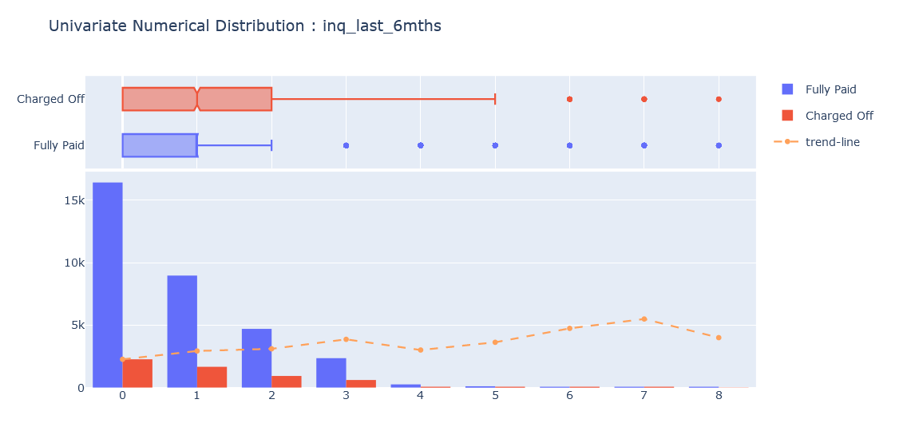
Number of Inquiries in past 6 months
- As the number of inquiries increase the loan default rates also increase than normal i.e has a upward trend line

Slide 45
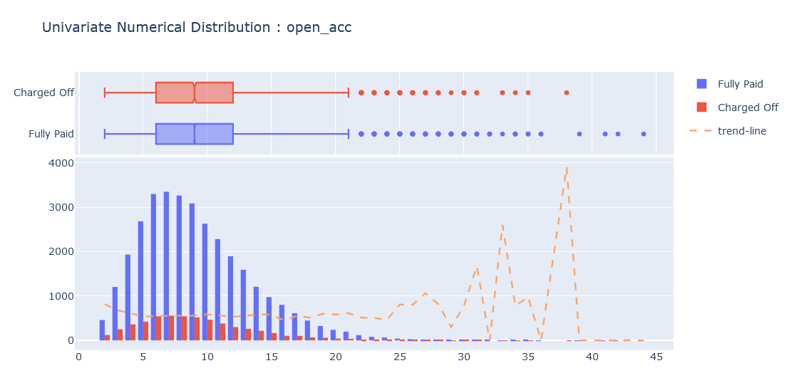
Open Accounts
- Due to outliers on the right i.e having many open accounts the the trend line is not very stable
- Actions : Perform an outlier removal

Slide 46
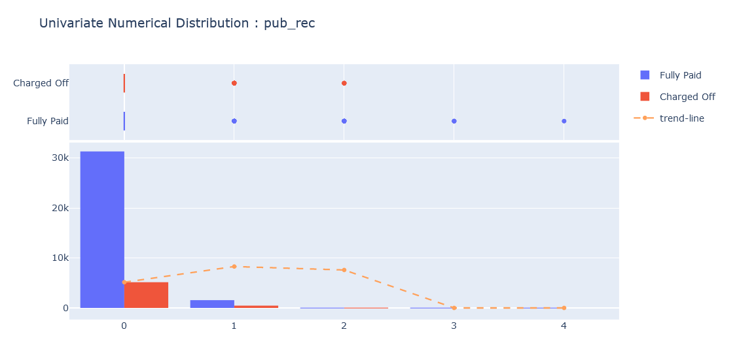
Derogatory Public Records
- The Loan defaulting percentages increases as soon as you have a derogatory public record (> 23%)

Slide 47
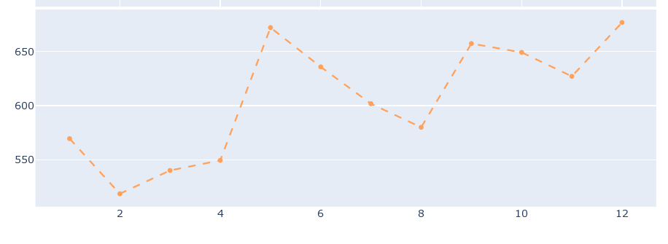
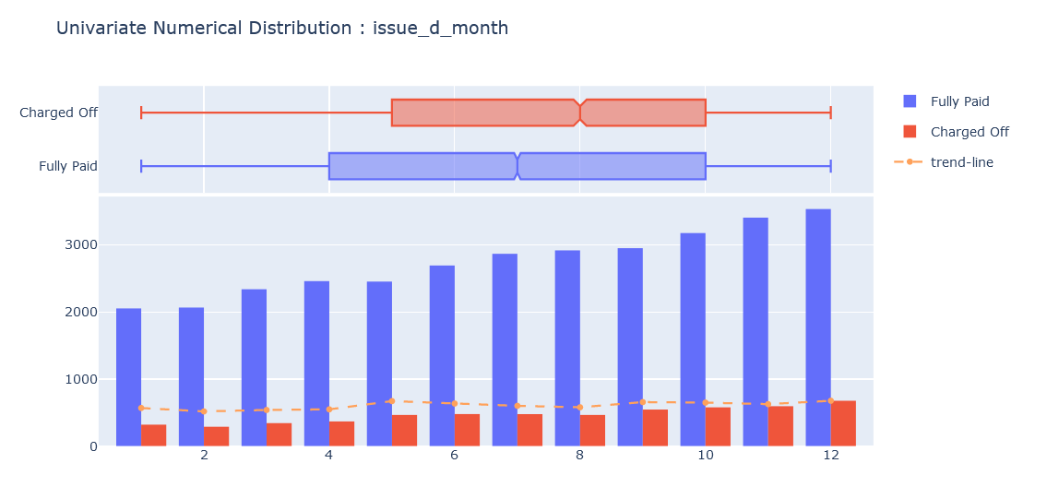
Issue Date - Month
- Loans issued in Feb, March, April have lower loan default rates (12-13%) than normal (15-16%)

Slide 48
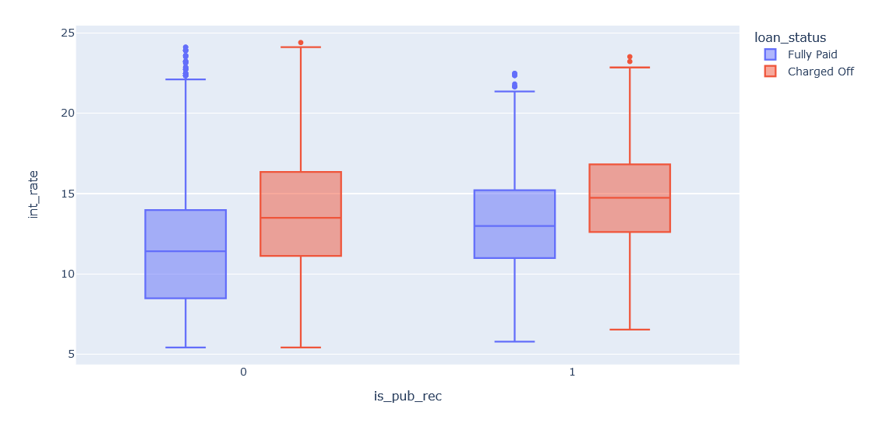
Public Records vs Interest Rate
Created a derived feature i.e is_pub_rec : Binary Feature whether there is a public derogatory record of the applicant or not
As soon as there is a public derogatory record the interest rates shoot up

Slide 49
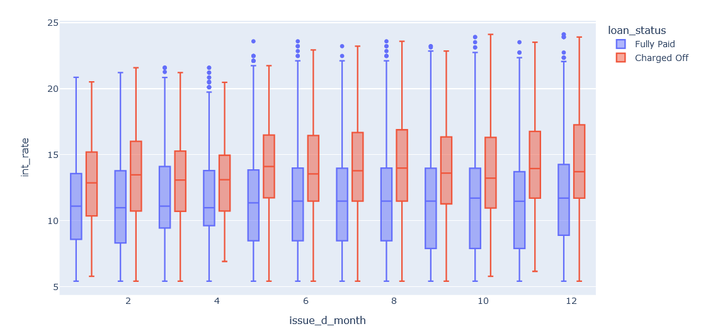
Issue Month vs Interest Rate
Nothing interesting information gain except that lower limits (25 percentile limit) for loans in months March and April are higher than normal i.e ~9.5 wheras the usual interest rate is around 8.5

Slide 50
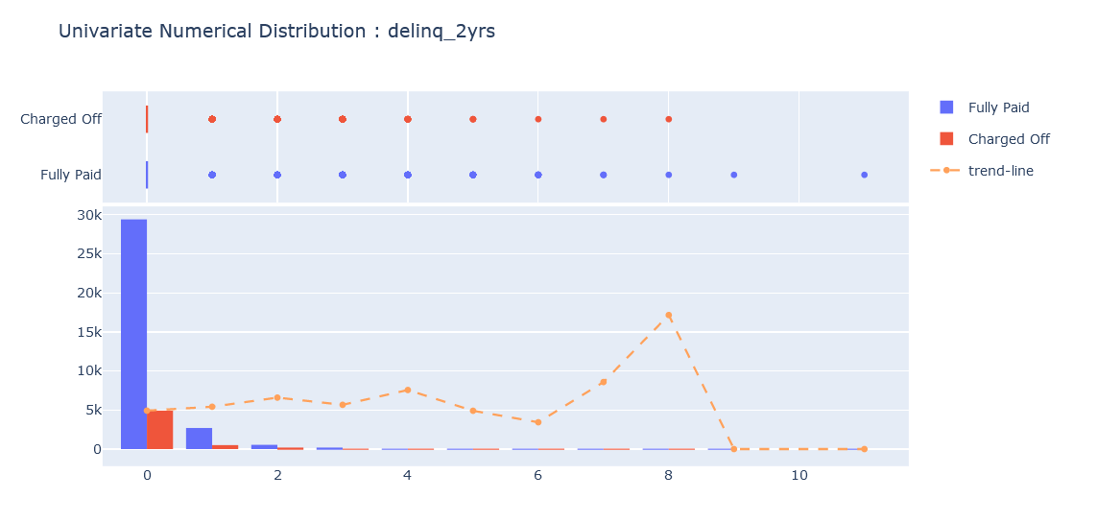
Number of Delinquency in past two years
The Loan defaulting percentages increases as soon as you have a delinquency i.e has a upward trend line

Slide 51

Public Record Bankruptcies
- The Loan defaulting percentages increases as soon as you have a publically recorded bankruptcy (22% and 33% for 1 and 2 bankruptcies reported respectively)

Slide 52


Earliest Credit Line
- Heavily Left Skewed i.e too many outliers in the left (outlier-ish loan applications which have very old applicants)
- Actions : Perform Outlier Removal

Slide 53

Interest vs SubGrade
It is clearly visible that as the sub-grade increases(lower grades) the interest rates linearly increase too

