Slide 1
AI based ChatBot for Health Information
PRESENTED BY
MALLEBOINA KRANTHI KUMAR
MIRUPALA VISHNU VARDHAN MACHARLA PANDU PRANAY
LAKAVATH VENU GOPAL
Under the guidance of
Samuel Chepuri
Asst. Professor, CSE Dept.

Slide 2
ABSTRACT
Use of AI based chat bot for providing health related information.
In this project, the chatbot uses AI(Artificial Intelligence) to make a note of symptoms entered by patient through text and analyze it for detailed understanding. Matching the query against large repository with medical data, the chatbot answers the patient queries.It acts as a symptom checker.

Slide 3
INTRODUCTION
Chat means 'Conversation',Bot means 'a Machine',ChatBot means 'Conversation with a machine'
Eliza was the first chatbot ever created.
But it didn't pass the Turing Test.
If you can't say whether you're talking to a person or a machine, the machine passes the Turing test.
Parry is the first chatbot to pass the test.

Slide 4
INTRODUCTION
Alexa,Google Assistant,Siri are some of the latest chat bots.
Chatbots in health care have the potential to provide patients with access to immediate medical information.
Health care chatbots could help patients better manage their own health, improve access and timeliness to care.
They provide information fast when there is not a moment to lose and are available 24x7.

Slide 5
HARDWARE SPECIFICATIONS
RAM: 4GB and Higher
Processor: Intel i3 and above
Hard Disk: 500GB: Minimum

Slide 6
SOFTWARE SPECIFICATIONS
OS: Windows or Linux
JupyterNotebook Required
Setup tools and Anaconda to be installed for 3.6
Language : Python

Slide 7
LITERATURE SURVEY
The operating model of a chatbot is always the same, whatever its scope, its theme and its level:
Users formulate their queries in natural language text interface.
The chatbot receives the request and the Model interprets it to understand it.
The chatbot provides a unique and qualified answer to the user’s query. The answer may be generic, contextualized or cusomized.

Slide 8
LITERATURE SURVEY
But the problem is most of these chatbots only provide answers for general healthcare FAQs.
We are creating a AI based chatbot that act as symptom checker.
Language Used
Python:Python is a high-level, interpreted, interactive and object-oriented scripting language. Python is designed to be highly readable

Slide 9
LITERATURE SURVEY
packages are:
nltk
numpy
tflearn
tensorflow
random
json
pickle
tkinter
Model
DNN(Deep Neural Network)

Slide 10
SYSTEM DESIGN
Architecture diagram
ChatBot Model
Process the user input.
Compare the symptoms.
Returns the highest confidence value as its response.
Get input from GUI
through text
Returns the response to GUI

Slide 11
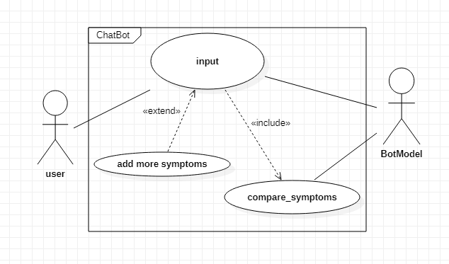
UML-Use Case diagram

Slide 12
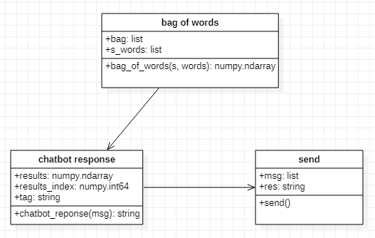
Class diagram

Slide 13
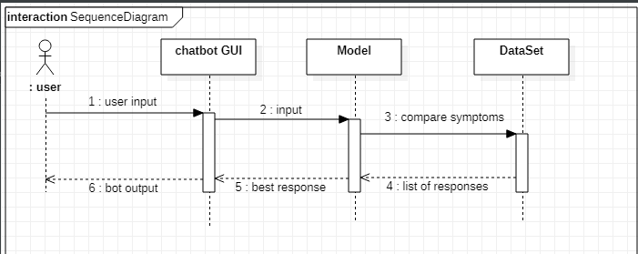
Sequence diagram

Slide 14
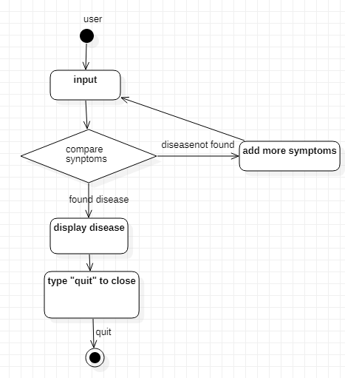
Activity diagram

Slide 15

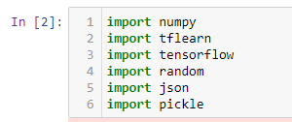
Implementation
Step 1:
Import the necessary packages.
Step 2:
Load the data set and Pre-process it.

Slide 16
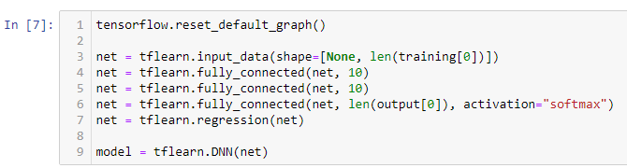
Implementation
Step 3:
Create the Model.

Slide 17
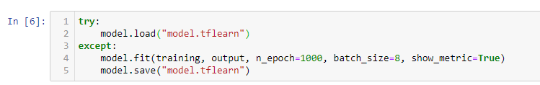
Implementation
Step 4:
Fit and Save the Model.
Step 5:
Create function to give input to the Model.

Slide 18
Implementation
Step 6:
Create GUI Chat window and other necessary components with tkinter.
Step 7:
Chat with Bot.
Step 8:
Type “quit” to Stop.
Step 9:
Open “anvil.works/build#” website and create a web app for DocBot.

Slide 19
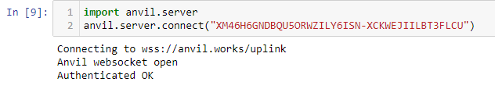
Implementation
Step 10:
Import anvil server in Jupyter notebook and connect it with the server.
Step 11:
Create anvil callable function in the Jupyter notebook.

Slide 20
Implementation
Step 12:
Open “anvil.works/build#” website and publish the DocBot web app in public domain with the following URL:
https://docbot.anvil.app/

Slide 21
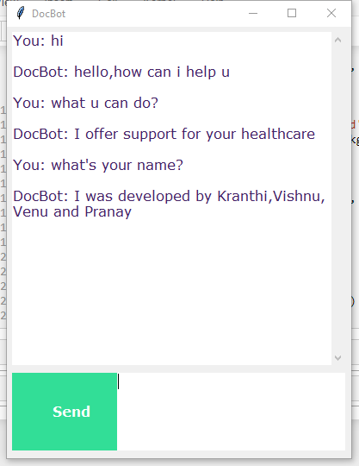
Output Screen
GUI DocBot output

Slide 22
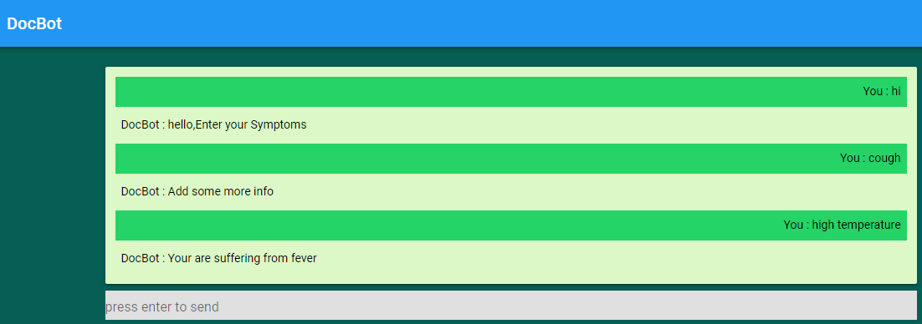
Output Screen
Published DocBot Web app
output

Slide 23
Testing
Test Case no | Input | Output | Expected Output | Result
1 | hi | hello,Enter your Symptoms | hello,Enter your Symptoms | PASS
Test Case no | Input | Output | Expected Output | Result
2 | 123 | You entered number.Please enter your symptoms | You entered number.Please enter your symptoms | PASS

Slide 24
Testing
Test Case no | Input | Output | Expected Output | Result
3 | bye | Have a nice day,Type 'quit' to end this session | Have a nice day,Type 'quit' to end this session | PASS
Test Case no | Input | Output | Expected Output | Result
4 | high temperature | Your are suffering from fever | Your are suffering from fever | PASS

Slide 25
Testing
Test Case no | Input | Output (Action) | Expected Output | Result
5 | quit | Window closes | Window closes | PASS
Test Case no | Input | Output | Expected Output | Result
6 | 123asd | You entered alphanumeric.Please enter your symptoms | You entered alphanumeric.Please enter your symptoms | PASS

Slide 26
Testing
Test Case no | Input | Output | Expected Output | Result
7 | @!$ | N/A | You entered special symbol.Please enter your symptoms | FAIL

