Slide 1

BATCH NO :- 02
DHANEKULA INSTITUTE OF ENGINEERING AND TECHNOLOGY
APPLICATIONS OF REMOTE SENSING AND BEST MANAGEMENT PRACTISE METHODS FOR FLOOD CONTROL MANAGEMENT IN FLOOD PRONE AREAS OF VIJAYAWADA
M.BHUVANA [178T5A0120]
S.VAMSI KRISHNA [168T1A0176]
T.NAGA MOHITH [168T1A0182]
N.KRANTHI KUMAR [168T1A0157]
M.HEMANTH [168T1A0152]
GUIDE: - Dr. G. Vinay kumar

Slide 2
INTRODUCTION:-
When inflow exceeds outflow in a low-lying areas, then it may be termed as flood.
Normally flood occurs when there is a heavy rainfall, or with seepage problem when rapid concretization occurs.
Mostly floods occur in low-lying areas and in urban areas, concretized due to ongoing increase in population.
Hence flood management practices are highly essential in this climatic change scenarios of 21st century.
RS and GIS, and BMP’s can be implemented to identify the flood zones and derivable solutions using BMP’s

Slide 3
AIM: -
To find flood prone areas and application BMP’S for the flood prone areas in Vijayawada.
OBJECTIVES: -
To find out the inundation zones in the low laying urban areas of Vijayawada.
To mitigate the floods by BMP and Remote sensing techniques
SCOPE: -
To analyse the flood prone areas and to mitigate the disasters during flood incidents

Slide 4
CASE STUDIES:-
PAUL D. BATES etc. (2012): The article produced in hydrological process by bates in 2004 used remote sensing data which provided a way in flood inundation modelling. The only data available to build, parameterize, calibrate and validate hydraulic models were from limited ground topographic surveys and space ground gauging stations with spacing’s of between 10 and 60km. the hydraulic models were carried in two main ways. First, the ground survey terrain data that were available were typically captured as a series of cross sections perpendicular to the channel and flood plain that were more easily integrated with one dimensional (1D) models. Second, the use of widely spaced point gauge data for calibration and validation meant that the only aspect of model performance that could be tested effectively was the ability of a model to route a wave in ID along a river network. The breakthrough came with the advent of remote sensing techniques for wide area topography mapping, principally using Air brone laser altimetry (LiDAR) which captured at approximately 2-5m spatial resolution at survey rates of up to 50km² and had a accuracy of approximately 10-15cm.

Slide 5
Emintas(2016):- He prepared the flood inundation maps using GIS and a hydraulic model (hec ras) in akarcay bolvadin sub basin of turkey. The akarcay basin (7605 km²) is a closed watershed, in joint area of Aegean, Mediterranean and central Anatolia regions of turkey. During investigation, water levels are determined and submerged areas for various return periods by using GIS based hydraulic model. The required input TIN layer is prepared in GIS, which acted as base of hydraulic model (grid resolution: 10mx10m).Hec georas is a subprogram in ArcGIS that supplies transfer of required topographic and geometric data with GIS base into the model. Input data into the model can be manual but using hec georas provides integration of GIS and hydraulic model. In the same breath, it is provided that input data into the model is quicker and more detailed.
VAHDETTIN DEMIR etc. (2015):- Has made the Flood Hazard Maps using Geographic Information System and Hydraulic Model for Mert River basin. This area is chosen as study area because it is almost under threat of flooding in each year. In this region, the main reason of devastating flood is the influence of seasonal rainfall. In addition, the human based constructions and the collapse of water retaining structures are among them are the main causes of flooding.

Slide 6
Geographic Information Systems (GIS) is successfully used to visualize the extent of flooding and also to analyse the flood maps to produce flood damage estimation maps and flood risk map in this study. First, 3D model of study area was prepared utilizing ArcGIS. Digital Elevation Model (DEM) was produced by 1/1000 scale topographical contour lines. Then, topographic data obtained from ArcGIS were transferred to HEC-RAS via hec georas module. developed by the USGS between 1962 and 1977 using photogrammetric methods. Only three of the eighteen DEMs that cover the study area were available for acquisition from the USGS. Sensitivity analyses of the three DEMs indicate that the horizontal and vertical resolutions of the DEMs were below the resolution demands imposed by the study area.
I. C. OVERTON (2005):- The dams have served to greatly reduce maximum discharges on the river, leading to a decreased spatial extent of inundation. They developed a comprehensive GIS database to support this research. All data were either input or derived within ARC/INFO (a vector-based GIS) or ARC/INFO GRID (a raster-based GIS). ARC/INFO uses the network approach to structure locational information, and the relational approach to structure non-locational information. The eighteen topographic maps (7.5-min quadrangle map series) that cover the study area were developed by the USGS between 1962 and 1977 using photogrammetric methods. Only three of the eighteen DEMs that cover the study area were available for acquisition from the USGS. Sensitivity analyses of the three DEMs indicate that the horizontal and vertical resolutions of the DEMs were below the resolution demands imposed by the study area. Specifically, the topographic subtleties critical to understanding the landforms, moisture variability, and corresponding distributions of vegetation were not well represented in the data or absent altogether from the elevation matrix.

Slide 7
JOY SANYAL (2003):- Has studied the flood depth from NOAA AVHRR imageries simply by the tonal difference of the flood water. In this study, the flood affected area was subdivided into different flood depth zones using supervised classification. Flood hazard has been assessed by calculating a weighted score for each land use, physiographic and geologic division of the country. The highlight of this methodology is that it assigns greater weight to the categories of deeper flood depth in an exponential manner. Thus by tonal differential method the flood inundation map is produced. Vegetation Index (NDVI) can be used to monitor river inundation from AVHRR images. It is well known that water has a unique spectral signature in the near infrared which is very different from other surface features. Therefore, when a surface feature is inundated its NDVI value changes considerably from the normal situation. Wang et al. (2002) observed that in the lower reaches of the Yangtze River, the NDVI value for inundated surface features remains negative while the value for non-inundated surface is commonly greater than 0.
MATEEUL HAQ, etc. (2012):- The techniques for mapping flood extent and assessing flood damages have been developed which can be served as a guideline for Remote Sensing (RS) and Geographical Information System (GIS) operations to improve

Slide 8
the efficiency of flood disaster monitoring and management. The information derived was very essential and valuable for immediate response and rehabilitation. Used Topographic maps had been used to extract different types of info-layers: administrative boundaries, rivers, lakes, roads, railway tracks, vegetated areas and other land use/ land cover categories. Moderate Resolution Imaging Spector-radiometer (MODIS) on board TERRA and AQUA images of 250 m resolution comprising bands 7, 2 and 1 were acquired and used as the principal input to map the flood affected areas. A standard supervised maximum likelihood classification of the images covering Sindh province was carried out and the required inundated class was converted into a shape file. Further editing of the images was carried out by visual interpretation of the inundated areas using expert knowledge. The topographic maps were then intersected with accumulated shape file of the inundated area to extract different types of info-layers for damage assessment. Flow chart of the methodology adopted in this study. The total cumulative flood extent was found to be 21,201 km2 affected 5.88 million people, 5329 settlements, 1500.44 km of road network, 382.05 km of railway tracks, 498.47 km2 of forests and 16440.48 km2 of agricultural land. Flood monitoring using satellite data proved to be an effective method to get quick and precise overview of flooded areas. In the study, timely and detailed analysis had been carried out using RS & GIS for locating and identifying flood affected areas along with land use/land cover features.

Slide 9
KULDEEP CHAURASIA, etc. (2015):
The flood plain delineation mapping has been carried out using Arc Hydro within a Geographical Information System (GIS). Discharges of Yamuna River are recorded by gauging station at the Hathnikund barrage situated in Yamuna nagar district of Haryana state, India at an elevation of 323m. This station is maintained by Irrigation department of Haryana state. Daily average discharges are available since 1995 with the exception of 1998-2001 period. DEM Generation: A high resolution Digital Elevation Model (DEM) is required to extract the topography information for reliable and accurate flood inundated area mapping. DEM of the study region has been generated from the stereo pair of Cartosat-1 images. The Cartosat satellite carries two high resolution imaging PAN cameras viz.The forward looking camera (Fore) and the afterward looking camera (Aft). Both the cameras capture panchromatic images with a spatial resolution of 2.5 m. The generation of detailed DEM involved five steps: interior orientation, exterior orientation, tie point generation, triangulation and model refinement using Ground Control Points (GCPs). Methodology adopted in this research work mainly consist of 4 steps viz. Image fusion, object based image classification, generation of water surface elevation raster and flood inundated area vector generation. The capabilities of the images can be enhanced if the advantages of both high spatial and spectral resolution can be integrated into one single image that can be done using a process known as image fusion. The outcome of image fusion is a new image which is more worthy for human and machine perception or further image-processing tasks such as segmentation, feature extraction and object recognition.

Slide 10
BEST MANAGEMENT PRACTISES: -
The practices or techniques which are more effective and practical in the means of reducing the water pollution and control of flood rate are called BMP’S. They may be vegetative, structural or managerial techniques. Basically there are five BMP’s which are in practice.
Permeable pavement and permeable pavers
Bio-Retention
Infiltration trench and Infiltration well
Rain Barrel and Cistern
Vegetated Roof
PERMEABLE PAVEMENT & PERMEABLE PAVERS: - The method of paving pavements which enable infiltration of runoff along with transportation for vehicle’s and pedestrians. They typically include concrete, coarse aggregate, a little amount of fine aggregate or nill.

Slide 11
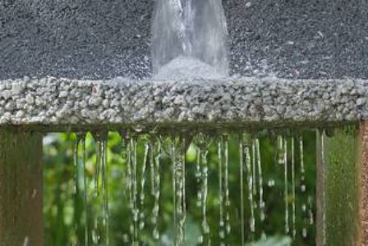
ADVANTAGES:-
They are easy to installation
More durable
Sustainable
Low cost
Can be temporary
Can be used for lawn parking
Eliminates costly drainage system
Used for control of erosion
DISADVANTAGES:-
Expensive to install as compared to traditional pavements.
Maintenance requirements of this pavement are quite different
They are not as strong as traditional or asphalt pavement
BIO-RETENTION:- This techniques consists of shallow depths which are underlain with a gravel layer and planted to capture the specified amount of runoff volume from an impervious layer. In time floods these ponds collects the surface water and filters through the mulch provided

Slide 12
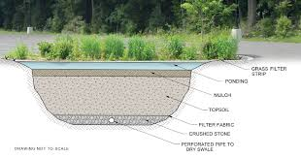
ADVANTAGES:-
Can be planned based on the topography of the land
Effective in removing urban pollution
Reduce the volume and rate of surface runoff
Flexible layout that fits the landscape
Effective in high impervious areas
Better retrofit capability
DISADVANTAGES:-
Requires management team
Clogging is more is surroundings
It is not suitable in steep slope areas
INFILTRATION TRENCHES & INFILTRATION WELL:-
Infiltration techniques are being used to control the surface runoff it may be through wells or trenches. Trench is filled by geotextile filter, fabric and backfilled with stone aggregate after the excavation is done.
The well may be bored, drilled, driven etc; provided with piping facilities to enhance the infiltration capabilities. Based on the structure these wells are also known as “Storage Drainage Well”.

Slide 13
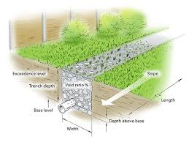
ADAVANTAGES:-
Reduces the volume of runoff from a drainage area
Can be effective at pollutant removal through filtering
Capable of ground water recharge
DISADVANTAGES:-
High failure rate due to improper sitting, poor design & lack of maintenance
Comprehensive geotechnical investigations required to confirm suitability
Not sufficient for draining pollution when there is high concentrations
Need large area to construct

Slide 14
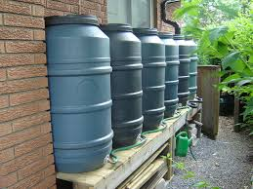
RAIN BARREL:- Rain barrels are nothing but rain water harvesting pits which usually collects the water from building roof tops and store the water in barrel like structure or pit (storage tank). This capacity ranges from 190 to 450 litres in residential areas and 750 to 40,500 litres in industrial areas.
ADVANTAGES:-
Most efficient in water conservation
They are lite and easy to move from place to another
Easy to install and maintenance
DISADVANTAGES:-
Main drawback is the size of the barrel
To increase the quantity of collection we need to link the multiple barrels
Leads to the growth of mosquitoes & other insects which leads to cause of diseases

Slide 15
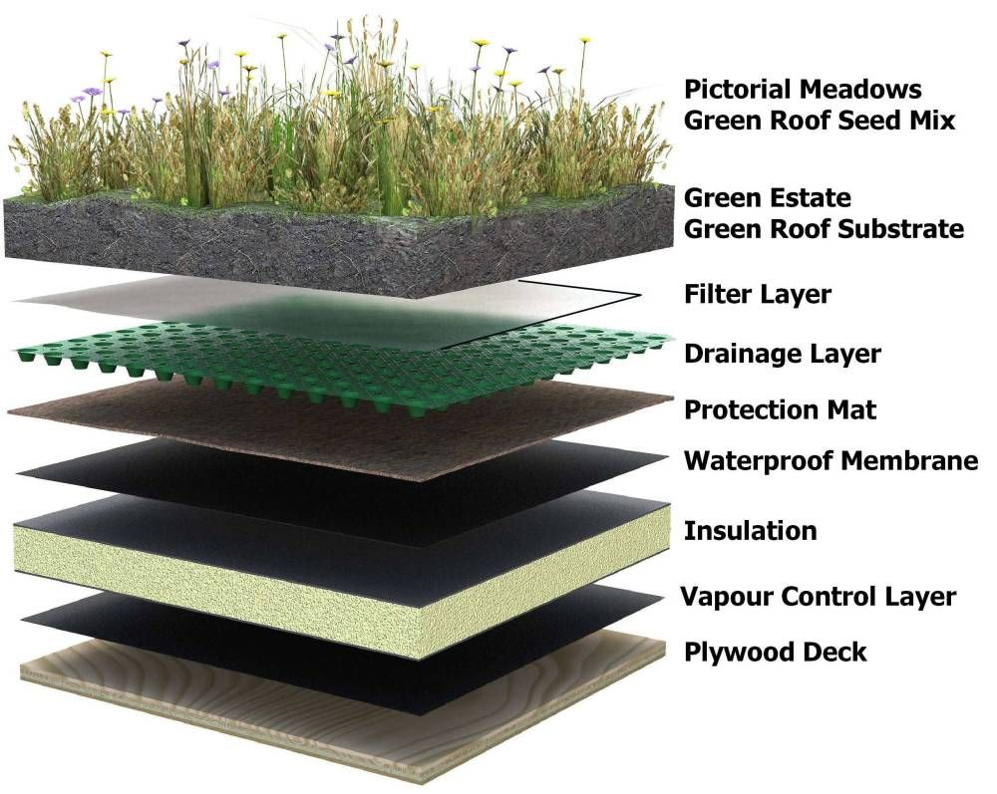
VEGETATED ROOF:- Green roofing or Vegetated roof contains a layer of vegetation which is installed on a flat or slope roof. The water drains vertically from the roofs by the soil medium provided and through the waterproof membrane horizontally.
ADVANTAGES:-
Improve drainage system
Lifespan of the roof can be increased
Thermal performance can be increased
Helps the environment
It supports the wildlife habitats
Air quality can be increased
DISADVANTAGES:-
Expensive than traditional roof
Weight on the roof will be increased
Extra maintenance is require

Slide 16
SATELLITE DATA USED FOR FLOOD INUNDATION: -
S.NO | SATILLITE | SPATIAL RESOLUTION (meters | TIME PERIOD
1 | BHASKARA ½ (TELEVISION CAMERA) | 1000 | JUNE 1979-1980 NOVEMBER 1981-1983
2 | IRS 1A/1B (LISS-I & LISS-II) | 36.5 & 72.5 | MARCH 1988-1992 AUGUST 1991-1990
3 | IRS 1C/D (LISS-III) | 23.5 | SEPTEMBER 1997- 2005
4 | CARTOSAT-1 (STERO PAN) | 2.5 | JUNE 2005-OPERATING
5 | CARTOSAT-2 (PAN) | 1 | JANUARAY 2007-OPERATING

Slide 17
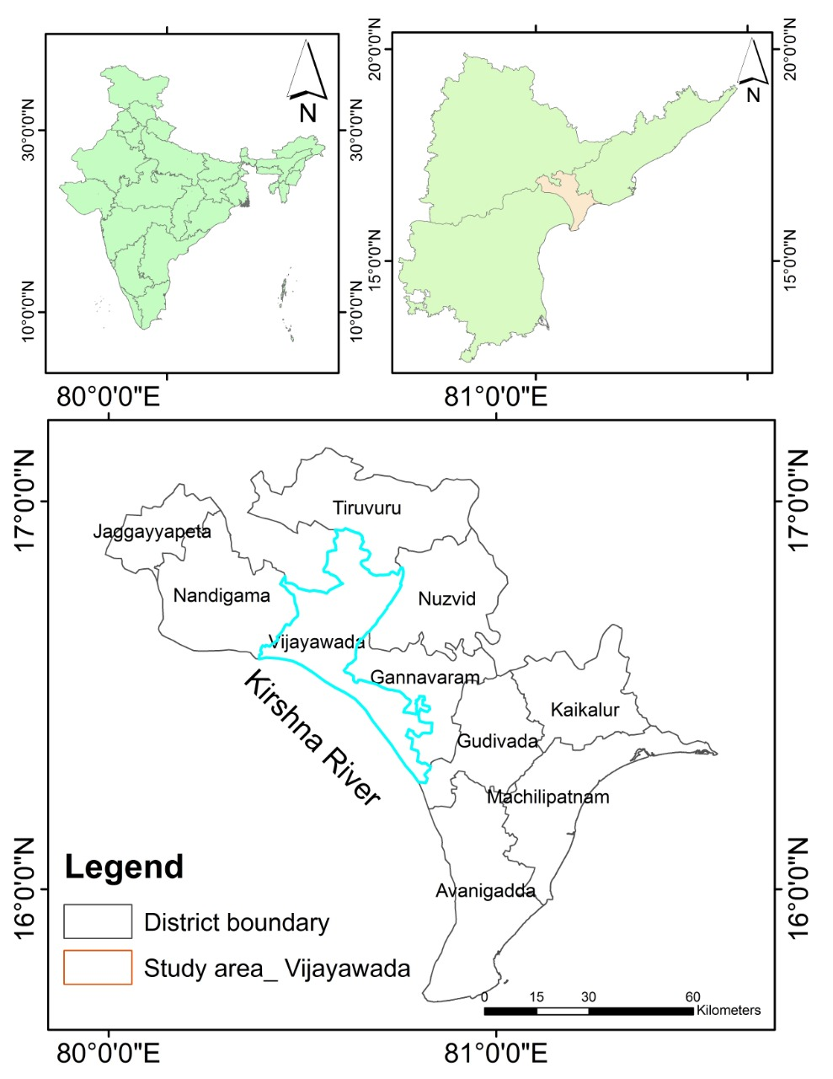
STUDY AREA:-
Area: - Vijayawada city
Location: - Banks of Krishna river
Altitude: - 11m (36ft) above the sea level
Mean Temperature: - 23.4°C – 35°C
Max. Temperature: - 40°C – 45°C
Avg. Rainfall: - 977.9mm (38.5in)

Slide 18
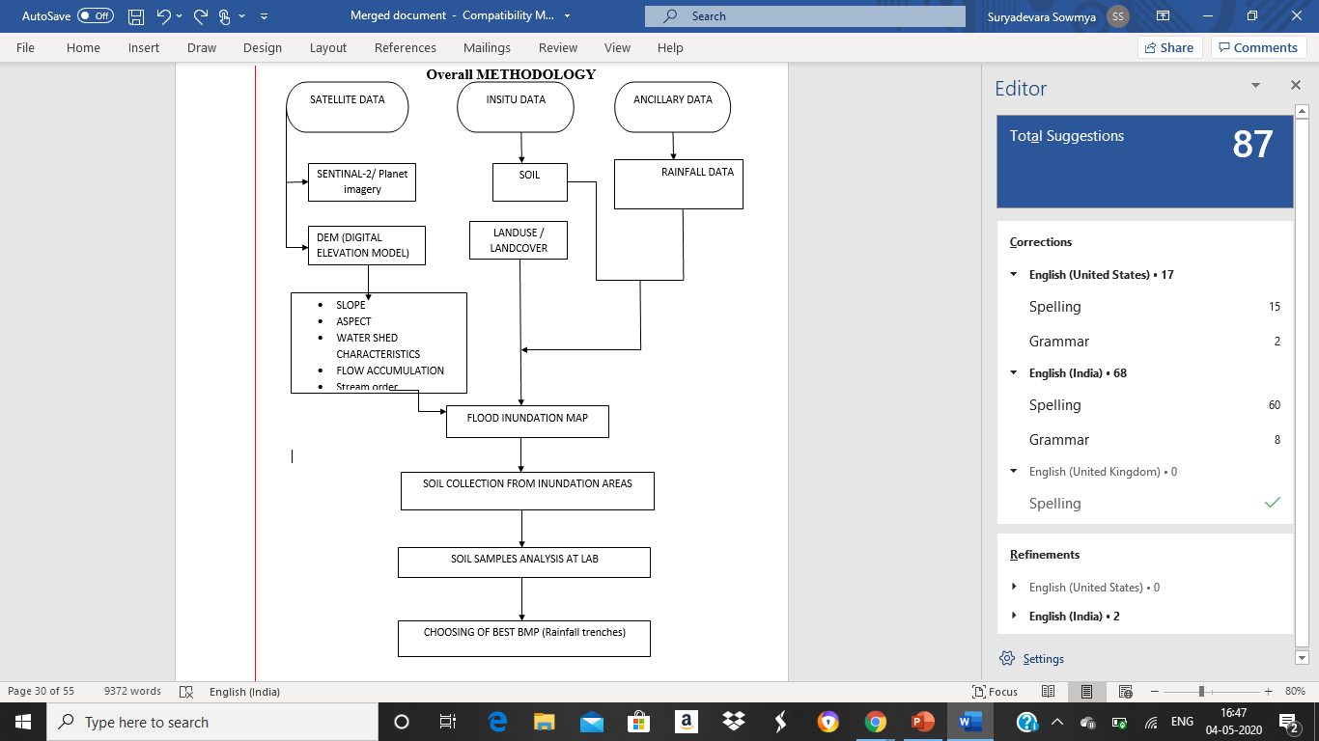

Slide 19
PROCESS OF watershed characteristics:-
DEM
FILL
DEPRESSION LESS DEM
FLOW DIRECTION
FLOW ACCUMULATION
STREAM LINK
BUFFER ZONES
WATERSHED CHARACTERISTICS

Slide 20
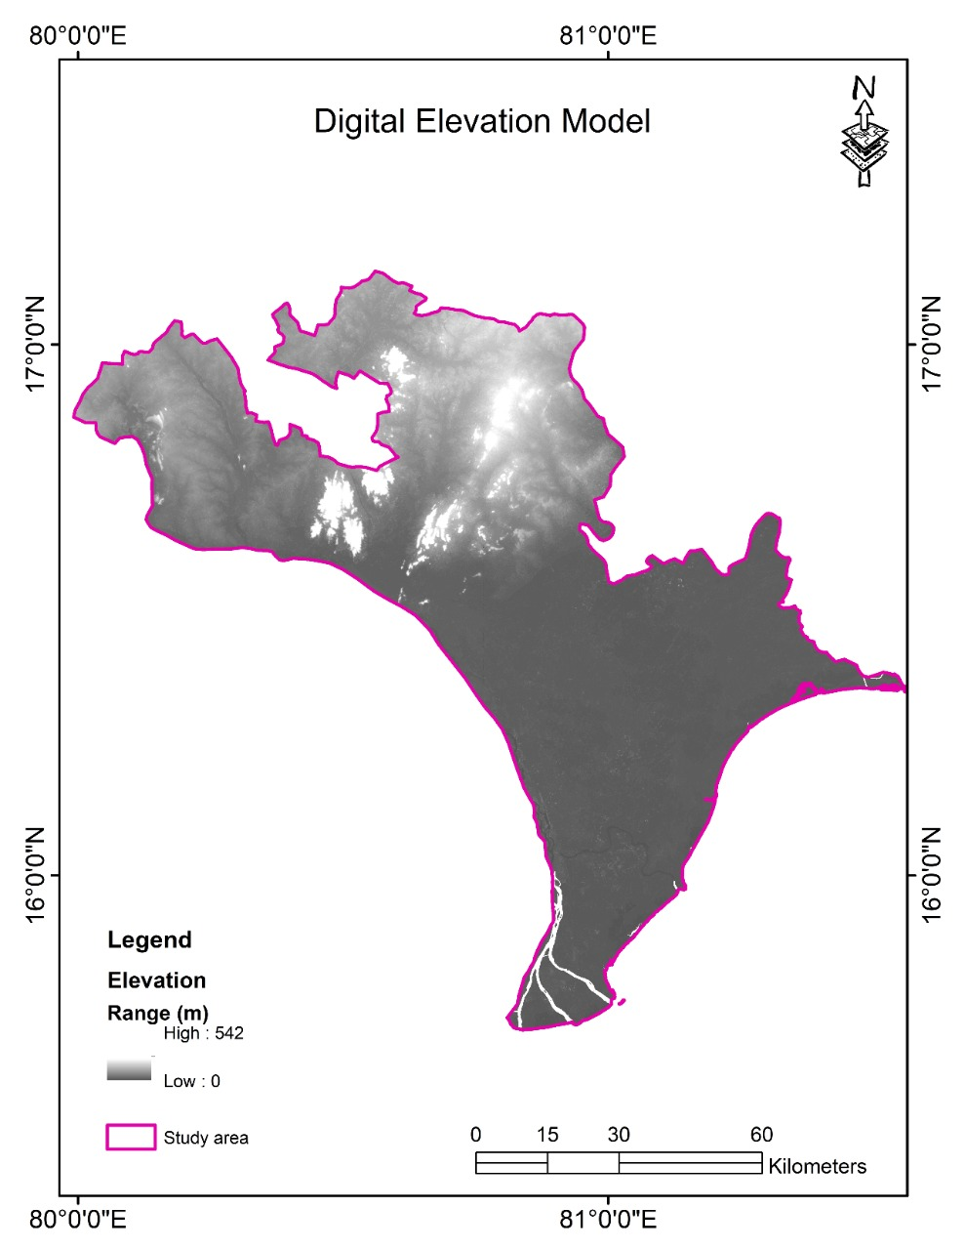
DEM ACQUICITION:-
The first required for water inundation analysis is DEM. Digital elevation models are a type of raster GIS layer. In a DEM each cell of raster GIS layer has a value corresponding to its elevation (2-values at regularly spaced intervals). DEM data files contain the elevation of the terrain over a specified area usually at a fixed grid interval over the “BARE EARTH”

Slide 21
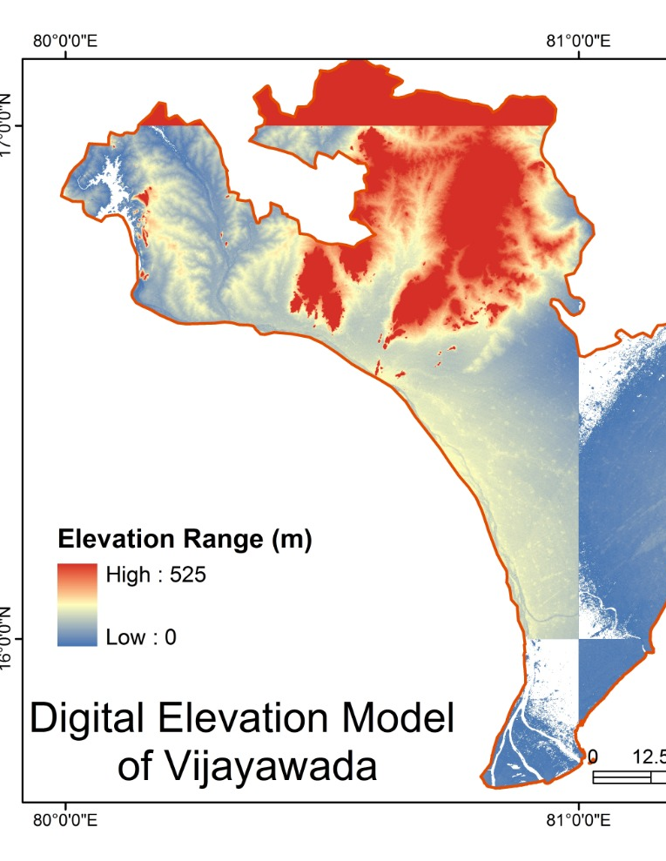
FILL: -
Fill sinks in a surface raster to remove small imperfections in the data. A filled DEM or elevation raster is void of depression. A depression is a cell or cells in an elevation raster that are surrounded by higher elevation value and thus represents an area of interval drainage. Although some depressions are real such as acquirers or glaciated pot holes, may be imperfection in the DEM. Therefore, depression must be removed. A common method to remove depression is to increase its cell value to the lowest overflow point out of the sink. This results in the flat surface.

Slide 22
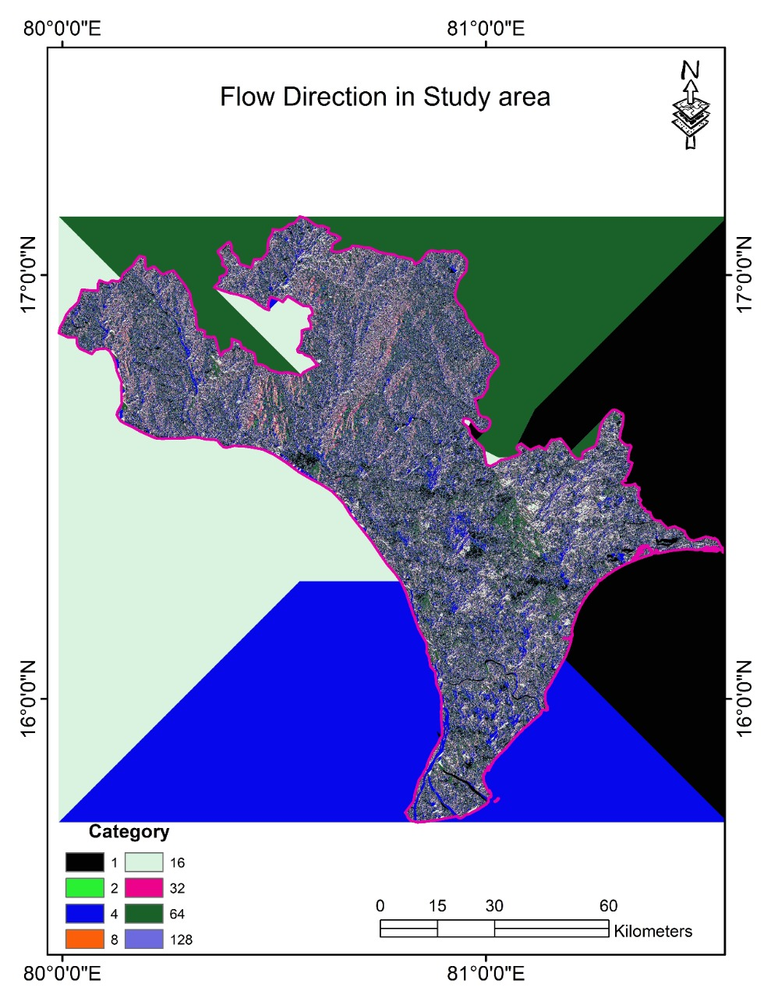
FLOW DIRECTION: -
A flow direction raster shows the direction water will flow out of each cell of a filled elevation raster. A widely used method for deriving flow direction is the D8 method, used by ARC GIS. In D8 method, assigns a cell flow direction to the one of its eight surrounding cells that has the steepest distance-weighted gradient.

Slide 23
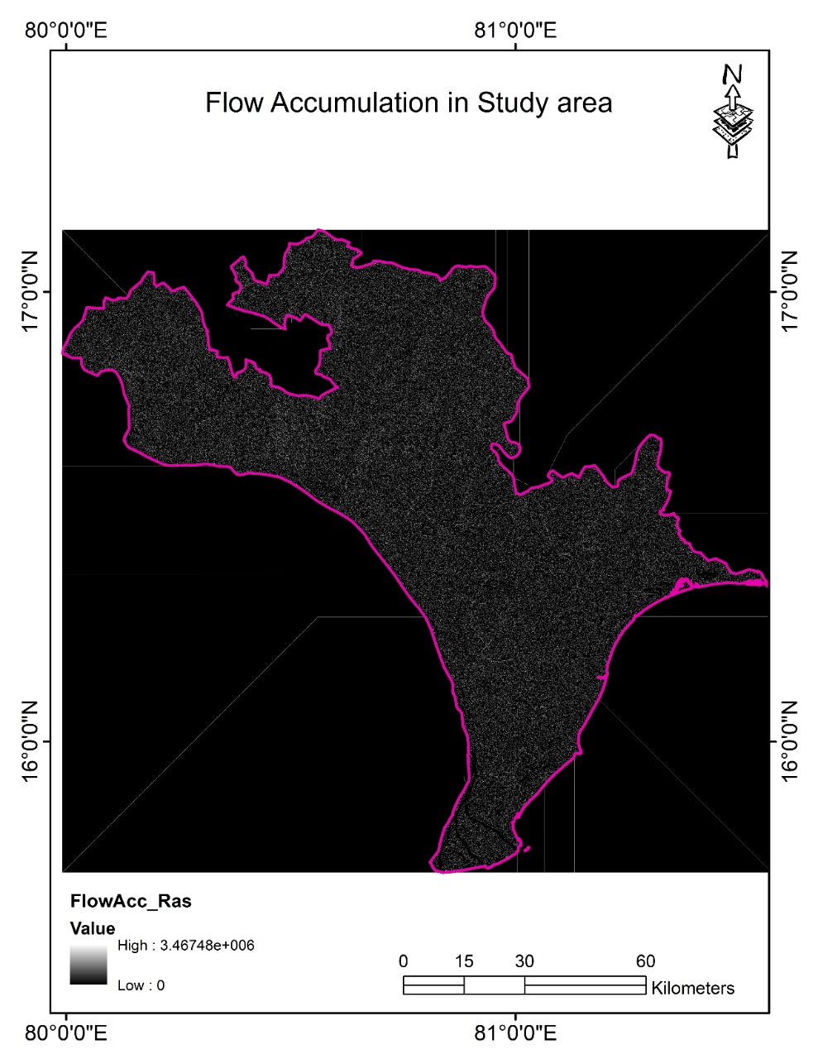
FLOW ACCUMULATION:
A flow accumulation raster tabulates for each cell the number of cells that will flow to it. The tabulation is based on the flow direction raster. A flow accumulation raster can be interpreted in 2 ways:-
Cells having accumulation values generally correspond to stream channels, whereas cells having an accumulation value of zero generally corresponds to rigid lines.
If multiplied by cell size, the accumulation value equals to drainage area.

Slide 24
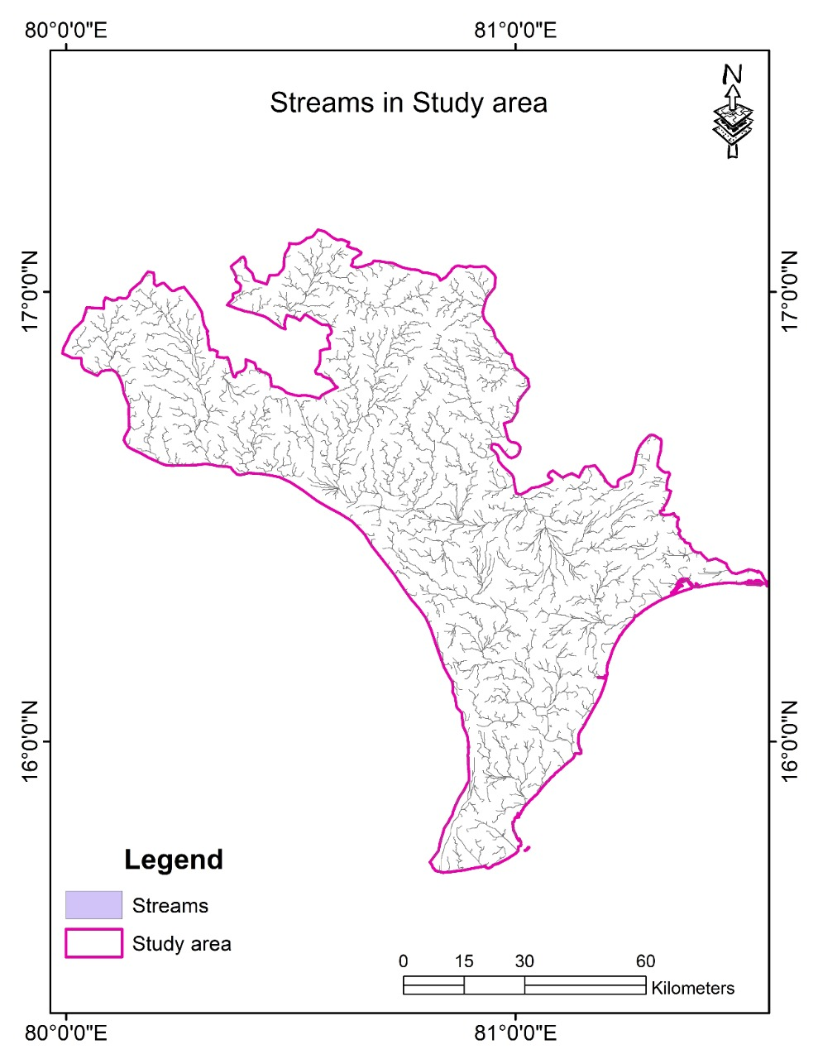
STREAM LINKS: -
Assigning a unique value and associating with flow direction to each section of stream network is a steeper producer to derive stream links. A stream link raster therefore resembles a topology based stream layer, the intersections or junctions are like arcs or reaches.

Slide 25
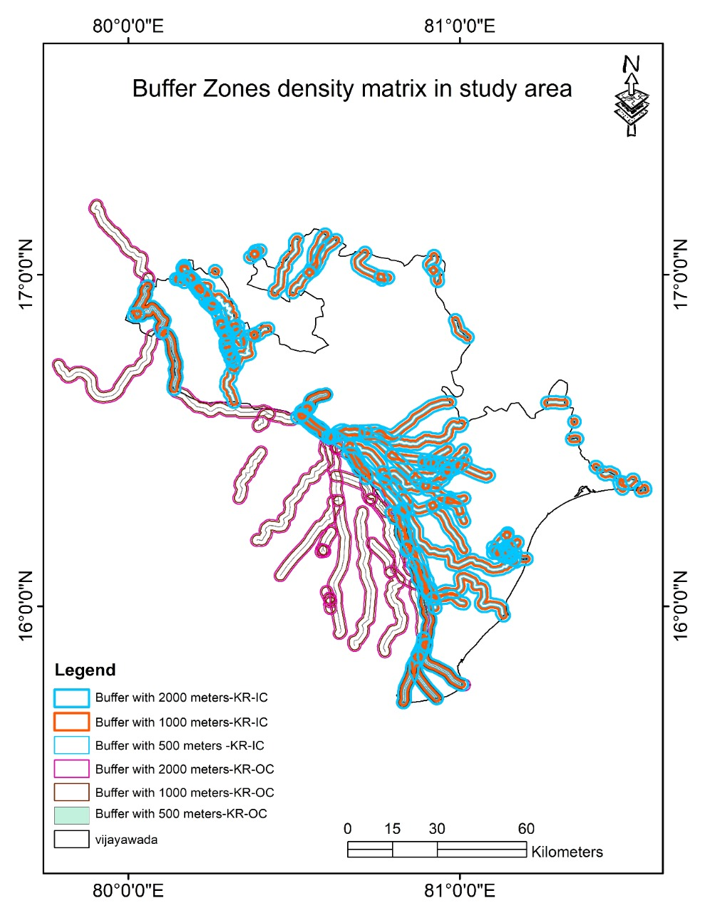
BUFFER ZONES:
A buffer zone in GIS is a zone around a map feature measured
in units of distance or time. A buffer is useful for proximity analysis. A buffer is an area
defined by the bounding region determined by a set of points at a specified maximum
distance from all nodes along segments of an object.
Weightages are given as below: -
˃ 1500m is 3 rank
1000 – 1500m is 4
500 – 1000m is 5 (higher rank)

Slide 26
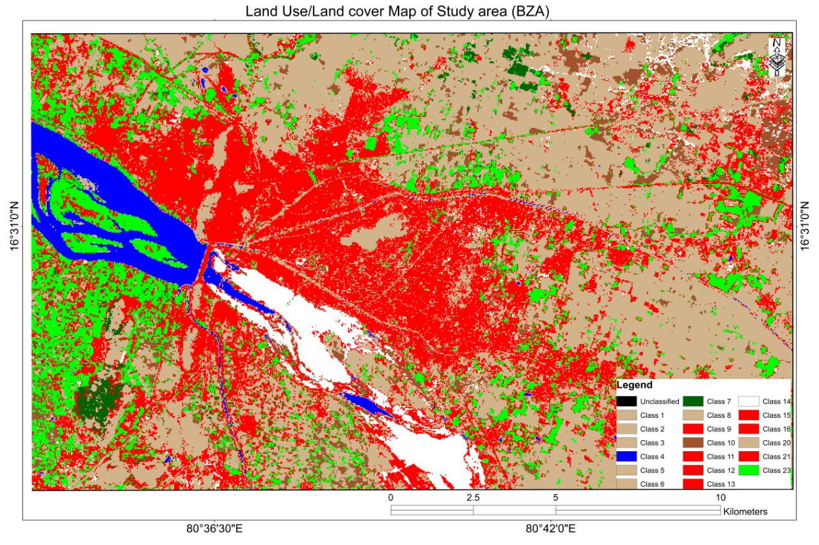
LAND USE AND LAND COVER DATA: -
Unsupervised classification is used to extract the values by allotting weightages to the raw data.
Generally it is between 1 to 5.
BLUE: - RIVER FLOW
WHITE: - EMPTY RIVERBED
RED: - CONSTRUCTIONS
GREEN: - VEGETATION

Slide 27
Rainfall data:-
Data is obtained from Indian water portal with a special permission. Data is obtained on a monthly scale from January to December 1900 to 2002. This century scale rainfall is further analysed by considering monthly variations of rainfall, so that it will be easy to understand the effect of rainfall in form of floods in different seasons of lowling areas.
The data is obtained from the website: https://www.indiawaterportal.org/articles/district-wise-monthly-rainfall-data-list-raingauge-stations-india-meteorological-department.
Further, Inverse distance weighted method is used for extrapolating the data at Vijayawada scale (regional scale) to understand the influence of rainfall.

Slide 28
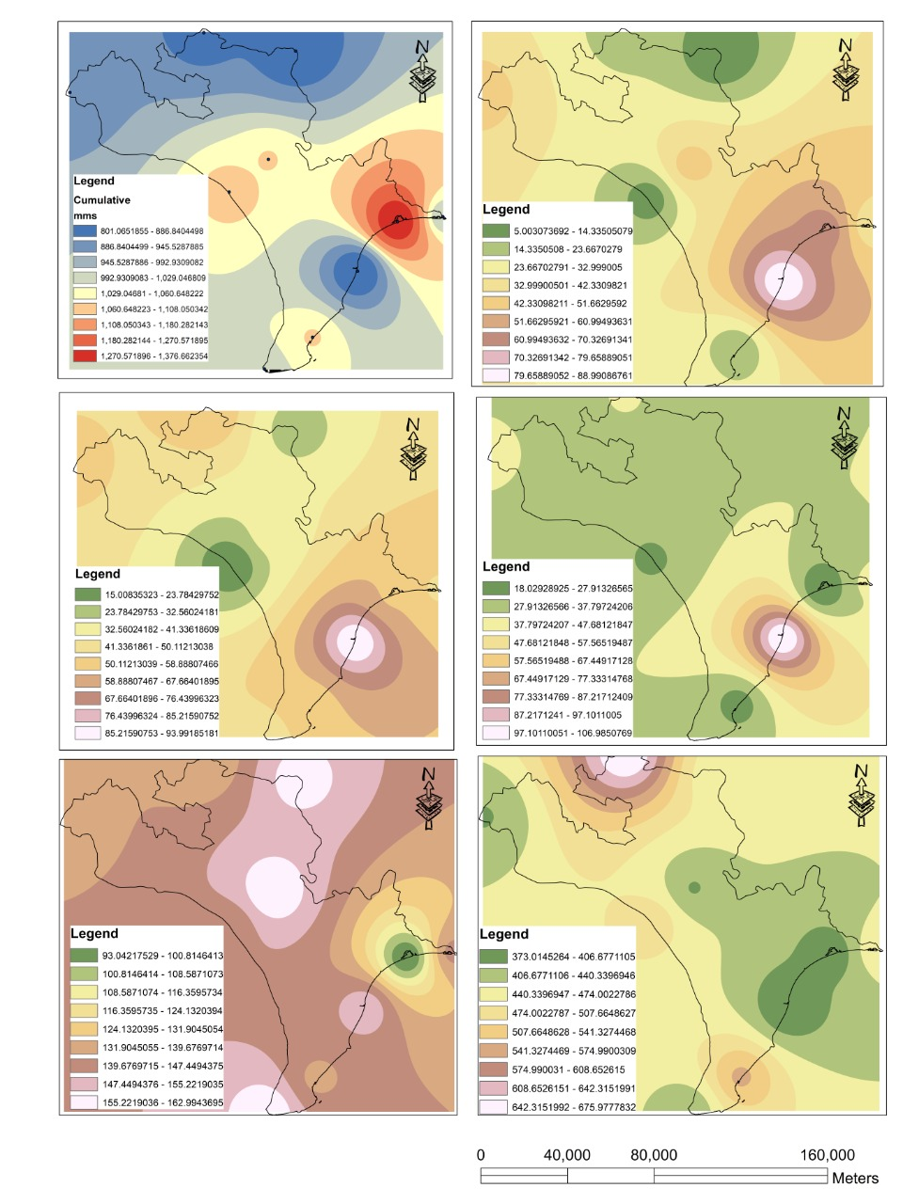
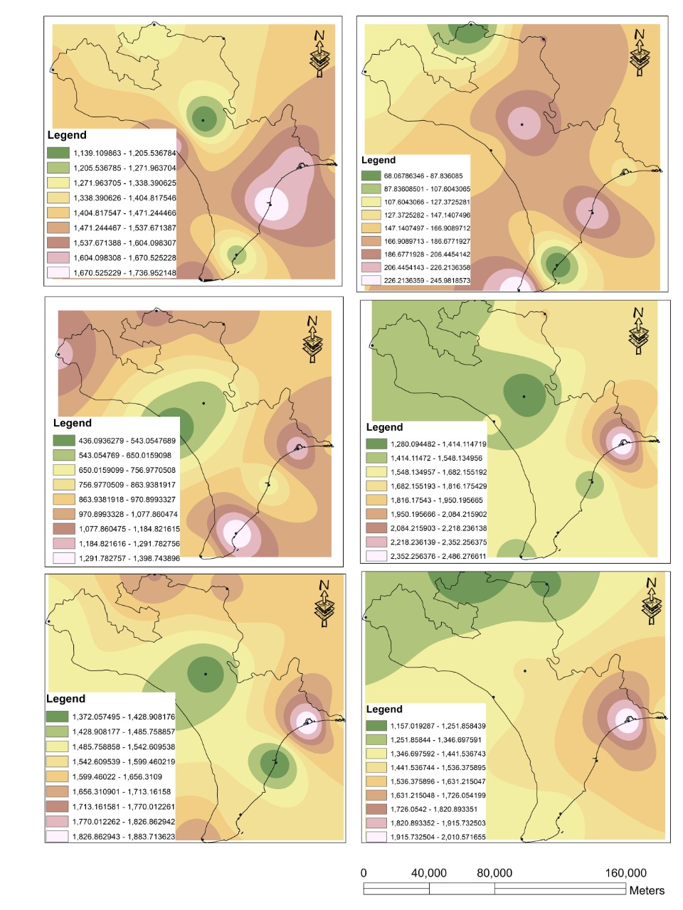

Slide 29
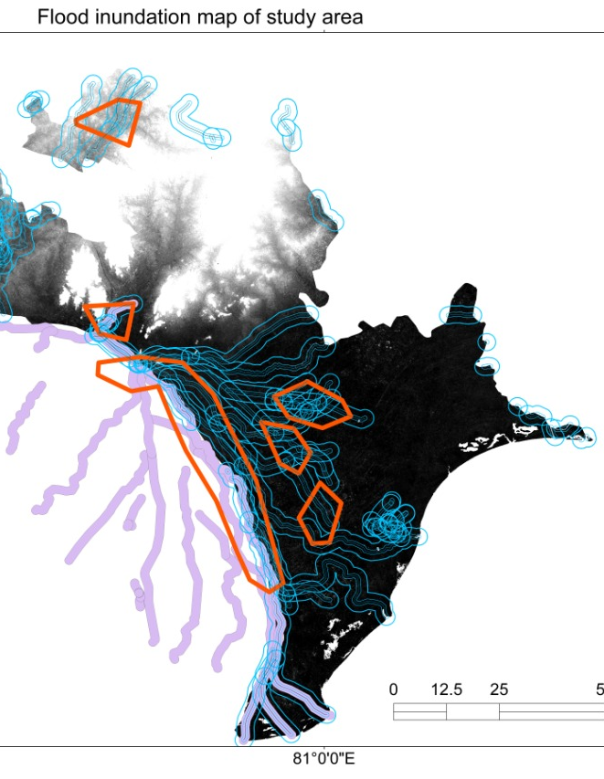
INUNDATION ZONES: -
The identified inundation zones are
Krishna Lanka
Yalamanakudhuru

Slide 30
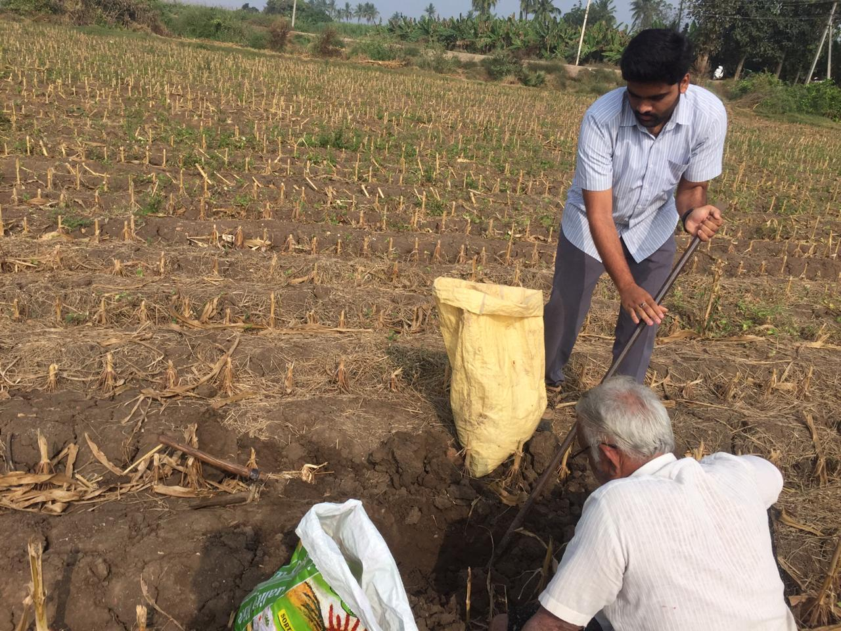
COLLECTION OF SOIL SAMPLES: -
Soil samples are collected from the both inundation zones.
Sample is collected from a depth of 1.5m below the ground level.

Slide 31
IDENTIFICATION OF BASIC PROPERTIES OF SOIL: -
The following are the basic properties of soil : -
Optimum moisture content
Specific gravity
Sieve Analysis
Free Swell
OPTIMUM MOISTURE CONTENT: - The knowledge of the natural moisture content is essential in all studies of soil mechanics. To sight a few, natural moisture content is used in determining the bearing capacity and settlement. The natural moisture content will give an idea of the state of soil in the field.
Moisture Content = {(W2-W₃)/ (W₃-W₁)} x 100
S.NO | OBSERVATIONS (gms.) | TRAIL 1 | TRAIL 2
1 | Wt. of container with lid (W₁₎ | 34 | 34
2 | Wt of container + wet soil (W₂) | 50 | 50
3 | Wt of container + dry soil (W₃) | 48 | 49
4 | Moisture content | 14.28% | 6.66%
KRISHNA LANKA SOIL SAMPLE: -

Slide 32
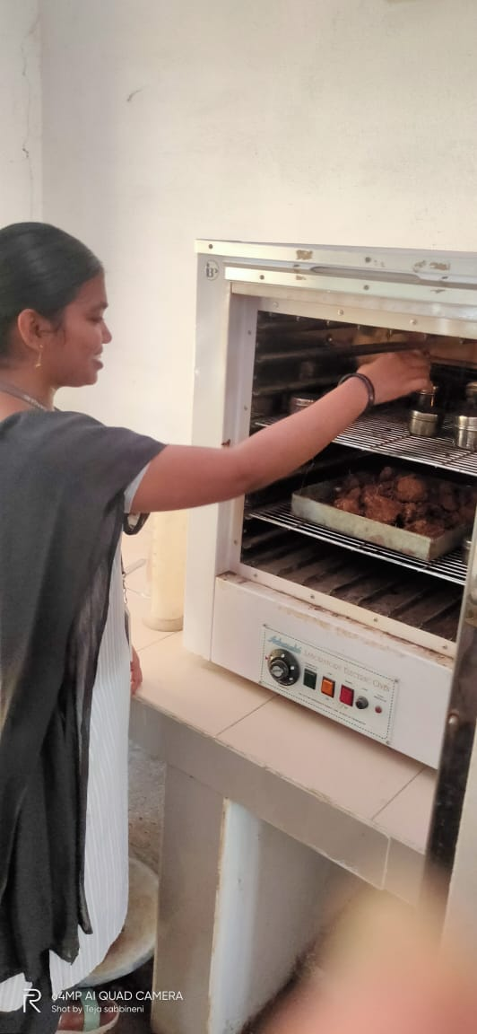
RESULT: -
The optimum moisture content of Krishna Lanka soil = 18.6%
The optimum moisture content of Yanamalakudhuru soil = 14.83%
S.NO | OBSERVATIONS (gms.) | TRAIL 1 | TRAIL 2
1 | Wt of container (W₁₎ | 34 | 34
2 | Wt of container + wet soil (W₂) | 50 | 50
3 | Wt of container + dry soil (W₃) | 48.5 | 49
4 | Moisture content | 10.344% | 6.666%
YANAMALAKUDHURU SOIL SAMPLE: -

Slide 33
SPECIFIC GRAVITY: - The knowledge of specific gravity is needed in calculation of soil properties like void ratio, Degree saturation etc.
constructions.
Specific Gravity= (W₂ -W₁)/ {(W₂ -W₁)-(W₃-W₄)}
S.NO | OBSERVATIONS(gms.) | TRAIL 1 | TRAIL 2
1 | Wt of density bottle(W1) | 28 | 28
2 | Wt of density bottle + Dry soil (W2) | 48 | 49
3 | Wt of density bottle + Dry soil + Water (W3) | 88 | 87
4 | Wt of bottle + water (W4) | 80 | 81
5 | Specific Gravity | 1.66 | 1.4
KRISHNA LANKA SOIL SAMPLE: -

Slide 34
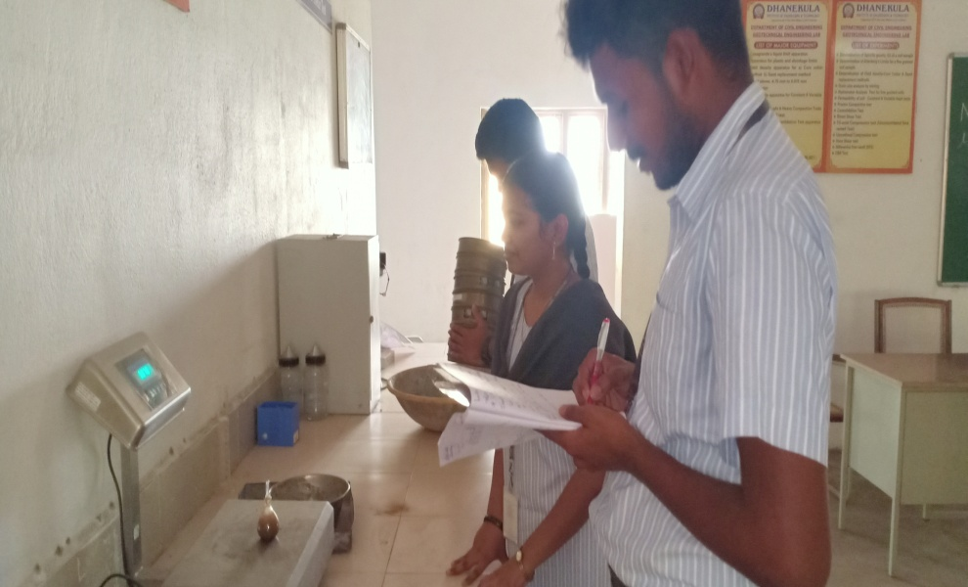
S.NO | OBSERVATIONS (gms.) | TRAIL 1 | TRAIL 2
1 | Wt of density bottle (W1) | 28 | 28
2 | Wt of density bottle + Dry soil (W2) | 48 | 47
3 | Wt of Density bottle + Dry soil + Water(W3) | 88 | 87
4 | Wt of density bottle + Water(W4) | 80 | 80
5 | Specific Gravity | 1.666 | 1.583
YANAMALAKUDURU SOIL SAMPLE: -
RESULT: -
The specific gravity of Krishna Lanka soil = 1.595
The specific gravity of Yanamalakuduru soil = 1.833

Slide 35
SIEVE ANALYSIS: - Sieve analysis is important for analysing materials because particle size distribution can affect the wide range of properties, such as the strength, suitability for various constructions.
KRISHNA LANKA SOIL SAMPLE: -
S.NO | SIEVE SIZE | PARTICLE SIZE | Wt. RETAINED | % Wt. RETAINED | CUMULATIVE % Wt. RETAINED | CUMULATIVE % Wt. PASSING
1 | 4.75mm | 4.75mm | 0.098 | 9.8% | 0 | 100%
2 | 1.18mm | 1.18mm | 0.432 | 43.2% | 53% | 47%
3 | 600µ | 0.60mm | 0.178 | 17.8% | 70.8% | 29.2%
4 | 425µ | 0.425mm | 0.034 | 3.4% | 74.25 | 25.8%
5 | 150µ | 0.150mm | 0.148 | 14.8% | 89% | 11%
6 | 75µ | 0.075mm | 0.74 | 7.4% | 96.4% | 3.6%
7 | PAN | PAN | 0.36 | 3.6% | 100% | 0%

Slide 36
D₁₀ = 0.13mm
D₃₀ =0.625mm
D₆₀ =1.63mm
C_{U} = D₆₀ / D₁₀ = 1.63 / 0.13 =12.53
C_{C} = (D₃₀)² / (D₆₀ x D₁₀) = (0.625)² / (1.63 x 0.13) = 1.84

Slide 37
YANAMALAKUDURU SOIL SAMPLE: -
S.NO | SIEVE SIZE | PARTICLE SIZE | Wt. RETAINED | % Wt. RETAINED | CUMULATIVE % Wt. RETAINED | CUMULATIVE % Wt. PASSING
1 | 4.75 | 4.75 | 0.234 | 23.4% | 0% | 100%
2 | 1.18 | 1.18 | 0.366 | 36.6% | 60% | 40%
3 | 600 | 600 | 0.152 | 15.2% | 75.2% | 24.8%
4 | 425 | 425 | 0.034 | 3.4% | 78.6% | 21.4%
5 | 150 | 150 | 0.136 | 13.6% | 92.2% | 7.8%
6 | 75 | 75 | 0.056 | 5.6% | 97.8% | 2.2%
7 | PAN | PAN | 0.022 | 2.2% | 100% | 0%

Slide 38
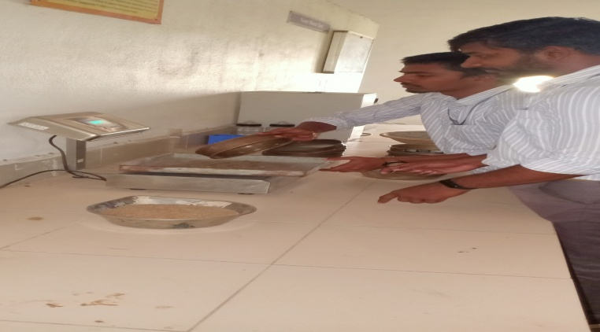
D10
D₁₀ = 0.179mm
D₃₀ =0.8 mm
D₆₀ =1.82 mm
C_{U} = D₆₀ / D₁₀ = 1.82 / 0.179=10.16
C_{C} = (D₃₀)² / (D₆₀ x D₁₀) = (0.8)² / (1.82 x 0.179) = 1.96
RESULT: - According the CC and CU values obtained from the calculation
Krishna Lanka soil sample is uniformly graded sand
Yanamalakuduru soil sample is uniformly graded sand

Slide 39
FREE SWELL: - The knowledge of Differential Free Swell gives an idea on the increase of volume of soil without any external constraint when subjected to submergence in water.
Differential free swell % = (V_{W}-V_{K}) / V_{K}
Differential free swell % of KrishnaLanka soil = ( (V_{w} – V_{k}) / Vk) x 100
= ( (13 -10) / 10) x 100
= 30%
Differential free swell % of Yanamalakuduru soil = ( (V_{w} – V_{k}) / Vk) x 100
= ( (14.5 -10) / 10) x 100
= 45%
CONDITIONS: -
If swell of sample less than 50% - non swelling soil
If the sell between 50 – 100 - medium swelling
If the swell between 100 – 200 - High swelling
If the swell of sample more than 200% - very high swelling
RESULT: -
Both soils are NON- SWELLING soil

Slide 40
Choosing of Best BMP: -
By considering the 5 available BMP’s, we are choosing RAIN BARRELS because the soil type is clay which takes long time to penetrate the water itself by which we can’t reduce the flood rate. Bio Retention type BMP is used in the fields and to construct the Infiltration Trenches, the place is not sufficiently available. Vegetated roofs are in practice in day to day life but not enough efficient to control the flood. Finally based on the based on the Soil condition, Density of Population, Land use / Land Cover Data,Type of Rain Fall, Climate, Amount of Rain Fall, Availability of land RAIN BARRELS is choosed as the best suitable BMP for that area.

Slide 41
SCOPE OF FUTURE STUDY:
Designing of RAIN BARRELS based on the quantity of flood in that area is the further process of this study. By providing the required dimensioned barrels we can control the flood rate and at the same time we can reduce the damages which occur to the lifestyle of the people.

Slide 42
CONCLUSION:
By installing the required dimensioned RAIN BARRELS in the identified inundation zone i.e. Krishna Lanka and Yanamalakuduru, we can reduce the flood rate and at the same time we can reuse the water for bathing, laundry, flushing toilets, watering the lawns, gardens and houseplants, composting, water for pets, outdoor ponds, and rinsing vegetables by storing it. We can recharge the ground water table by not letting it as a waste product into the sea.

Slide 43
THANK YOU

