Slide 1
Cloud Native vRAN
Kranthi

Slide 2
RAN Virtualization Overview
Advantages of moving towards Cloud Native
Throughput Challenges in vRAN for 5G
Who is moving towards Cloud Native?
Front-haul capacity calculation for Edge Computing
Fronthaul capacity between the RRH and BBU
FH_C requirement between the RRH and BBU for 20MHz
Cloud Native performance with GPOS and RTOS
Performance Analysis between Container and VM
Potential vRAN Architecture
Proposal to Build RANaaS in Cloud Native
Time estimation to build vRAN into containers (5 Stages)
Towards Edge computing and 5G
Areas to focus for Telcos

Slide 3
vRAN Overview
Virtualization | vEMS | vCU | vDU | Comments
Horizontal Scaling | No | No | No | Split architecture is highly recommended for reducing hardware resources and moving towards cloud native.
High Availability | Yes | No | No | Fault tolerance for vCU, vDU & EMS is only 99% (>5days/year). It should be atleast 99.9% (~8 hours/year). Desirable 99.99%(~5mins/year)
Resiliency | No | Only system level | No | vEMS : Partially vBBU & vDU: Only service level
Load Balancing | No | No | No | vEMS : No vBBU & vDU: No
Automation | In progress with gVNFM (Cisco ESC) | In progress with gVNFM (Cisco ESC) | In progress with gVNFM (Cisco ESC) | sVNFM should be developed and has to be open sourced
Upgrade/ Update | 30 Mins for Upgrade proccess | 15 mins for Upgrade | 20 mins for upgrade | Zero down time can be achieved for upgrade

Slide 4
Advantages of vRAN in Cloud Native
Reduce Hardware resources:
Save 50-60% of hardware resources by split architecture.
Base Guest OS is taking minimum of 1 to 1.5 GB RAM (12-15% of RAM in stage1)
90% of deployment time is reduced:
Launching vRAN software (vEMS, vCU & vDU) it saves <90% of time
Image Building can be done by Dockerfiles. Uses only >1/4th of VM image size
Image files can be shared among different containers, only one image file needs to be built to setup the cluster. Note: Setting up time will the same.
Bootup latency is very low.
Performance is as good as baremetal
The high CPU wait time also indicates large amount of disk I/O with long latencies.
Container releases its memory after it finishes its workload, while a VM still holds the memory even after it becomes idle.

Slide 5
Advantages if vRAN in Cloud Native
Zero Down time:
For update/upgrade backend, frontend and DB structures (docker/haproxy)
High Availability :
Adding replica nodes to cluster in case of eNB failures
Load Balance user requests across the Nodes
Horizontal scalability :
Micro-service design pattern with horizontal scaling is very quick
Scale-Up/Scale-Down scenarios for per-cluster resource metrics (like CPU, RAM). Utilization or raw values across the cluster can be configured and produce a ration for desired number of replicas.
Kubernetes has feature Horizontal Auto-scaler
Great tools for Orchestrating cloud native application

Slide 6
Advantages of heading towards Cloud Native vRAN
New RAN has to quickly and automatically scale with the variable amount of mobile traffic.
Consume less power providing higher capacity and network coverage at the same time.
Allow mobile operators to frequently upgrade and operate the service over multiple/heterogeneous Open air interfaces (OAI).
Coordinate and joint signal processing to increase the spectral efficiency (ULCOMP).
Represents a good match between the spatial-temporal traffic variations and available computational resources and hence power consumption

Slide 7
Throughput Challenges in vRAN for 5G
1. Dimensioning of the fronthaul capacity:
vCU pool has to support a high fronthaul capacity to transport I/Q samples for a typical set of 10–1000 base-stations working in the vDU–RRH configuration.
Due to a low processing budget of RAN, the upper bound for the maximum one-way delay has to be estimated.
Very low jitter has to be maintained for the clock synchronization among DU and RRH.
2. Processing budget at the BBU:
In the LTE FDD setup, the Hybrid automatic repeat request (HARQ) mechanism with an 8 ms acknowledgment response time provides an upper bound for the total delay of both fronthaul latency and BBU processing time.

Slide 8
Cont…
3. Requirements of the RT-OS and Virtualization-System:
To successfully provide frame/subframe timings, the execution environment of the DU & CU has to support strict deadlines of the code execution.
Load variations in the cell (e.g., day/night load shifts) impose the requirement on the on-demand resource provisioning and load balancing of the BBU pool.
4. Front-haul multiplexing
5. Optimal clustering of CU, DU and RRH
6. CU-DU interconnection and cooperative radio resource
management
7. Energy Optimization

Slide 9
Who is moving towards Cloud Native
Organization | L1/L2 | L3 | Comments
Ericsson | No | Yes | vCU-CP and vCU-UP moving towards containers
Nokia | No | Yes | vCU-CP and vCU-UP moving towards containers
ZTE | Partially | Yes | vCU-CP and vCU-UP moving towards containers. Few services they are moving towards containers.
Huawei | No | Yes | vCU-CP and vCU-UP moving towards containers
Mavenir | No | Yes

Slide 10
Front-haul capacity calculation for Edge Computing
Front-haul capacity
FH_C = (2 x A x S x SR x W x C) x (O x K)
Cell configuration:
FH_c = Front-haul
A – Number of receiving and transmitting antenna ports
S – Number of Sectors
SR – Sampling Rate
W– bit width of a I/Q symbol
C – number of carrier components
Front-haul configuration
0– ratio of transport protocol and code overhead
K– compression ratio

Slide 11
Fronthaul capacity between the RRH and BBU
BW (Hz) | Antenna-Port | Sectors | Sampl’g Rate | W(Bits) | Overhead | Carrier | Compression Ratio | FH_c (Mb/s)
1.4 | 1x1 | 1 | 1.92 | 16 | 1.33 | 1 | 1 | 81
5 | 1x1 | 1 | 7.68 | 16 | 1.33 | 1 | 1 | 326
5 | 2x2 | 1 | 7.68 | 16 | 1.33 | 1 | 1 | 653
10 | 4x4 | 1 | 15.36 | 16 | 1.33 | 1 | 1/2 | 1300
20 | 1x1 | 1 | 30.72 | 16 | 1.33 | 1 | 1 | 1300
20 | 2x2 | 3 | 30.72 | 16 | 1.33 | 1 | 1 | 7850
20 | 4x4 | 3 | 30.72 | 16 | 1.33 | 1 | 1 | 15600

Slide 12
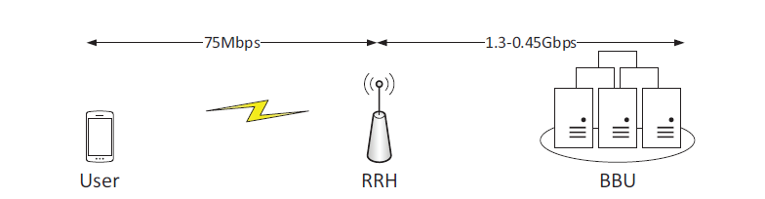
FH_C requirement between the RRH and BBU for 20MHz
Minimum required fronthaul capacity without compression is estimated at 1.3 Gb/s, the deployment of 1/3 compression ratio decreases the required capacity to 0.45 Gb/s

Slide 13
Requirements Latency, Jitter and Signal Processing
Fronthaul should still maintain the latency requirement to
meet the HARQ deadlines.
RTT between RRH and BBU equipped with a CPRI link cannot exceed 700 micro secs for LTE and > 400 µ secs for 5G.
Jitter required by advanced CoMP schemes in the MIMO case is below 65 ns as specified in 3GPP 36.104.
Next Generation Mobile Networks (NGMN) adopts the maximum fronthaul round-trip-time latency of 500 micro seconds.
The propagation delay, corresponding to timing advance, between RRH and UE, affects only the UE processing time. The timing advance value can be up to 0.67 ms.
Consequently, this leaves the BBU PHY layer only with around 2.3–2.6 ms for signal processing at a centralized processing pool.

Slide 14
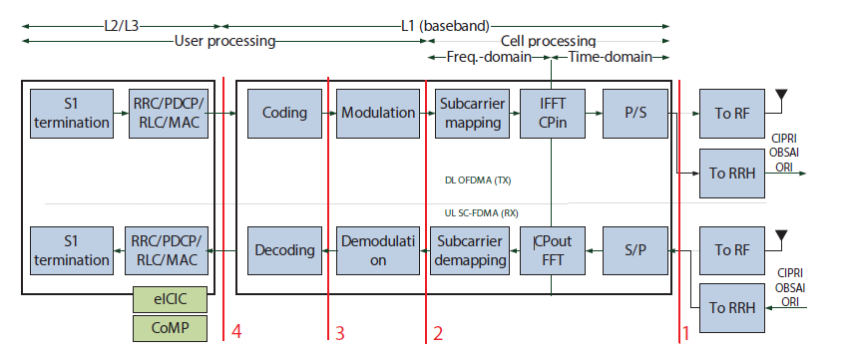
Functional Block Diagram of L1 & L2/L3

Slide 15
Cloud Native performance with GPOS and RTOS
General Purpose Operating System (GPOS) | Real-time Operating System (RTOS)
Centos in present deployments of vCU and vDU. vEMS can still run in base OS as GPOS | RT-Linux patch for vDU, but base OS is still Centos
Full Virtualization (Type-2 Virtual Machines) creates more overhead as it emulates virtual hardware in guest OS. Note: Para-virtualization can still have lot of overhead which may not meet the deadline | Container (Type-1 Cloud Native) with RTOS is recommended for vDU and vCU-DP. It is desirable vCU-UP also. (i.e., total L1, L2/L3).
Not designed to support real-time applications with hard deadline. Example: Max HARQ is 8ms | Designed to support real-time applications with hard deadline
Behavior is unexpected in handling interrupts at low latency. | Deterministic behavior in low latency (interrupt response delay is 100 micro sec)
Task can remain suspended for an arbitrarily long period of time. | Performance is accurate
No Schedule policy Optimization | The scheduler is able to preempts the kernel code to meet the deadline and allocates the required runtime (i.e., CPU time) to each task period.

Slide 16
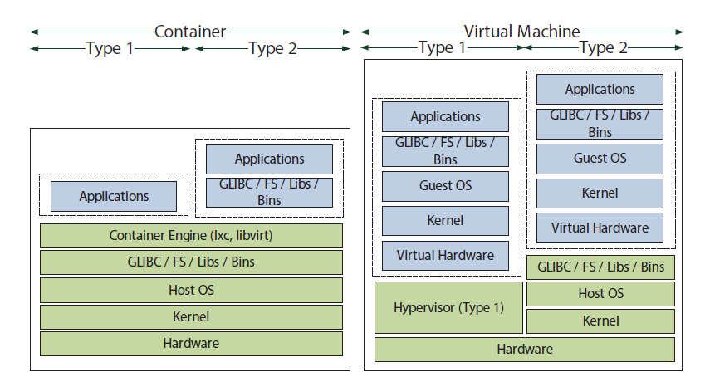
Types of a VM and Container virtualized environment

Slide 17
Main aspects of RAN Virtualization
I/O Virtualization:
I/O access is a key for a fast access to the front-haul interface and to the hardware accelerators that might be shared among BBUs
Hardware emulation overhead should be removed and requires device mapping
Requires fast and direct access to hardware
In particular that of radio front-end hardware, techniques such as single/multi root I/O virtualization (SR/MR-IOV) are required
Service composition of the software radio application:
Atomic services, Decomposition and composed services should be dis-aggregated
An atomic service in RAN can be defined on per carrier, per layer, per function basis.
For instance, a radio application could be defined as a composition of layer 1 and layer 2/3 services supported by a monitoring as a service

Slide 18
Performance Analysis between Container and VM
I/O Performance Analysis & BBU processing time
To determine the overhead caused by resource sharing
To determine how virtualisation affects the inter-process communication performance, considering:
(a) Communication using only intra-node communication mechanisms;
(b) Communication using a physical network interface
Test bed setup for High Performance linpack (HPL)
Intel Core i7-4770 processors operating in 3.4 GHz, 16GB DDR3 SDRAM, 16 cores
Hyper-threading and turbo mode disabled.
Linux Schedules: SCHED DEADLINE
OS: Ubunut 14.04 LTS 64 bit
Environment | Nodes | Cores/node | Memory/node (MB)
Native | 1 | 4 | 3096
Virtual-1 | 1 | 4 | 3096
Virtual-2 | 2 | 2 | 1536
Virtual-4 | 4 | 1 | 768

Slide 19
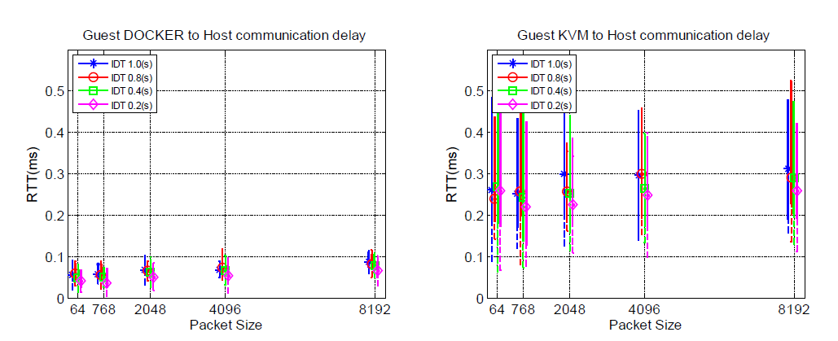
I/O Performance Analysis & BBU processing time
Containers are extremely efficient with 4-5 times lower round trip times (RTT)
KVM has a high variations, and requires optimization to lower the
Interrupt response delay as well as host OS scheduling delay.
Results validate the benefit of containerization for high performance networking

Slide 20
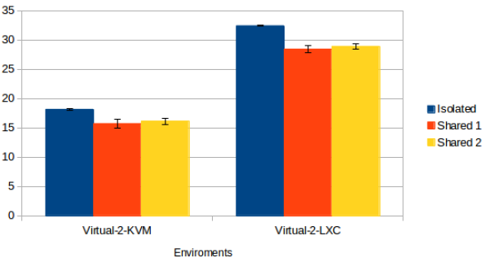
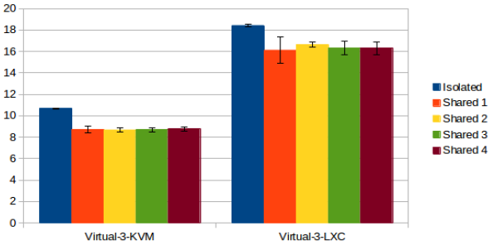
Overhead caused by resource sharing (CPU Performance vs Environments )
Resource sharing on performance with two and four instances running concurrently

Slide 21
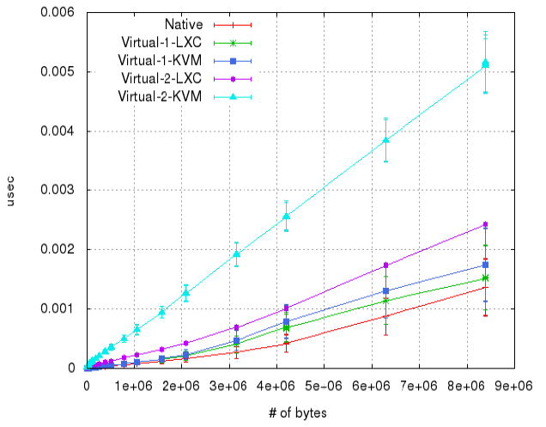
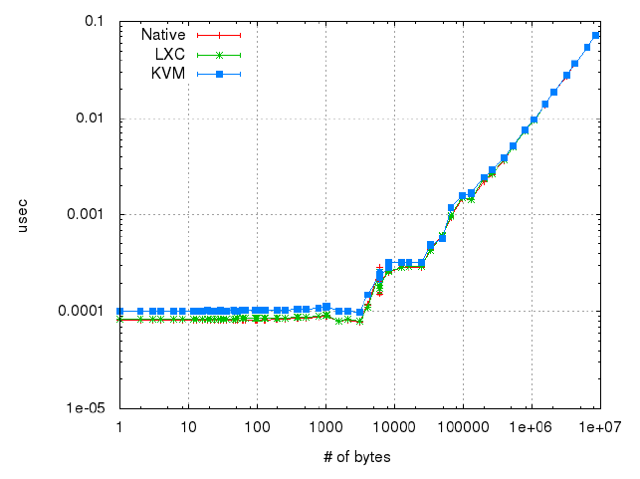
Network Performance -- IPC latency
Inter-process communication latency (same host)
Inter-process communication latency(cluster)

Slide 22
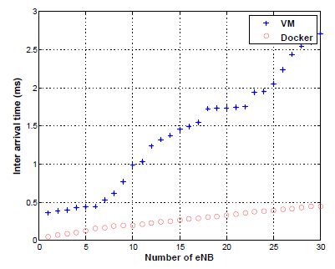
Packet Traversal VM vs Container
Inter-arrival time of the packets collected from the eNBs served by the Application (SDN Controller). Increase in number of eNBs gradually resulted in significant difference in the behavior of the VM and Container test beds.

Slide 23
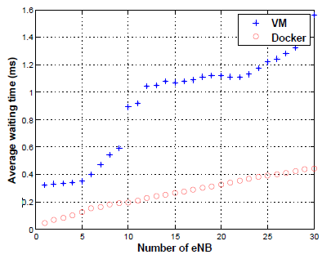
Average Waiting time from eNB to Application
Average waiting time from eNB to application and vice versa, for the VM and Container based architecture. Due to the fact the hardware resource of physical machine that is virtualized using VMs would easily get over-loaded with the increase in the number of virtual nodes.

Slide 24
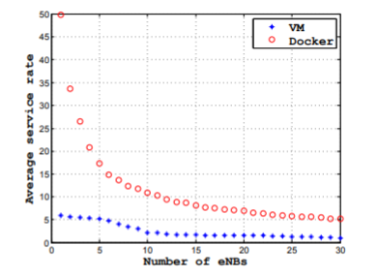
Average Service Rate
Service processing time estimate the processing time required for the eNBs information update from the application (eg. SDN controller, Mongo DB, etc)

Slide 25
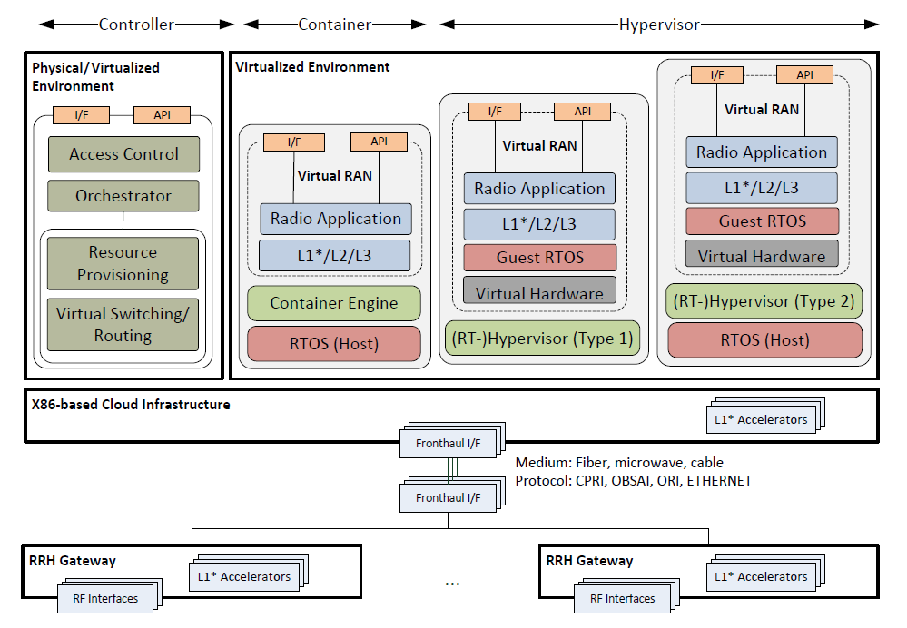
Potential vRAN Architecture

Slide 26
Cont…
Case1: Hardware platform can either be a full GPP or a hybrid
Case2: All or part of the L1 functions might be split and placed either locally at the BBU cloud infrastructure or remotely at the RRH unit
In either cases, some of the L1 functions might be offloaded to dedicated accelerator. It can be seen that a pool of base station (BS) can be virtualized inside the same (or different) cloud infrastructure and mapped to RF interface within the RRH gateway.
vRAN can rely on the same cloud infrastructure to provide localized edge service such as content caching and positioning, and network APIs to interact with the access and core networks
RAN brings the required flexibility in splitting, chaining, and placement of RAN functions while meeting the real-time deadlines along with the following principles NFV and Micro service Architecture, Scalability, Reliability, Placement, Multi-tenancy & Real time services

Slide 27
Proposal to Build RANaaS in Cloud Native
vRAN to adopt:
Lightweight containers
Real-time Linux kernels
Fast packet processing networking with MR/SR-IOV, DPDK and VPP
VNFM to Orchestrate, Onboard and perform life cycle management of vRAN

Slide 28
Time estimate to build vRAN into Containers
Stage | Action Items | Time | Desciptions
Stage1 | Raw vEMS, vCU & vDU in Containers | 6 month | Directly take existing software and build the container images and deploy vRAN. Significant reduction in CPU processing , RAM and overall Hardware resources (Slides 20-25)
Stage2 | vCU-CP vCU-UP | 9 month | Identify the vCU-CP and vCU-UP services (Slide 33) and build images. Micro services design shall be optimized to reduce Hardware resources like CPU and RAM with a split architecture. To reduce latency, jitter and wait period and service availability between vCU-UP and vCU-CP services.
Stage3 | vDU | 6 month | Build micro services of vDU by segregation of software and hardware embedded (FPGA or ASIC) modules. (Slide15 and Slide26)
Stage4 | Complete Automation | 4 month | Orchestration and LCM of vCU, vDU and vEMS-App/ vEMS-Data nodes in Containers should be done with Kubernettes.

Slide 29
Stage1: Software development stages to Build vRAN for 5G
Build container images for vCU, vEMS and vDU
Onboard raw images in containers and check the resource usage (Atleast 12-15% of resources overhead will be reduced)
Present Images, source code and CPU:
Service | RAM (GB) | CPU | Image size (GB) | RPM (MB)
vEMS | 8-50 | 8 | 3 | 320
vCU | 8-12 | 8 | 1.1 | 220
vDU | 16 | 8 | 1.8 | 226

Slide 30
Stage1: Software development to Build vRAN for 5G
Split vEMS-App and vEMS-Data nodes
vEMS-App node will have only software required for running application node
vEMS-Data node will have only software required for running data node
Build separate images for vEMS-App and vEMS-data node
Launch them in containers and configure the CNI (Container network interface)
Run vEMS along with traditional vCU and vDU in VM’s or Containers

Slide 31
Split the vEMS in Application and Data Nodes
EMS Application Node:
Web NMS Application
Tomcat
EMS Application
SNMP Agent
HA_Proxy
EMS Data Node:
Remote Agent (RA)
Postgress DB
PG Pool
FTP
NTP

Slide 32
Stage3…. Isolation of vCU-CP and vCU-DP
Build vCU-CP & DP as a microservice
vCU-Control Plane:
Resource Manager
Subscriber manager
Transport Manager
RRM
vCU-Data Plane:
E1CMGR
NR-PDCP
Transport Manager

Slide 33
Tools to Orchestrate & LCM of vRAN
Container Runtime:
Docker
LXC
Rtx
Container Management:
Kubernettes
Docker-swan

Slide 34
Towards Edge computing and 5G
 | 4G LTE | 5G
Average Data Rate | 25 Mb/s | 100 Mb/s
Peak Data Rate | 150 Mb/s | 10,000 Mb/s
Latency | 50 ms | 1 ms
Connection Density | 2,000 km² | 100,000 km²
5G Technology need edge computing –IoT Devices & AI
Comparing the 4G LTE technologies with 5G, the following changes are being planned. Below throughput can be achieved with Cloud Native apporach

Slide 35
Areas to focus for Telcos
vCU (control plane and user plane) in Containers
vDU in Containers
Orchestration of Containers through VNFM
Optimize vCU & vDU code to build into microservices.
SR/MR-IOV with DPDK and Vector Packet processing (VPP) -- this promises Baremetal performance
Base image from Centos to RT-Linux (present we are using a RT-Linux patch for vDU)
Build use-cases with cross platform SDN/NFV’s

Slide 36
References
“vRAN - Increased agility with network flexibility | Mavenir”
https://mavenir.com/solutions/cost-reduction/virtualized-ran-vran
“Cloud Native Applications in a Telco World –OpenStack”
https://www.openstack.org/assets/presentation-media/5G-Cloud-Native-v4.pdf
“Why Do You Need a 5G Cloud-Native Core? | Light Reading”
https://www.lightreading.com/mobile/packet-core/why-do-you-need-a-5g-cloud-native-core/a/d-id/745195
“Towards a Cloud-Native Radio Access Network”
https://pdfs.semanticscholar.org/cfd6/14b9f7efec2deb2821c2cbfbb988a5ed7bb2.pdf
“Cloud-Native: What Does It Mean for Infrastructure?”
https://www.networkcomputing.com/networking/cloud-native-what-does-it-mean-infrastructure
“Achieving Cloud-Native HPC Capabilities in a Mixed Workload Environment”
https://thenewstack.io/achieving-cloud-native-hpc-capabilities-mixed-workload-environment/

