Slide 1
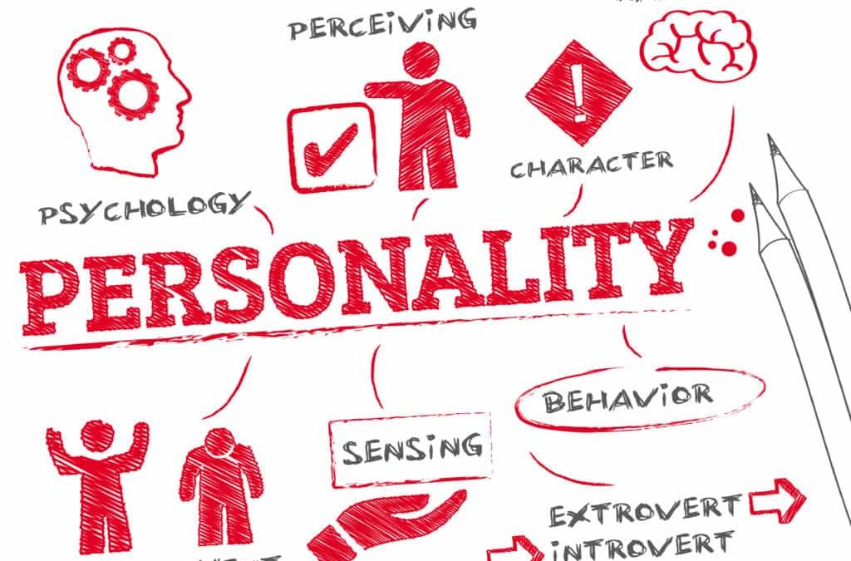
PERSONALITY PREDICTION
BATCH NO:11A
TEAM DETAILS:
S. Hema Swaraj (2111CS030041).
G. Kranthi Varma (2111CS030048).
P. Nithin Kumar Reddy (2111CS030069).
M. Raghavendra (2111CS030083).
G U I D E NAME:
Ms. RubeenaRab

Slide 2
AGENDA :
Abstract 03
Introduction 04
Literature Survey 06
Proposed method 07
Existing Method 08
Implementation 09
Results 10
Conclusion 11
References 12

Slide 3
Abstarct :
The prediction of an individual's personality traits has garnered significant attention in various fields, including psychology, human resources, and marketing.
Understanding personality can provide valuable insights into an individual's behavior, preferences, and decision- making processes.
By using advances in machine learning and data analysis techniques, Our primary objective is to predict the reliable personality traits of an individual.

Slide 4
INTRODUCTION:
The personality of a human plays major role in his personal and professional life.
Personality is useful for recognizing how people lead,influence, communicate ,collaborate , negotiate business and manage stress.
The project is based on identifying the personality of an individual using machine learning and BIG five model.
The BIG Five model also known as the FIVE-FACTOR model(FFM) (or) ocean model. Those personality traits are extraversion ,agreeableness ,openness ,conscientiousness and neuroticism.
We have used the logistic regression algorithm to develop the machine learning model.

Slide 5
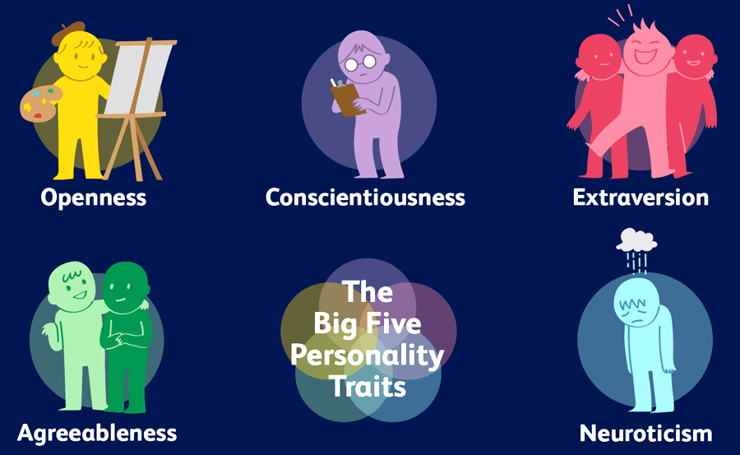

Slide 6
LITERATURE SURVEY:
To analyse data , Machine learning has given many Solutions by its algorithms.
Educational Game (Detecting personality of players in an educational game)
A System for Personality and Happiness Detection Using Twitter Content to Predict Psychopathy.
An Examination of Online learning effectiveness using data mining.
So, finally we opted to develop ML model by using logistic regression and Big five personality traits to get best accuracy score compared to previous models.

Slide 7
PROPOSED METHOD:
We are going to predict the personality of a person by using the machine learning algorithm.
We have choosen the logistic regression algorithm to develop the model because it is the best algorithm we have in machine learning
algorithms to predict the categorical dependent variable.
It also gives the best accuracy score.

Slide 8
Existing Method:
Machine Learning
Natural Language Processing (NLP)
user Behavior Analysis
Gamification and Quizzes
Social Media Analysis

Slide 9
IMPLE ME NTATION:
STEP1:
Collecting the data.
STEP2:
Classification Algorithm.
STEP3:
Evaluation of Big Five Personality Traits.
STEP4:
Personality Classification.

Slide 10
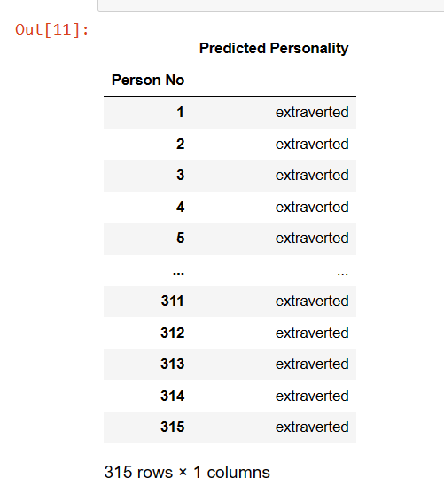
RESULTS:
The model will predict the personality of person basing on the rating given to the every personality trait of a person in a particular range(1-8),the system will decide the personality of a person based on highest rating given to the personality trait and decides the Personality factors in a traits.

Slide 11
CONCLUSION:
This project, we discuss about how the personality is identified using different classification algorithms. Here we study relationship between user and his/her personality. In this we used logistic regression because it gives best accuracy while compare to other algorithms that are used previously like naive Bayes, SVM, Logistic regression is fast and give accurate results compared to other algorithms.

Slide 12
REFERENCES:
Machine Learning in Data Science using python-Dr.R.Nageshwar Rao
We Referd From IEEE Xplore and Kaggle. https://youtube.com/watch?v=Cavebr_NNq8&feature=share.
https://www.verywellmind.com/the-big-five-personality-dimensions2795422.

