Slide 1
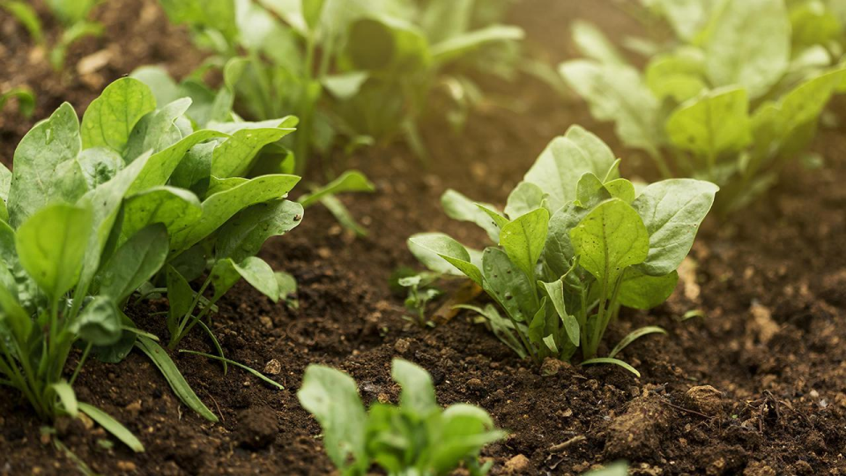
Crop Yield Prediction Using Deep Learning
Team Members:
MENTOR:
ASWIN KUMAR .K(2111CS030016)
GNANA DURGA SAI. M(2111CS030031) KRANTHI VARMA GUNJA(2111CS030048)
MS. S. Mrudhula
DATE: 27- 0 8-2024

Slide 2






Table of contents
01 AIM 04 CODE | INTRODUCTION 02 INTRODUCTION 05 OUTPUT
03
METHODOLOGY
06
CONCLUSION AND
FUTURESCOPE

Slide 3
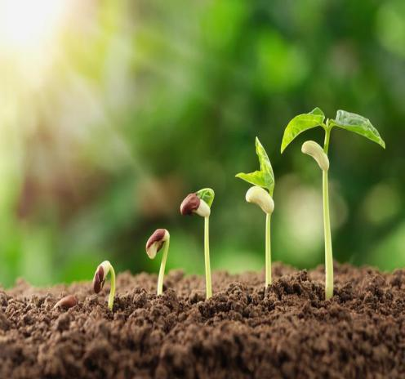
AIM: The ultimate goal of the project is to predict the crop to be chosen to grow.
INTRODUCTION:
Crop yield prediction is becoming more important because of the growing concern about food security. Early crop yield prediction plays an important role in reducing famine by estimating the food availability for the growing world population . Hunger is one of the most devastating issues in the world and increasing crop yield production is a feasible solution to overcome this problem.

Slide 4


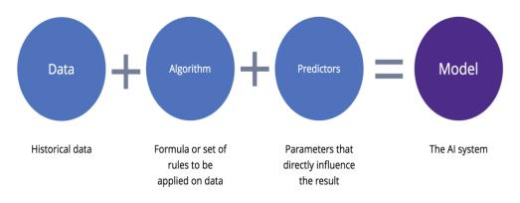
METHODOGY:
1. DATA COLLECTION AND
PROCESSING
2. DATA MODELING
3.PREDICTING THE CROP

Slide 5
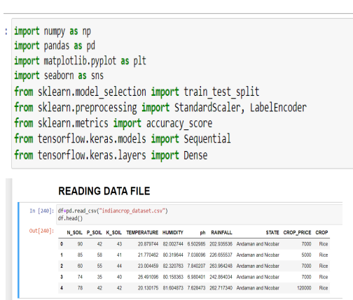
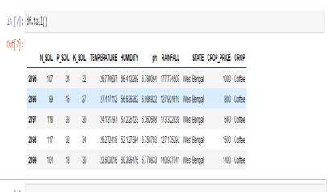
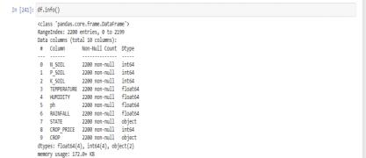
CODE:
IMPORTING REQUIRED LIBRARIES

Slide 6
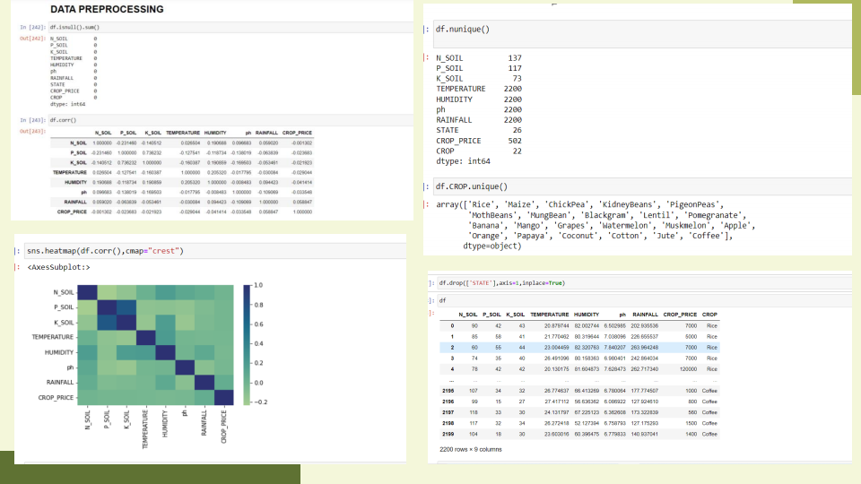

Slide 7
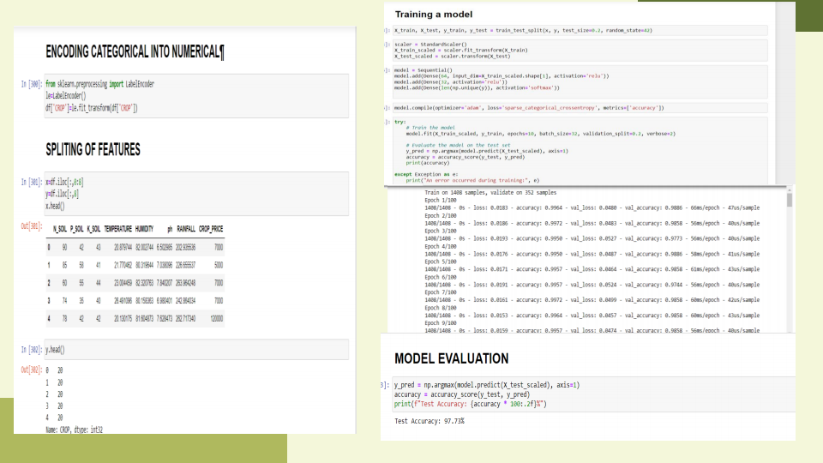

Slide 8
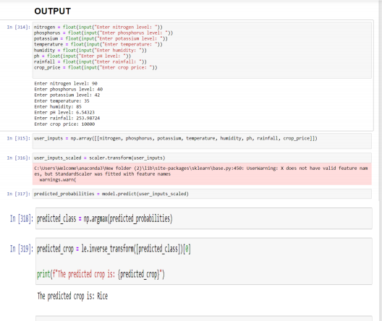
OUTPUT:

Slide 9



ThankYou!
Do you have any questions?

