Slide 1
Clustering Software
© 2010, Centre for Development of Advanced Computing, Pune

Slide 2
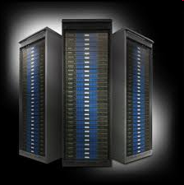
Agenda
Definition
Software stack
Software stack components
Component support
Cluster tools
xCAT
KUSU
OSCAR
Rocks
© 2010, Centre for Development of Advanced Computing, Pune

Slide 3
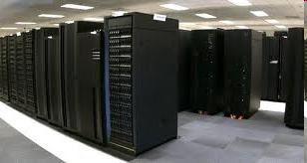
Clustering tool
A clustering tool allow a group of linked computers, to work together closely thus in many respects forming a single computer.
© 2010, Centre for Development of Advanced Computing, Pune

Slide 4
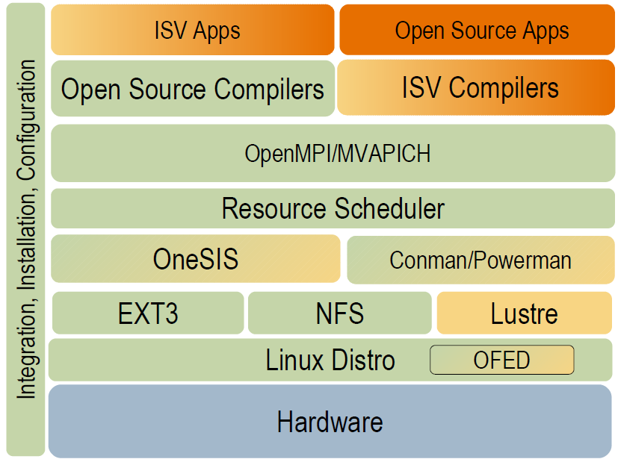
Software stack
© 2010, Centre for Development of Advanced Computing, Pune

Slide 5
Software stack components
Schedulers
  PBS
  SGE
  LSF
  MOAB
  Slurm
Libraries
  OFED
  OpenMPI
  LaPACK, Atlas
Compilers & Debuggers
  Intel
  AMD
  PGI
  Totalview
OS/Kernel space
  CentOS
  Luster
  OSS/MDS
  Sam-QFS
© 2010, Centre for Development of Advanced Computing, Pune

Slide 6
Software stack components cont.
Verification Modules
  Lozone3
  IOR
  NetPipe
  HPCC Benchmarking
  IOkit
  LNET Telf Test
Adapters
  Ethernet
  Mellanox IB
  SATA
  Fiber channel
  Graphics/VIZ
  GPGPU
© 2010, Centre for Development of Advanced Computing, Pune

Slide 7
Software stack components cont.
HW platform
  SW RAID
  Constellation
  Galaxy/blade/etc. technologies
  Switch
  Drivers including OFED
Node
  ILOM
  IPMI-based
  Service processors
  Power on/off
  BIOS integration
© 2010, Centre for Development of Advanced Computing, Pune

Slide 8
Component Support
Open Softwares
CentOS(RHEL)
GNU Compiler collection
IPMItool
OpenSM
Product Support
Server OEM's
LNET
Self Test
IOKit
3rd Party ISV
TotalView
PGI Compiler
Intel Compiler
LSF
PBS
MOAB Cluster Resources
Verification Modules
Community
SLURM Ganglia OpenMPI
OneSIS CFEngine
FreeIPMI pdsh OFED
Conman Powerman
NetPIPE
HPCC Bench Suit
Iozone3 IOR
© 2010, Centre for Development of Advanced Computing, Pune

Slide 9





Some Cluster tools
xCAT
KUSU
OSCAR
Rocks
OpenHPC
© 2010, Centre for Development of Advanced Computing, Pune

Slide 10
xCAT
xCAT (Extreme Cluster Administration Toolkit) is open-source distributed computing management software used for the deployment and administration of clusters.
It can:
  create and manage diskless clusters
  install and manage many Linux cluster machines in parallel
  set up a high-performance computing software stack, including software for batch job submission, parallel libraries, and other software that is useful on a cluster
  cloning and imaging Linux and Windows machines
© 2010, Centre for Development of Advanced Computing, Pune

Slide 11
features
xCAT has specific features designed to take advantage of IBM hardware including:
Remote Power Control
Remote POST/BIOS console
Serial over LAN functions
Hardware alerts and vitals provided via SNMP and EMAIL
Inventory and hardware management
© 2010, Centre for Development of Advanced Computing, Pune

Slide 12
OSCAR
OSCAR (Open Source Cluster Application Resources) is a snapshot of the best known methods for building, programming, and using clusters. It consists of a fully integrated and easy-to-install software bundle designed for high performance cluster computing.
© 2010, Centre for Development of Advanced Computing, Pune

Slide 13
Rocks
Rocks Cluster Distribution is a Linux distribution intended for high-performance computing clusters.
Based on the Red Hat Linux distribution.
Cluster on a DVD ( or set of CDs)
Goals of Rocks
  Make Clusters Easy
  Reduce dependence on system administrators by reducing system administration
  Enable scientists to concentrate on science rather than on computing.
© 2010, Centre for Development of Advanced Computing, Pune

Slide 14
Rolls
Alpha
Area51
Base
Bio
Condor
Ganglia
Grid
hpc
Java
kernel
© 2010, Centre for Development of Advanced Computing, Pune

Slide 15
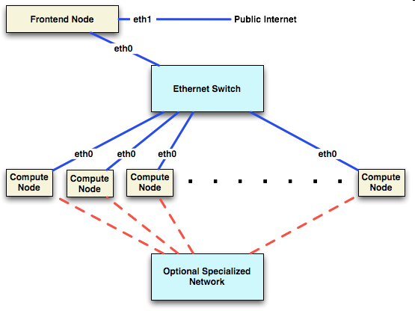
Architecture
© 2010, Centre for Development of Advanced Computing, Pune

Slide 16
Installing Rocks
Rocks provides for installation of a cluster with minimum user interaction
Steps involved
  Boot from CD or DVD
  Answer a few questions
  Get favorite beverage
  You’re on your way to a full fledged cluster in 2 hours or less.

Slide 17
Innards of Automatic Installs
Rocks uses Redhat’s Kickstart mechanism for automated installs
Kickstart file generated and given to the installer
Installer follows instructions in Kickstart file.
Generation of Kickstart file done automatically by Rocks scripts

Slide 18
The Head Node
Users login, submit jobs, compile code, etc
Uses two Ethernet interfaces
  one public, one private for compute nodes
Normally has lots of disk space
(system partitions < 30 GB)
Provides many system services
  NFS, DHCP, DNS, MySQL, HTTP, 411, Firewall,etc
Cluster configuration
Notes:
Basic OS file system takes 13 GB of disk space not including the /export which is used for home directories and installation directories.
LVM is not supported in ROCKS.
ss

Slide 19
Compute Nodes
Basic compute workhorse
Lots of memory (if lucky)
Minimal storage requirements
Single Ethernet connection for private LAN
Disposable
OS easily re-installed from head node
Nodes can be heterogeneous

Slide 20
NFS in ROCKS
User accounts are served over NFS
  Works for small clusters (< 128 nodes)
  Will not work for large clusters (>1024)
  NAS tends to work better
Applications are not served over NFS
  /usr/local does not exist
  All software is installed locally (/opt)

Slide 21
411 Secure Information Service
Provides NIS-like functionality
Securely distributes password files, user and group configuration files and the like using Public Key Cryptography to protect file content.
Uses HTTP to distribute the files
Scalable, secure and low latency

Slide 22
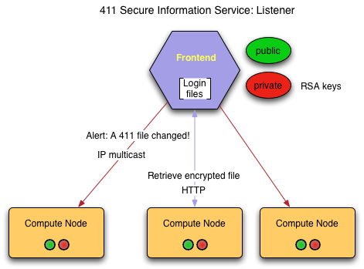
411 Architecture
Client nodes listen on the IP broadcast address for “411 alert” messages from the head node.
Nodes then pull the file from the head node via HTTP after some delay to avoid flooding the master with requests.

Slide 23
Ganglia Monitoring
Ganglia is a scalable distributed monitoring system for high-performance computing systems such as clusters and grids
It leverages widely used technologies such as XML for data representation, XDR for compact, portable data transport, and RRDtool for data storage and visualization.
It uses carefully engineered data structures and algorithms to achieve very low per-node overheads and high concurrency.
Provides a heartbeat to determine compute node availability.
Notes:
XDR External Data Representation standard
RRDtool Data logging and graphing application.
RRD is the acronym for Round Robin Database. It is a system to store and display time-series data.
(ie network bandwidth, server load average, machine temps, etc)
XML Extensible Markup Language

Slide 24
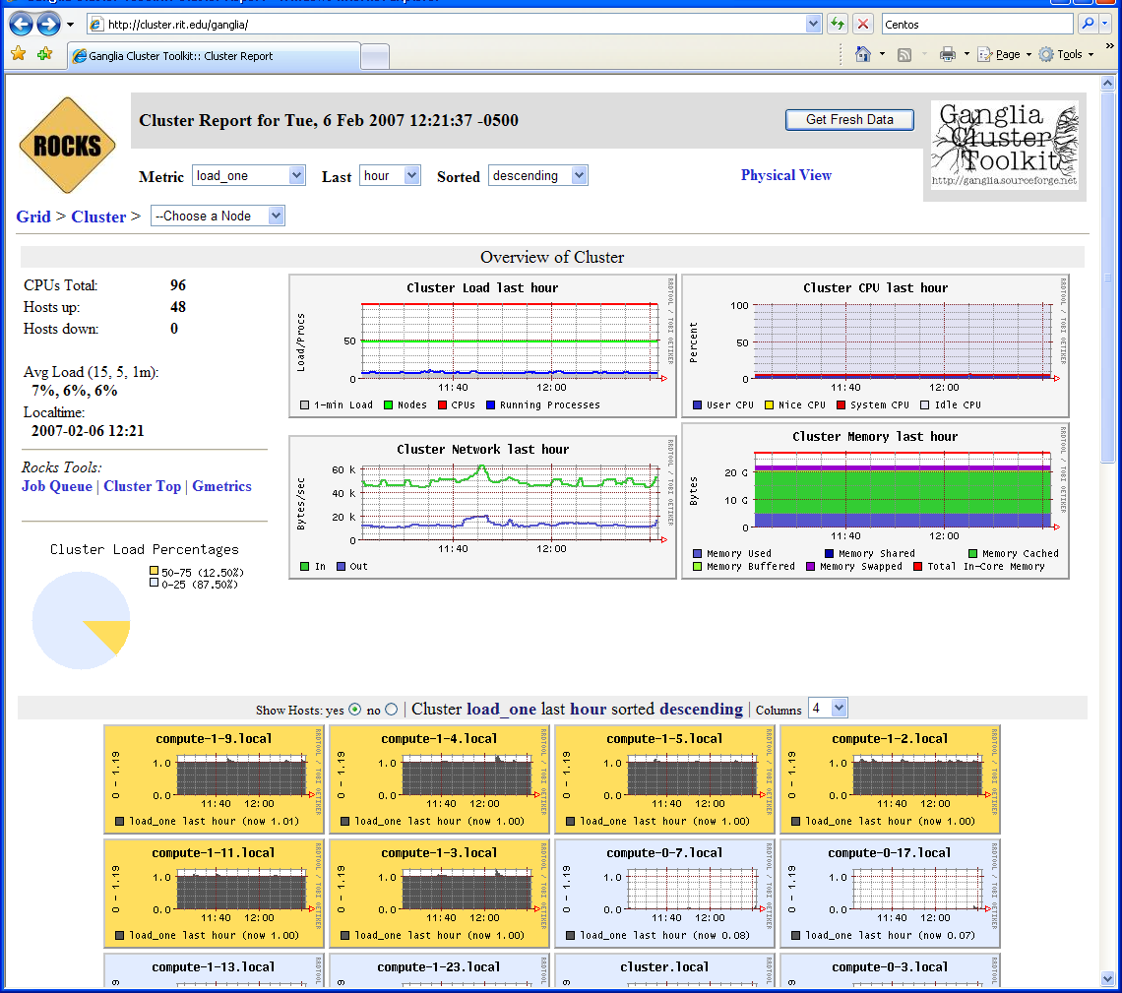
Cluster Status with Ganglia

Slide 25
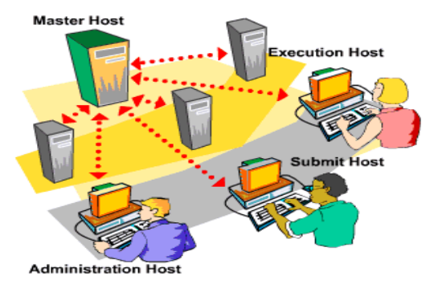
Sun Grid Engine (SGE)
SGE is resource management software
  Accepts jobs submitted by users
  Schedules them for execution on appropriate systems based on resource management policies
  Can submit 100s of jobs without worrying where it will run
  Supports serial as well as parallel jobs

Slide 26
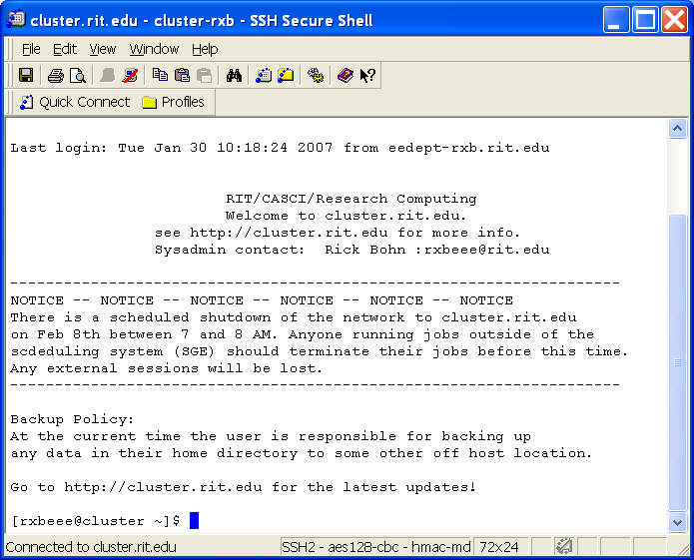
Accessing the Cluster
Access the cluster via an SSH client
  PuTTY
  SSH Secure Shell
  X-Win32
  F-Secure
To transfer data to the cluster use either scp or sftp.
Windows users can download and use WinSCP (http://winscp.net)

Slide 27
Thank you
© 2010, Centre for Development of Advanced Computing, Pune

