Slide 1
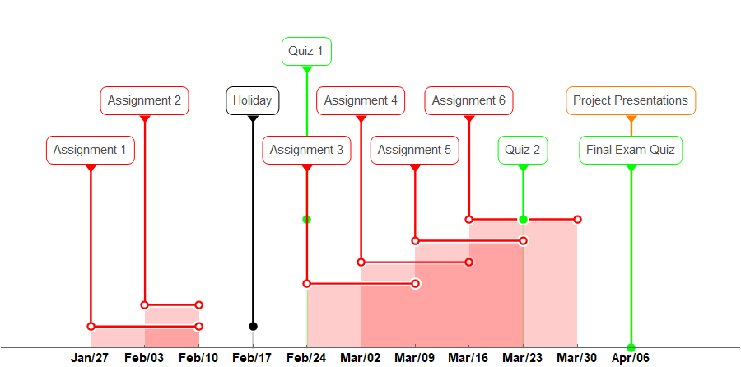
COMPSCI X433.6 – 008 Schedule of Assignments, Quizzes and Team Project
Important: Please read the policy on late submissions

