Slide 1

1
Copyright © 2005 – 2006 MES-English.com

Slide 2
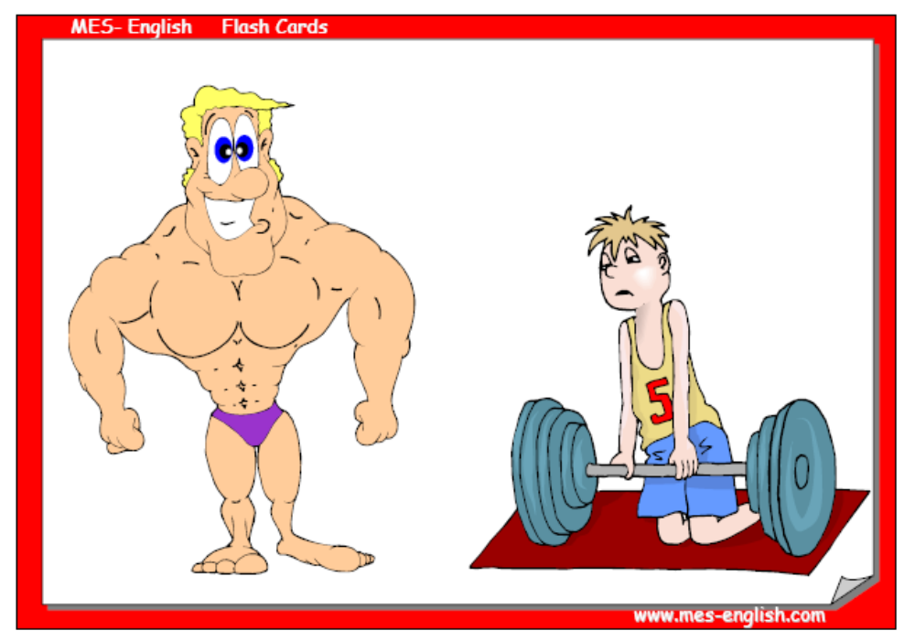
Strong
Weak

Slide 3
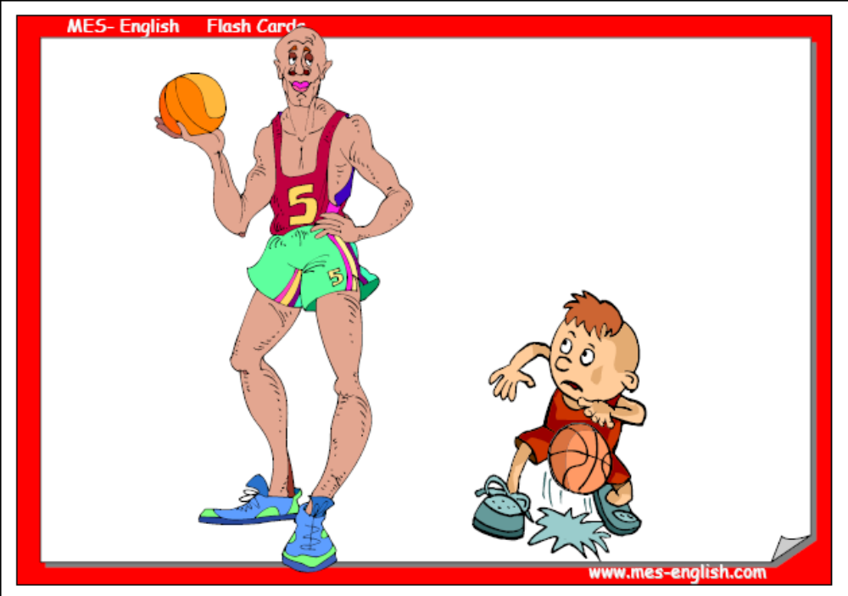
Short
Tall

Slide 4
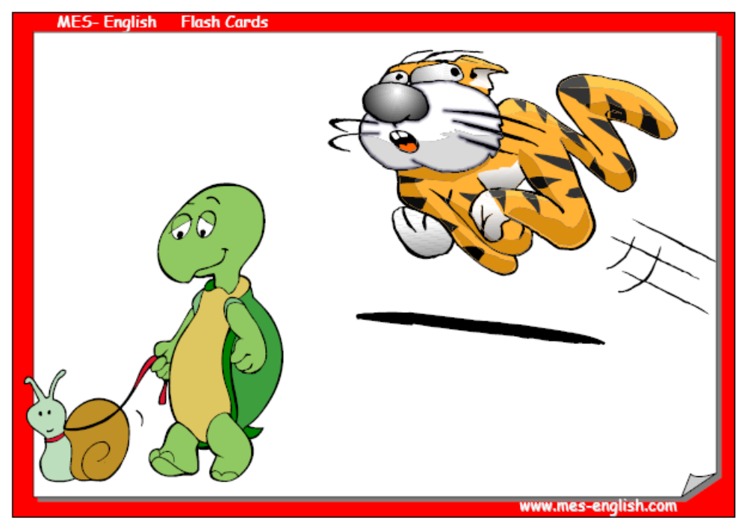
Slow
Fast

Slide 5
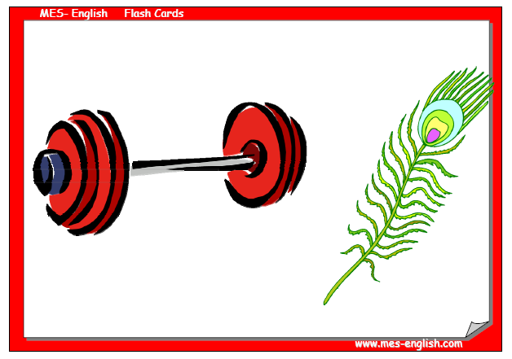
Heavy
Light

Slide 6
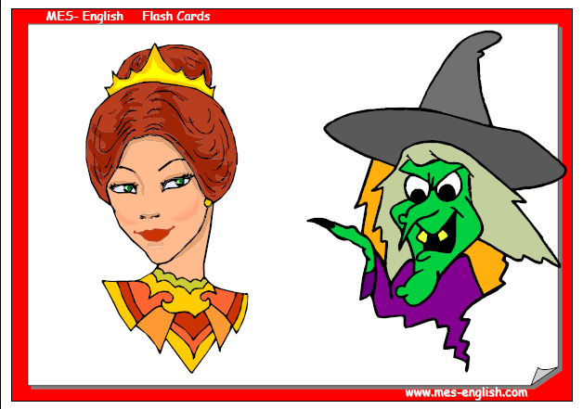
Ugly
Beautiful

Slide 7
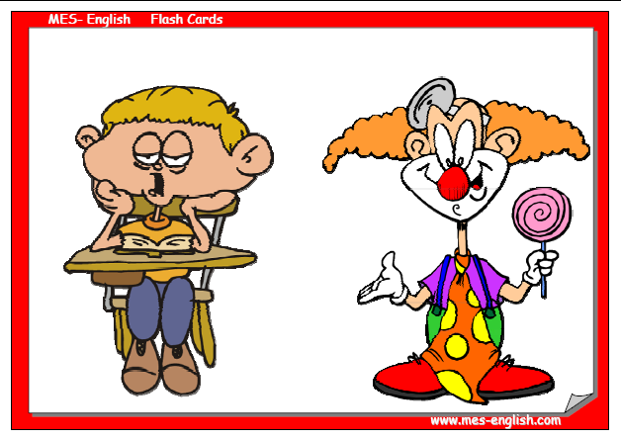
Boring
Funny

Slide 8
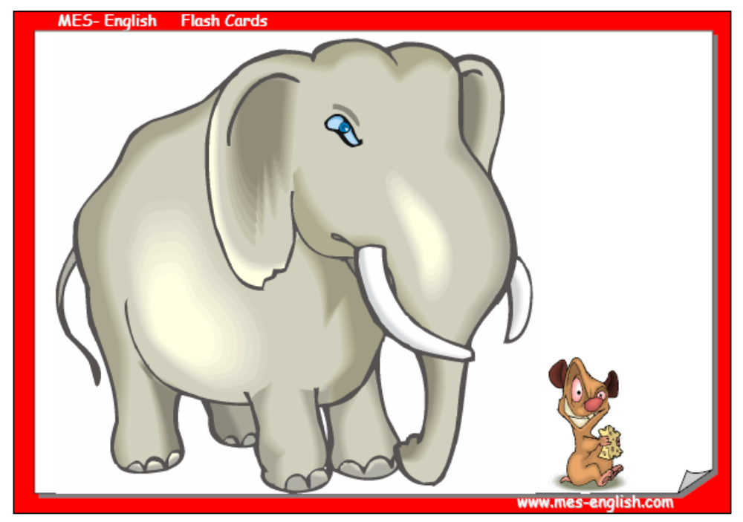
Big
Small

