Slide 1
Trust and reputation in agent marketplaces

Slide 2
Basic description
Buyer and seller agents in a distributed environment
Central authority for service advertisement
Heterogeneous trust and reputation mechanisms

Slide 3
Agents
Each agent is both seller and buyer of services that belong to categories
Seller advertises services in the central authority
Buyer discovers services from central authority

Slide 4
Agent society
Agents live in neighborhoods
Neighborhoods change dynamically
Each agent can talk with the agents in its neighborhood and directly to service providers
Each agent can buy and sell to agents irrespective of their neighborhood.

Slide 5
Trust and reputation
Each agent keeps a score for every agent with whom a transaction has been made based on the outcome.
Each agent can ask the opinion of his neighborhood’s agents for the reputation of any other agent they have been in transaction with
Each agent can provide references that have been acquired from other agents at the end of transactions
Each agent keeps a score for every other agent by whom it has gathered information for another agent generating a score of trustworthiness.

Slide 6
Service advertisement and querying
Central authority
Search for services
Service advertisement

Slide 7
Reputation mechanism
Central authority
Sellers’ sockets
Seller of A
Buyer of A
Seller of A

Slide 8
Reputation mechanism
Central authority
Buyer contacts the sellers
Sellers send their references and the price of their service
Buyer estimates each seller’s reputation and offer in its own way
Seller and buyer decide if they will proceed to agreement
Based on transaction outcome each of them updates its scores and references.
Seller of A
Buyer of A
Seller of A

Slide 9
Reputation mechanism
Central authority
Seller of A
Buyer of A
Seller of A

Slide 10
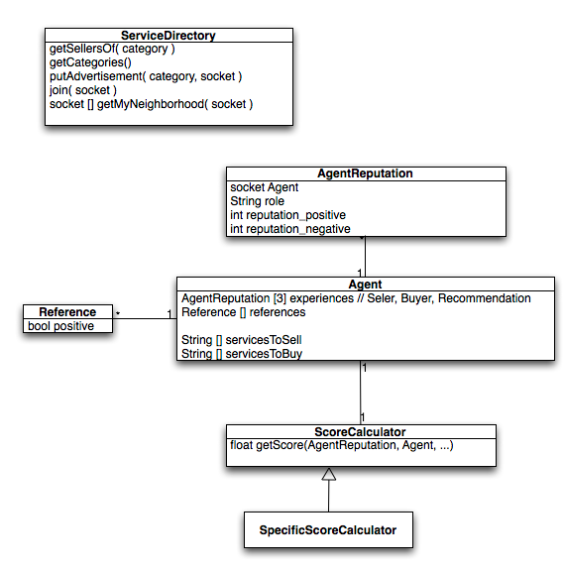
Class diagram

