Slide 1
2015 NBA Playoff Tracker for the Chicago Bulls
Angelica Rodriguez & John Krasich CSSE 477

Slide 2
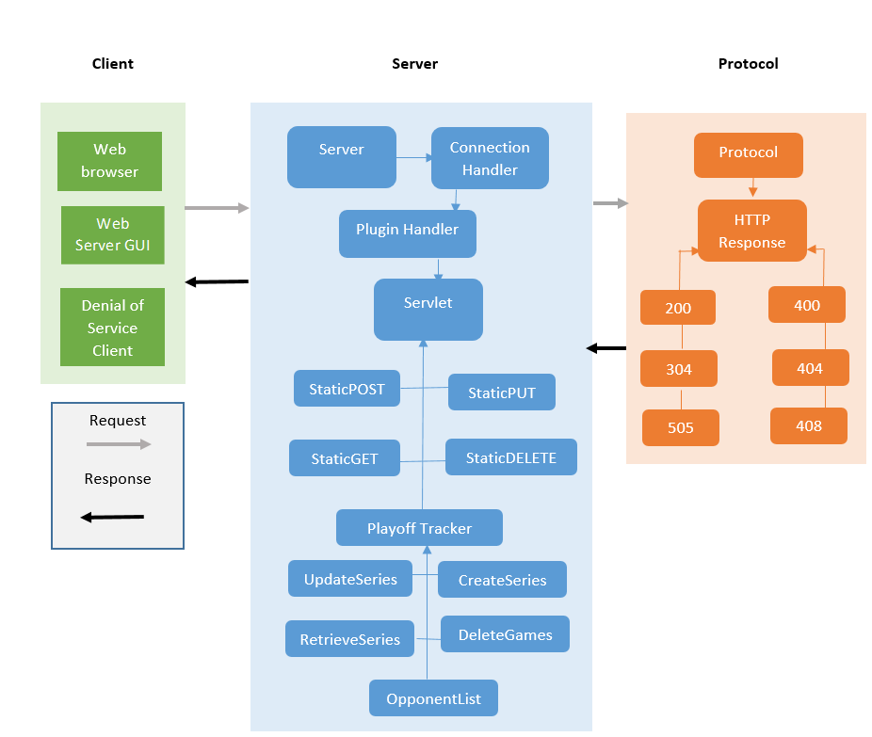
Overall Architecture

Slide 3
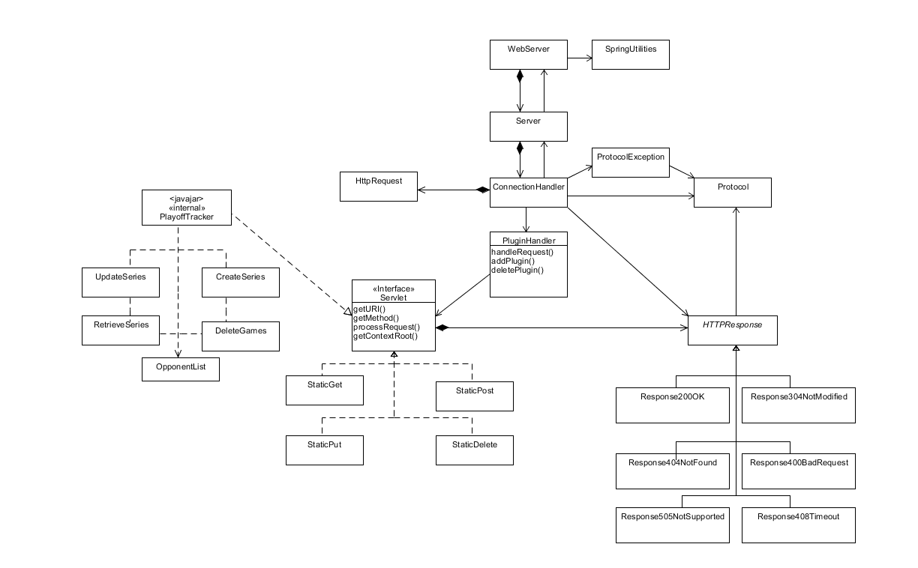
Class Diagram

Slide 4
PlayoffTracker Plugin
CreateSeries – POST
RetrieveSeries – GET
Opponent List – GET
UpdateSeries – PUT
DeleteGames – DELETE

Slide 5
AJAX Use
Application ran entirely from index.html
Container with navigation bar and content div
AJAX calls replace inner HTML of content div
All AJAX located in ajax.js file
Body of plugin responses are HTML

Slide 6
Demo / Questions
http://localhost:8080/index.html

