Slide 1

2015 NBA Playoff Tracker for the Chicago Bulls
Angelica Rodriguez & John Krasich CSSE 477

Slide 2
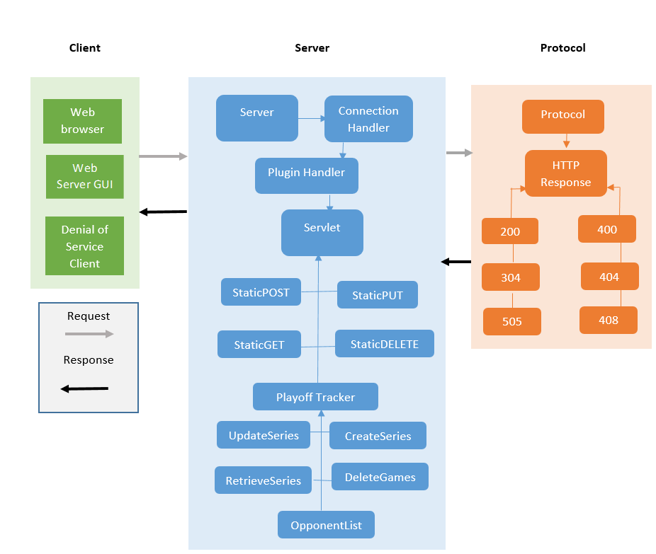
Overall Architecture

Slide 3
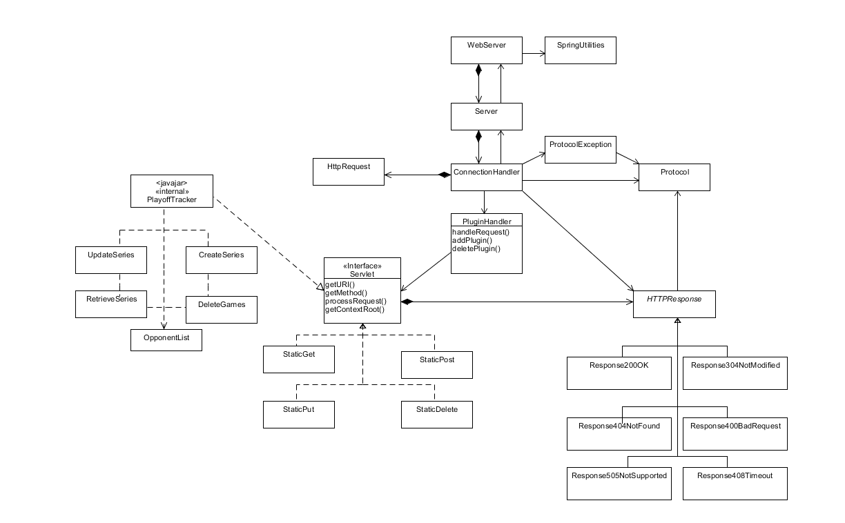
Class Diagram

