Slide 1
Team “Dubai”
Java Basics January 2015 Teamwork

Slide 2



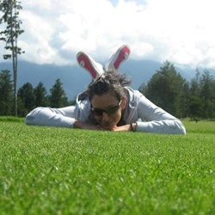
Team “Dubai” MEMBERS
Asen Temelkov (AsenT)
Daniel Jelev (Jinjaar)
Krasimir Malakov (krasimalakov)
Vesela Toleva (Vessela)

Slide 3
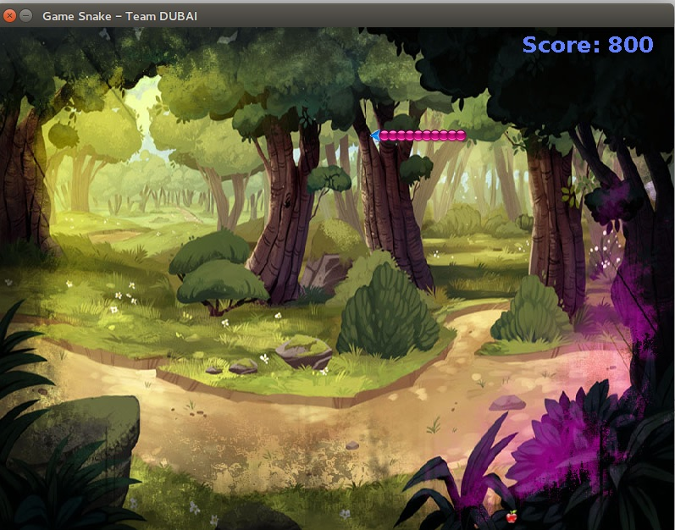
Team “Dubai” – GAME SNAKE

Slide 4
Team “Dubai”
Repository URL - https://github.com/krasimalakov/Java-Basic-Teamwork
Snake is old classic video game. It concept originated during the late 1970.
Later it was programmed and for computers.
The player controls the snake on the board plane.
The object is to eat as much apples as possible running into them with the head of the snake. Each apple eaten makes the snake longer.
While turning left/up/right/down we hear sounds.
The game is over when the snake hit the border of the board plane or itself.

