Slide 1
Purplebit
Logic Game Project

Slide 2


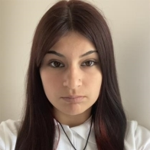

Our Team
Румен Петков
Q&A engineer
Ванеса Кърджева
BACKEND DEVELOPER
Красимира Русева
SCRUM TRAINER
Елена Кесерджиева
BACKEND DEVELOPER

Slide 3
STAGES OF WORK
01
02
03
distribution of roles
working on the project
findig teammates
04
final project

Slide 4
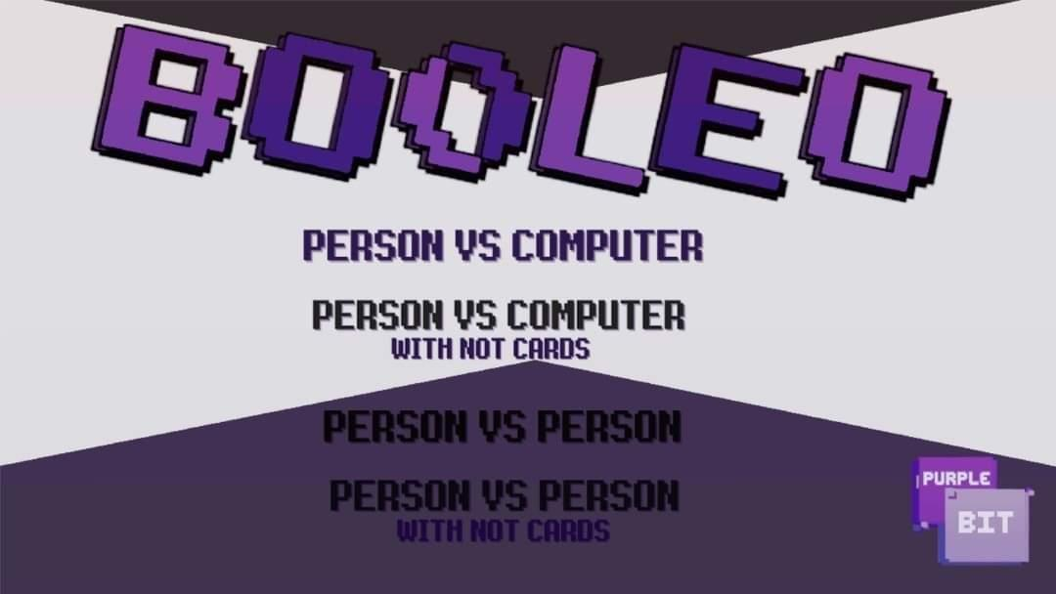
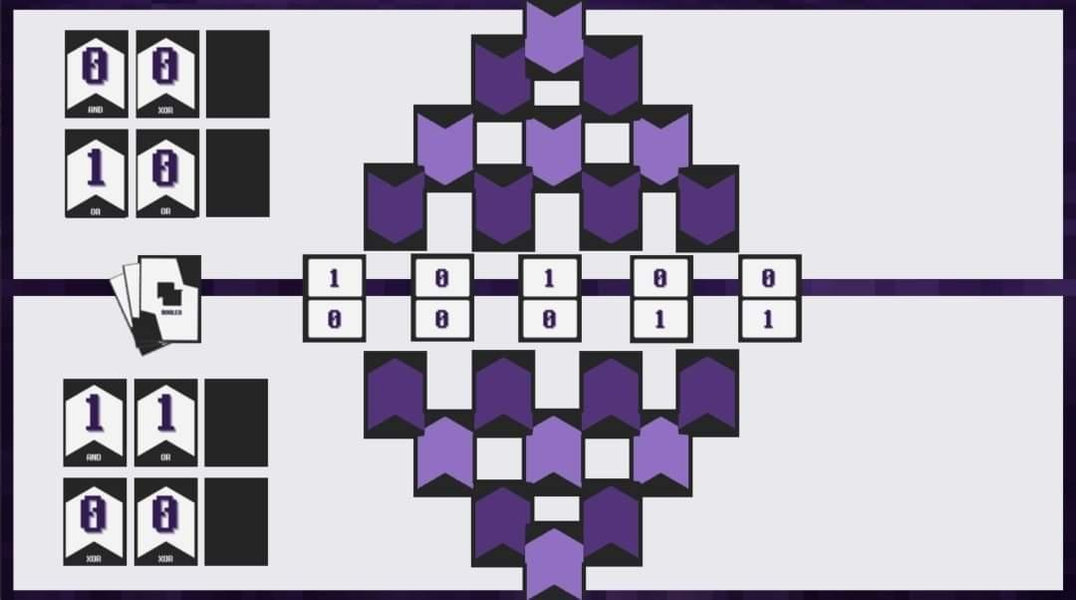
Our Idea

Slide 5








TECHNOLOGIES

Slide 6
Thank you!

