Slide 1

WHAT IS UNIT TESTING
JUnit Framework
Samet BUDAK (sbudak@uni-yaz.com)

Slide 2
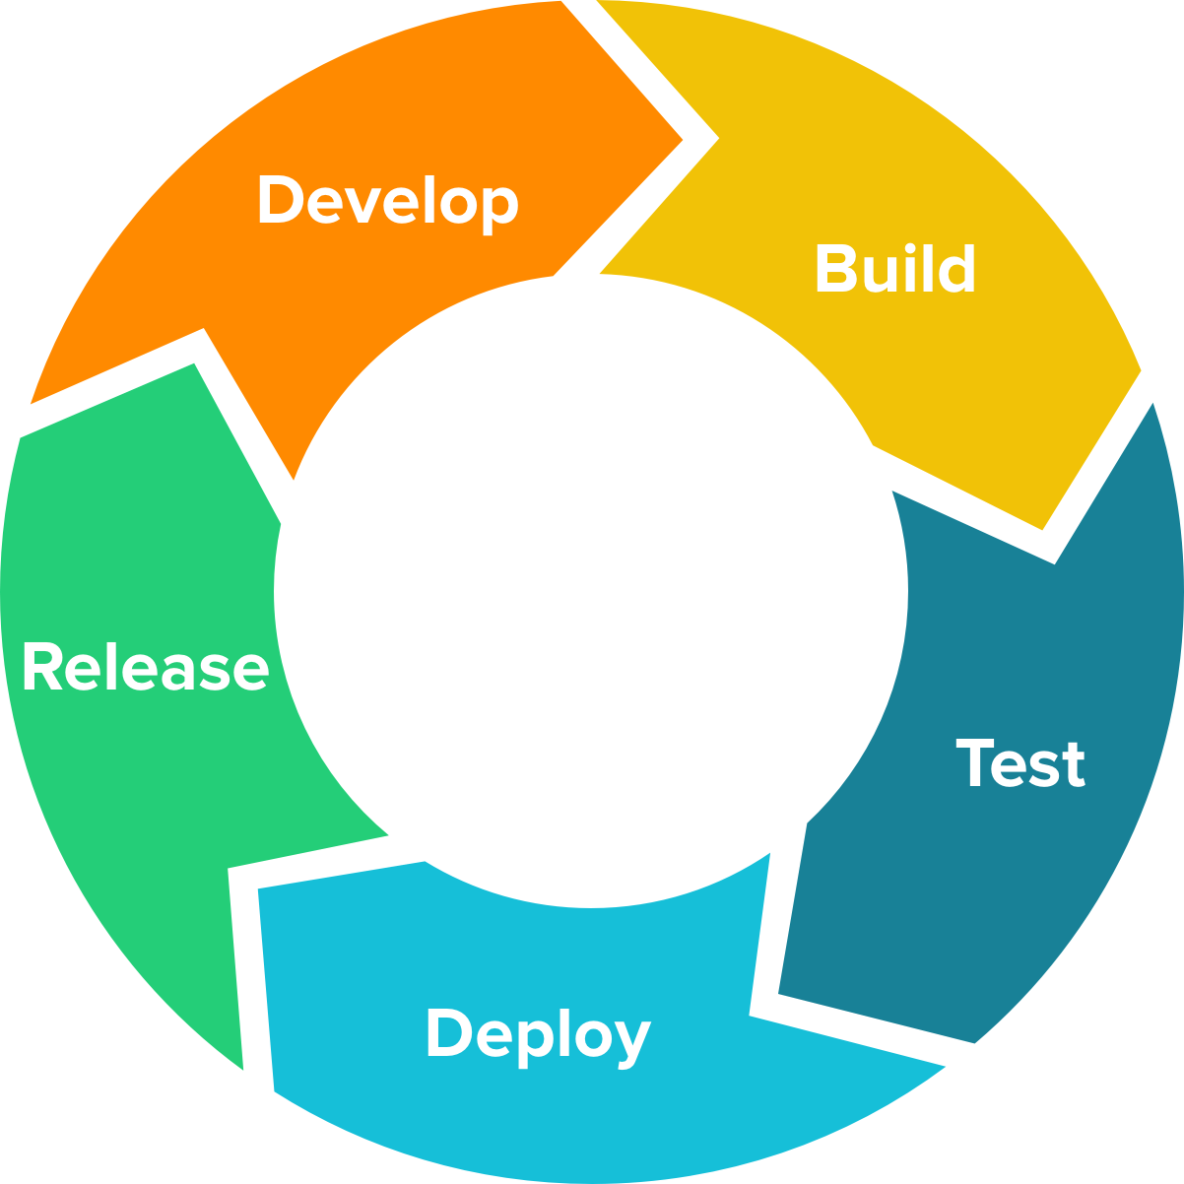




AGENDA
What we’ll talk about
1
Software Testing in general
2
What is Unit Testing?
3
All about JUnit
4
What is Mockito
5
Some demo about unit testing

Slide 3
SOFTWARE TESTING DEFINITION
Process of executing a program with the intent of ﬁnding errors.
Don’t
Do
1
Finding error
1
Try demonstrating that errors are not present
2
Check if the program does what it’s not supposed to do
2
Try to show that the program performs its intended functions correctly
3
Test with uncommon scenario (such as give null pointer as input)
3
Establishing confidence that a program does what is supposed to do
4
Test with (if can) every possible scenario
4
Test with some or even one possible scenario

Slide 4
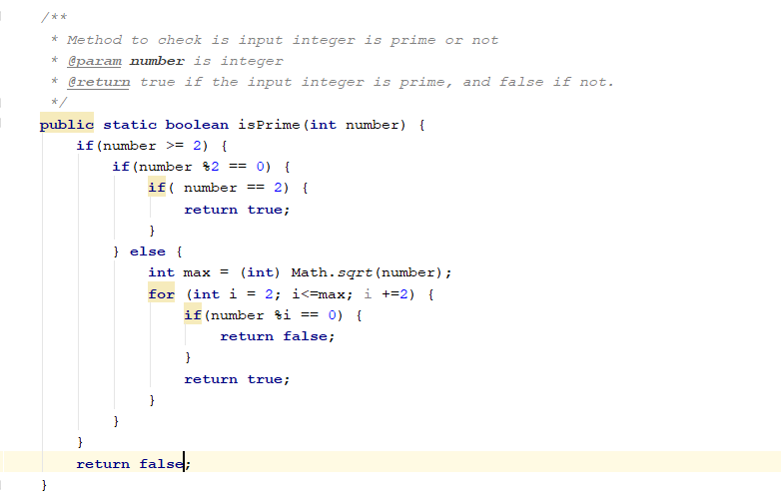
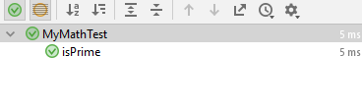

CODE COVERAGE
A measurement of how many parts of your code are executed (Usually in percentage)
FUNCTION COVERAGE
Has each function / method in
the program been called?
STATEMENT COVERAGE
Has each statement in the program
been executed?
BRANCH COVERAGE
Has each branch of each control
structure been executed?

Slide 5

BLACK BOX TESTING
Black-box testing is a method of software testing that examines the functionality of an application without peering into its internal structures or workings. This method of test can be applied to virtually every level of software testing: unit, integration, system and acceptance.
possibleInput1 possibleInput2 possibleInput3
.
.
.
possibleInputN
Pass ? Fail ?
Black Box

Slide 6
BLACK BOX EXAMPLE
Say we have method “isPrime” to check whether the number is prime number or not. The method will accept an integer data type and return Boolean data type. This method will return true if we pass prime number integer as input, and false if we pass dividable number and invalid number as input. To test the method, we need to input all the possible input, which is all the integer number, and check all the input. Because we doesn’t know how the method works. It will be an exhausting test.
-n … 0 1
2 3 … n
boolean isPrime(int number)
false
… false false true true … true/false

Slide 7

WHITE BOX TESTING
White-Box (also known as clear box testing, glass box testing, transparent box testing, and structural testing) is a method of testing software that tests internal structures or workings of an application, as opposed to its functionality
testCase1
Case 3
testCase2
Case 1
Input
Output
Pass ? Fail ?
Case 4
testCase3
Case 2
testCase4

Slide 8
WHITE BOX EXAMPLE
With same method (“isPrime”) but with exposed internal structure, we can create some testing scope and test the condition at least once per case (more is better!) and be sure that every case are tested. In this scenario, it’s not really necessary to test the method with every integer number.
1 2 7 8 21
(<2) (even) (odd) (even) (odd)
Number >= 2?
False
True
Even number?
Dividable by every odd number which less or equals than input’s root?
2?
Pass/Fail?

Slide 9


WHAT IS UNIT TESTING ?
Unit testing is a software development process in which the smallest testable parts of an application, called units, are individually and independently scrutinized for proper operation. Unit testing is often automated but it can also be done manually.
User Acceptance Test
System Integration Test
The goal of unit testing is to isolate each part of the program and show that the individual parts are correct.
Execution Time
Unit Test
Number of Test

Slide 10
WHAT IS UNIT TESTING ? (OOP)
The units in unit testing is the smallest parts of class which are methods. We need to test each method individually and independently to search every bug and error (if possible) in every method and fix it before the class are integrated with the main program.
Class MyClass
Fix the code
firstMethod
Once all the method pass the test, then we can proceed to Integration Test.
PASS ?
secondMethod
TEST EACH METHOD
…
Integration Test
nMethod

Slide 11
HOW IT WORKS ? (OOP)
Unit Test Class will create object or call methods from Class A, and running it in Unit Test methods individually. If Class A need outside object to run, we’ll need Test Double Objects to mimic the real object for Class A. The test double objects can also be used by Unit Test Class to check any desired test condition for Class A.
Unit Test Class
Class A (Under Test)
Finally, Unit Test Class will generate result from testing for us to determine whether Class A is pass the test or not.
Fake Test
Object
Fake Objects
Fake Objects
RESULT

Slide 12
CREATE THE UNIT TEST FIRST?
Create unit test first
Create unit testing after
Unit test will likely have maximum code coverage Developer have full creativity to create the code
+
Help developer to really consider what needs to be done
+
+
Have immediate feedback while developer work
+
+
Have “blue print” of system design
-
Developer have feedback after unit testing is finished
Code will likely doesn’t meet the requirement
-
It can be confusing if the unit testing is buggy
-

Slide 13
THE BENEFITS (AND THE CONS) OF UNIT TESTING
The Pros (+)
The Cons (-)
1
Find the problems early
1
Time consuming
2
Facilitates changes
2
Does not show absence of errors
3
Simplifies Integration
3
Cannot be run in actual deployment environment
4
Documentation
4
Test code is likely to be buggy

Slide 14


JUNIT
(www.junit.org)
1
Java-based unit testing framework
2
Elegantly simple
3
Easy to write unit tests
4
Easy to manage
5
De facto java standard
6
Generic testing framework

Slide 15
SOME Information About Junit - (JUnit 4.12)
- A Java framework for writing and running unit tests
Test cases and fixtures
Test suites
Test runner
- Written by Kent Beck and Erich Gamma
- Written with “test first” and pattern-based development in mind
Tests written before code
Allows for regression testing
Facilitates refactoring
- JUnit is Open Source
www.junit.org
JUnit Version 4, released Mar 2006
Goal: Accelerate programming and increase the quality of code.

Slide 16
JUNIT CONCEPT
1
Class A
Class under test
Assert
Test Runnable Method (Runnable)
Test Class
2
Test Class
Class with test methods for every Class A methods
Use
Use
3
Test Runnable (Runnable)
Runnable method to run Test Case Class
Pass / Fail
Class A (Under Test)
4
Result
Result from Assert (JUnit API) to determine is test is pass/fail

Slide 17
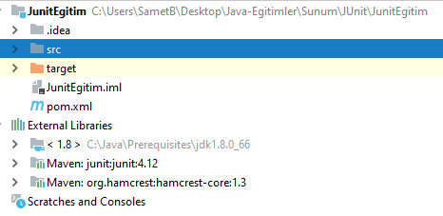
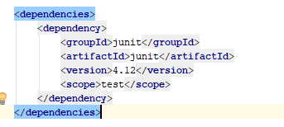
JUNIT INSTALLATION
1
Using Jar
Download “junit.jar” and “hamcrest-core.jar” at www.junit.org and put on your class path
2
Using POM (Maven)
Add this dependency in pom.xml on your maven
module / project.

Slide 18



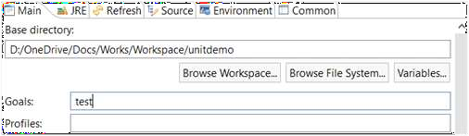

RUNNING JUNIT
public class TestRunner {
public static void main(String[] args) {
Result result = JUnitCore.runClasses(TestClass.class);
for (Failure failure : result.getFailures()) {
System.out.println(failure.toString());
}
System.out.println(result.wasSuccessful());
}
}
1
Using runnable method
We can create runnable method to run the test class and using assert from test class to check the result.
2
Right click on test class (Intellij/Eclipse)
There is IDE feature which we can right click on JUnit test class and run it with Junit.
3
Run with maven (Maven)
We can run JUnit using maven goal “test”, or even run it automatically every time we use “package” goal

Slide 19
SOME OF JUNIT API (JUnit 4.12)
1 org.junit.Assert.*
It will fail the test if not true
assertTrue(boolean)
Assert that boolean is true
assertEquals(type, type)
Assert that two variables are equals
assertArrayEquals(type[], type[])
Assert that two arrays are equals
assertNotNull(object)
Assert that object reference is not null
org.junit.Assume.*
It will ignore the test if not true
assumeNoException(Throwable)
Assume there is no exception
assumeTrue(boolean)
Assume boolean is true
asumeNotNull(object)
Assume object reference is not null
assumeThat(type, Matcher)
Assume that type is match with Matcher
2

Slide 20
SOME OF JUNIT ANNOTATION (JUnit 4.12)
@Test
Tells JUnit to run the method with this annotation as a test method.
@Before
Tells JUnit to run the method with this annotation before running every test method
@BeforeClasss
Tells JUnit to run the method with this annotation before running everything in the test class
@After
Tells JUnit to run the method with this annotation after running every test method
@AfterClass
Tells JUnit to run the method with this annotation after all the test are executed
@RunWith(Class)
Tells JUnit to run the class with this annotation with “Class” parameter
@Parameterized.parameter
Tells JUnit to use return value from method with this annotation as parameter for test method

Slide 21
JUNIT EXAMPLE (1)
In this example, we create a class named MyMath which have one static method named isPrime. As we can see in this slide, this method will accept integer number as input and return boolean value as return value. This method will return true if integer number is prime and false if not.

Slide 22
JUNIT EXAMPLE (2)
Cause the class’s source code are exposed, so we can say it’s a white
box test. In order to create unit test
with maximum code coverage, we
can create flow chart of the programs to identify every possible test case for the method.
int number
No
>= 2 ?
In this case, we need to create test case with this type of number at least one : less than 2, bigger than 2 and even, bigger than 2 and odd, exactly 2 and prime number as well.
Yes
No
No
Even?
Dividable?
Yes
Yes
No
= 2 ?
Yes
true
false
false
true

Slide 23

MOCKITO
(www.mockito.org)
1
Java-based mocking framework
2
Clean & Simple API
3
Very readable
4
Clean verification errors
5
Can use to create Test Double Objects
6
Can run with JUnit

Slide 24

MOCKITO CONCEPT
1
Class A
Class under test
Use
Test Class
Class A (Under Test)
2
Mock Object
Object use to mimic real object and to verify test correctness
Use
3
Test Class
Class to create and initialize scenario, and verify the result
Fake Objects
Fake Objects
Fake MObojcekcts
Objects
4
Result
Result from mock objects to check how the object are treated
RESULT

Slide 25
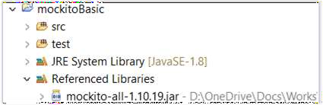
MOCKITO INSTALLATION
1
Using Jar
Download “mockito-core.jar” at www.mockito.org and put on your class path
2
Using POM (Maven)
Add this dependency in pom.xml on your maven
module / project.
<dependency>
<groupId>org.mockito</groupId>
<artifactId>mockito-all</artifactId>
<version>1.10.19</version>
</dependency>

Slide 26
SOME OF MOCKITO API (Mockito 1.10.19)
mock(Class)
will return object reference of mock to mimic Class
when(object.methodCall).thenReturn(variable)
if methodCall is called, then it will return variable
verify(object). methodCall
will verify if methodCall is called
verify(object, times(int)). methodCall
will verify if methodCall is called with given times
verify(object, never()). methodCall
will verify if methodCall is never called
verify(object, atLeastOnce()). methodCall
will verify if methodCall is called at least once
verify(object, atLeast()). methodCall
will verify if methodCall is called at least in given times
verify(object, atMost(int)). methodCall
will verify if methodCall is called at most in given times
inOrder.verify(object). methodCall
will verify if methodCall is called in order we order this scripts
Explanation:
Class : Name of class
Example : MyClass.class
methodCall : Method and it’s parameters
Example : myMethod(9)
object : Name of object
Example : myObject
variable : variable or value
Example : 1

Slide 27
Samet BUDAK (sbudak@uni-yaz.com)

