Slide 1
"The decision making subsystem based on Gauss methods, the Nelder-Mead method, the main and minmax criteria"
Completed: student group 10702314 Krasko I.S.
Checked: Associate Professor Kovaleva I.L.

Slide 2
The purpose of the course project is the development of a decision-making subsystem.
Realization of the algorithms used (single-source optimization methods: bisection, Gauss method, multicriteria optimization methods: Nelder-Mead, main criterion, minmax);
Develop a program for the implementation of algorithms;
User's manual
Perform the test.

Slide 3
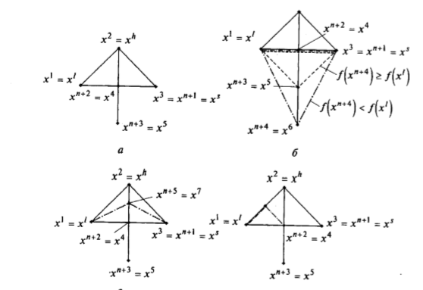
The Nelder-Mead method
The Nelder-Mead method, also known as the deformable polyhedron method and the simplex method, is a method of unconditional optimization of a function from several variables that does not use the derivative of the function, and therefore it is easy to apply to nonsmooth and / or noisy functions.

Slide 4
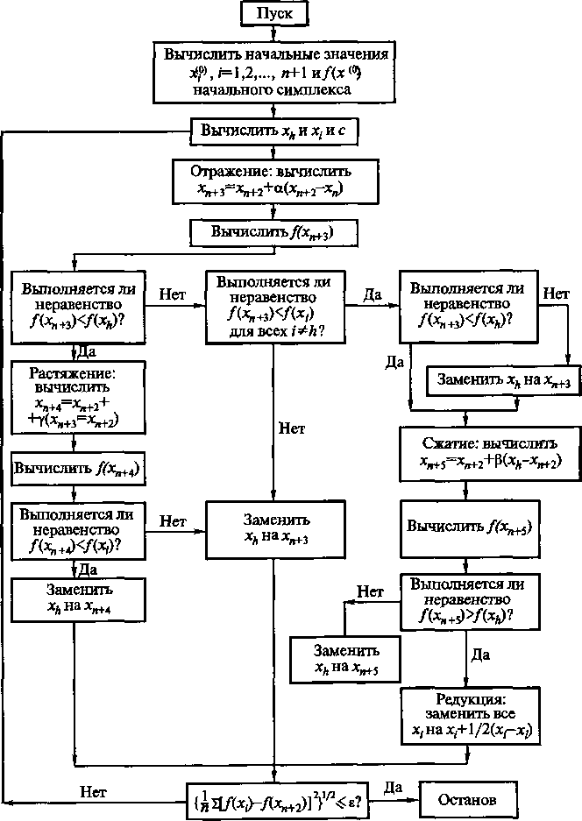
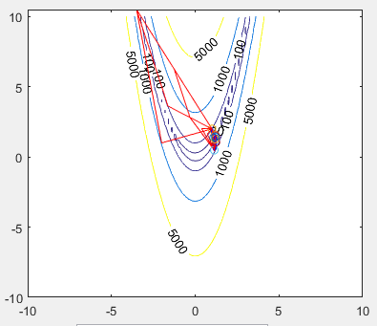
The Nelder-Mead method
Block diagram
Рrogram execution

Slide 5
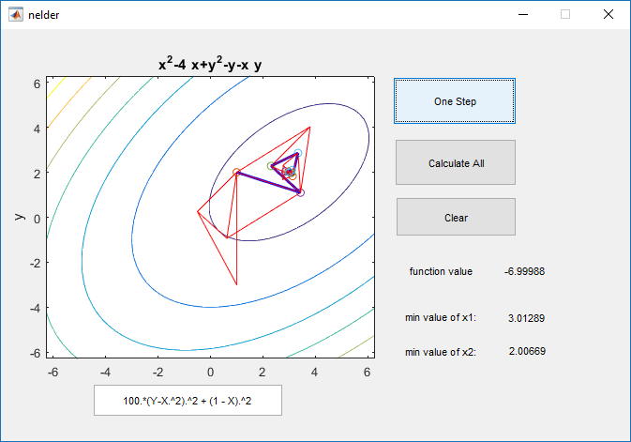
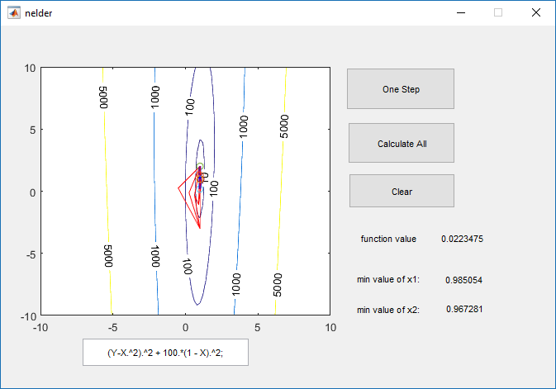
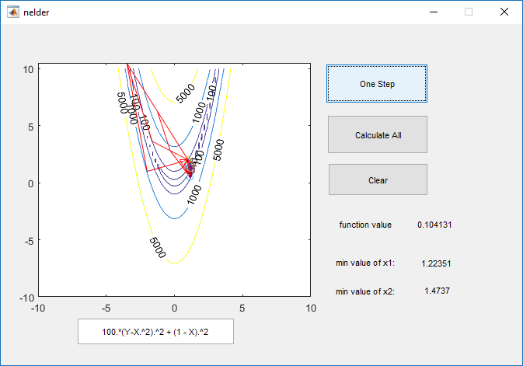
Testing
Testing of the method by various functions.
Result test:

Slide 6
Conclusion
During the course project, an application was developed for solving single-criterion and multicriteria tasks.
We have developed a software implementation of the data of our methods on MATLAB.
MatLab includes the GUIDE environment, which we used to create an application with a graphical user interface.
Testing showed that all methods work efficiently.

