Slide 1
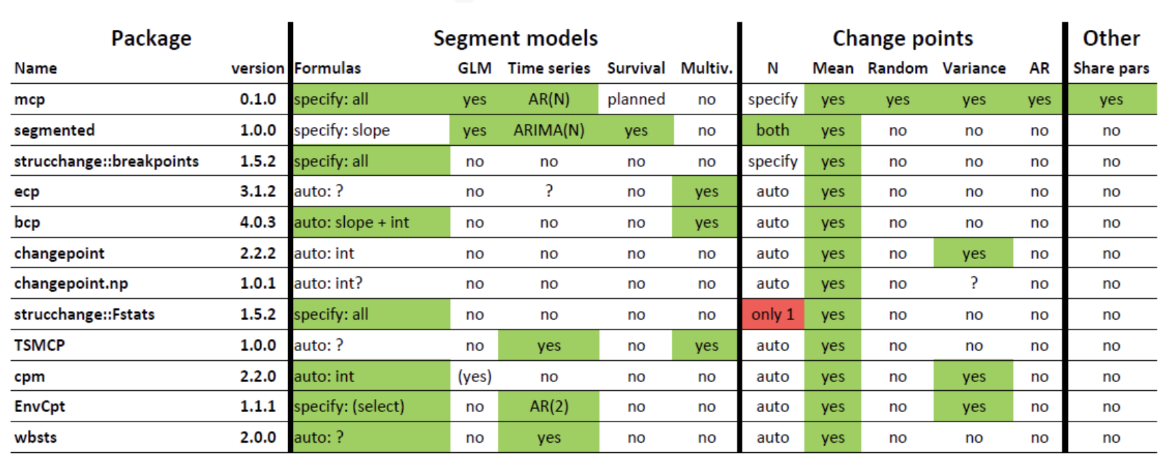
Options for breakpoints/changepoint: summary
Source: https://lindeloev.github.io/mcp/articles/packages.html

Slide 2
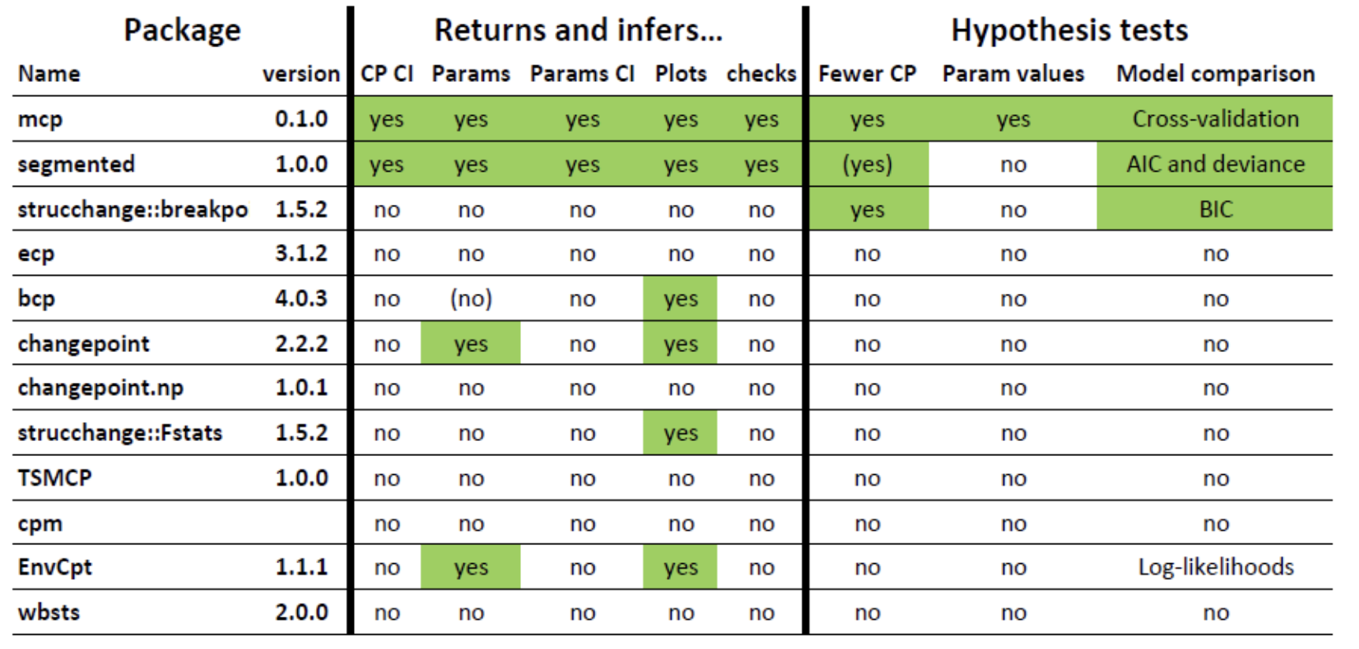
Options for breakpoints/changepoint: inference
Source: https://lindeloev.github.io/mcp/articles/packages.html

Slide 3
Manual searching for breakpoints/changepoints
source: https://www.r-bloggers.com/2012/08/r-for-ecologists-putting-together-a-piecewise-regression/

Slide 4
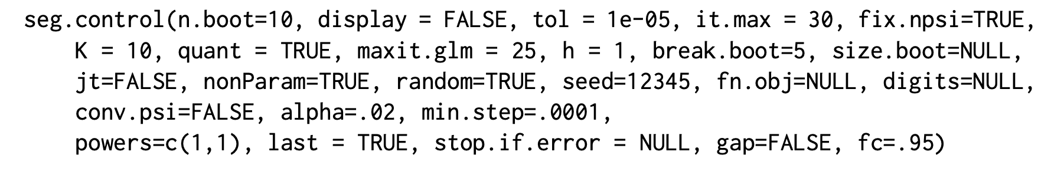
“Segmented” – how it find the breakpoint

Slide 5
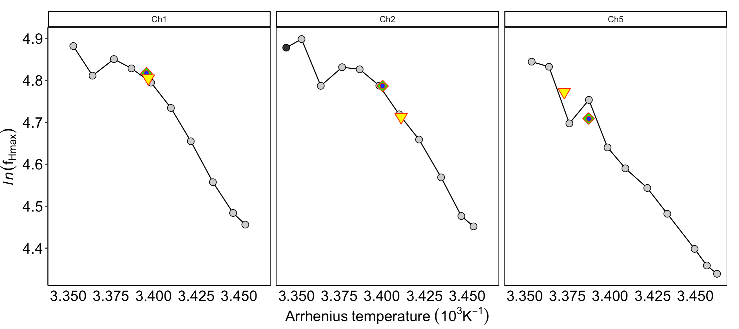
Outcome example 1:

Slide 6
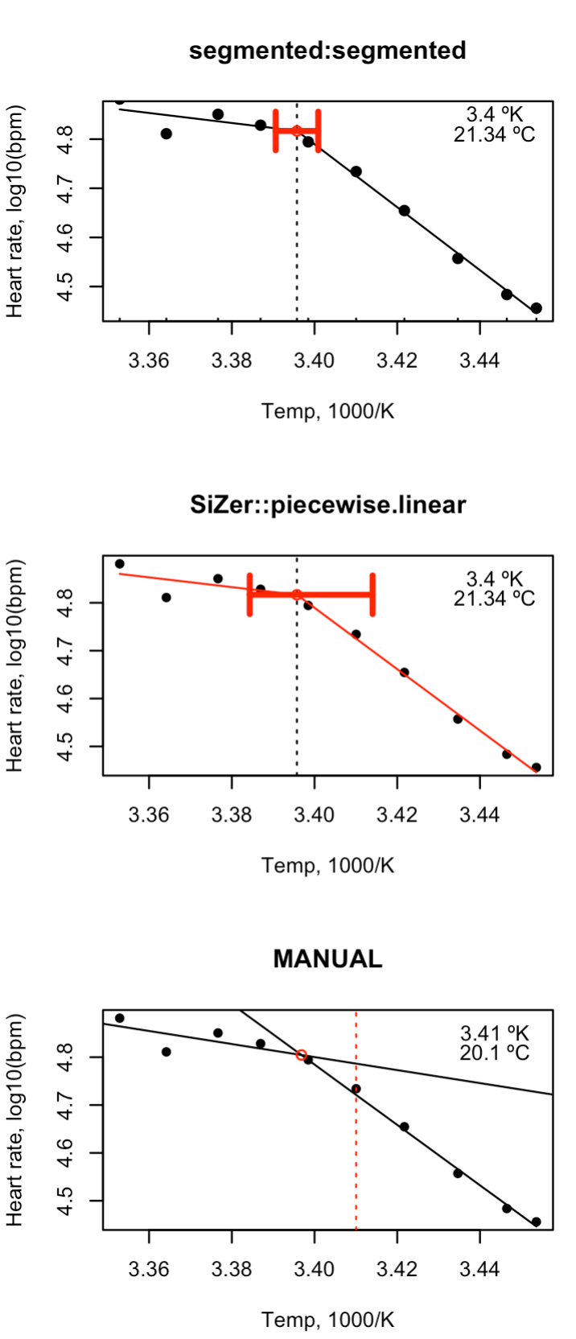
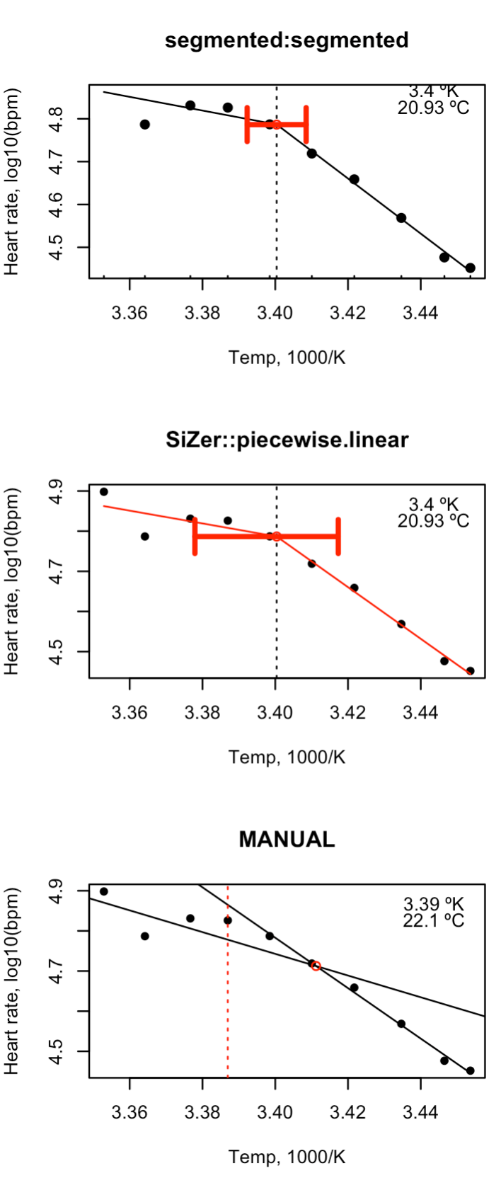
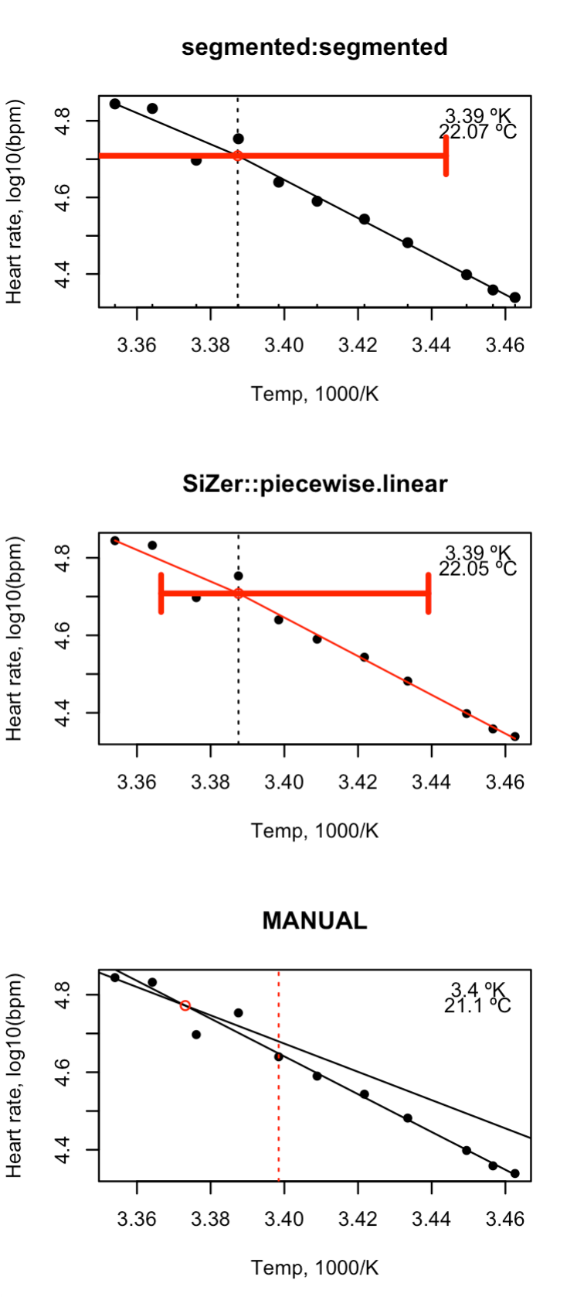
Error estimates will be SE
Error estimates will be CI 2.5 % and 97.5%
NO error estimates, plotted slope intersection points and the empirical “change point”

Slide 8
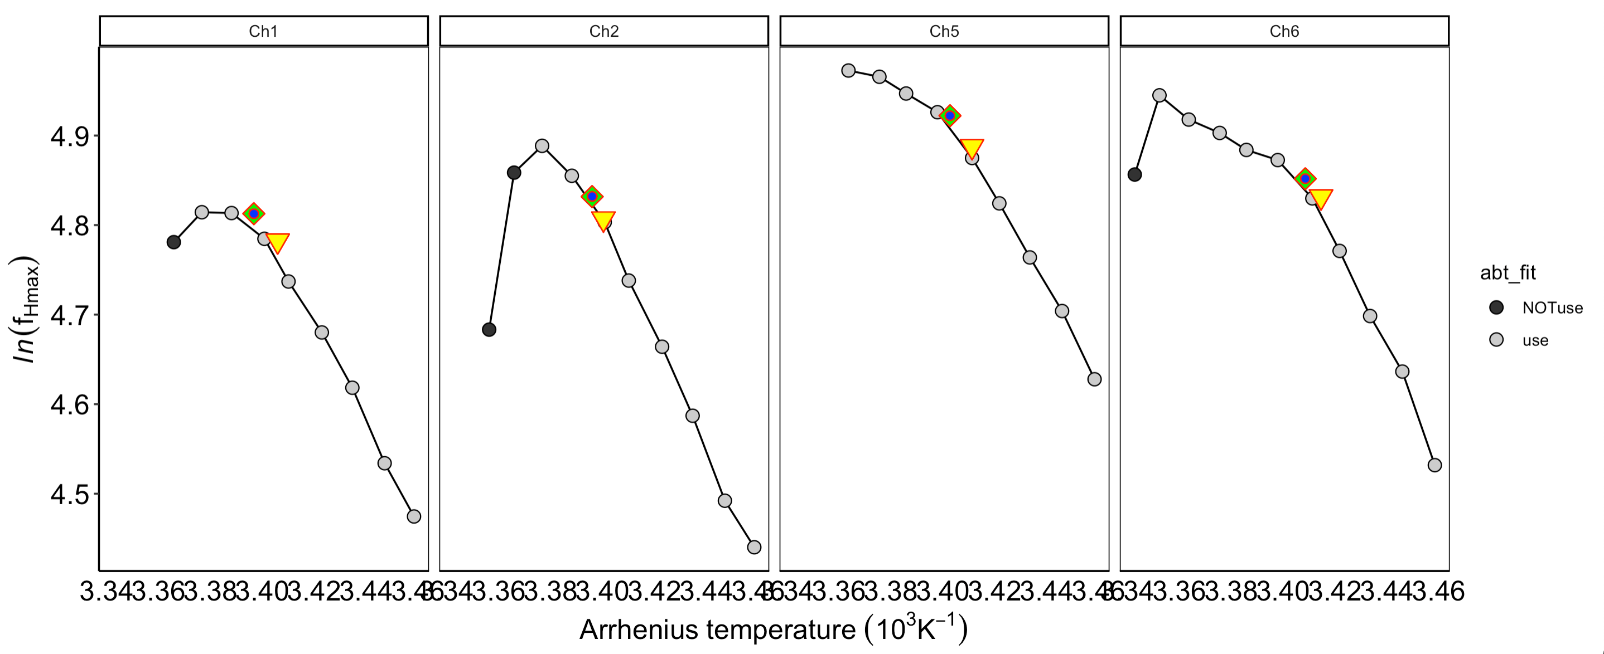
Outcome example 2:

Slide 9
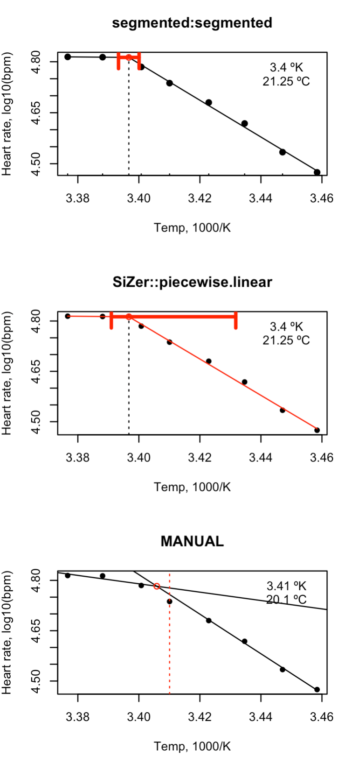
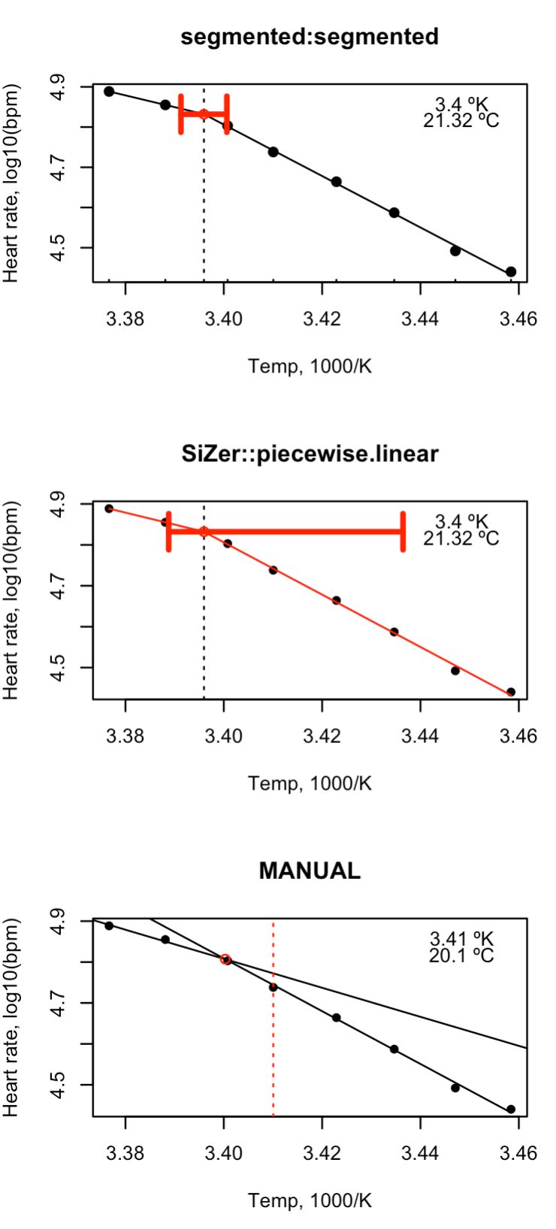
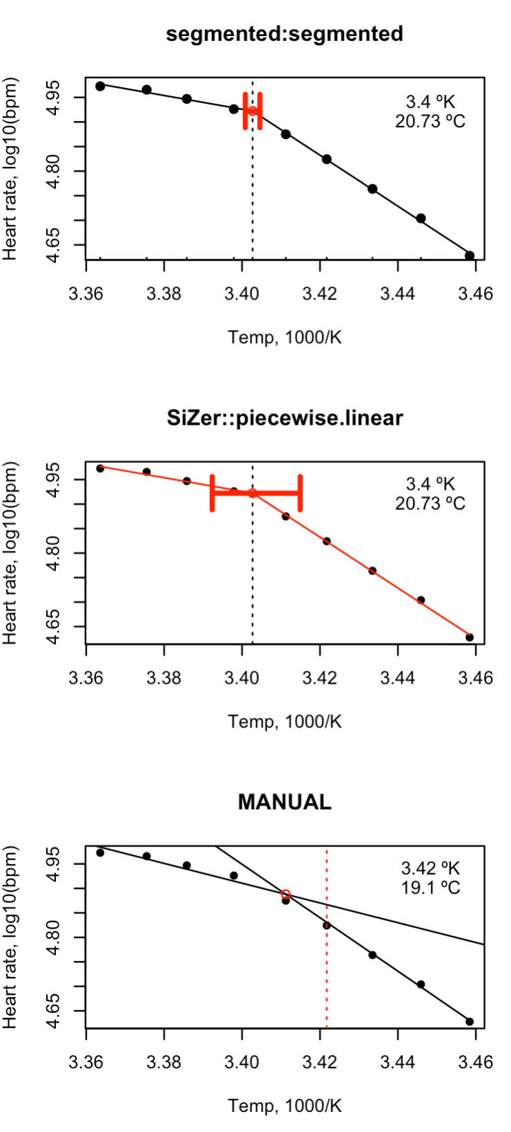
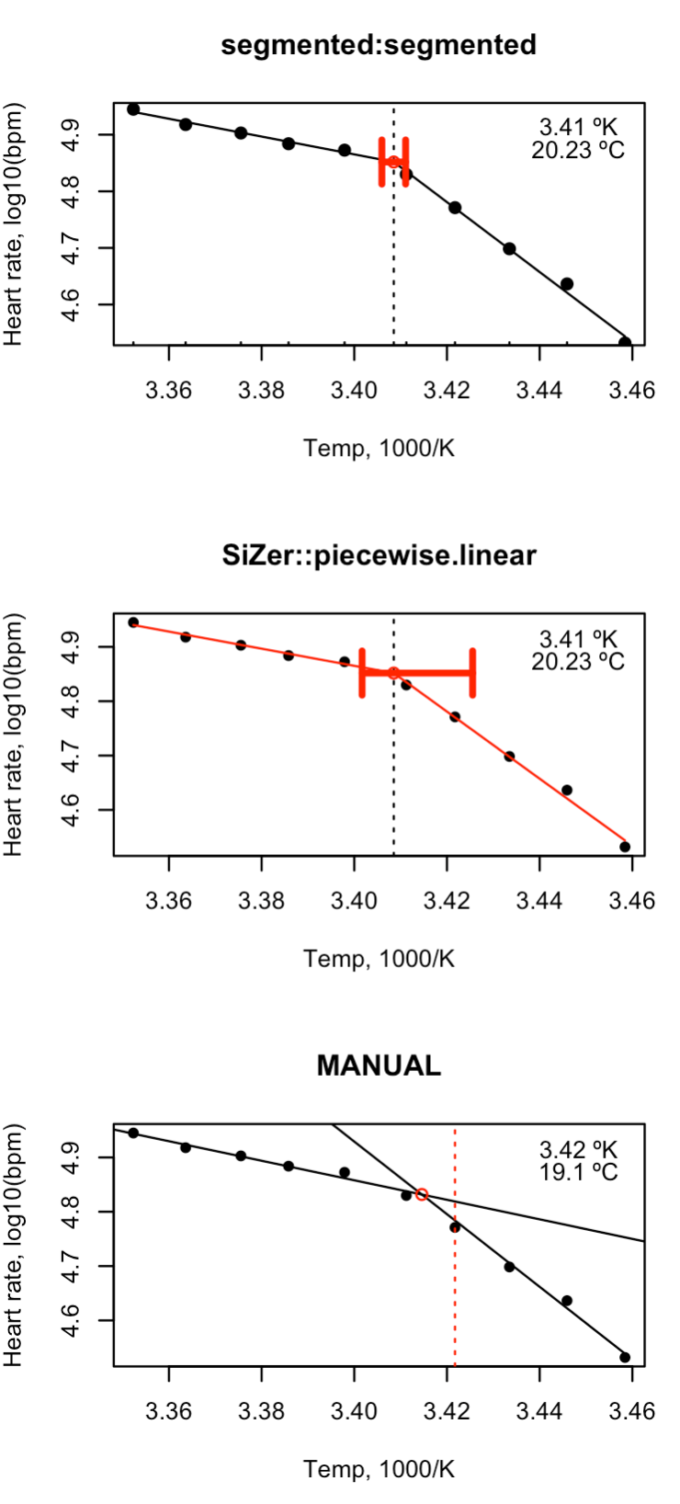
Outcome examples:

Slide 10
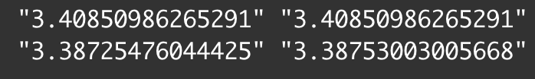
What makes results to differ between runs? (segmented package)
1) set.seed ()
We could identify replicate unsuccessful runs when using specific set.seed() settings
-> Solution ** - more boot.samples, ** has some variation in estimates (e.g. 2/100 runs had tiny diff ),

Slide 11
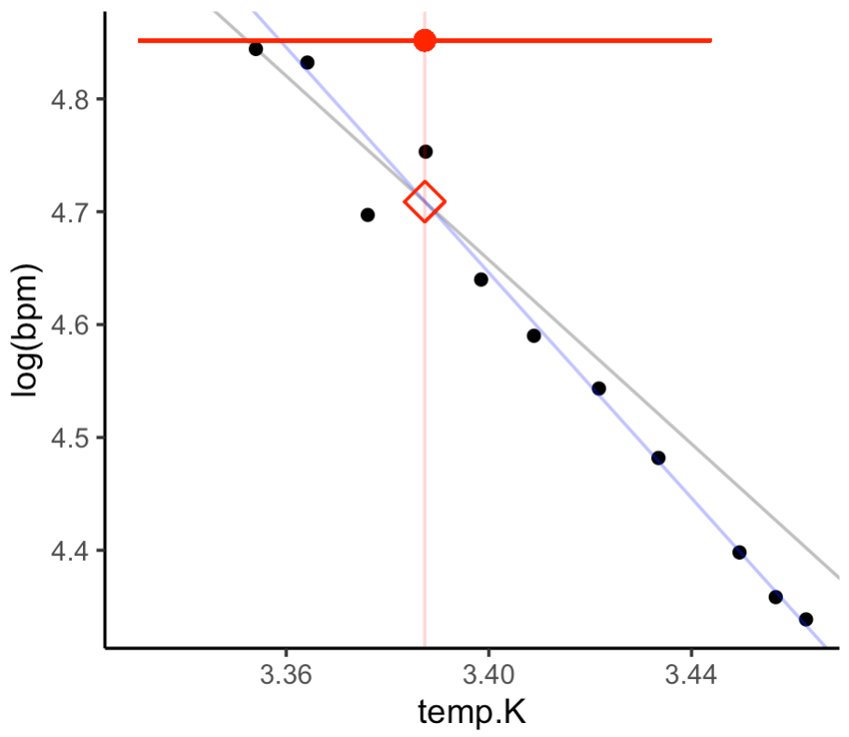
What makes results to differ between runs? (segmented package)
set.seed ()
I rest session: set.seed(NULL)
Run with default (my.seg <- segmented(breakpoint.lm, seg.Z = ~ temp.K)
Getting more variation – is the internal set.seed = 12345 not working?
→ Solution ** , make sure we set that ourselves.

