Slide 1
Eliason Lab Respo Cleaning Guidelines
April 10 2020
K. Kraskura, E. Hardison, T. Dressler, J. Van Wert

Slide 2
Data Analysis Pipeline:
1) Visualize Data
a. Plot all MO2 data using AnalyzeResp code
b. Visually inspect all MO2 plots (all files - background, MMR, SMR)
2) Clean Data
a. Identify all clean MO2 data with linear decline - keep
b. Identify any plots with minor issues - correct
c. Identify erroneous MO2 plots - remove
3) Background
a. Assess if background is present
b. If background is present, correct all MO2 slopes for background respiration (see Rosewarne et al 2016 for guidance)
c. We generally assume a linear increase between the “before” and “after” background and apply that to the slopes.
4) Plot your data and Calculate values
a. ALWAYS plot MO2 vs time and temperature vs time. ESSENTIAL for every fish.
b. Calculate SMR, RMR, MMR, EPOC, time to MMR50, MMR 75
c. Many ways to do this – talk to collogues and peers (i.e. which sliding measurement window; which SMR value; which EPOC threshold)
5) Assess for scaling
a. Plot your data – SMR vs body mass; MMR vs body mass
b. Adjust for scaling if needed (see above).

Slide 3
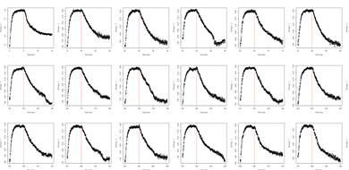
Notes before Cleaning:
Check for leaks
Plot flush plot ON
Are L shapes consistent across files? If yes, you might have a leak.
Note: Do not cut your measurement down to below your “sliding window” length.
For cleaning: R2 below 0.7 are immediately rejected-- no cleaning
If you have any measurements where you have a note that you were messing with the chamber (relieving a bubble, etc) or where data is missing from the measurement (low signal in probe can cause this), exclude the measurement

Slide 4
Decision Tree - Oxygen Visualization
Is the oxygen data messy?
NO
YES
Move on, still look at temp
Does the temp data look messy?
YES
NO
The role of the experiment is to measure MR with?
CHECK!
1. Flush and measurement cycle assignments correct?
2. System wide anomalies. Do all channels do the same thing at once?
3. Double check for leaks
Δ Temps
Constant temps
Convert O2 to % AS and back to mg/L using average temp in each measurement?
Option 1: Recalibrate all data with fixed temp across file
By converting O2 to % air sat. and back to mg/L

Slide 5
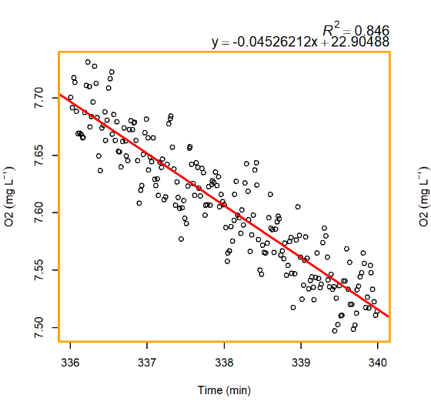
Scatter
if there are linear decreases with a slightly reduced R^2 due to scatter, this is likely because the measurement cycle was too short or because the O2 probe is old and signal is poor. If these look like clean linear oxygen consumption apart from the points being spread more than usual, adjust your r^2 threshold accordingly (nothing below 0.7) for all your files.

Slide 6
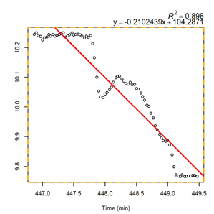
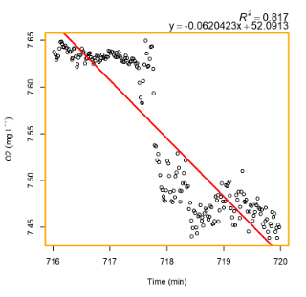
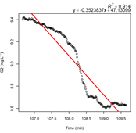
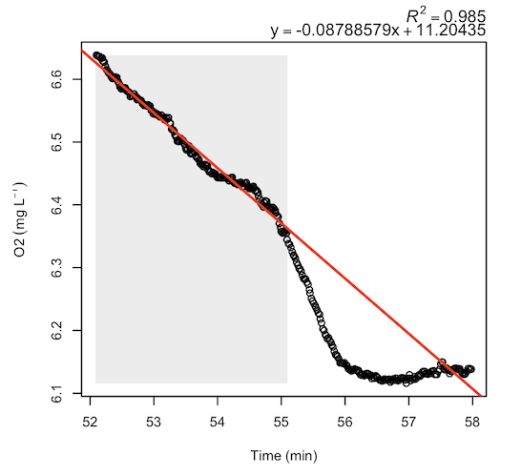
Z-Shape - three part change
IS THIS SETUP RELATED? (e.g. huuuge fish in small chamber, where every data point is super influenced by actual consumption of the fish) - if yes, don’t clean trust the avg regression.
If this is an anomaly-– we propose excluding this measurement. Could be due to a mixing or pump problem. E.g. Recirculation pump has seized and water is not flowing consistently past O2 probe. Or there is a bubble in T joint adjacent to probe. Data cannot be trusted
Notes:
Some sort of Z-shape: if it is recurring, double check flush plot; look at neighboring traces their slopes/regression parameters (r2, intercept, slope) (does it stand out as outlier?); look at summary plot (does it stand out as messy time period?);
IS THIS SETUP RELATED? (e.g. huuuge fish in small chamber, where every data point is super influenced by actual consumption of the fish) - if yes, don’t clean trust the avg regression.
Not? Not sure at all? - ditch entirely or keep? (check in with Erika). This may be anomalous. TOSS? Is the consensus.

Slide 7
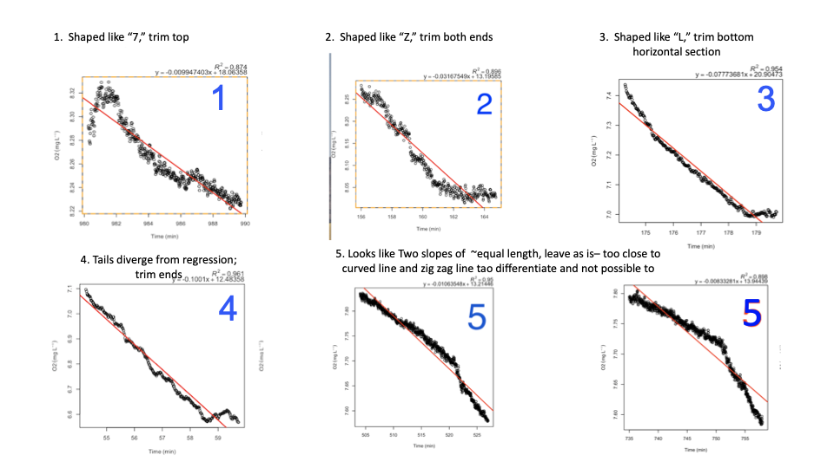
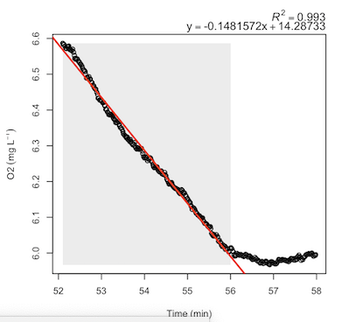
L- shape - Bottom of L must be >1/4 of the trace to be classified as an L
Cut the bottom of the L off
Notes:
Is this consistent across files? You might have leak.
Is this anomalous?
Note from Erika: Agreed that L must be a small portion of trace in fish traces (in inverts this could be due to apnea but in fish, this is likely a bubble). None of these traces look like leaks. E.g. The first 2 super fast declines and then flat (a leak is more of a slow tapering towards end). I’d keep first 2 traces and cut off flat end.

Slide 8
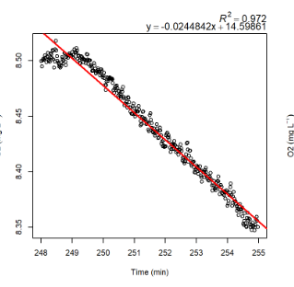
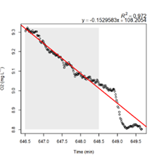
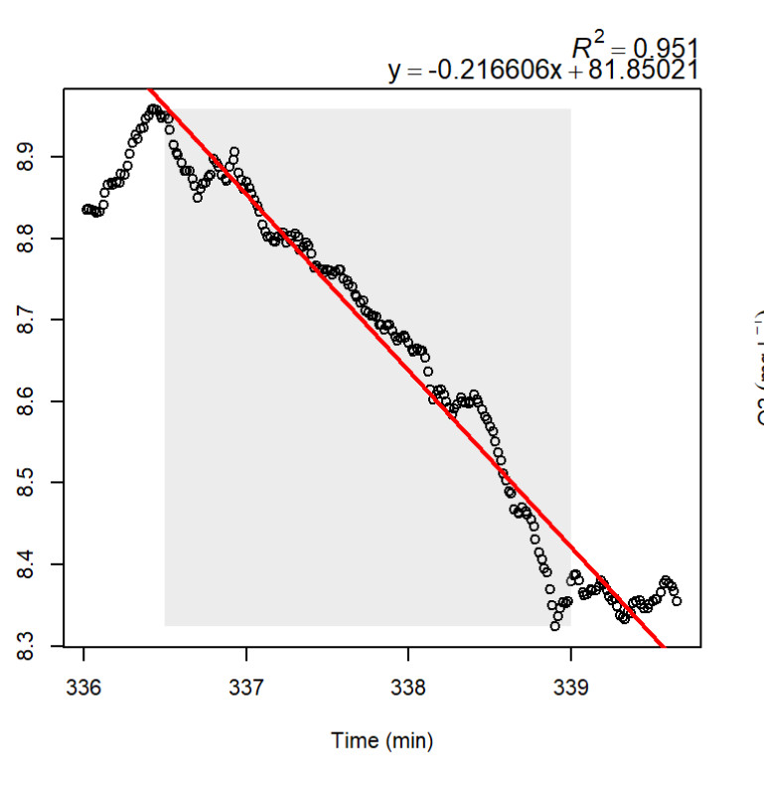
Tiny Tails - ends deviate from linearity (small 7 or or small L)
Chop off end
Notes:
Is this consistent across files? You might have leak.
Is this anomalous?
Note from Erika: Agreed – and does not look look like leak to me, it is too abrupt. Looks like timing may be off for pump start/stop. Mixing issue more likely.

Slide 9
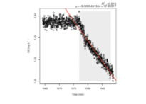
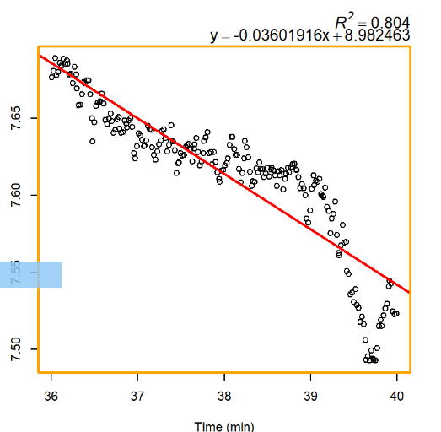
7’s - top of measurement is flat and >¼ of the file
Cut the top of the 7 (reverse L)
Notes:
Note from Erika: yes, this is essentially a delay and likely due to poor mixing. Cut off flat top and use linear decline only. But need to have a good portion of time remaining (e.g. middle trace), minimum R2 curt-off applies etc.

Slide 10
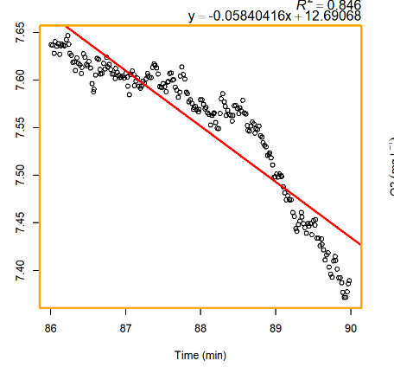
Double Slope - two clearly defined decreasing slopes
You have a choice on how to handle this. You just need to be consistent in YOUR analysis and it needs to make sense for YOUR goals of your experiment. So, make a decision and stick with it for your entire study.
Options:
1) If it is rare, and you have lots of data, just delete this file.
2) You can take the longer slope (rationale = most representative of this measurement period), if it meets R2 cut-off, then use it.
3) You can take the shallower slope (rationale = we are trying to measure minimum metabolism estimates and this is real data representative of the fish), if it meets the R2 cut-off.
4) (Less likely, but possible) If you are trying to estimate MMR, see just how fast the steep slope is in case it meets your MMR criteria. If it does, use it for your MMR.

Slide 11
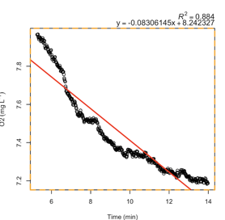
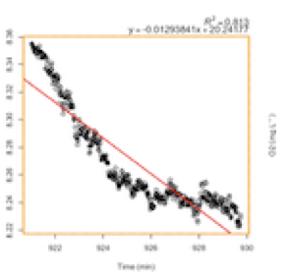
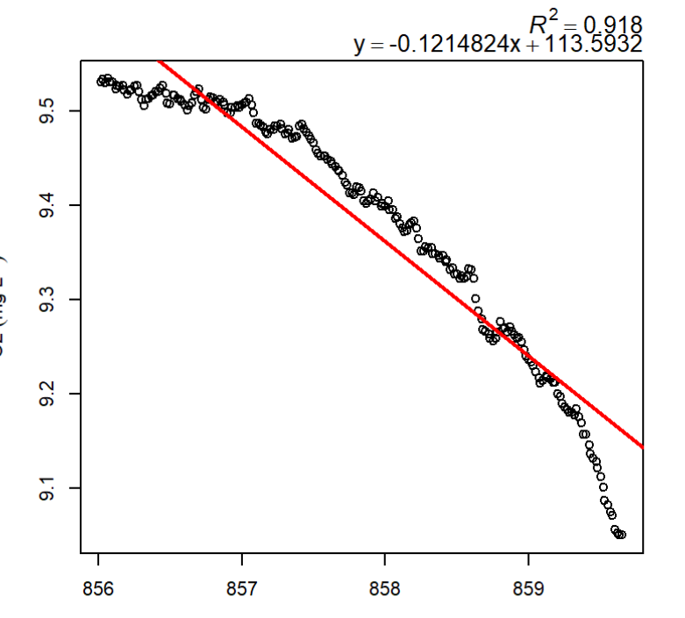
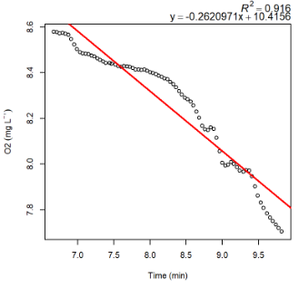
Concave and convex (Note that this is for individuals that do not have a leak in the respo)
*Common during EPOC
Common procedure: Convex traces can be real, fish is slowly increasing it’s o2 consumption. I Assign an R2 cut-off for this single measurement (recommend 0.05 higher than your global cut-off) and keep it if it’s within that threshold because it is probably good data.
NOTE: Evaluate how frequent these traces are. Could make a personal judgment call for an alternate options:
For long measurements (trace 1): chop that data into smaller time periods. Min 5-8 = slope 1, Min 8-11 = slope 2, Min 11-14 = slope 3. You have a recovering fish that has very different metabolic rates over this 10 minute period and you are losing really interesting discrimination power by averaging over this entire time period.
If it’s rare and not at critical time point, delete.
Either handling choice is ok, but must stay consistent across all trace analysis for any given study.

Slide 12
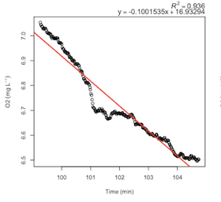
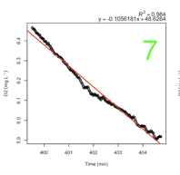
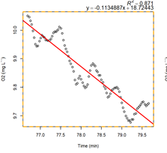
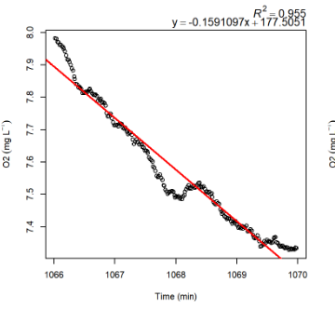
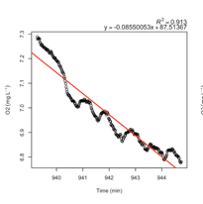
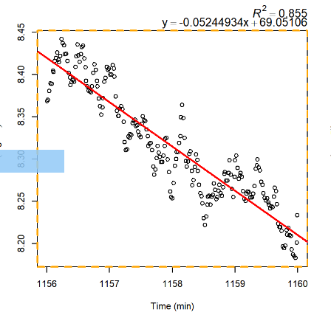
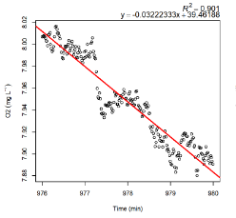
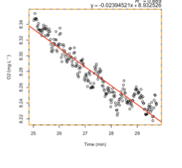
Zig Zags, blips, and blops in the middle
Could be caused by temperature probe; let the R2 filter

Slide 13
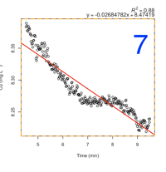
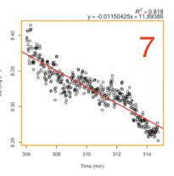
Step down (lightning bolt)
Look at temp plot. Is the plateau due to temp?
Yes → Trim out the plateau
No → Reject trace

Slide 14
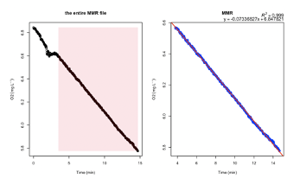
Specifically for MMR
Visualize your data and look for blips in your MMR measurement
For files where there ARE blips, double check where the sliding window is calculating MMR.
If the sliding window with the steepest slope is over that blips, remove the blip from your analysis and re-run your MMR file.

Slide 15

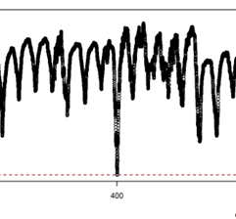
Problem | Potential issue | Protocol | Example
Sudden, rapid decline in [O2] | poor mixing or issue with recirc pump. If the fish truly respired that much and decreased the DO levels in the chamber that low, the flush pump would not be able to return the DO back up to full saturation in one single flush cycle | Remove the slope(s)
Consistent non-linearity | Examine all trials. Cross-check with temp. Respirometer might have a leak and data is unreliable. | X
Overshoot | Sudden large drop in [O2] and flush then overcompensates. Common in animals with high metabolic rates (i.e. salmon) | Remove the slope(s)

