Slide 1
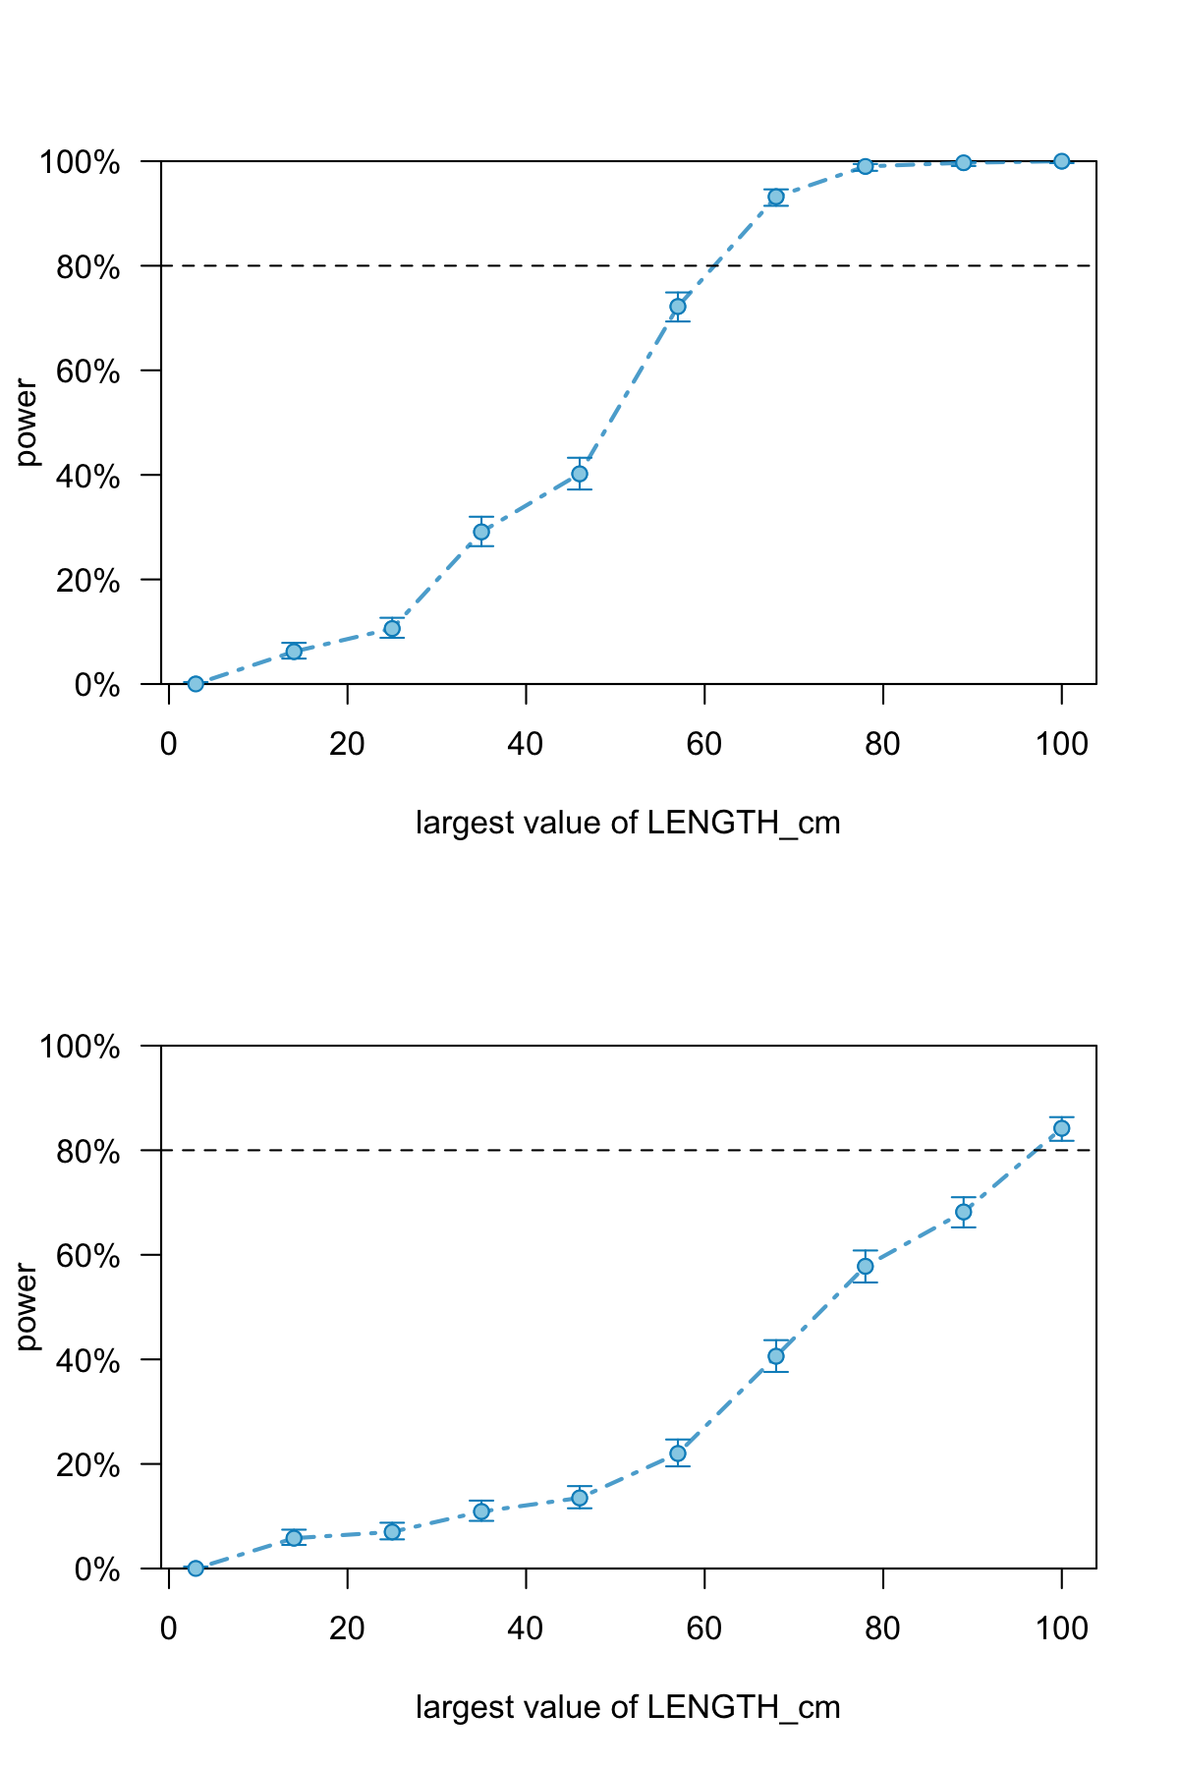
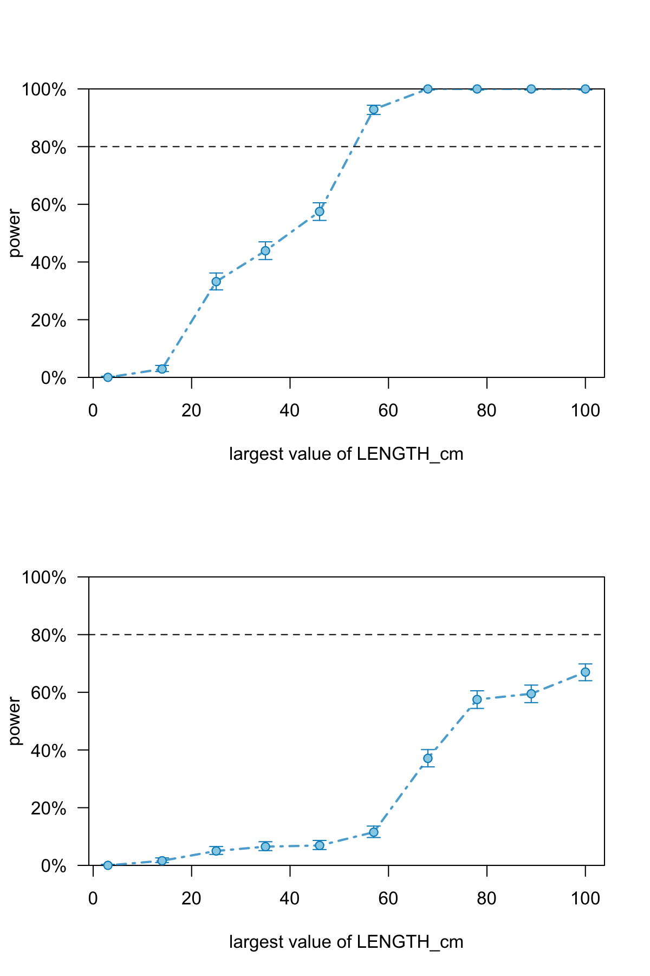
Swim speeds > 250 cm/s, effect size BL (cm) = -1.0
Swim speeds < 250 cm/s, effect size BL (cm) = -1.0
A
n = 232
B
n = 286
n = 190
(sample size required)
n = 265
Largest value of body length (BL, cm)
Largest value of body length (BL, cm)
Swim speeds > 250 cm/s, effect size BL (cm) = -0.5
Swim speeds < 250 cm/s, effect size BL (cm) = -0.2
C
n = 332
D
n = 291
n = 546
Largest value of body length (BL, cm)
Largest value of body length (BL, cm)

