Slide 1

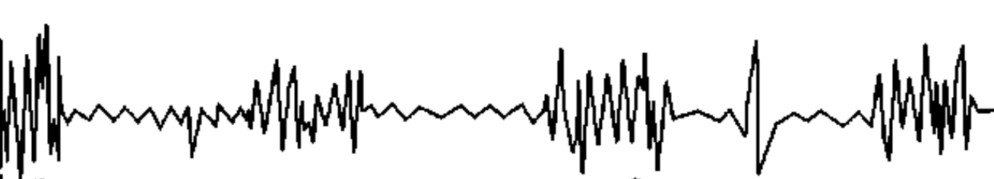

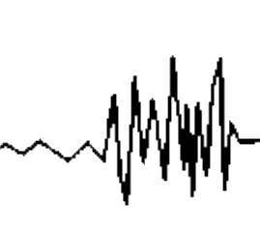
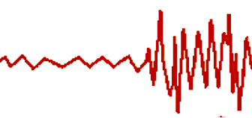
Field observations
Swim tests
U_{crit} / U_{max}
Time to fatigue / endurance
LONG ( h), HIGH METABOLIC COST
SHORT (< h) MEDIUM METABOLIC COST
EMG tag
Recovery
costs
RECOVER WHILE SWIMMING
ANAEROBIC
Muscle
activation
White muscle
Red muscle
AEROBIC
Sustained long timeframes, indefinite
BURST
BURST
&
COAST
Speeds above what can be measured in swim flumes & tunnels
Swim speed
STEADY SWIM (FAST)
STEADY SWIM
BURST
PROLONGED
SUSTAINED
< 15 s
min
~ 30 min to 2 h
Hours to days
Timeframe

