Slide 1
INPUTS
OUTPUTS
Define Classes
For Munoz full food web model:
One data frame
Replicates Figures 3, 4 (sun et al)
BMF and BCF
Data frame, lm, predicted lm data
Replicates Fig 2, and suppl. Fig 8
Used to get Table S6c
Steady State model
One function to use for our system
Bioaccumulation model

Slide 2
Input files
(.csv)
Input data
(hard coded)
OceanData
ChemicalPArameters
chemicalData
oganismData
foodWebData
NgData (BMF & BCF)
Consoer_PFOSratio (BMF & BCF)
Consoer_PFOAratio (BMF & BCF)
observedData_BCF
observedData_BMF
BCF units: L/kg
BMF units: kg/kg

Slide 3
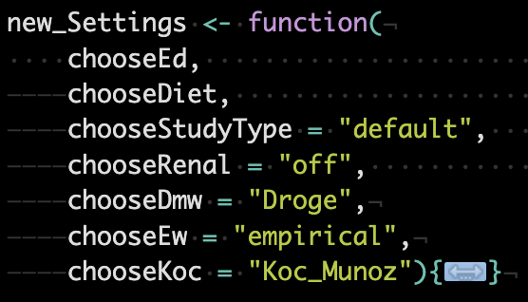
Define Classes
OUTPUTS/ description
New settings, used to define how the model runs
chooseEd
E_D = Chemical absorption efficiency across the gut membrane (gut or dietary chemical absorption efficiency)
In chemicalParameters data
chooseDiet
‘default’, ‘zero’, 'Martin BMF’ | 'Martin BMF rev’, 'forced Munoz’ (Manual –read in provided data)
dietData
chooseDmw = "Droge”
Partitioning to phospholipids is described by the membrane-water partitioning coefficient
In chemicalParameters data
Table S3a. Log Dmw
chooseEw = "empirical”
Chemical absorption efficiency across the gill membrane (aqueous chemical absorption efficiency)
In chemicalParameters data
chooseKoc = "Koc_Munoz”
Koc is the organic carbon partitioning coefficient; Koc = Kd / OCS
OCS is the organic carbon content of the sediment
Kd = Dietary uptake rate constant
In chemicalParameters data
Settings
Environment
Chemical
Chemical Data
Organism

Slide 4
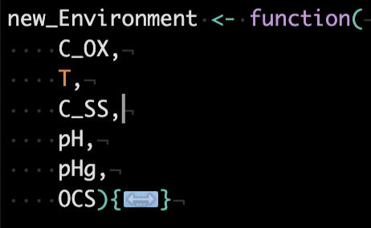
Define Classes
OUTPUTS
(all provided no internal calculations)
Settings
Environment
Chemical
Chemical Data
Organism
oceanData
C_OX: dissolved oxygen concentration (mg/L)
T: temperature (C)
C_SS: concentration of suspended solids (kg/L)
OCS: organic carbon content of the sediment (kg/L)
pH
pHi = 7.4 default for internal pH as suggested by Armitage et al. 2013

Slide 5
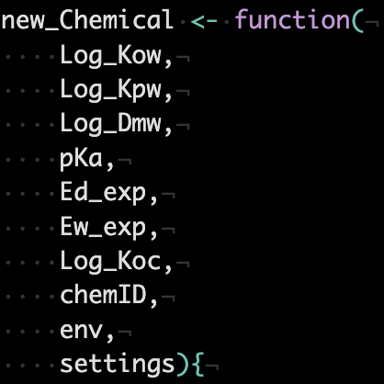
Define Classes
OUTPUTS/description
Dataclass that holds parameters unique to each PFAS chemical.
Parameters include physiochemial properties, pH-dependent properties (varies with environment), and empirically-derived parameter values (sometimes varies with organism characteristics/study; this choice is made during the instantiation of this class)
Functions include calculation of chemical-specific parameters, which may depend on environmental parameters (class Environment):
Partitioning coefficients
Organism functions
Diet functions
Rate constant functions (e.g. k_1 = clearance rate constant (L/kg*d) for chemical uptake via respiratory area (i.e., gills and skin)
Settings
Environment
Chemical
Chemical Data
Organism

Slide 6
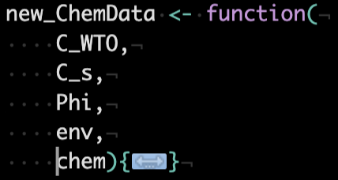
Define Classes
OUTPUTS
Settings
Environment
Chemical
Chemical Data
Organism
Dataclass that holds chemical data that is unique to each model system. This includes both model parameters and input variables
(ChemData .csv)
Cs = Concentration in sediment
OCS =organic carbon content of the sediment
Koc = organic carbon partitioning coefficient; Koc = Kd / OCS

Slide 7
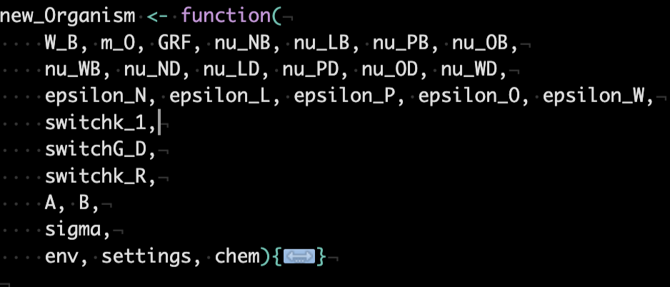
Define Classes
OUTPUTS
Settings
Environment
Chemical
Chemical Data
Organism
Functions include calculations of
(1) diet composition
(2) bioenergetic rates
(3) partitioning coefficients
(4) chemical uptake and elimination rate constants

Slide 8
Goals:
BMF with our data:
Change:
organism weight (organismData); see table S2
Temperature (oceanData)
DO? (oceanData)
OCS (oceanData)
growth rates? (cite)
Chemical uptake rates (use trout Martin et al)
OCS: they don’t have for Martin BCF BMF – we do!
The BAF with mean max etc.
Use S6c (while body )
Season
Temp
DO
Body size
Activity (ventilation rate)
The water PFAA???
Can we incorporate?

Slide 9
