Slide 1
Instance-based Security with the Security Annotation Framework (SAF)
ICW Developer Conference
Martin Krasser / 07.05.2008

Slide 2
Martin Krasser
Software Architect @ Professional Gate
Focus
  Application Security
  Application Integration Platforms
  Application Integration Solutions
  Research & Development

Slide 3
Agenda
Introduction
Architecture
Code Examples
Outlook
Live Demo

Slide 4
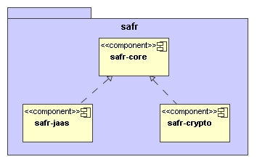
Overview
Open Source Security Project @ sourceforge.net
  Instance-level access control
  Attribute-level encryption
Driven by Java 5 Annotations
  @Secure and @Filter annotations to enforce access decisions
  @Encrypt annotation to trigger encryption/decryption operations
Framework with provider interfaces (SPI) for
  Authorization Providers
  Encryption Providers
  Reference implementations available
Notes:
Framework does not implement a certain permission model (permission types, roles, groups etc.)
Framework does not provide certain encryption algorithms (RSA, DES, ...)
This is left to authorization providers and encryption providers.

Slide 5
Motivations
Java EE doesn‘t provide instance-level access control mechanisms
  Access decisions and policy definitions in Java EE only based on static application properties (methods, ...)
  Instance-level access control is additionally based on runtime application properties (domain object state, ...)
Encryption mechanisms decoupled from data storage/binding mechanisms
  No Hibernate-specific encryption interceptors ...
  No JAXB-specific marshal/unmarshal listeners ...
Avoid complex configurations
  No need to deal with Spring/AspectJ AOP details
  Place security interceptors using annotations
Support for pluggable authorization and crypto providers
  Access control and encryption logic provided by plugins/providers
  Different applications have significantly different access control and encryption requirements
Notes:
Java EE defines policies (role X may invoke method Y)
SAF only defines policy enforcement points.
Policy implementation by autorization provider.

Slide 6
History
SAF initially developed as part of the eHF
  Refactoring of complex Spring/AspectJ AOP configurations
Open source since March 2007
  Apache 2.0 License
Three releases so far
  Latest release is 0.8.2 (production-stable)
  Current development on 0.9-SNAPSHOT

Slide 7
SAF Access Control Architecture
Requestor
Security
Interceptor
Domain
Object
SAF Core
AccessManager
Authorization
Provider
SAF JAAS
Spring Security
...
Security Interceptor (Policy Enforcement Point)
  Implemented by annotating domain objects, methods and method parameters
Authorization Providers (Policy Decision Point)
  Makes access decisions based on class instances
  Reference implementation based on JAAS extensions

Slide 8
SAF Crypto Architecture
Requestor
Crypto
Interceptor
Instance
Attribute
SAF Core
CryptoProvider
Crypto
Provider
SAF Crypto
...
Crypto Interceptor
  Implemented by annotating instance attributes
Crypto Service Provider
  Runs encrypt/decrypt operations
  Reference implementation coming soon

Slide 9
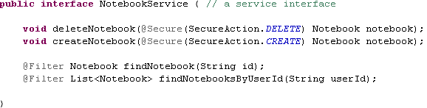
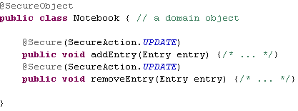
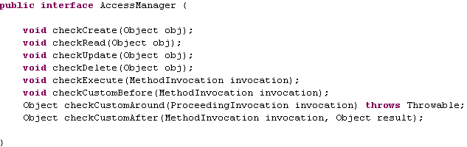
Code Example – Access Control

Slide 10
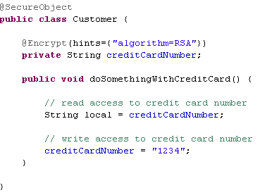
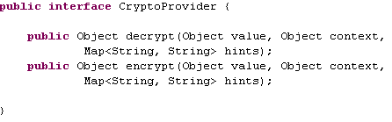
Code Example – Attribute Encryption
BUT: No crypto operations for access via reflection
Hibernate can be configured for reflective access (field access)
  Encrypted storage of attribute values in databases
JAXB2 can be configured for reflective access (field access)
  XML binding of encrypted attribute values

Slide 11
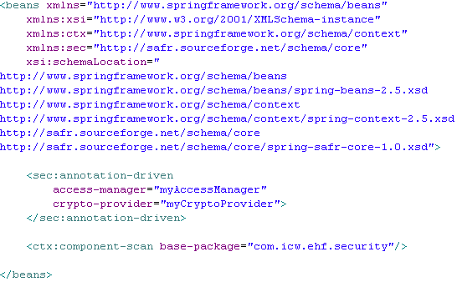


Configuration
Spring 2.5 Application Context
Provider Implementations
loads

Slide 12
Behind the Scenes
Client
Spring AOP
AspectJ
Spring
AOP Proxy
Method
Interceptor
Enhanced
Bytecode
AspectJ
Advice
RT
CT
Domain
Object
Service
Application
SAF
Spring Bean
Infrastructure
RT
Created at runtime
Access
Manager
Crypto
Provider
CT
Created at compile time

Slide 13
Outlook – 1.0 Release
Crypto provider reference implementation
AspectJ load-time weaving
AspectJ 1.6 upgrade
  Support for parameter-level annotations
OSGi support
  Make SAF components OSGi compliant bundles
  OSGi sample application using SAF components
Security annotations on
  Static domain object methods
  Constructors
Documentation extensions
  Document new features, more examples
  Translate Java Magazin article to English
Acegi authorization provider integration (optional)

Slide 14
Resources
Project Site
  http://sourceforge.net/projects/safr
Web Site
  http://safr.sourceforge.net/
Article
  Instanz-basierte Zugriffskontrolle, Java Magazin 7.2007

Slide 15
Live Demo
Notebook web application

Slide 16
Thank you for your attention! martin.krasser@icw.de

