Slide 1

Practical 1: Understanding the posterior distribution
GMS-MT2019
Wellcome Centre for Human Genetics
Instructor: Dr Andre Python

Slide 2

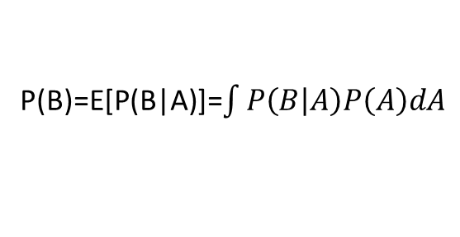
Bayes’ theorem
likelihood
prior
posterior
constant
A: parameters
B: data
E[ ]: expectation
P: probability distribution
P(B)=E[P(B|A)]=$\int{P\left(B | A\right)P\left(A\right)dA}$

Slide 3
Likelihood
First and most influential component of a Bayesian model is the likelihood
Specifies the plausibility of the data
Relies on assumptions. Ex: binomial distribution:
Independence of trials
Probability of success is identical for each trial
Major assumptions in both Bayesian (and non-Bayesian) models are the likelihood function and their relations to the parameters
As sample size increases, the likelihood matters more and more

Slide 4
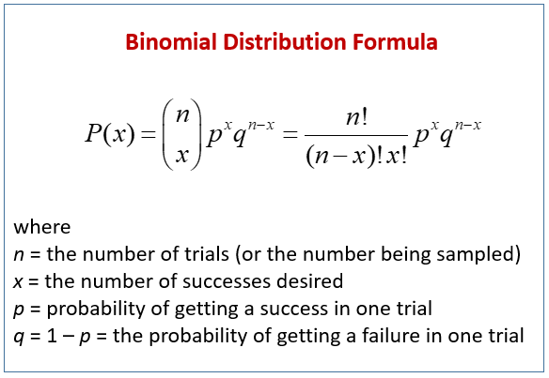

Slide 5
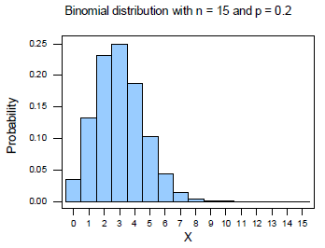
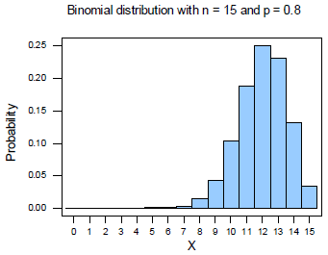

Slide 6
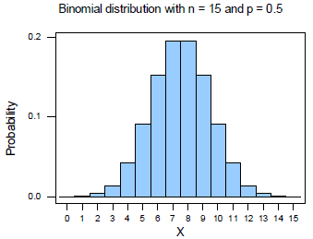
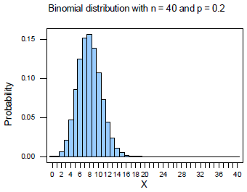

Slide 7
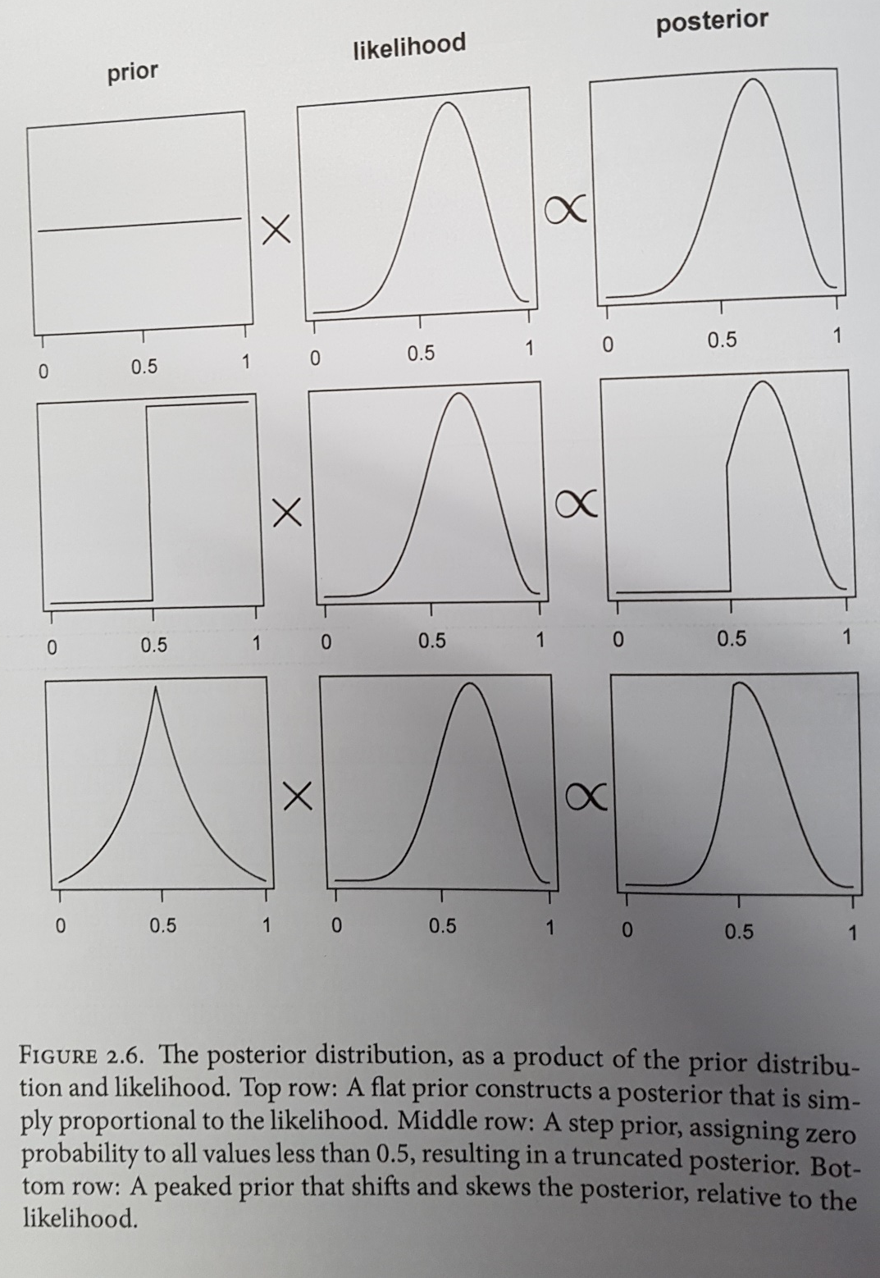
Posterior distribution is proportional to the likelihood multiplied by the prior
Producing the posterior can be viewed as
Conditioning the prior on the data.
Posterior: usually impossible to compute analytically
Numerical techniques used to compute it:
Grid approximation
Quadratic approximation
MCMC
…

Slide 8
Grid approximation
Approximation of a continuous posterior distribution by considering a finite grid of parameter values
1. define number of grid points + make list of parameter values on the grid
2. compute the value of the prior at each parameter values on the grid
3. Compute the likelihood at each parameter value
4. Compute the (unstandardized) posterior at each parameter value by multiplying the prior by the likelihood.
Repeat (2-4) for each value in the grid
→This generates an approximation of the exact posterior distribution
(Not used in practice but showed here to illustrate Bayesian updating)

Slide 9

A thought experiment
Source: Statistical rethinking, R. MacElreath (book "SR")
Context: how much water covers the earth? imagine a version of the globe small enough to hold in your hands.
Experience: you toss the globe up in the air, when you catch it you record whether or not the surface under your right finger is water or land. You repeat the procedure n times.
Statements:
The true proportion of water is p
A single toss of the globe has probability p of producing water and 1-p of producing land
Each toss is independent

Slide 10
Number tosses
Count of (“water”) follows a Binomial distribution
Prob (“water”)
Prob (“land”)

Slide 11
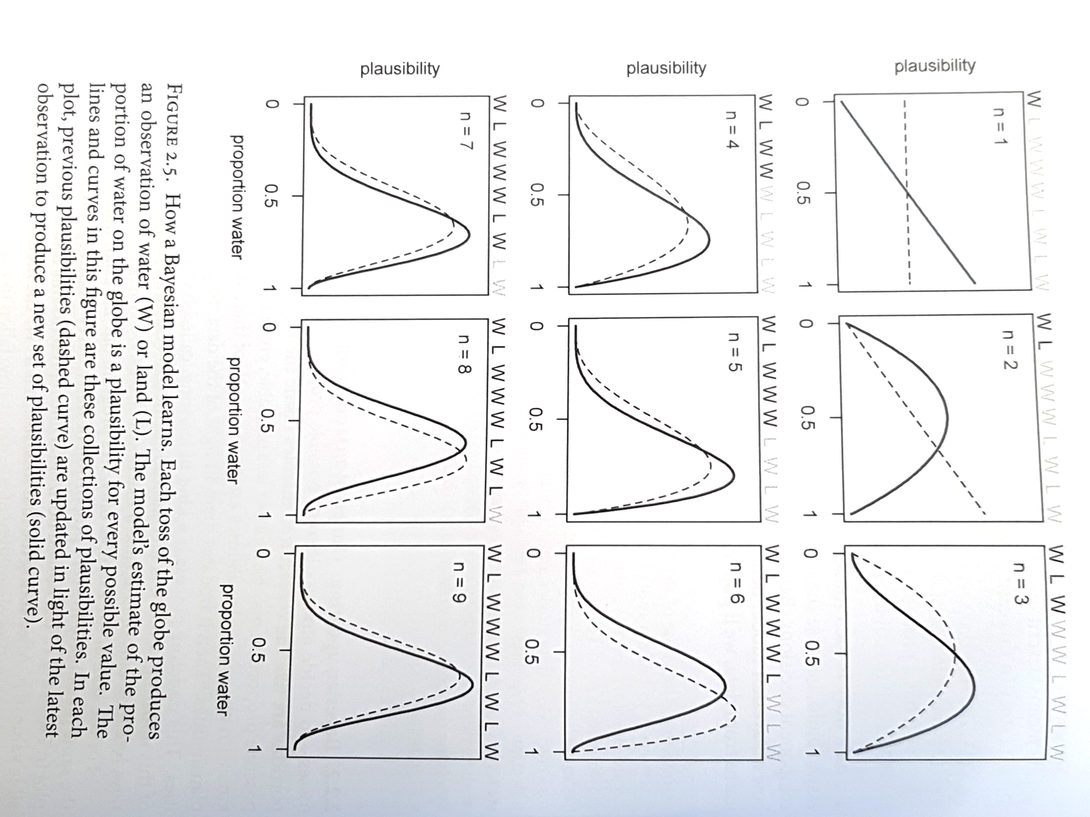
How a Bayesian model learns?
Proportion of “water” on earth
Each toss of the globe produces
an observation (W or L).
W: water
L: land
Solid curve: new plausibility
Dashed curve: previous plausibility

Slide 13
Practical
Start and complete the first R practical (practical_nb.1.R)

