Slide 1
Hidden Markov Models for Genomics
GMS Program Lecture
Jason A. Hendry
2021/11/09

Slide 2
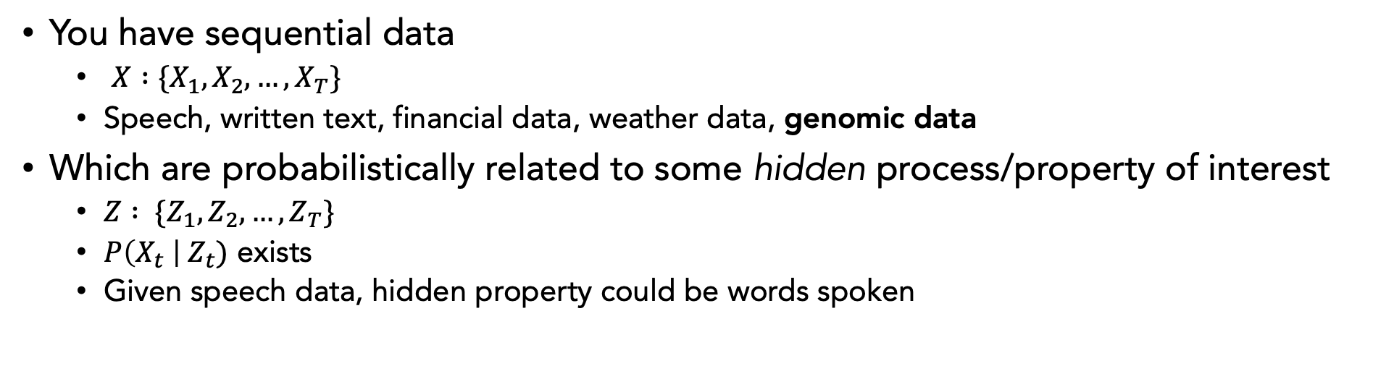
When are Hidden Markov Models (HMMs) used?
You have sequential data
$X :\{X_{1},X_{2},…, X_{T}\}$
Speech, written text, financial data, weather data, genomic data
Which are probabilistically related to some hidden process/property of interest
$Z : \{Z_{1},Z_{2},…, Z_{T}\}$
$P\left(X_{t} \right| Z_{t})$ exists
Given speech data, hidden property could be words spoken
Notes:
- You believe or know this hidden property exists, and that it is influencing your data, but you don’t get to measure it directly; it is not part of the data you can collect

Slide 3
When are Hidden Markov Models (HMMs) used?
You have sequential data
$X :\{X_{1},X_{2},…, X_{T}\}$
Speech, written text, financial data, weather data, genomic data
Which are probabilistically related to some hidden process/property of interest
$Z : \{Z_{1},Z_{2},…, Z_{T}\}$
$P\left(X_{t} \right| Z_{t})$ exists
Given speech data, hidden property could be words spoken
Why are they used?
If you can represent your phenomenon with an HMM
there are a set of well established dynamic programming algorithms
you can use to make inferences
Notes:
- You believe or know this hidden property exists, and that it is influencing your data, but you don’t get to measure it directly; it is not part of the data you can collect

Slide 4
HMM examples in genomics
Inferring copy number variation from coverage data
Inferring CpG islands from DNA sequence data
Inferring DNA sequence from current data in nanopore sequencing
Notes:
- You believe or know this hidden property exists, and that it is influencing your data, but you don’t get to measure it directly; it is not part of the data you can collect

Slide 5
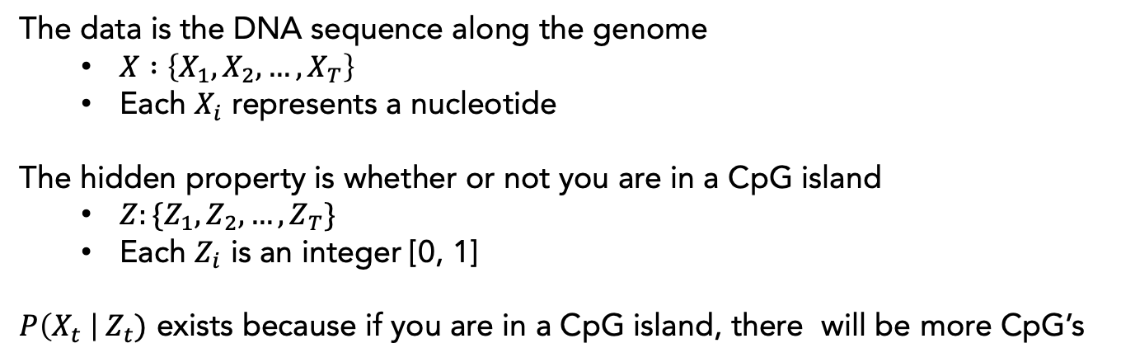
Inferring location of CpG islands from DNA sequence
The data is the DNA sequence along the genome
$X :\left\{X_{1},X_{2},…, X_{T}\right\}$
Each $X_{i}$ represents a nucleotide
The hidden property is whether or not you are in a CpG island
$Z:\{Z_{1},Z_{2},…, Z_{T}\}$
Each $Z_{i}$ is an integer [0, 1]
$P\left(X_{t} \right| Z_{t})$ exists because if you are in a CpG island, there will be more CpG’s
Durbin et al. (1998) Biological Sequence Analysis
Notes:
- You believe or know this hidden property exists, and that it is influencing your data, but you don’t get to measure it directly; it is not part of the data you can collect

Slide 6
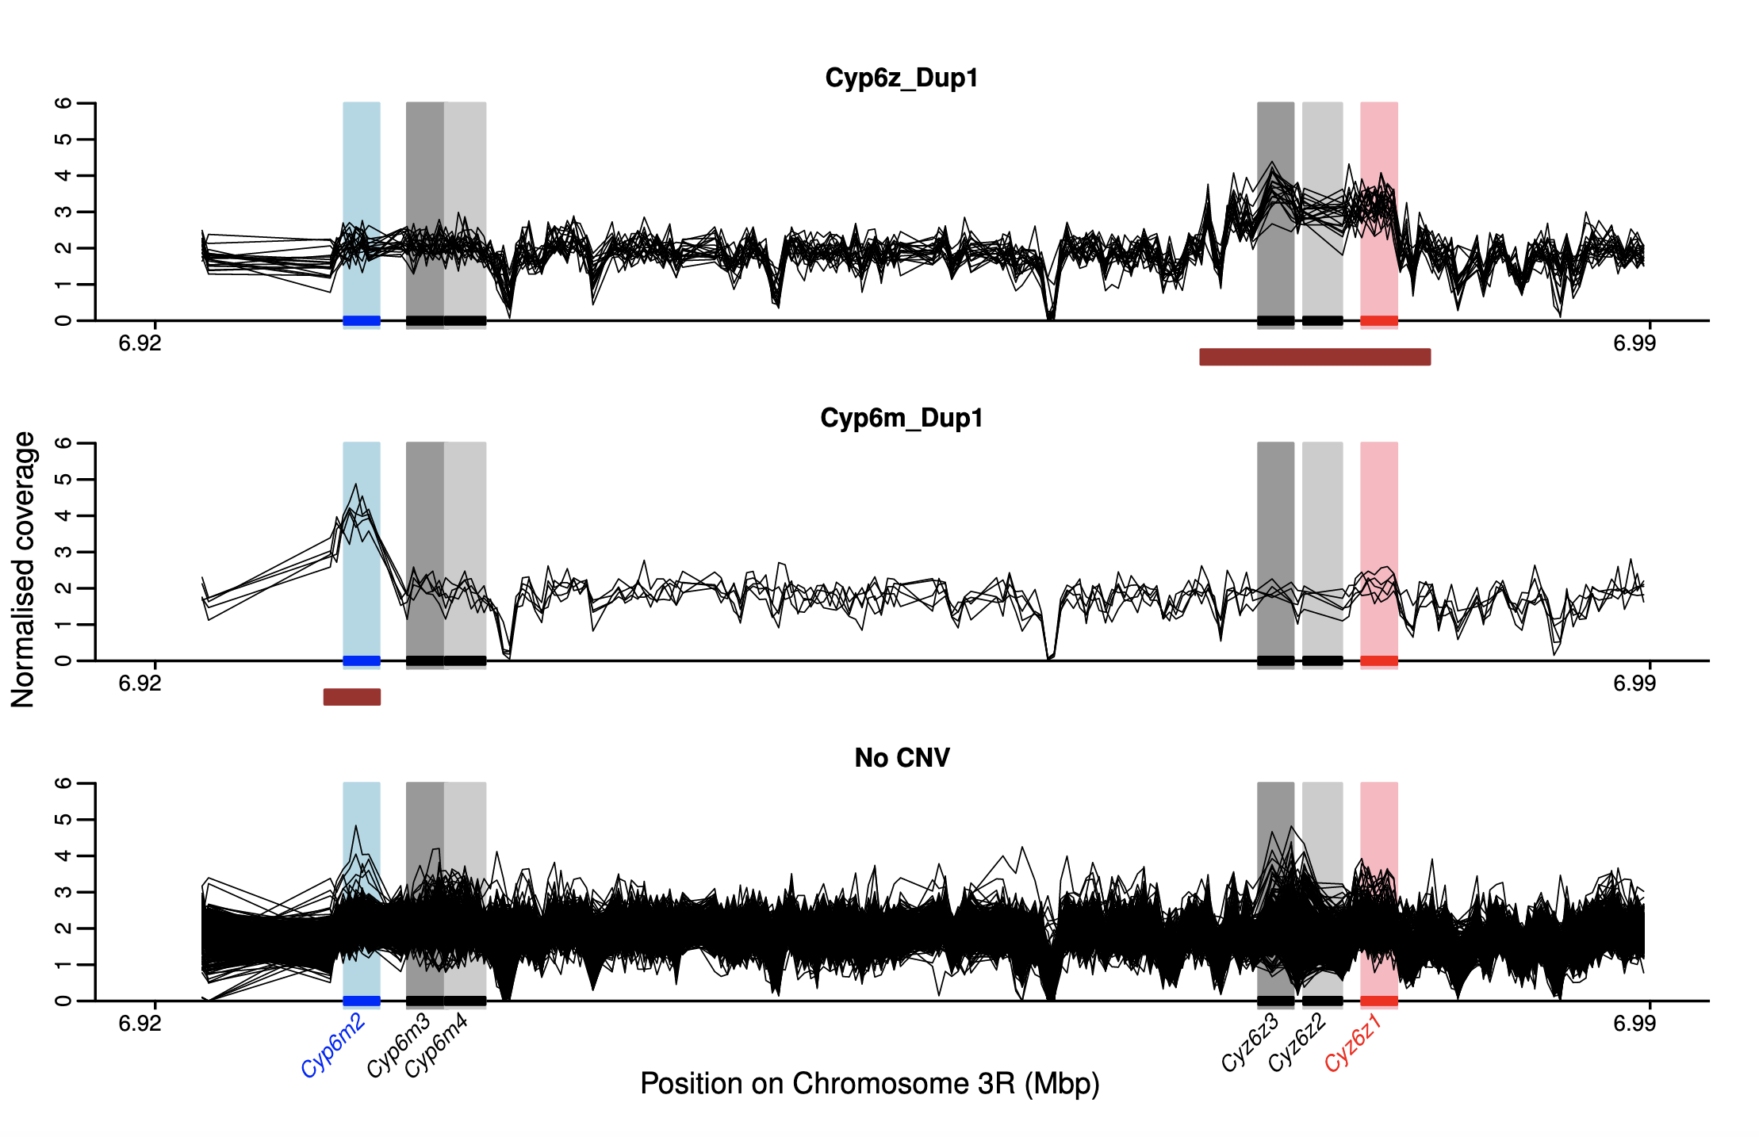
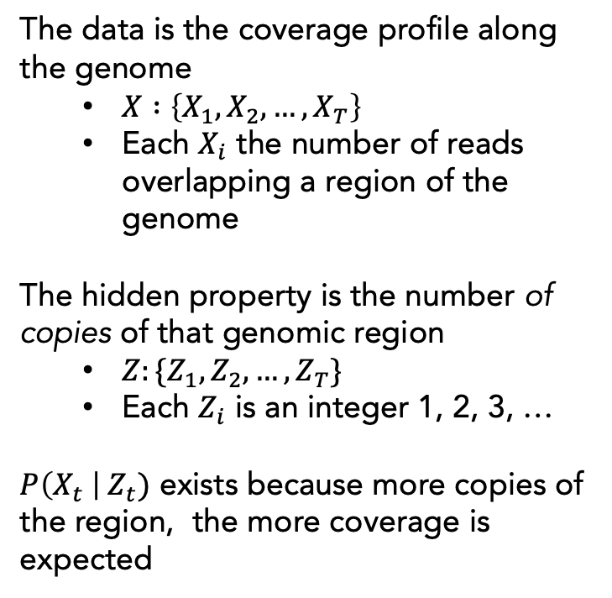
Inferring copy number variation from coverage
The data is the coverage profile along the genome
$X :\left\{X_{1},X_{2},…, X_{T}\right\}$
Each $X_{i}$ the number of reads overlapping a region of the genome
The hidden property is the number of copies of that genomic region
$Z:\{Z_{1},Z_{2},…, Z_{T}\}$
Each $Z_{i}$ is an integer 1, 2, 3, …
$P\left(X_{t} \right| Z_{t})$ exists because more copies of the region, the more coverage is expected
Lucas et al. (2019) Whole-genome sequencing reveals high complexity of … Genome Research
Notes:
- You believe or know this hidden property exists, and that it is influencing your data, but you don’t get to measure it directly; it is not part of the data you can collect

Slide 7
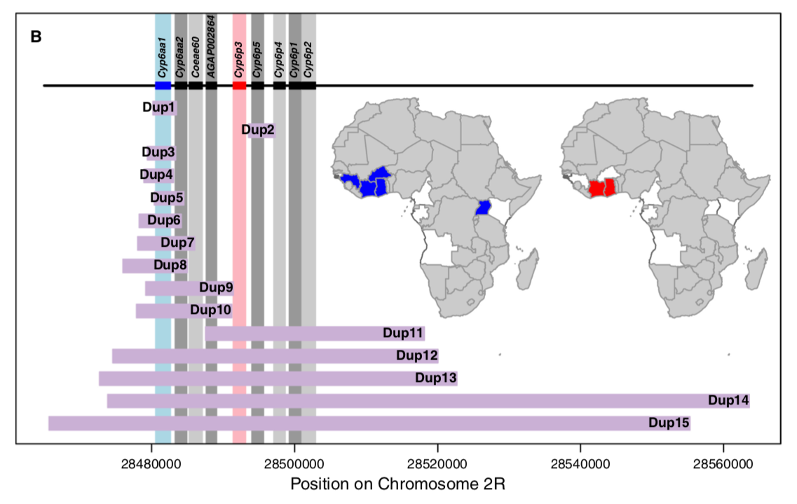
Inferring copy number variation from coverage
The data is the coverage profile along the genome
$X :\left\{X_{1},X_{2},…, X_{T}\right\}$
Each $X_{i}$ the number of reads overlapping a region of the genome
The hidden property is the number of copies of that genomic region
$Z:\{Z_{1},Z_{2},…, Z_{T}\}$
Each $Z_{i}$ is an integer 1, 2, 3, …
$P\left(X_{t} \right| Z_{t})$ exists because more copies of the region, the more coverage is expected
Lucas et al. (2019) Whole-genome sequencing reveals high complexity of … Genome Research
Notes:
- You believe or know this hidden property exists, and that it is influencing your data, but you don’t get to measure it directly; it is not part of the data you can collect

Slide 8
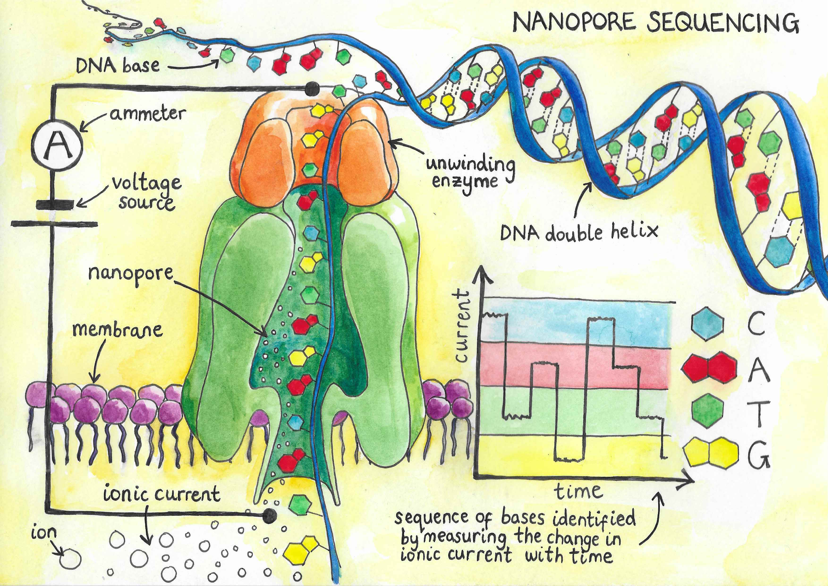
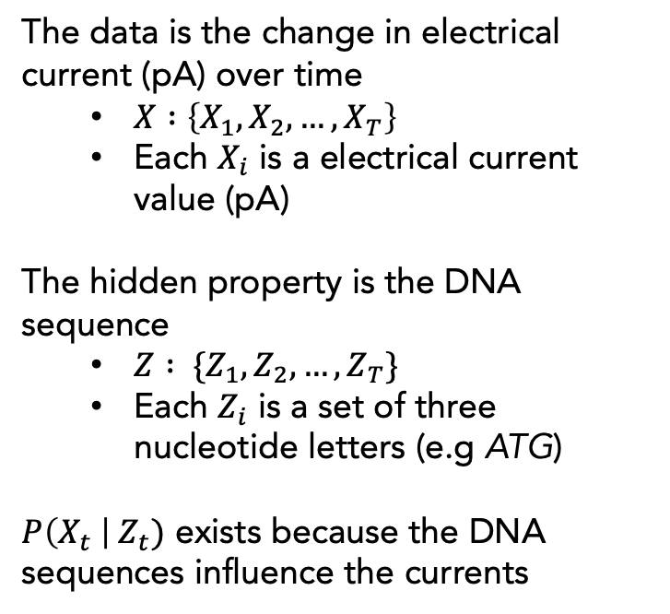
Inferring DNA sequence from electrical current data
The data is the change in electrical current (pA) over time
$X :\left\{X_{1},X_{2},…, X_{T}\right\}$
Each $X_{i}$ is a electrical current value (pA)
The hidden property is the DNA sequence
$Z : \{Z_{1},Z_{2},…, Z_{T}\}$
Each $Z_{i}$ is a set of three nucleotide letters (e.g ATG)
$P\left(X_{t} \right| Z_{t})$ exists because the DNA sequences influence the currents

Slide 9
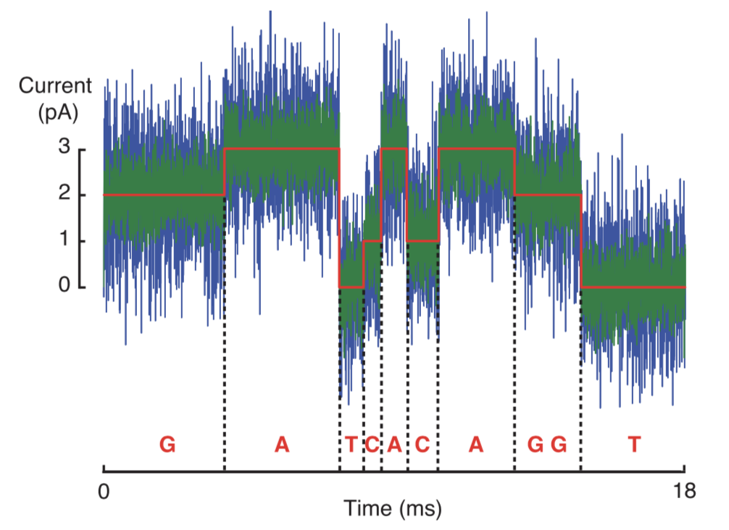
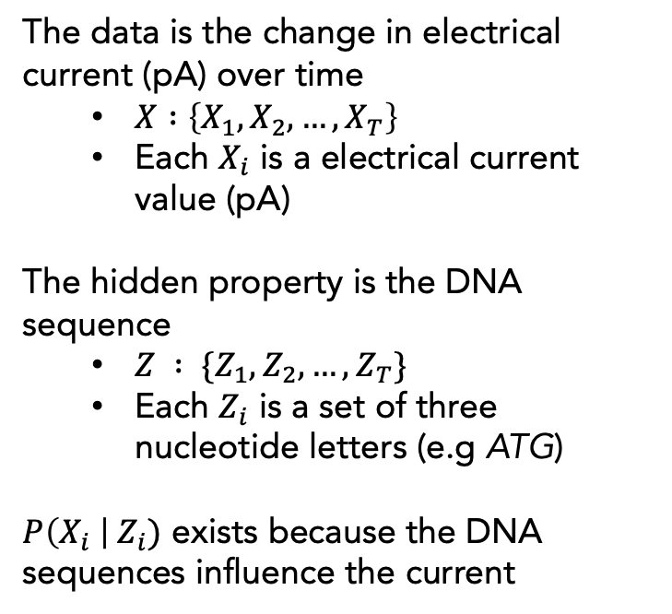
Inferring DNA sequence from current data
The data is the change in electrical current (pA) over time
$X :\left\{X_{1},X_{2},…, X_{T}\right\}$
Each $X_{i}$ is a electrical current value (pA)
The hidden property is the DNA sequence
$Z : \{Z_{1},Z_{2},…, Z_{T}\}$
Each $Z_{i}$ is a set of three nucleotide letters (e.g ATG)
$P\left(X_{i} \right| Z_{i})$ exists because the DNA sequences influence the current

Slide 10
HMM examples in genomics
Inferring CpG islands from DNA sequence data
Inferring copy number variation from coverage data
Inferring DNA sequence from current data in nanopore sequencing

Slide 11
HMM examples in genomics
Inferring CpG islands from DNA sequence data
Inferring copy number variation from coverage data
Inferring DNA sequence from current data in nanopore sequencing
Inferring the location of genes from DNA sequence data
Inferring relatedness between samples from DNA sequence data
Inferring phase from DNA sequence data
Inferring the best alignment from two DNA sequences
Inferring core features of a protein family from AA sequences
HMMs are ubiquitous in genomics

Slide 12

A more formal look at HMMs
Data $X :\{X_{1},X_{2},…, X_{T}\}$ where $X_{t}∈\left\{o_{1},o_{2}, …o_{m}\right\}$
Hidden states $Z :\{Z_{1},Z_{2},…, Z_{T}\}$ where $Z_{t}∈\left\{s_{1},s_{2}, …s_{m}\right\}$
The hidden states behave like a Markov Process
Notes:
- You believe or know this hidden property exists, and that it is influencing your data, but you don’t get to measure it directly; it is not part of the data you can collect

Slide 13


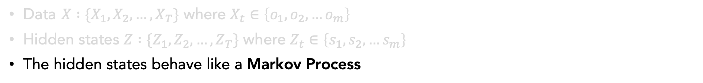


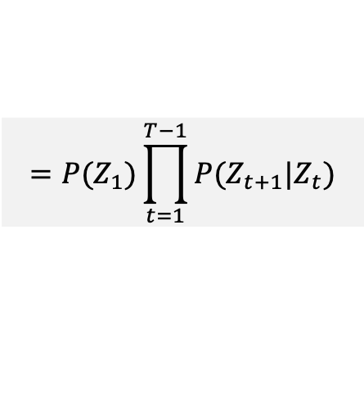







Markov Process Overview
Data $X :\{X_{1},X_{2},…, X_{T}\}$ where $X_{t}∈\left\{o_{1},o_{2}, …o_{m}\right\}$
Hidden states $Z :\{Z_{1},Z_{2},…, Z_{T}\}$ where $Z_{t}∈\left\{s_{1},s_{2}, …s_{m}\right\}$
The hidden states behave like a Markov Process
For any random sequence…
$$Z_{1}$$
$$Z_{2}$$
$$Z_{3}$$
…
$$Z_{T}$$
$$P\left(Z\right)=P\left(Z_{1}, Z_{2}, …Z_{T}\right)$$
$$=P\left(Z_{1})P\left(Z_{2} | Z_{1}\right)P(Z_{3}|Z_{2}, Z_{1}) …{P(Z}_{T}|Z_{T−1}, Z_{T−2}, …, Z_{1}\right)$$
The Markov Property
The future is independent of the past, if we know the present
All information about the past is capture by the present
The present is the “complete” state of the system
$$P(Z_{t+1}|Z_{t, }Z_{t−1},…,Z_{1})=P\left(Z_{t+1 }\right|Z_{t})$$
For a Markov Process…
$$P\left(Z\right)=P\left(Z_{1}, Z_{2}, …Z_{T}\right)$$
$$Z_{1}$$
$$Z_{2}$$
$$Z_{3}$$
…
$$Z_{T}$$
$$=P\left(Z_{1})P\left(Z_{2} | Z_{1}\right)P(Z_{3}|Z_{2}) …{P(Z}_{T}|Z_{T−1}\right)$$
$$=P(Z_{1})\prod_{t=1}^{T−1}{P(Z_{t+1}|Z_{t})}$$
Notes:
- You believe or know this hidden property exists, and that it is influencing your data, but you don’t get to measure it directly; it is not part of the data you can collect

Slide 14
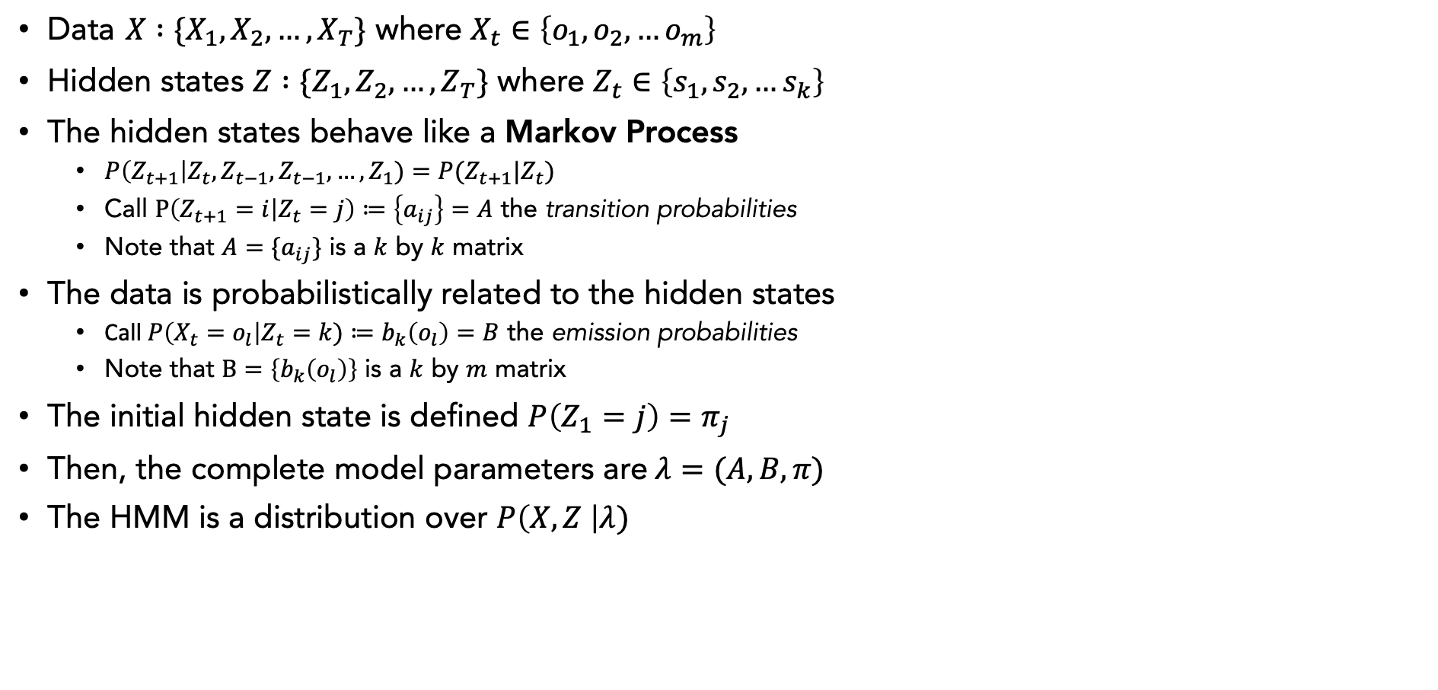
A more formal look at HMMs
Data $X :\{X_{1},X_{2},…, X_{T}\}$ where $X_{t}∈\left\{o_{1},o_{2}, …o_{m}\right\}$
Hidden states $Z :\{Z_{1},Z_{2},…, Z_{T}\}$ where $Z_{t}∈\left\{s_{1},s_{2}, …s_{k}\right\}$
The hidden states behave like a Markov Process
$P\left(Z_{t+1}\right|Z_{t},Z_{t−1},Z_{t−1},…,Z_{1})=P(Z_{t+1}|Z_{t})$
Call $P\left(Z_{t+1}=i | Z_{t}=j\right)≔\left\{a_{ij}\right\}=A$ the transition probabilities
Note that $A=\{a_{ij}\}$ is a $k$ by $k$ matrix
The data is probabilistically related to the hidden states
Call $P\left(X_{t}=o_{l}\right|Z_{t}=k)≔b_{k}\left(o_{l}\right)=B$ the emission probabilities
Note that $B=\left\{b_{k}\left(o_{l}\right)\right\}$ is a $k$ by $m$ matrix
The initial hidden state is defined $P\left(Z_{1}=j\right)=π_{j}$
Then, the complete model parameters are $λ=(A, B, π)$
The HMM is a distribution over $P\left(X, Z \right|λ)$
Notes:
- You believe or know this hidden property exists, and that it is influencing your data, but you don’t get to measure it directly; it is not part of the data you can collect

Slide 15

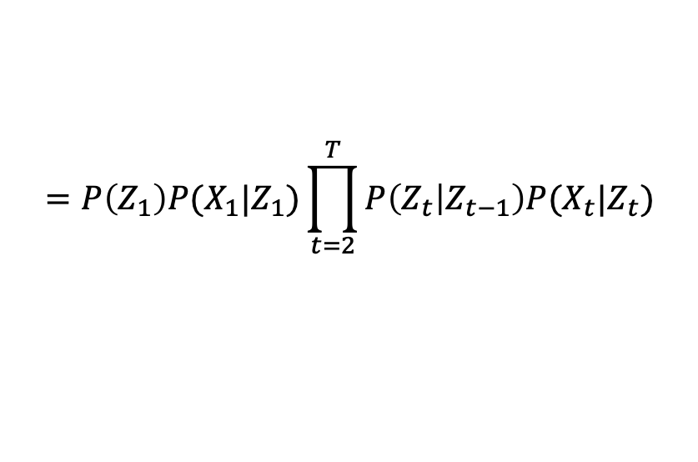









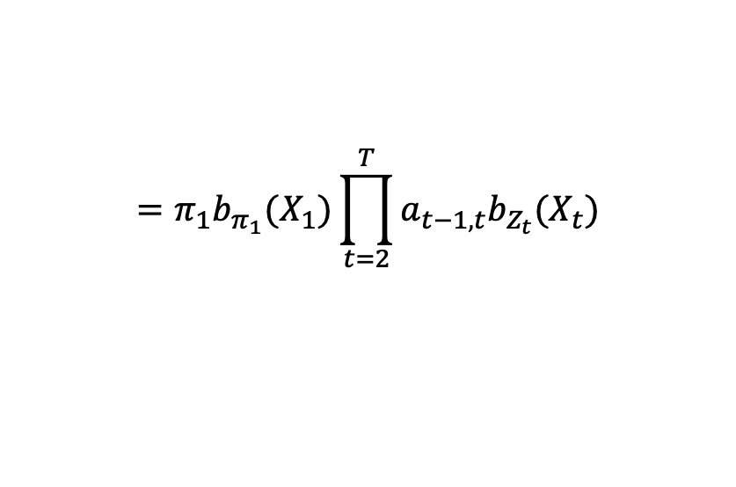
A more formal look at HMMs
The HMM is a distribution over $P\left(X, Z \right|λ)$
$$X_{1}$$
$$X_{2}$$
$$X_{3}$$
…
$$X_{T}$$
$$Z_{1}$$
$$Z_{2}$$
$$Z_{3}$$
…
$$Z_{T}$$
$P\left(X, Z \right|λ)=P(X_{1}, …, X_{T}, Z_{1},…,Z_{T}|λ)$
$$=P\left(Z_{1}\right)P(X_{1}|Z_{1})\prod_{t=2}^{T}{P\left(Z_{t} | Z_{t−1}\right)P(X_{t}|Z_{t})}$$
$$=π_{1}b_{π_{1}}(X_{1})\prod_{t=2}^{T}{a_{t−1,t}b_{Z_{t}}(X_{t})}$$
Notes:
- You believe or know this hidden property exists, and that it is influencing your data, but you don’t get to measure it directly; it is not part of the data you can collect

Slide 16
Whiteboard example
Notes:
- You believe or know this hidden property exists, and that it is influencing your data, but you don’t get to measure it directly; it is not part of the data you can collect

Slide 17












What kind of inferences can we make?
The HMM is a distribution over $P\left(X, Z \right|λ)$
$$X_{1}$$
$$X_{2}$$
$$X_{3}$$
…
$$X_{T}$$
$$Z_{1}$$
$$Z_{2}$$
$$Z_{3}$$
…
$$Z_{T}$$
Given $X$ and $λ$, what is the most likely $Z$?
$$Z^{∗}=\underset{Z}{argmax}{P\left(X,Z | λ\right)}$$
How?
$$Z^{∗}=\underset{Z}{argmax}{P\left(Z | X,λ\right)}$$
Brute force is super expensive: O(Tm^{T})
There is a recursive solution, called the Viterbi Algorithm
Notes:
- You believe or know this hidden property exists, and that it is influencing your data, but you don’t get to measure it directly; it is not part of the data you can collect

Slide 18




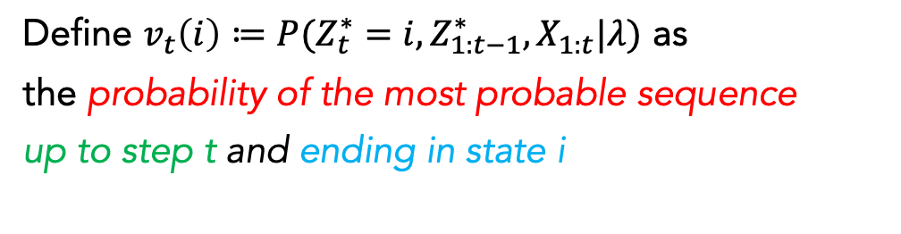



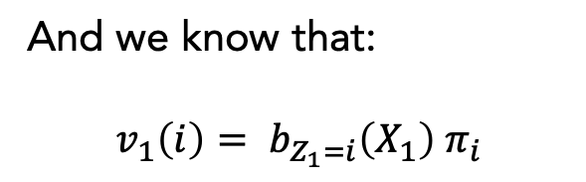




Recursion underlying the Viterbi Algorithm
$$Z^{∗}=\underset{Z}{argmax}{P\left(Z | X,λ\right)}$$
Define $v_{t}\left(i\right)≔P({Z_{t}^{∗}=i, Z}_{1:t−1}^{∗}, X_{1:t}|λ)$ as
the probability of the most probable sequence
up to step t and ending in state i
$$X_{1}$$
$$X_{2}$$
$$X_{3}$$
…
$$X_{T}$$
$$Z_{1}$$
$$Z_{2}$$
$$Z_{3}$$
…
$$Z_{T}$$
$v_{t}\left(i\right)$can be solved recursively
$$v_{t+1}\left(i\right)=b_{Z_{t+1}=i}\left(X_{t+1}\right)\max_{j}{{\{ a}_{ji}v_{t}\left(j\right) \}}$$
And we know that:
$$v_{1}\left(i\right)= b_{Z_{1}=i}\left(X_{1}\right) π_{i}$$
Notes:
- You believe or know this hidden property exists, and that it is influencing your data, but you don’t get to measure it directly; it is not part of the data you can collect

Slide 19





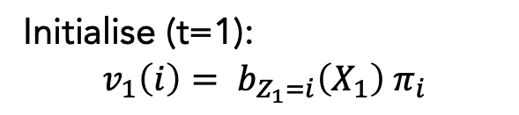
The Viterbi Algorithm
Initialise (t=1):
$$v_{1}\left(i\right)= b_{Z_{1}=i}\left(X_{1}\right) π_{i}$$
Recursion (t=1…T-1):
$$v_{t+1}\left(i\right)=b_{Z_{t+1}=i}\left(X_{t+1}\right)\max_{j}{{\{ a}_{ji}v_{t}\left(j\right) \}}$$
$${ptr}_{t+1}\left(i\right)=\underset{j}{argmax}{{\{ a}_{ji}v_{t}\left(j\right) \}}$$
Termination:
$$P\left(Z^{∗} | X,λ\right)= \max_{j}{\{ v_{T}\left(j\right) \}}$$
$$Z_{T}^{∗}= \underset{j}{argmax}{\{ v_{T}\left(j\right) \}}$$
Traceback (t=T-1…1):
$${Z_{t}^{∗}=ptr}_{t+1}\left(Z_{t+1}^{∗}\right)$$
Notes:
- You believe or know this hidden property exists, and that it is influencing your data, but you don’t get to measure it directly; it is not part of the data you can collect

Slide 20
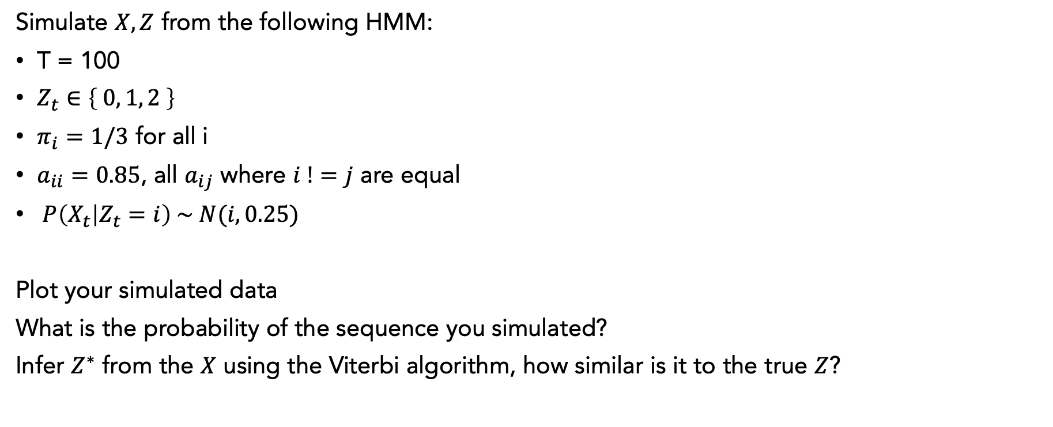
Coding challenge
Simulate $X,Z$ from the following HMM:
T = 100
$Z_{t}∈\left\{ 0, 1, 2 \right\}$
$π_{i}=1/3$ for all i
$a_{ii}=0.85$, all $a_{ij}$ where $i !=j$ are equal
$P\left(X_{t} | Z_{t}=i\right) \sim N(i, 0.25)$
Plot your simulated data
What is the probability of the sequence you simulated?
Infer $Z^{∗}$ from the $X$ using the Viterbi algorithm, how similar is it to the true $Z$?

Slide 21




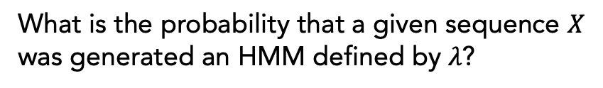
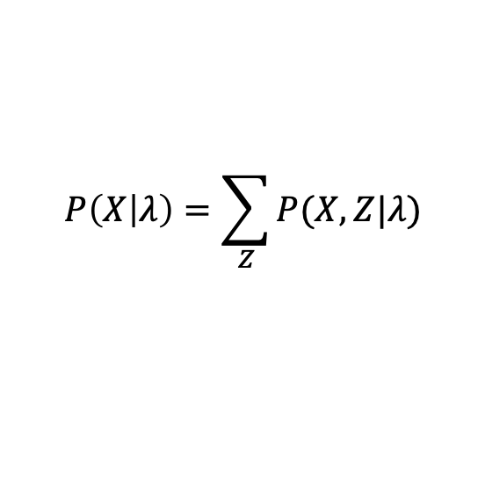
What kind of inferences can we make?
The HMM is a distribution over $P\left(X, Z \right|λ)$
$$X_{1}$$
$$X_{2}$$
$$X_{3}$$
…
$$X_{T}$$
$$Z_{1}$$
$$Z_{2}$$
$$Z_{3}$$
…
$$Z_{T}$$
Given $X$ and $λ$, what is the most likely $Z$?
$$Z^{∗}=\underset{Z}{argmax}{P\left(Z | X,λ\right)}$$
Viterbi Algorithm
What is the probability that a given sequence $X$ was generated an HMM defined by $λ$?
$$P\left(X | λ\right)=\sum_{Z}{P(X,Z|λ)}$$
Forward Algorithm
What is the probability that the hidden state at position $t$ is $i$ given $X$ and $λ$?
$$P\left(Z_{t}=i \right|X, λ)$$
Forward-backward Algorithm
Notes:
- You believe or know this hidden property exists, and that it is influencing your data, but you don’t get to measure it directly; it is not part of the data you can collect

