Slide 1

Exploratory Data Analysis
G2M Investment Study
07/20/2022
by: Kiarash Rastegar

Slide 2
Background
Overview:
XYZ investment firm are looking to invest in the cab industry due to its growing market in the past few years
As part of their Go-to-Market strategy they are looking to understand the market before they make their investment
There are two cab companies that seem promising:
Yellow Cab
Pink Cab
Problem Statement:
To make an educated decision on which company to invest in, we need to investigate a few aspects of the market such as:
Profit per Ride
Profit per City
Number of Rides
Age and Gender Demographic

Slide 3
Data Exploration
Data Features:
Features that we will be focusing on are:
19 different cities around the USA
Gender
Age Group
Profit
Amount of Transactions/ # of Rides
Time Frame (01/1/2016-12/31/2018)
Rides on Holidays
Assumptions:
We are assuming that the outlier data points will not have a significant effect on overall trends and therefore were removed
The average profits per ride show the same trends as the overall sum for each year and/or quarter

Slide 4
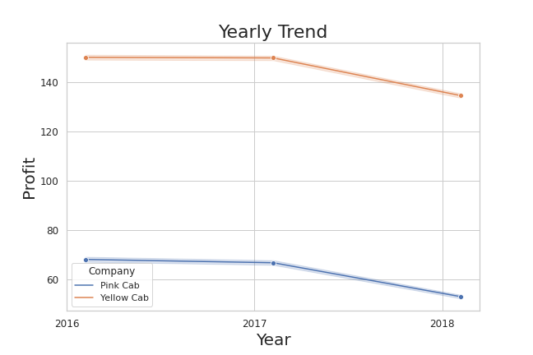
Data Analysis
We begin by looking at the overall trends of both companies from the past few years
Comparing the two companies, we see that yellow cab has >2x average profit per ride than pink cab

Slide 5
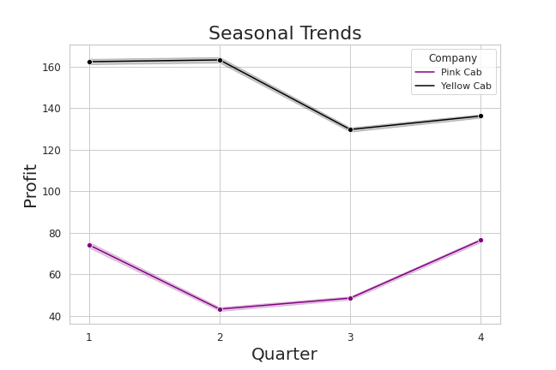
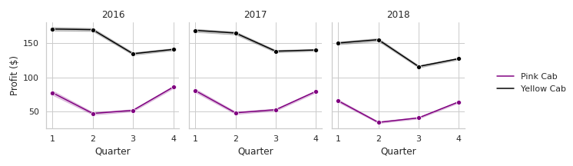
Data Analysis
We see that the yellow cab company averages more profit across all 4 quarters
To investigate further, we look at the seasonal trends each year to

Slide 6
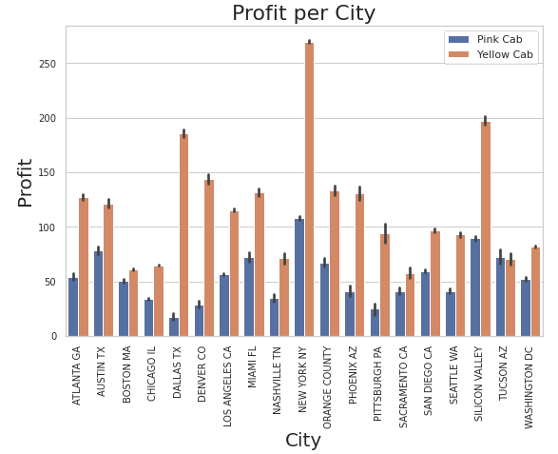
Data Analysis
Looking at the profit margin for both companies in each city across the USA.
We see that the Yellow Cab company beats out Pink Cab company in almost every city

Slide 7
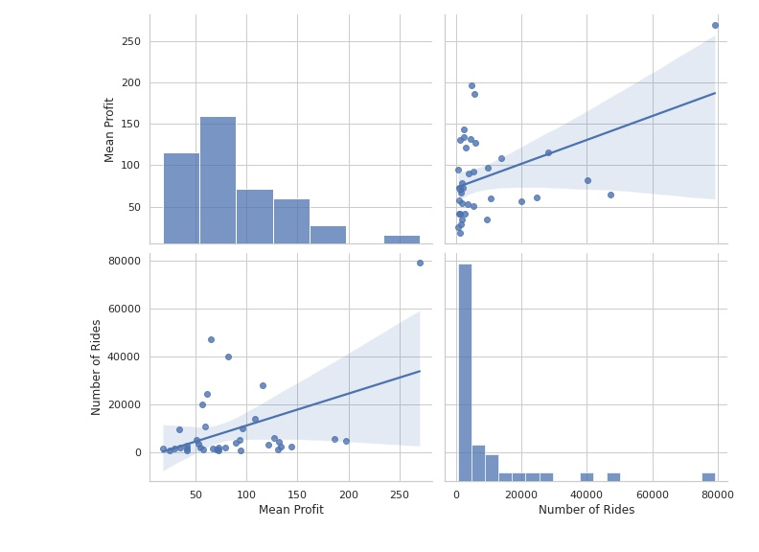
Data Analysis
Next we are going to check our assumption that the number of cab rides correlates with higher mean profit
As we can see from the correlation plot we do see a slight trend between number of cab rides and mean profit

Slide 8
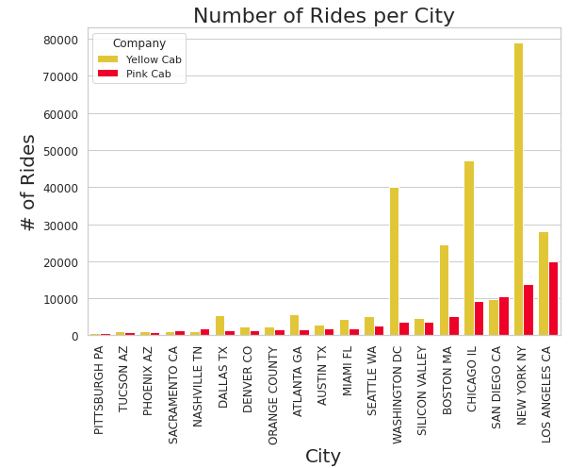
Data Analysis
Looking at the amount of transactions from both companies we see that in most cities the Yellow Cab has more rides.
Surprisingly there are a lot of cities were both companies have similar amount of transactions. Suggesting that the profit margins for Yellow Cab company are higher.

Slide 9
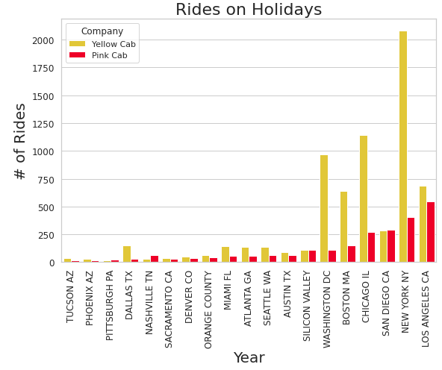
Data Analysis
The next thing we looked at our the number of rides from both companies during the holidays
Again we see the same trend we saw in the previous slide. The Yellow Cab company have more rides during the holidays in most cities.

Slide 10
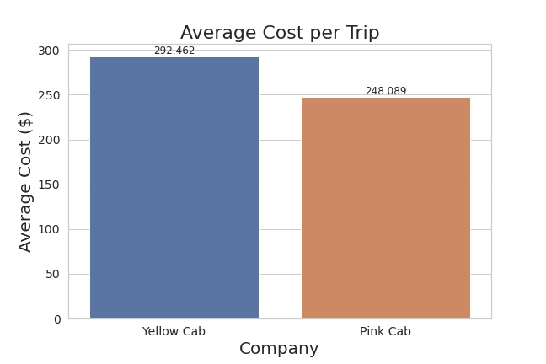
Data Analysis
Taking a deeper look at the average cost of each trip
We see that Yellow cab charges around $50 more for each trip than Pink Cab

Slide 11
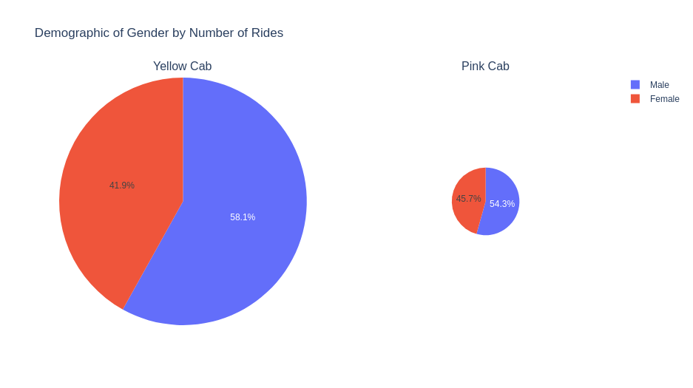
Data Analysis
Finally we end up looking at the demographic of each company. We will start with Gender
The size of the pie charts are directly proportional to the number of rides between the two companies
We see that both companies have close to a 60/40 split between male and female clients

Slide 12
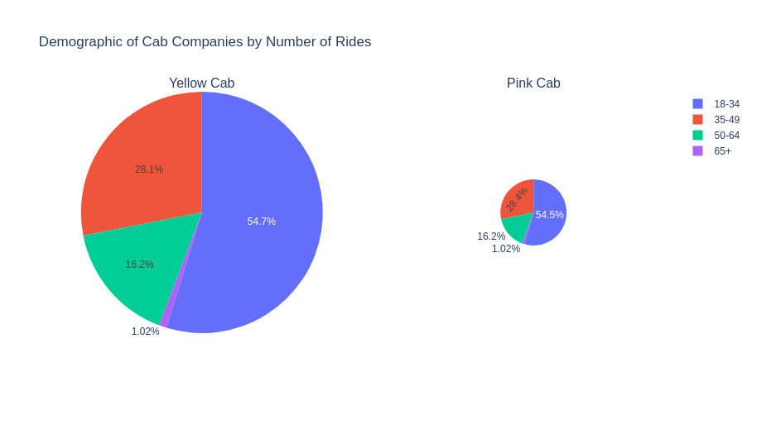
Data Analysis
Looking at the distribution of age groups for both companies we see that both companies have almost identical composition of clientele
Both companies largest clientele are from the 18-34 age group.

Slide 13
Recommendations
After investigating both companies on multiple aspects, we have come to the conclusion that the Yellow Cab company would be the best choice for investment based on the following observations.
Yearly Trend: Yellow Cab has earned over 2x the amount of profits than Pink Cab for the past 3 years
Profit vs Cities: Yellow Cab earns more profit than Pink Cab in almost every major city in the US
Number of Rides: Yellow Cab has more or the same amount of transactions in almost every city. They also have more rides during the holidays in almost all of the cities
Average Cost: Yellow Cab still makes more money in the cities where they have the same number of transactions, due to its higher average cost per transaction
Demographic: Yellow Cab reaches all the same demographics as Pink Cab
Based on these observations we recommend that XYZ invests in Yellow Cab

Slide 14
Thank You

