Slide 1
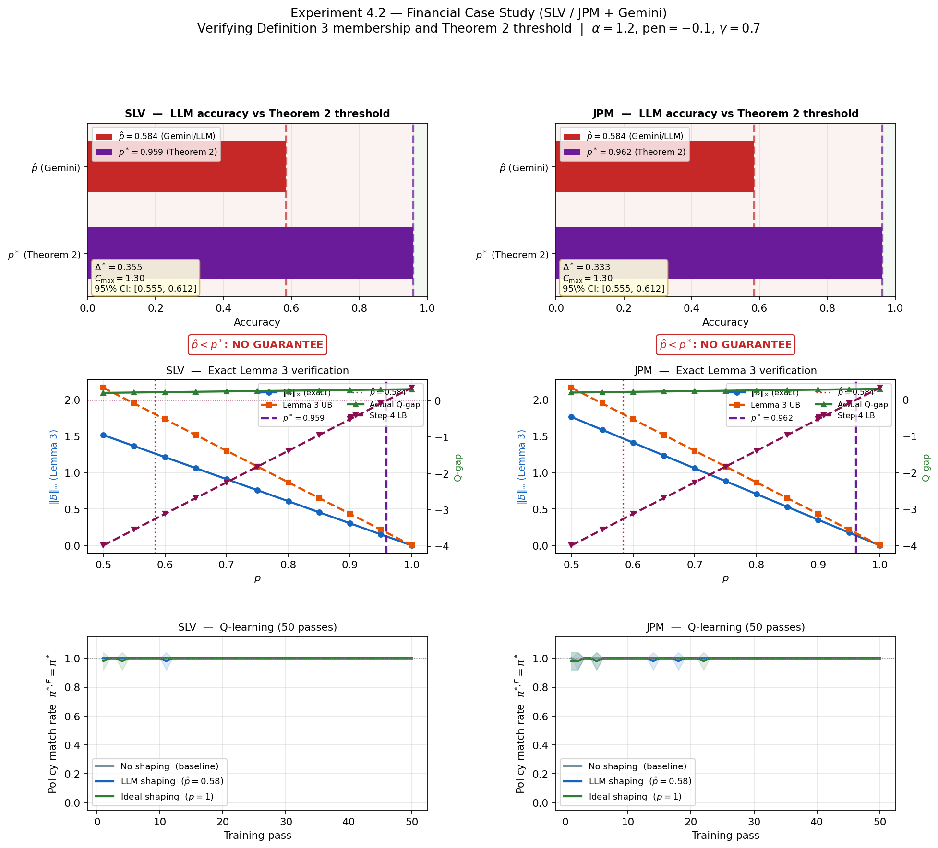
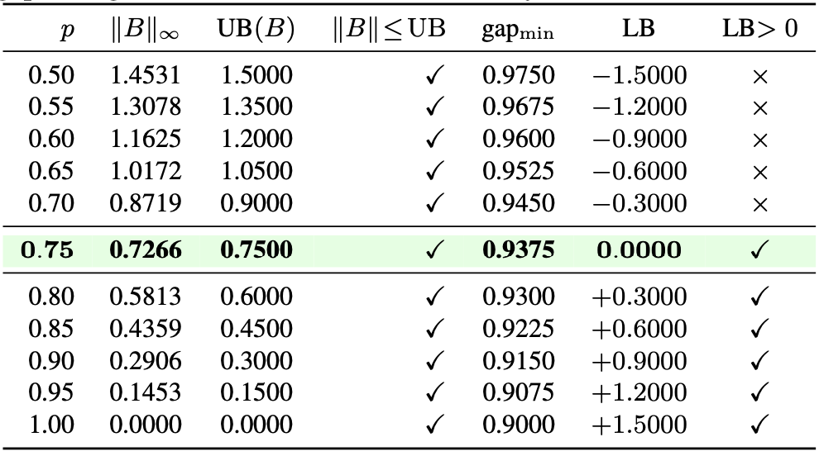
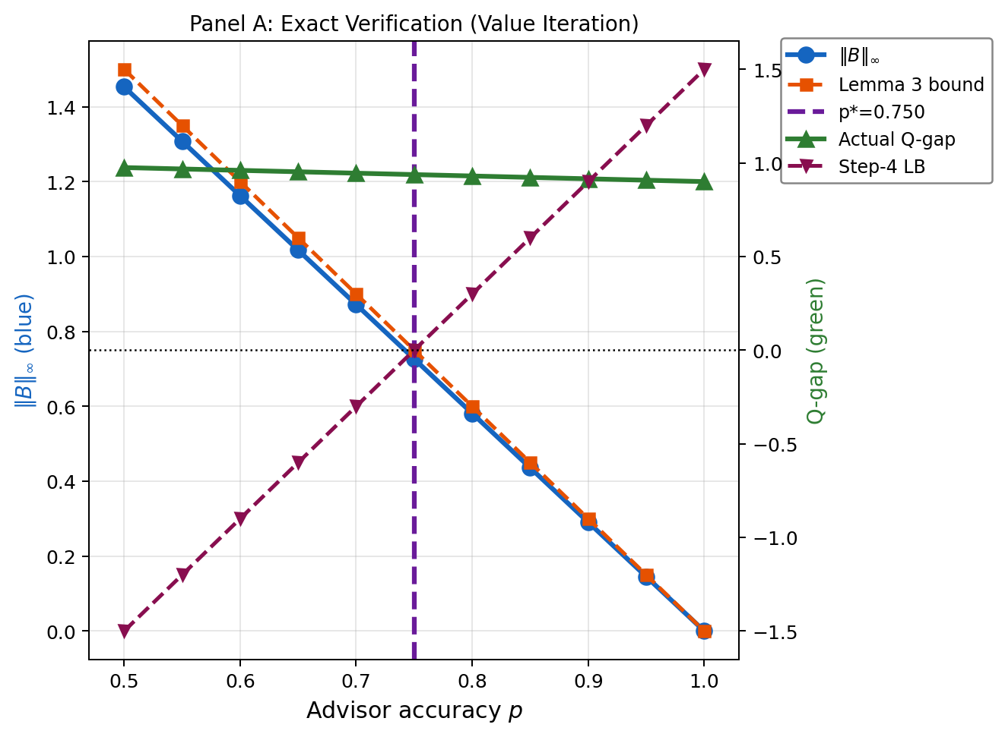
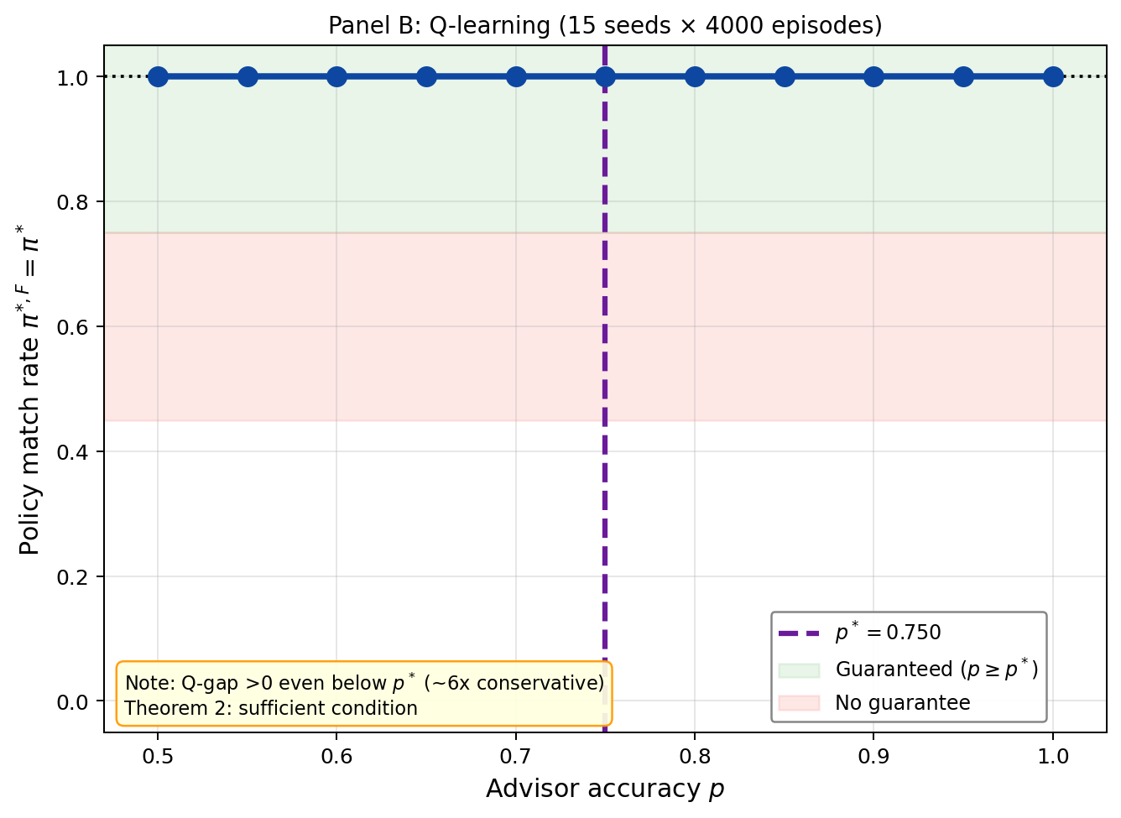
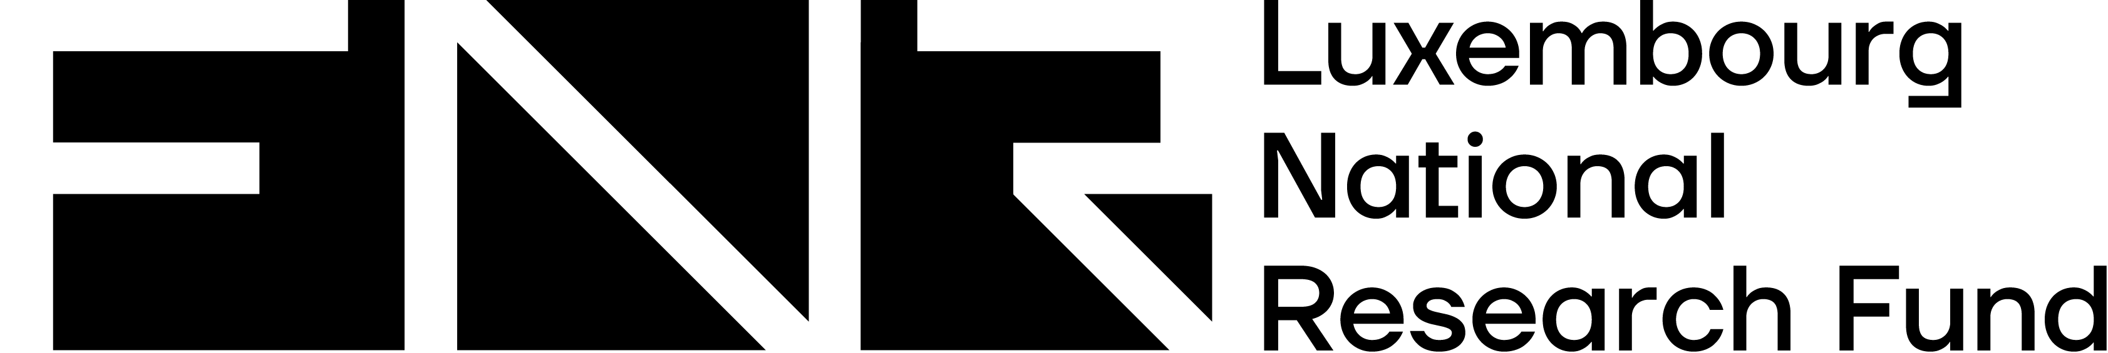
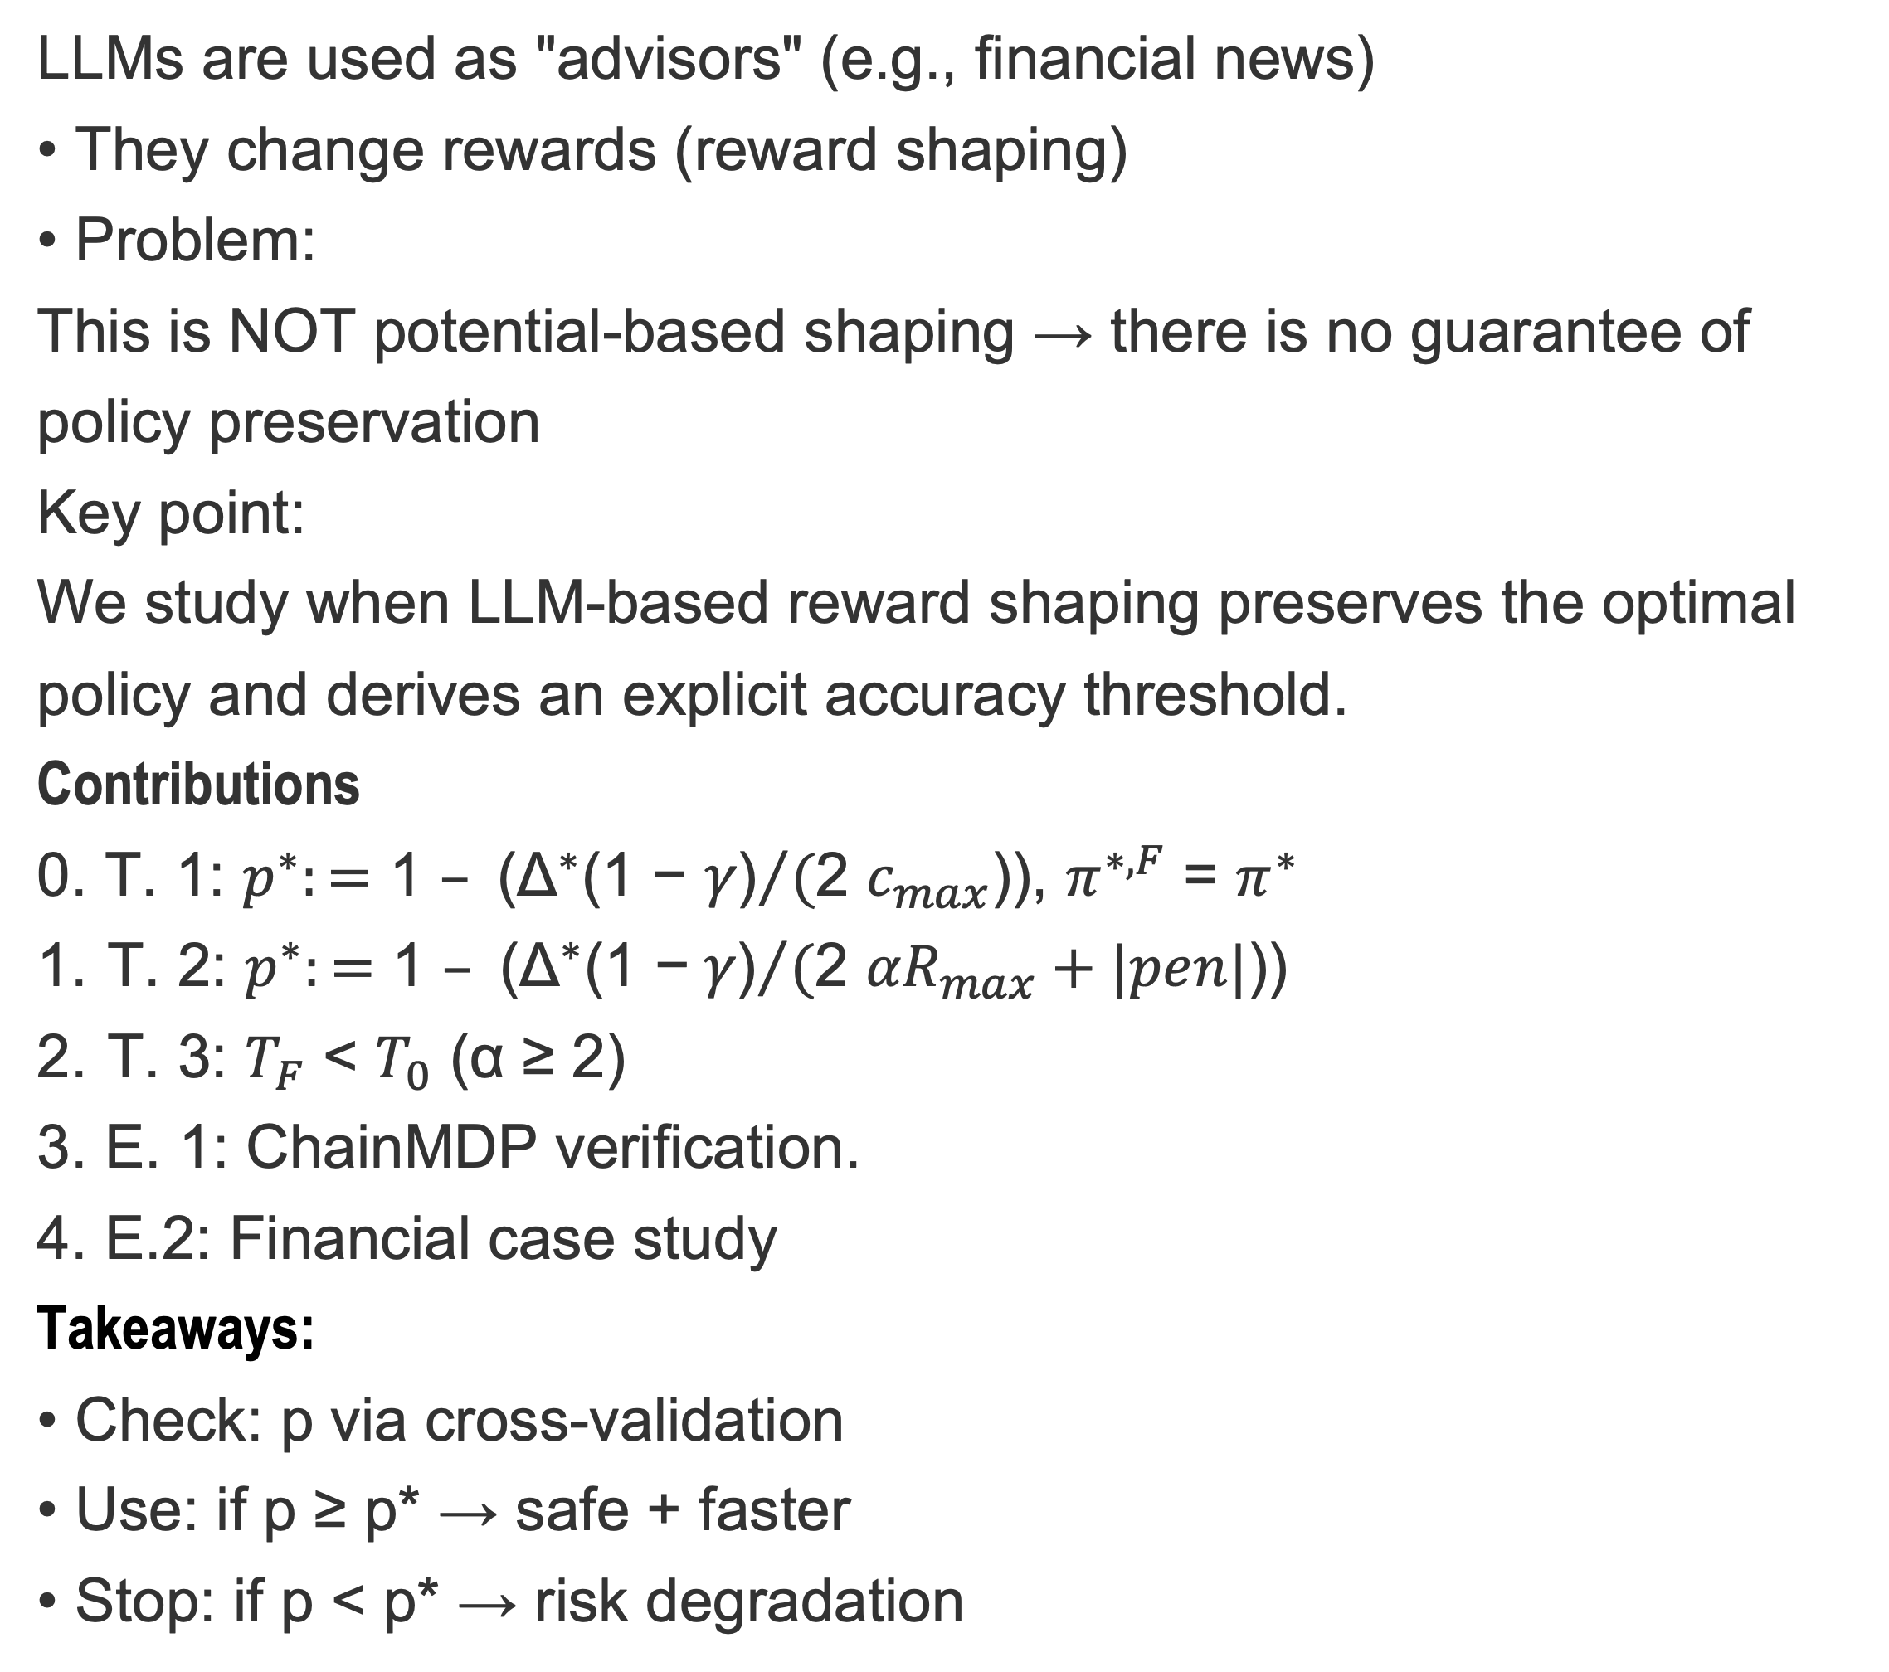
When Does LLM-Based Reward Shaping Preserve Optimal Policy?
Aleksandr Koviazin
Radu State
Services and Data Management (SEDAN)
Problem: LLM Shaping
LLMs are used as "advisors" (e.g., financial news)
• They change rewards (reward shaping)
• Problem:
This is NOT potential-based shaping → there is no guarantee of policy preservation
Key point:
We study when LLM-based reward shaping preserves the optimal policy and derives an explicit accuracy threshold.
Contributions
0. T. 1: ${p^{∗}:=\text{1 }– \text{(}{\text{Δ}}^{∗}\text{(1} \text{−} γ\text{)}}/($2 $c_{max}$)), $π^{∗, F}$ = $π^{∗}$
T. 2: ${p^{∗}:=\text{1 }– \text{(}{\text{Δ}}^{∗}\text{(1} \text{−} γ\text{)}}/($2 ${αR}_{max}+|pen|$))
T. 3: $T_{F}$ < $T_{0}$ (α ≥ 2)
3. E. 1: ChainMDP verification.
4. E.2: Financial case study
Takeaways:
• Check: p via cross-validation
• Use: if p ≥ p* → safe + faster
• Stop: if p < p* → risk degradation
LLM-based shaping preserves the optimal policy if and only if the advisor accuracy exceeds a critical threshold p*.
The threshold depends on reward scale, shaping strength, and optimality gap.
Critical accuracy threshold
Shaping strength
Faster convergence
Theory
Main result
Convergence
LLM-shaping is not PBRS
Error policy invariance ε(p)
Introduction to optimality gap Δ*
$$p^{∗}:=1 − \frac{{\text{Δ}}^{∗}\text{(1−}γ\text{)}}{\text{2} {αR}_{max}+|pen|}$$
Shaping increases gap
• noise is limited
• SNR increases
For α ≥ 2, shaping improves signal-to-noise ratio and accelerates learning.
↑ α - need more accurate LLM
↑ Δ* - a less precise LLM is possible
In collaboration with
Supported by the Luxembourg National Research Fund (FNR) (https://github.com/krastykovyaz/llm_shaping_eval.git)

