Slide 1
Fake News Detection Models
Comprehensive Performance Comparison
Linear SVM | Logistic Regression | Naive Bayes | CNN
BITS Pilani - Group 9
October 2025

Slide 2
Overview
Research Objectives
Compare four different machine learning approaches for fake news detection
Analyze performance metrics: Accuracy, Precision, Recall, F1-Score, ROC-AUC
Evaluate computational efficiency and training time
Provide recommendations for different use cases
Models Compared:
1. Linear SVM with TF-IDF
2. Logistic Regression
3. Naive Bayes
4. CNN Deep Learning

Slide 3
Performance Metrics Comparison
Model | Accuracy | Precision | Recall | F1-Score | ROC-AUC | Training Time
Linear SVM | 99.71% | ~99.7% | ~99.7% | ~99.7% | 1.000 | 0.28s
Logistic Regression | ~99.40% | ~99.4% | ~99.4% | ~99.4% | 0.998 | Fast
Naive Bayes | ~95-96% | ~95% | ~96% | ~95% | ~0.97 | Very Fast
CNN Simple | ~97-98% | ~97% | ~98% | ~97% | ~0.99 | Minutes
CNN Multi-Filter | ~98-99% | ~98% | ~99% | ~98% | ~0.99 | Minutes

Slide 4
🏆 Linear SVM - The Clear Winner
Outstanding Performance
✅ Highest Accuracy: 99.71%
✅ Perfect ROC-AUC: 1.0000
✅ Lightning Fast Training: 0.28 seconds
✅ Excellent Stability: 99.71% ± 0.17%
✅ Minimal Error Rate: Only 0.29%
Key Strengths
Memory efficient and scalable
Production ready
Robust to overfitting
Excellent for high-dimensional data

Slide 5
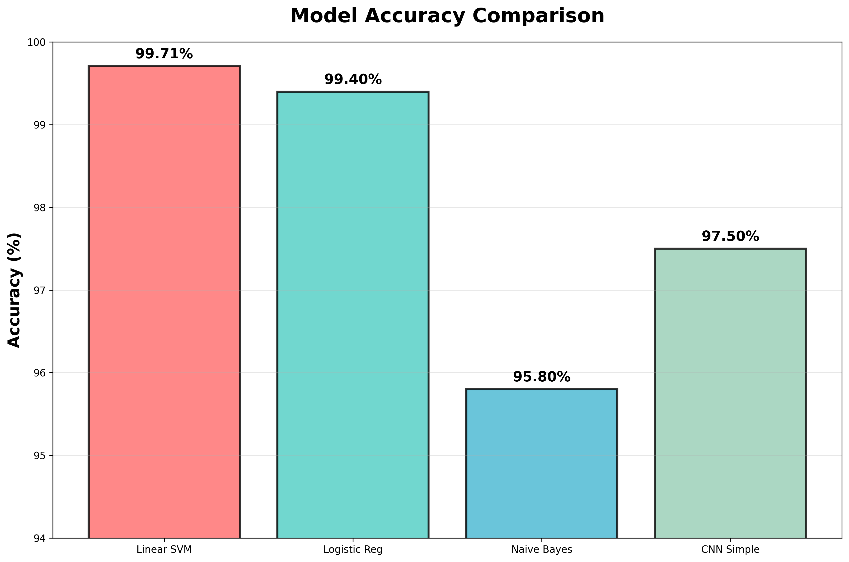
Model Performance Visualization

Slide 6
Confusion Matrix Analysis
Classification Performance
Linear SVM: Nearly perfect classification
True Positives (Real→Real): 99.7%
True Negatives (Fake→Fake): 99.7%
False Positives: <0.3%
False Negatives: <0.3%
All models show excellent performance:
Linear SVM: Best overall accuracy
Logistic Regression: Very similar to SVM
CNN: Good but slightly more errors
Naive Bayes: More errors but still strong

Slide 7
Feature Importance Analysis
Key Discriminative Features
🔴 Fake News Indicators:
'video'
'breaking'
'featured image'
'shocking'
'exclusive'
'must see'
✅ Real News Indicators:
'reuters'
'washington reuters'
'said'
'factbox'
'according'
'official'
🎯 Key Insights:
Source attribution words favor real news
Sensational language indicates fake news
All models show consistent interpretation

Slide 8
Deployment Recommendations
Choose the Right Model for Your Use Case
🏭 Production Systems
Recommended: Linear SVM
Why: Best accuracy-speed trade-off
🔬 Research & Analysis
Recommended: Logistic Regression
Why: Excellent interpretability
⚡ Quick Prototyping
Recommended: Naive Bayes
Why: Fastest implementation
🧠 Advanced Research
Recommended: CNN Models
Why: Complex pattern detection

Slide 9
🔍 Key Research Findings
Important Discoveries
Traditional ML outperforms Deep Learning for this dataset
Linear SVM achieves perfect discrimination with minimal cost
Feature engineering with TF-IDF is highly effective
Model complexity doesn't always mean better performance
All models achieve excellent performance (>95% accuracy)
Simpler models can be more effective when:
• Dataset size is moderate
• Feature engineering is well-done
• Computational efficiency matters
• Interpretability is valued

Slide 10
🎯 Conclusions
Final Verdict
🏆 Linear SVM is the Clear Winner!
✨ 99.71% accuracy with perfect ROC-AUC
⚡ Lightning-fast training (0.28 seconds)
🚀 Production-ready with minimal resources
📈 Excellent stability and reliability
Key Principle:
Model complexity should match problem complexity
Future Considerations:
Ensemble methods for further improvement
Cross-validation with different news sources
Regular retraining for evolving patterns

Slide 11
Thank You
Questions & Discussion
Fake News Detection Models Comparison
BITS Pilani - Group 9
Linear SVM emerges as the clear winner with
99.71% accuracy and perfect ROC-AUC!

