Slide 1
Sales & Profit Analysis Dashboard Report
Power BI Insights | Prepared for Stakeholders
By : Krati Chourasia

Slide 2
Introduction & Objectives
Identify top-performing products
Evaluate regional sales performance
Understand customer demographics
Analyze sales trends for the past 12 months
Provide actionable business recommendations

Slide 3
Dataset Overview
- Sales Data: Orders, Revenue, Profit, Quantity
- Products Data: Categories, Cost, Unit Prices
- Customers Data: Age, Gender, Demographics
- Regional Data: Sales by Location

Slide 4
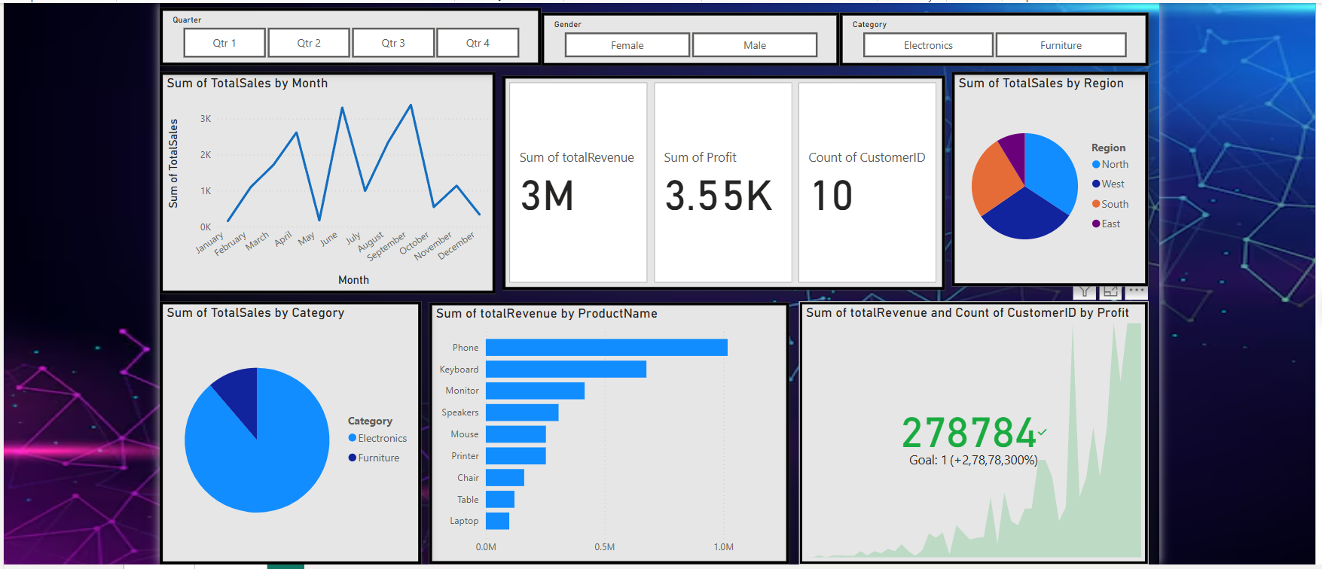
Sales Analysis Dashboard:

Slide 5
Sales Trend Analysis (Last 12 Months)
Identify peak and low sales periods.
Seasonal trends and fluctuations.
Insights for better inventory planning and promotions.

Slide 6
Top 10 Products by Revenue
- Highlight best-performing products.
- Compare revenue contribution per product.
- Strategy to focus on high-selling items.

Slide 7
Sales Distribution by Product Category
- Compare sales share across product categories.
- Identify underperforming categories for improvement.
- Diversify marketing efforts based on insights.

Slide 8
Regional Sales Performance (Map View)
- Visual representation of sales by geography.
- Identify strong and weak sales regions
- Improve logistics and targeted marketing

Slide 9
Customer Demographics Insights
- Analyze age group distribution
- Gender-wise purchase behavior
- Understand target audience for better engagement

Slide 10
Key Findings & Business Recommendations
- Focus on top-performing products
- Increase marketing in low-sales regions
- Adjust pricing strategies for better margins
- Optimize inventory based on seasonal trends
- Improve customer engagement with targeted promotions

Slide 11
Conclusion & Next Steps
- Summarize key insights from analysis
- Implement suggested strategies for improvement
- Continuously monitor sales trends in Power BI
- Share report with stakeholders for informed decision-making

