Slide 1
HR Analytics Dashboard Report – Power BI Implementation
Analyzing Employee Performance, Attrition, and Recruitment Trends
By : Krati Chourasia

Slide 2
Objective:
To analyze HR data for better workforce management.
To track employee attrition trends, performance analysis, and recruitment statistics.
To provide insights that help HR teams make data-driven decisions.
Key Focus Areas:
Employee performance ratings.
Attrition rates over time.
Department-wise recruitment analysis.

Slide 3
Project Requirements:
Datasets Used:
Employees Data: Employee ID, Name, Department, Role, Hire Date, Performance Rating, Gender, Age.
Recruitment Data: Applications Received, Offers Made, Department.
Attrition Data: Resigned Employees, Termination Dates, Reason for Attrition.
Tools Used:
Power BI for visualization.
DAX (Data Analysis Expressions) for calculations.
Power BI Service for sharing insights and setting alerts.

Slide 4
Key Challenges:
Data Cleaning:
Handling missing values in employee tenure.
Removing duplicate records in recruitment data.
Data Integration:
Creating relationships between Employees, Departments, and Recruitment Tables.
Attrition Rate Calculation:
Identifying the right formula to measure employee turnover.
Filtering Data Dynamically:
Using slicers for Department, Job Role, and Hire Date.

Slide 5
Key Dashboard Features:
Card Visuals:
Displays Total Employees, Attrition Rate, and New Hires.
Slicers: Filters by Department, Job Role, and Quarter.
Line Chart: Shows Attrition Rate over the past 5 years.
Bar Chart: Compares Recruitment Trends by Department.
Matrix Table: Shows department-wise performance ratings.
Pie Chart: Represents gender diversity across the organization.
Key Metrics Calculated Using DAX:
Attrition Rate = (Total Employees Left / Total Employees) × 100
Average Tenure = SUM(Tenure) / COUNT(Employees)
Recruitment Success Rate = (Total Offers Made / Applications Received) × 100

Slide 6
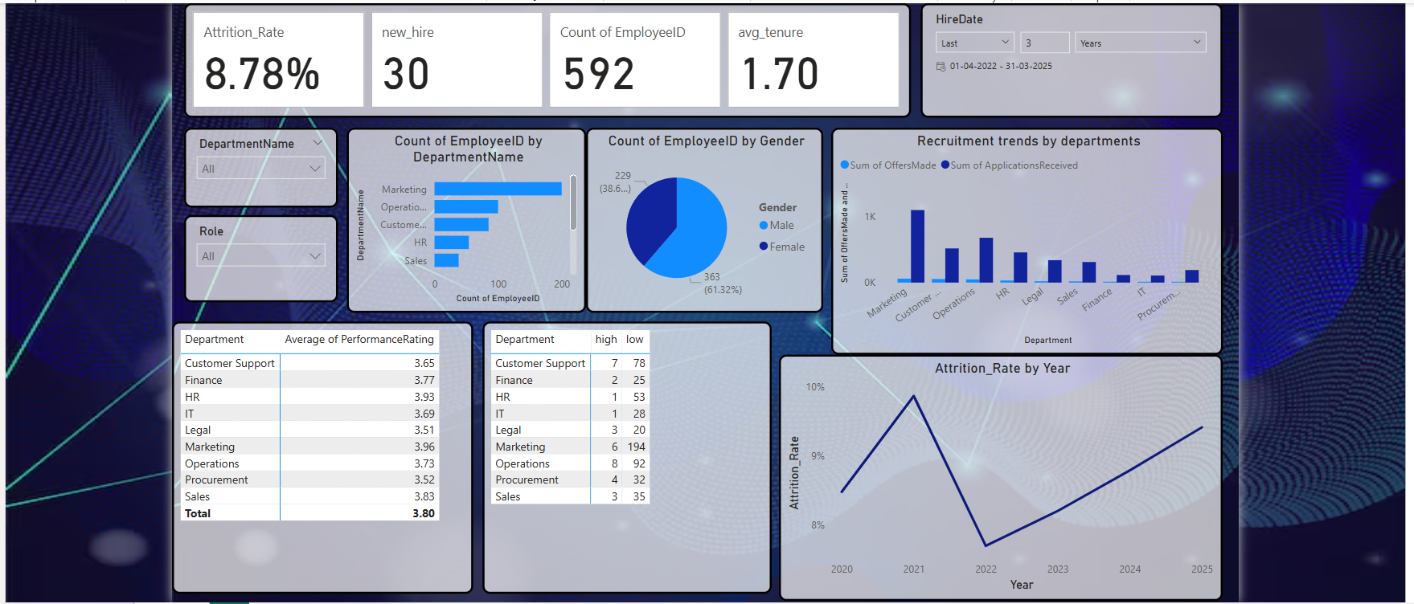
HR Analytics Dashboard

Slide 7
HR Strategy Recommendations:
Improve Retention Strategies:
  High attrition departments need engagement programs.
  Focus on career growth opportunities.
Optimize Hiring Process:
  Increase offer rates for high-demand departments.
Gender Diversity Initiatives:
  Encourage more female hiring in Operations & Sales.
Performance Management:
  Upskilling programs for Operations employees.

Slide 8
Conclusion & Next Move :
Key Takeaways:
  Attrition Rate is fluctuating, requiring better employee retention policies.
  Marketing & Sales have high performance but high hiring needs.
  Operations needs better workforce planning.
Future Improvements:
  Predictive Analytics: Forecast attrition based on employee history.
  AI-Based Insights: Automated recommendations for HR.
  Deeper Employee Segmentation: By age, experience, and location.

