Slide 1
NIDIS NOAA PREDICTING WILDFIRE AND THEIR EFFECTS ON COUNTIES IN NEW ENGLAND
Ting-Hsuan Chen, Risheng Guo, Kratik Gupta, Jiazhi Jia, Maria Stella Vardanega

Slide 2
TOPICS
01
02
03
PROBLEM STATEMENT
EDA
DEVELOPING MODELS
Background, Hypotheses
and Proposal
Data Collection, Exploratory
Data Analysis for Wildfire, Drought, and Census Datasets
Feature Engineering;
Machine Learning
04
05
06
COST CALCULATION
KEY FINDINGS
BUSINESS IMPACT/CONCLUSION
Calculating the wildfire cost proportion on different counties
Major conclusions reached
after analysis and research
Business Impact; Limitations
and Future Research

Slide 3
01
PROBLEM STATEMENT
Background, Hypotheses and Proposal

Slide 4
Background
Intense wildfires in the New England region have historically been a less common occurrence than on the West Coast.
New England region residents do not perceive the risk of wildfires
Wildfire vulnerability is spread un-equally across races and ethnicity.

Slide 5
Hypotheses
Minority groups suffer greater loss in wildfires
Communities that are mostly black, Hispanic, or Native American experience 50 percent greater vulnerability to wildfires compared with other communities. (Davies et al., 2018)

Slide 6
Proposal
Provide a wildfire severity prediction system that predicts the severity of wildfires in New England regions
Shed light on the difference in the impact that wildfires have on underserved communities
Spread more awareness of the disparities between these communities that are prone to wildfires

Slide 7
02
EDA
Data Collection, Exploratory Data Analysis for Wildfire, Drought, and Census Datasets

Slide 8
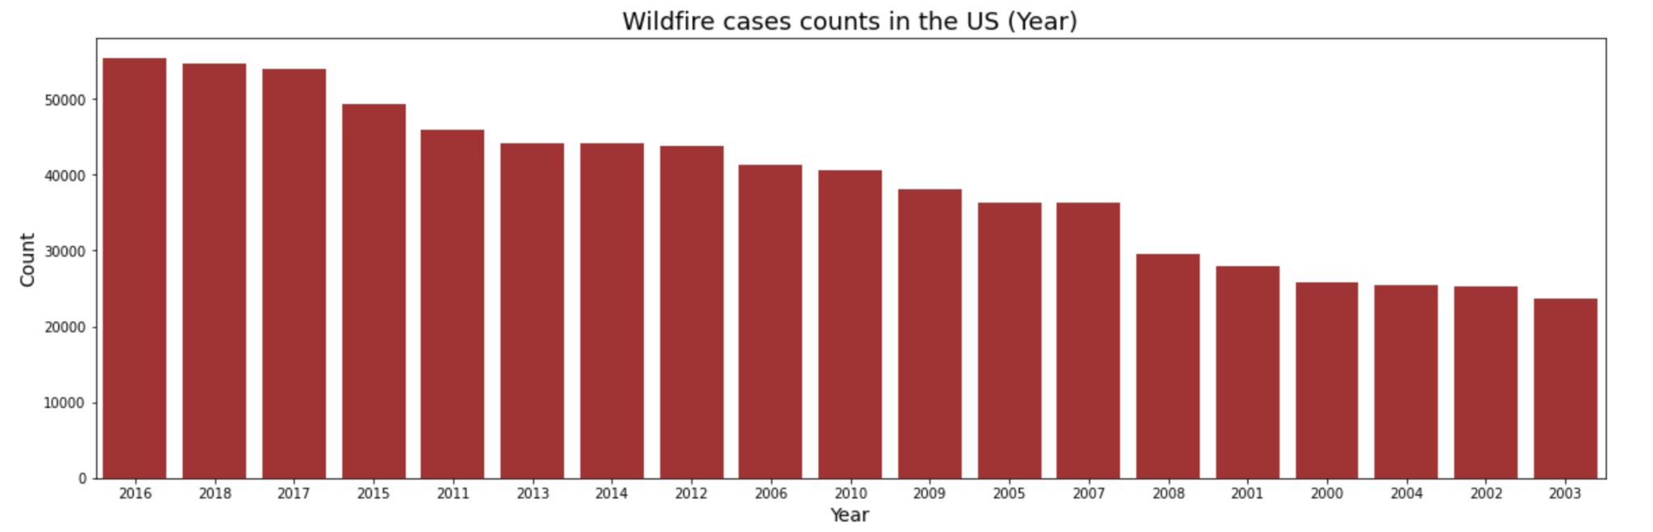
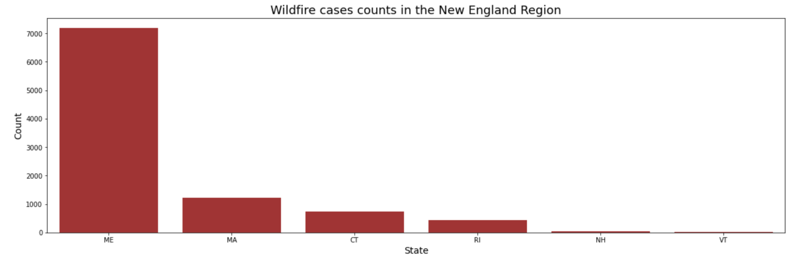
Wildfire dataset

Slide 9
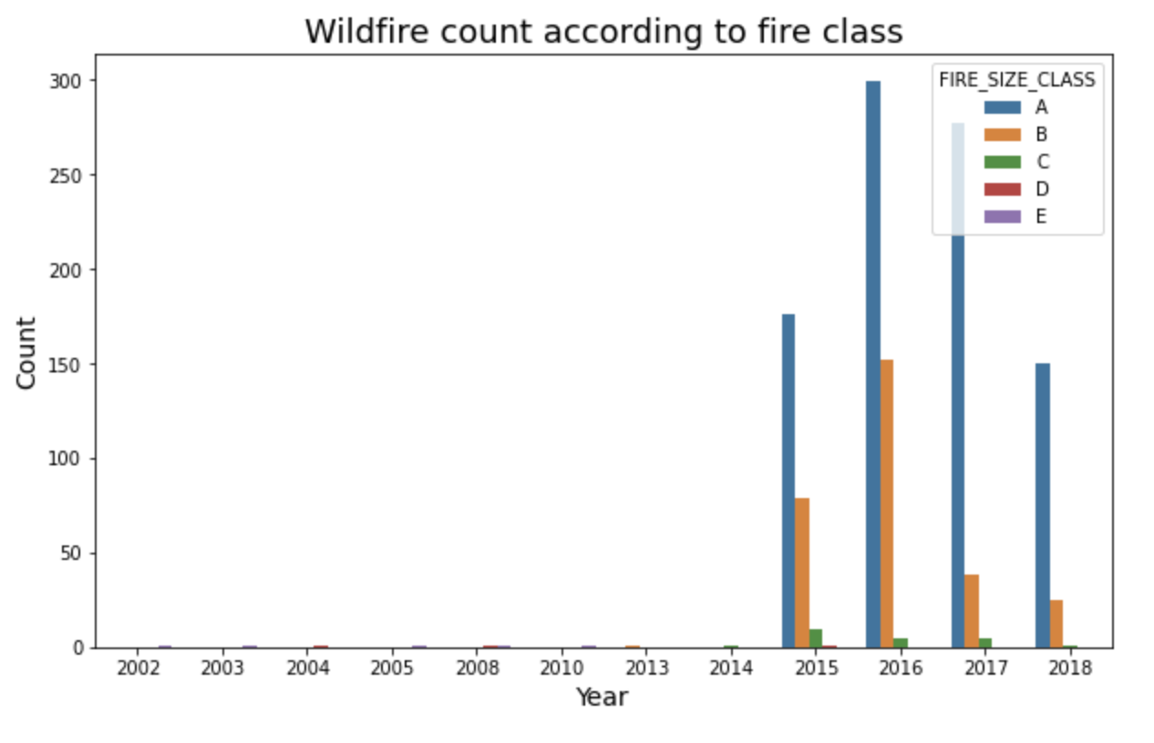
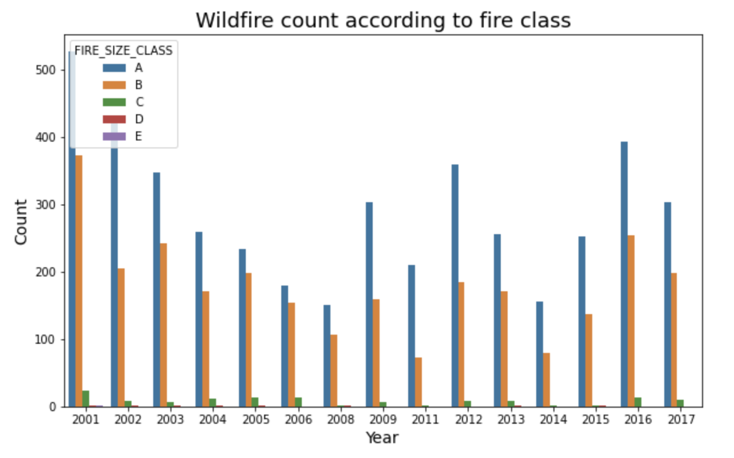
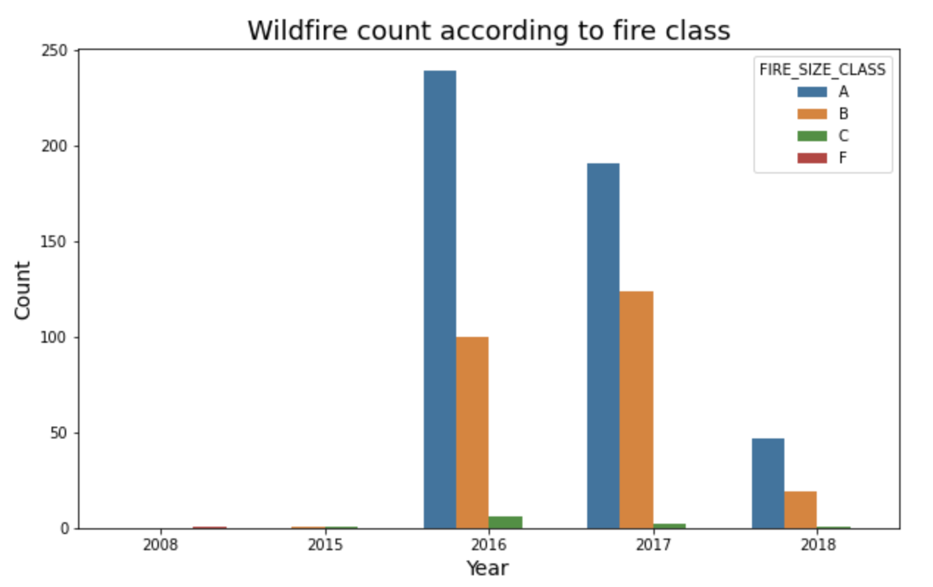
Wildfire dataset
Massachusetts
Maine
Connecticut

Slide 10
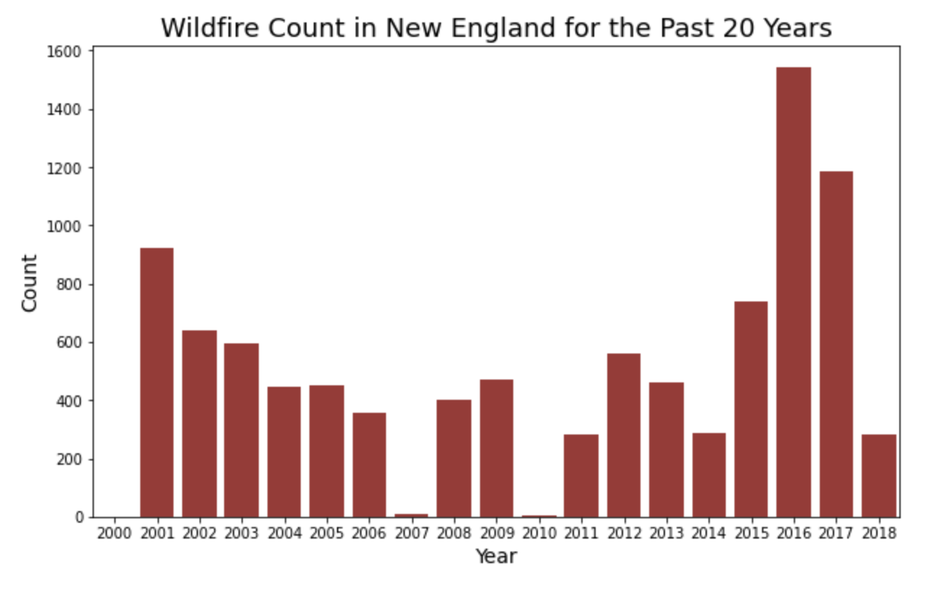
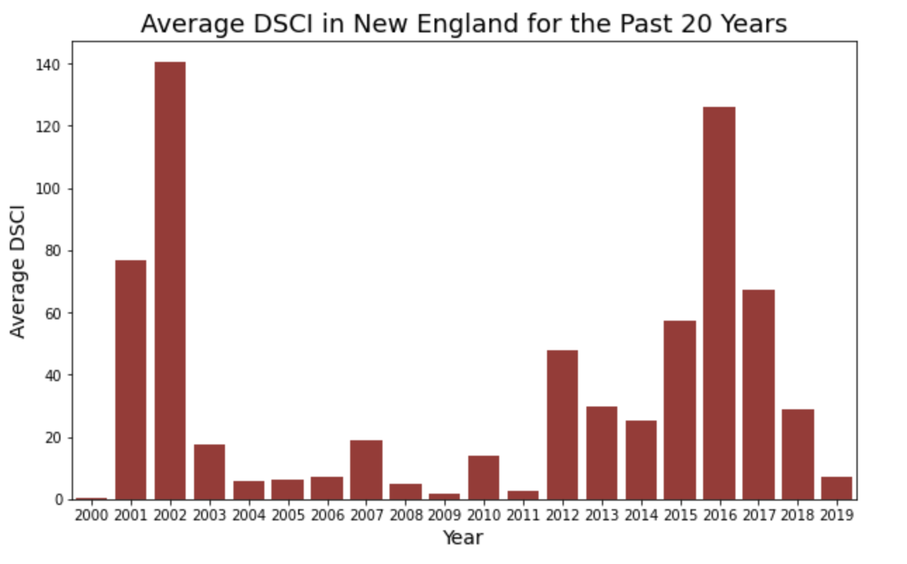
Wildfire dataset
Drought dataset

Slide 11
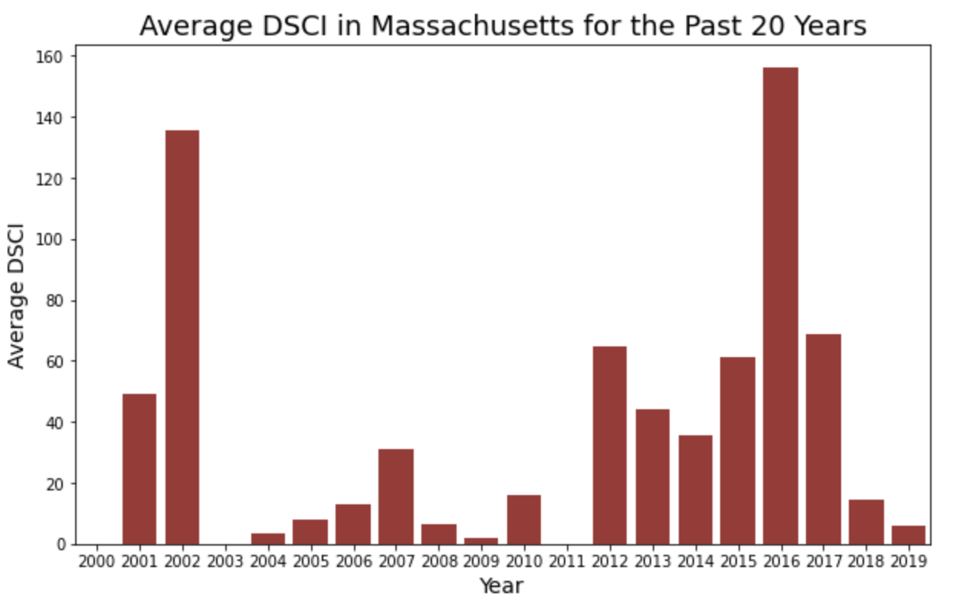
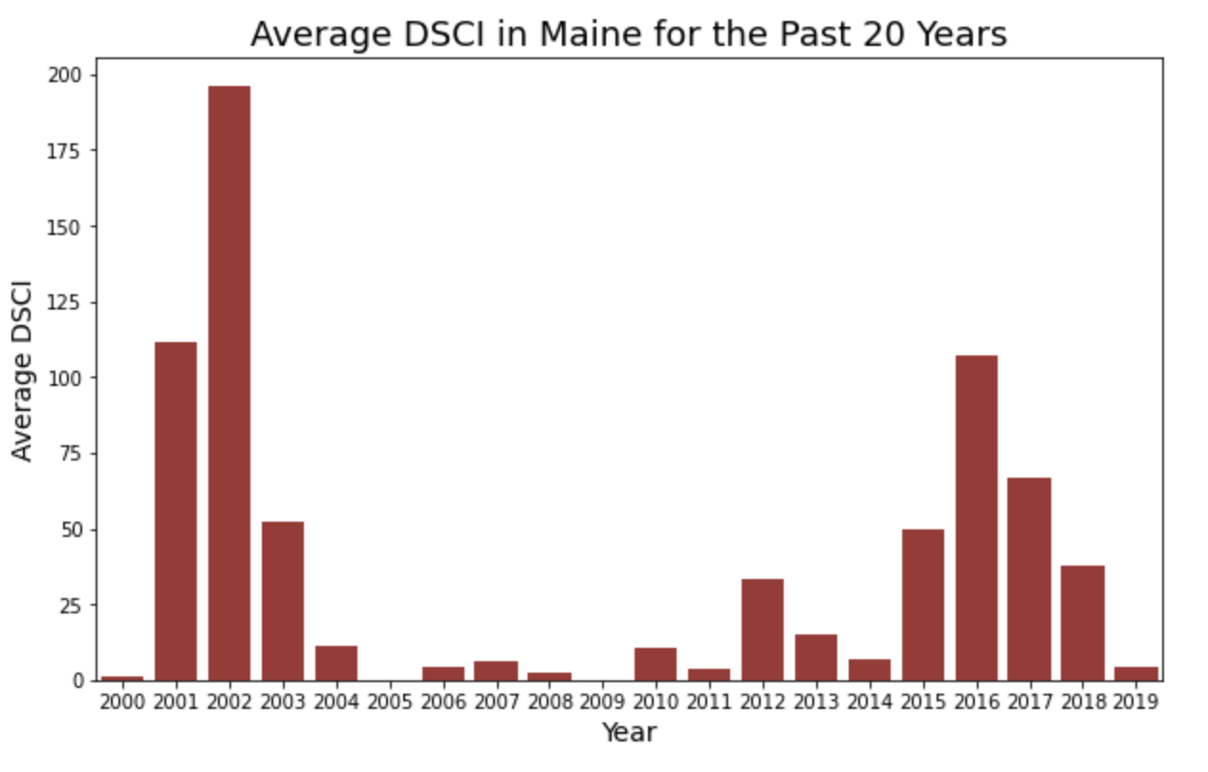
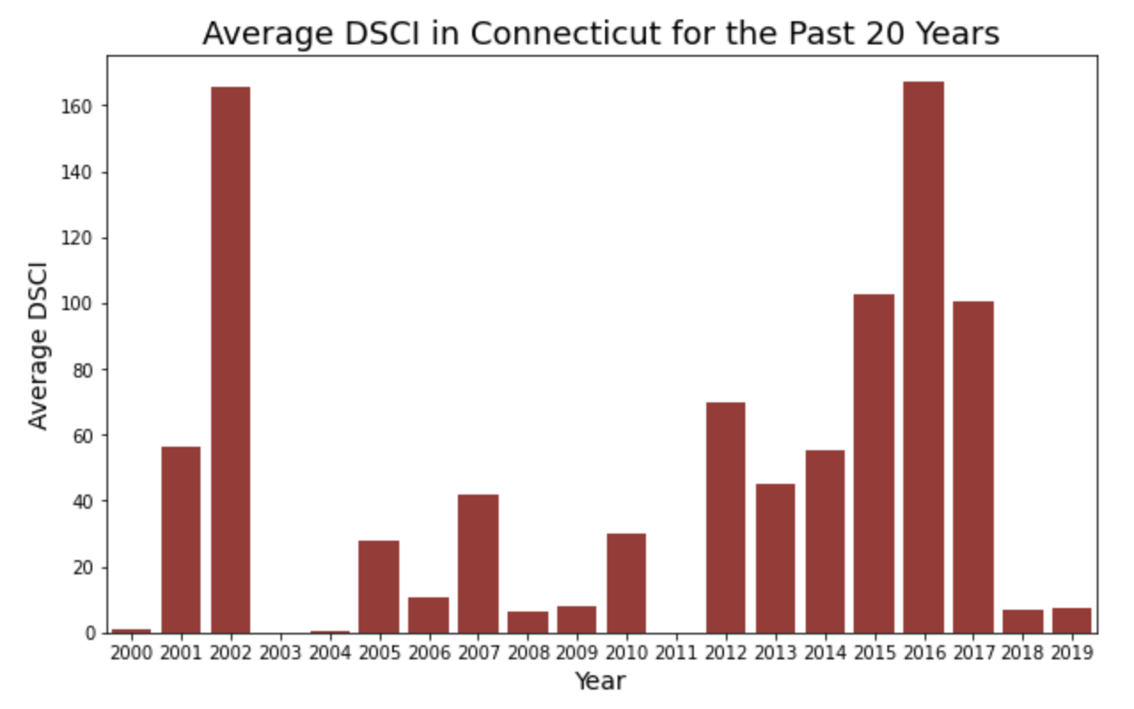
Drought dataset
Massachusetts
Maine
Connecticut

Slide 12
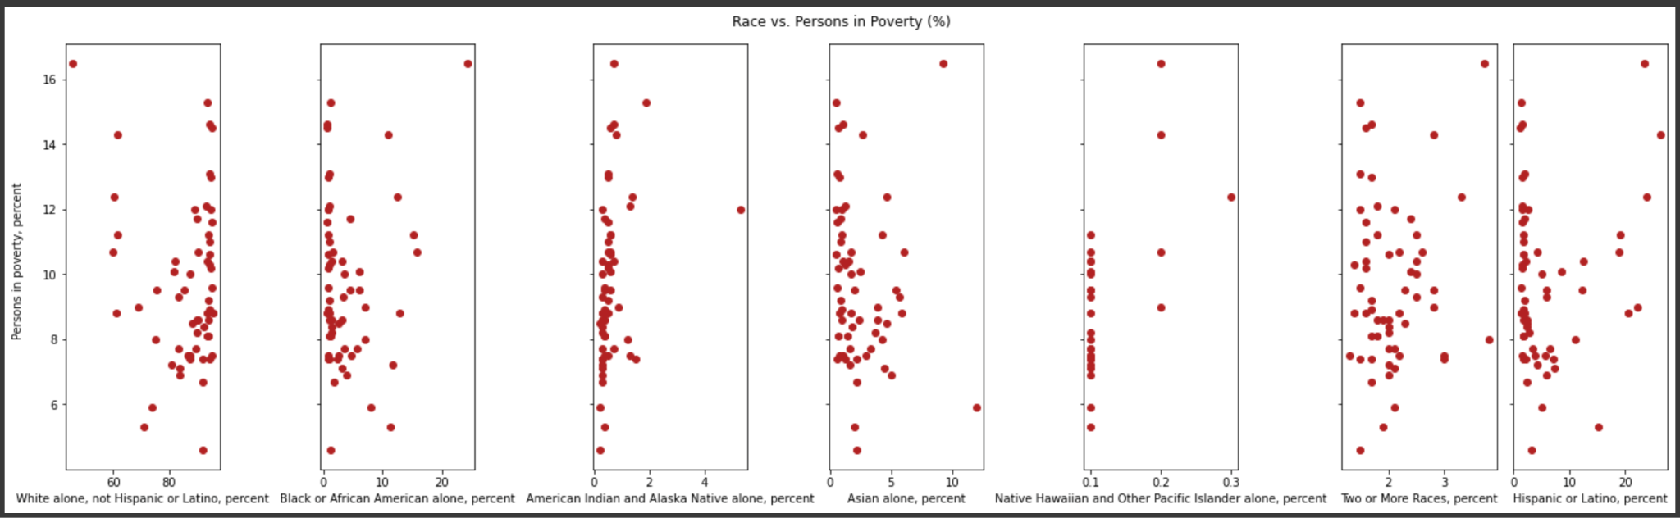
Census dataset
It is difficult to see the relationship between poverty and race, but the racial distribution varies greatly from county to county.

Slide 13
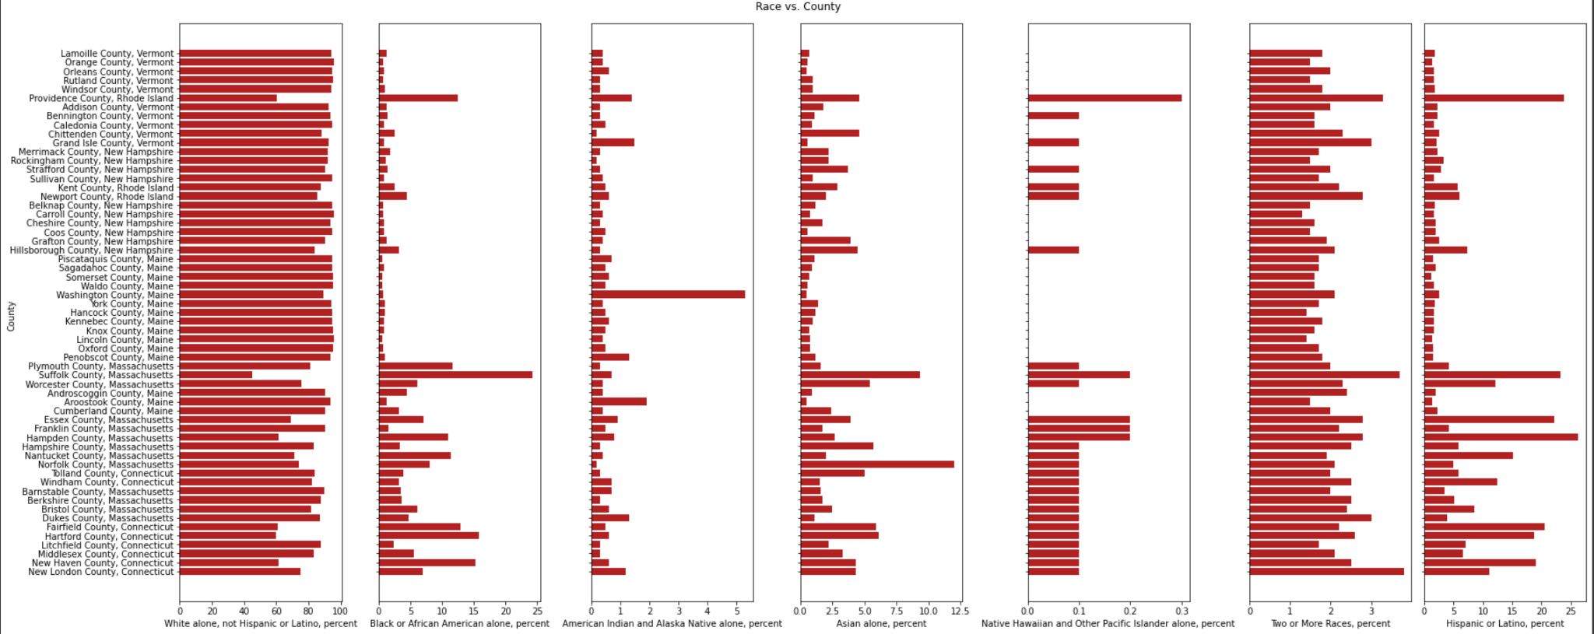
Census dataset

Slide 14
03
DEVELOPING MODELS
Feature Engineering; Machine Learning

Slide 15
FEATURE ENGINEERING
Created function that calculated average DSCI score from previous 4, 8, and 12 weeks.
Conducted machine learning.
STEP 1
STEP 3
Confirmed that the wildfire and drought dataset contained the same counties.
STEP 2
Added average DSCI columns by joining on county, state, and date.
STEP 4

Slide 16
A LOOK AT THE FEATURES IN OUR FINAL MACHINE LEARNING DATASET
'FOD_ID', 'FPA_ID', 'SOURCE_SYSTEM_TYPE', 'SOURCE_SYSTEM', 'NWCG_REPORTING_AGENCY', 'NWCG_REPORTING_UNIT_ID', 'NWCG_REPORTING_UNIT_NAME', 'SOURCE_REPORTING_UNIT', 'SOURCE_REPORTING_UNIT_NAME', 'FIRE_YEAR', 'DISCOVERY_DATE', 'DISCOVERY_DOY', 'DISCOVERY_TIME', 'NWCG_CAUSE_CLASSIFICATION', 'NWCG_GENERAL_CAUSE', 'CONT_DATE', 'CONT_DOY', 'CONT_TIME', 'FIRE_SIZE', 'FIRE_SIZE_CLASS', 'LATITUDE', 'LONGITUDE', 'OWNER_DESCR', 'STATE', 'FIPS_CODE', 'FIPS_NAME', '4_Week_AVG', '8_Week_AVG', '12_Week_AVG'

Slide 17
MACHINE LEARNING
Model
Method
Results
Linear Regression
Fire size
MSE: 168.83
MAE: 3.091
Regression Model
Random
Forest
Regressor
Fire size
MSE: 272.94
MAE: 2.179

Slide 18
MACHINE LEARNING
Model
Method
Results
Fire Class
Accuracy: 0.582
F1 Score: 0.588
Logistic
Classification Model
Random Forest
Fire Class
Accuracy: 0.627
F1 Score: 0.611
Balanced RFC
Fire Class
Accuracy: 0.254
F1 Score: 0.265

Slide 19
04
COST CALCULATION
Calculating the wildfire cost proportion on different counties

Slide 20
WHERE WE STARTED
For homeowners the cost of a wildfire usually includes:
SMOKE DAMAGE | CHEMICAL DAMAGE
BURNT MATERIALS | WATER DAMAGE
SOOT DAMAGE | STRUCTURAL DAMAGE

Slide 21
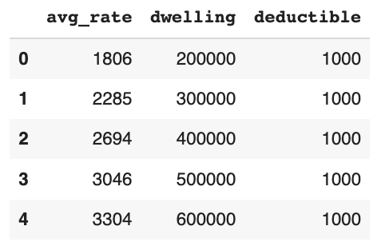
COST CALCULATION FORMULA
We assumed the deductible to be 1000$ as this was shown to be the most common and we changed the dwelling rate according to median household value which resulted in specific insurance premiums (‘avg_rate’ column).
WILDFIRE COST = (AVG_RATE*RATE INCREASE % AFTER FIRE) + DEDUCTIBLE
Average rate was chosen through the dwelling. The respective rate was chosen according to the dwelling rate closest to household value.

Slide 22
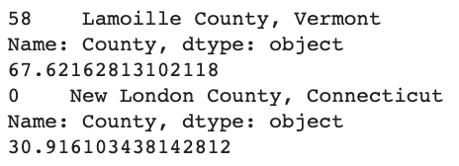
PROPORTION CALCULATION
We calculated each county proportion by using the following formula:
The highest and lowest proportion are shown below:
PROPORTION OF WILDFIRE COST = MEDIAN HOUSEHOLD INCOME/ESTIMATED WILDFIRE COST

Slide 23
05
KEY FINDINGS
Major conclusions reached after analysis and research

Slide 24
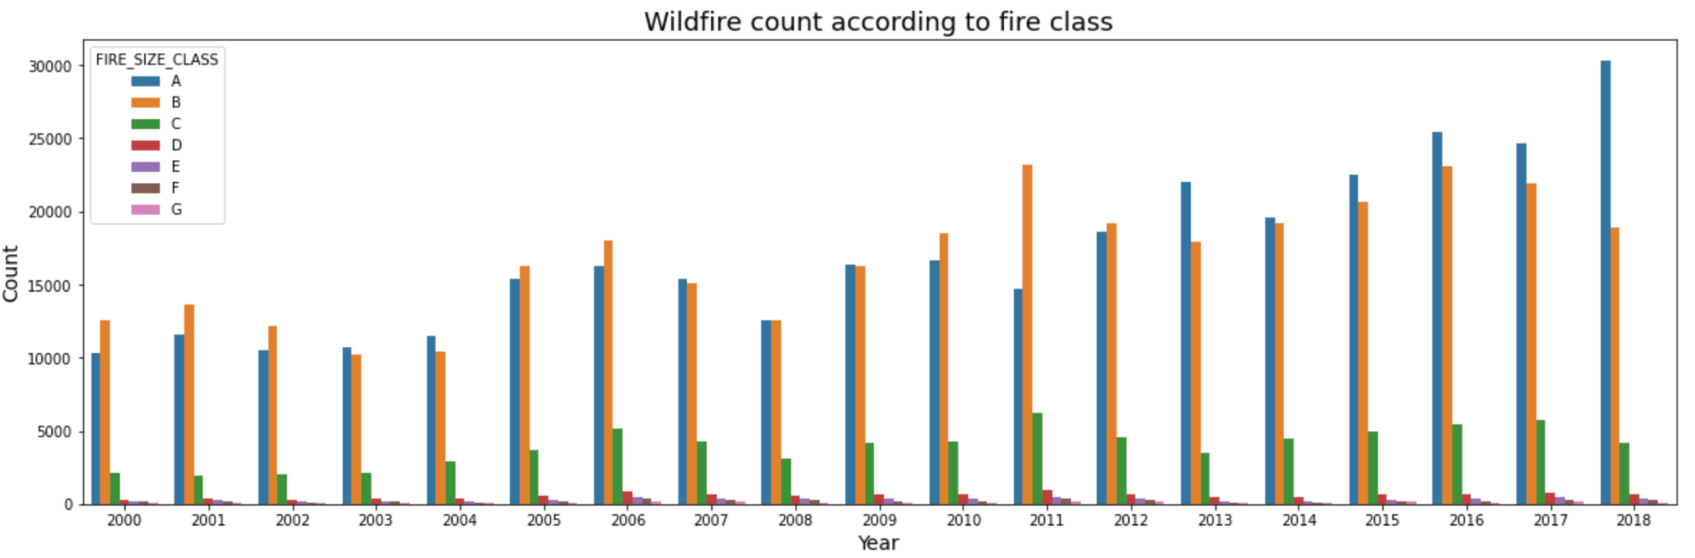
FIRE CLASSIFICATION DISTRIBUTION IN NEW ENGLAND

Slide 25
IMPROVEMENTS AND SUGGESTIONS
African American, Asians and other ethnic minorities have fewer households on average, and their income is relatively low. Usually, low-income groups would choose to live near suburbs because of housing prices. These are the places that are most vulnerable to wildfire in the first place.
We noticed that the frequency of fires fluctuated periodically. And after about two years (2024), the number of fires was likely to increase again as well as the average DSCI. This illustrates that the New England region could become more dry and therefore more prone to wildfires.

Slide 26
DIFFERENCES BETWEEN EXTREME PROPORTION COUNTIES
*The NaN illustrates that the percentage of that race was too small to include without infringing privacy on the residents.
FACT | LAMOILLE COUNTY, VERMONT | NEW LONDON COUNTY, CONNECTICUT
Households | 10770 | 109616
Persons in poverty, percent | 8.1 | 8
White, percent | 94.3 | 75.1
Black or African American, percent | 1.2 | 7.0
American Indian and Alaska Native, percent | 0.4 | 1.2
Asian, percent | 0.7 | 4.3
Native Hawaiian and Other Pacific Islander, percent | NaN | 0.1
Two or More Races, percent | 1.8 | 3.8
Hispanic or Latino, percent | 1.8 | 11.1

Slide 27
FINDINGS FROM COUNTY SPECIFIC ANALYSIS
COUNTY | POVERTY RATE, PERCENT | NUMBER OF WILDFIRES (POSITION IN RELATION TO ALL OF NEW ENGLAND)
Aroostook County, ME | 15.3 | 840 (2nd)
Piscataquis County, ME | 14.6 | 409 (10th)
Somerset County, ME | 14.5 | 509 (6th)
Oxford County, ME | 13.0 | 503 (7th)
Penobscot County, ME | 12.1 | 1011 (1st)

Slide 28
OVERALL FINDINGS
We expected that counties where the proportion of wildfire cost represented more income compared to other counties would have mostly non-white residents. The opposite was found.
Counties with the highest average DSCI are not the same counties that experience the most wildfires. This was unexpected as we hypothesized drought to be a relevant predictor for wildfires. This relationship was also visible in the machine learning models as they were performing poorly due to the fact that the predictor data did not include enough wildfire severity explanatory variables like fuel and topography.
One finding that did corroborate our initial hypotheses was that counties which experienced the most wildfires were also the one with the highest poverty rates, which was confirmed by the census data.

Slide 29
06
BUSINESS IMPACT/
CONCLUSION
Business Impact; Limitations and Future Research

Slide 30
BUSINESS IMPACT AND IMPLICATION
Insurance
FEMA
Damage Limitation
Insurance firms can research more into what is the proportion of claims they are paying for damages by wildfires and compare it with the revenue from premiums received by households to gain a better understanding to calculate the cost they are sustaining.
There is a vast difference in counties in terms of mean income per capita, which makes poor counties more vulnerable to wildfires when compared with rich counties - FEMA can focus on these counties to ensure that they are able to meet the cost of wildfire.
The model is able to predict wildfire severity on a certain date of the year, giving an opportunity to limit the damage by taking necessary steps in those areas. The Fire Department and county municipalities can take the size/class into account when preparing for damage mitigation.

Slide 31
LIMITATIONS AND FUTURE GROWTH
Wildfire
data
Drought
data
Census
data
Limited access to data
Insufficient data
Future work
Two major limitations
New England Region
United States

Slide 32
THANKS!
Please keep this slide for attribution

