Slide 1
Code B A S I C S
Challenge : Provide Insights to the Marketing Team in Food & Beverage Industry

Slide 2
Table of contents
01
02
03
About us
Timeline
objectives
04
05
06
Goal/our team
Primary insights
Recommendations

Slide 3

Our company
CodeX

Slide 4
01
About us
CodeX is a German beverage company.

Slide 5
Our Project
Few months ago
10 different cites in India
received results from 10k respondents.
Launched their energy drinks
conducted a survey in those 10 cities.

Slide 6
Objectives
increasing brand awareness.
Market share
Make the market in India
Product development.

Slide 7
Goal
Our team
To convert these survey results to meaningful insights
Peter Pandey
Marketing data analyst

Slide 8
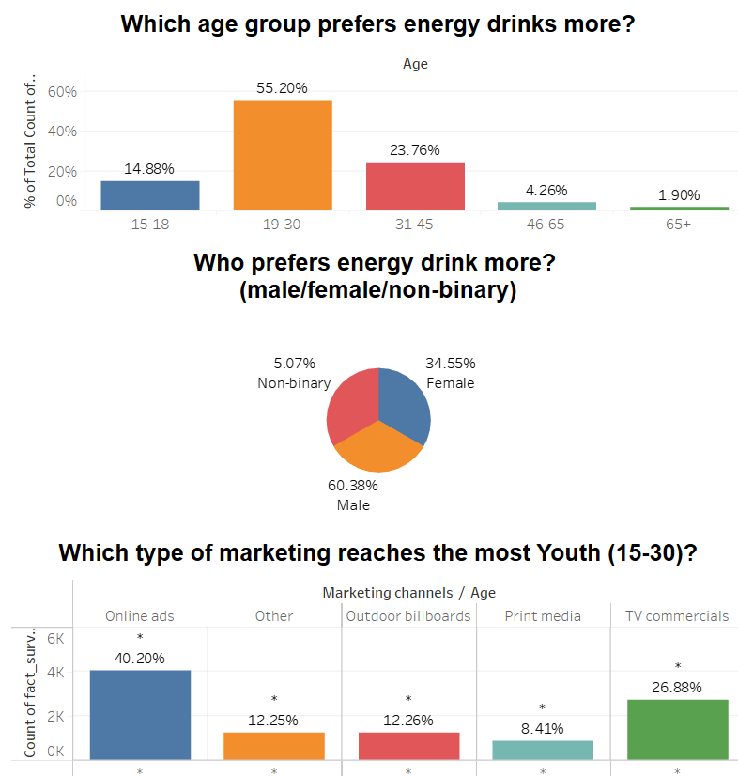
Demographic Insights

Slide 9
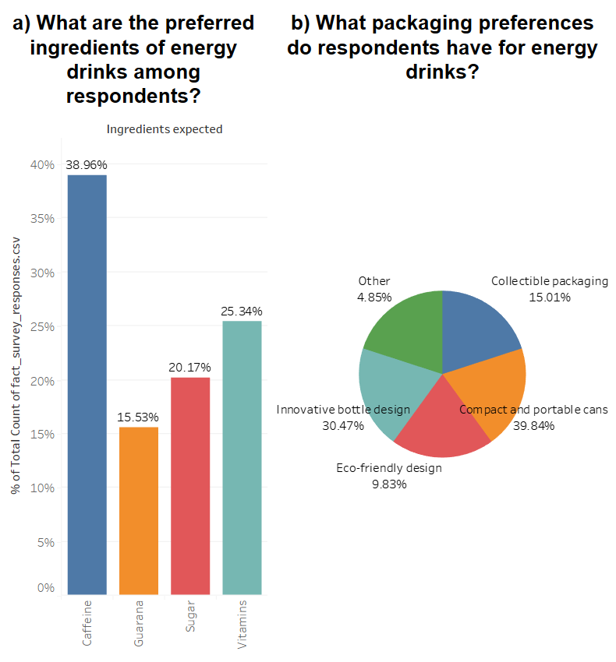
Consumer Preferences

Slide 10
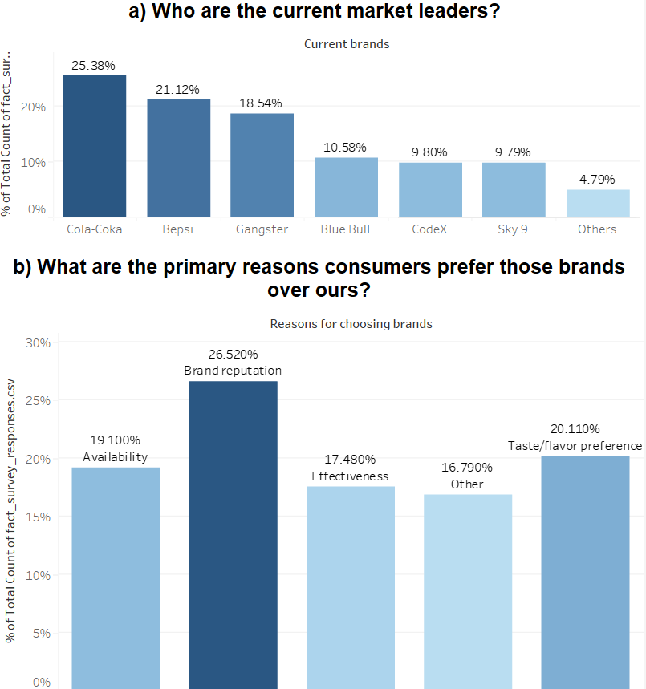
Competition Analysis

Slide 11
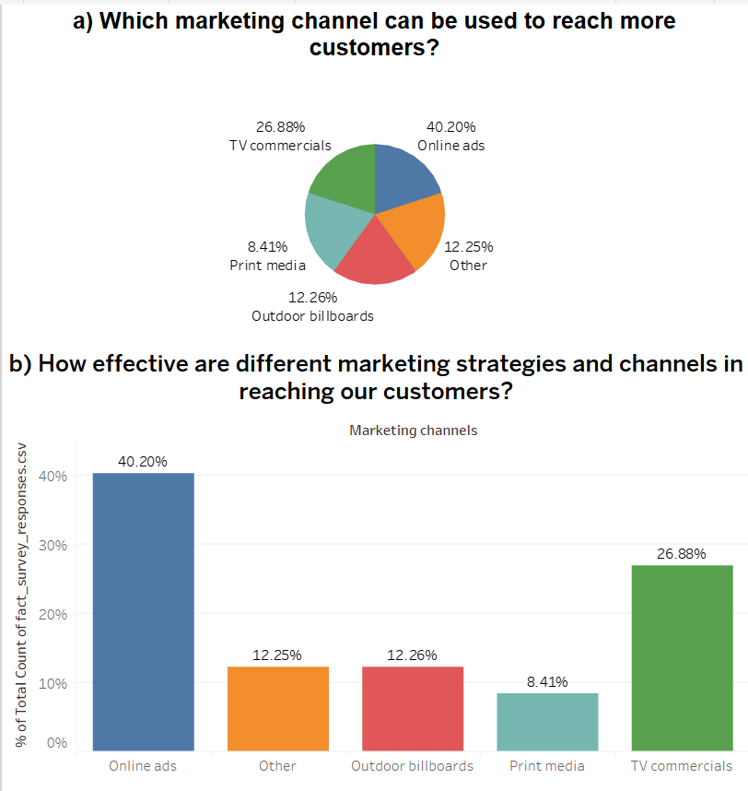
Marketing Channels and Brand Awareness

Slide 12
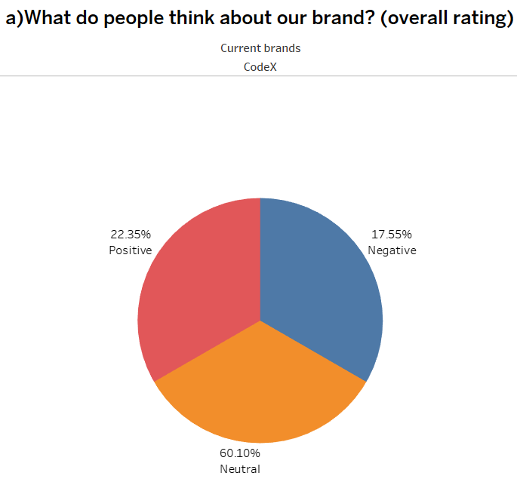
Brand Penetration

Slide 13
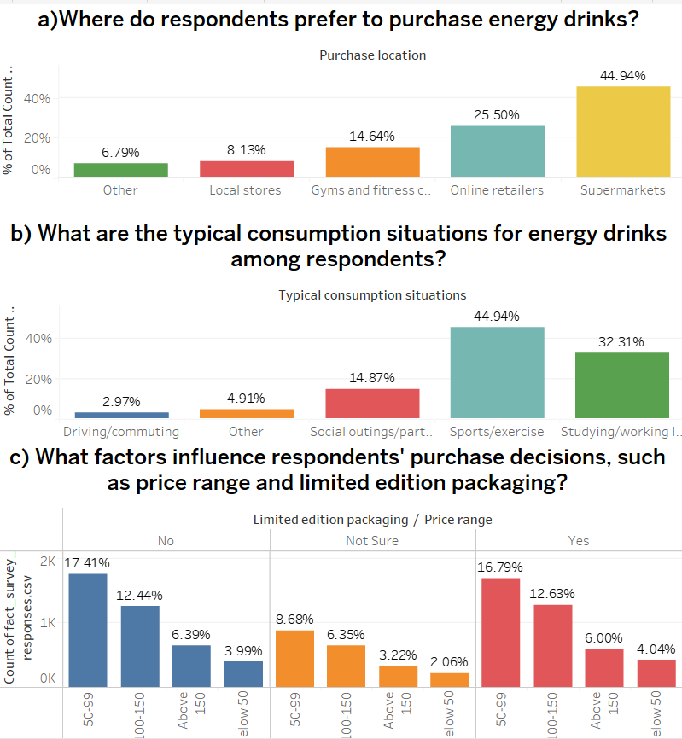
Purchase Behaviour

Slide 14
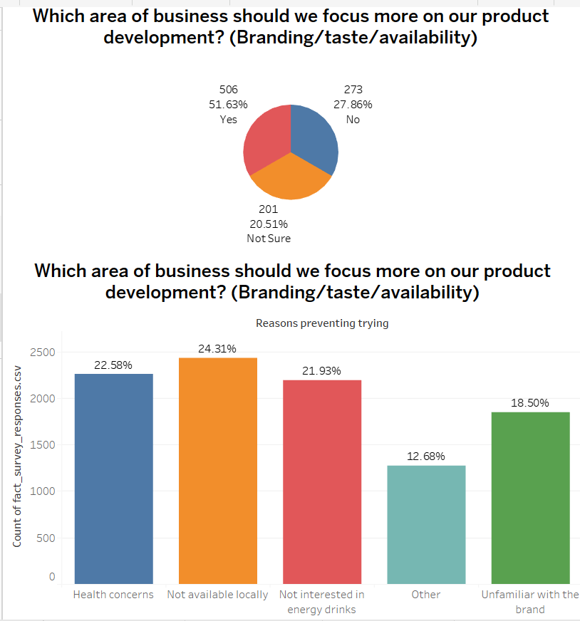
PRODUCT DEVELOPMENT

Slide 15
Key action items
What immediate improvements can we bring to the product?
1
Awareness
As according to the survey results only 44.7% respondents knowns about codex
40-30% respondents wants to go with innovated packaging as well as small and portal cans
Packing
2
24.31% respondents have this issue as energy drink is not omnipresent
3
Availability

Slide 16
Key action items
4
Health concern
60% having some health concerns.
Reduced sugar content around 30% respondents demand for this
Ingredients
5

Slide 17
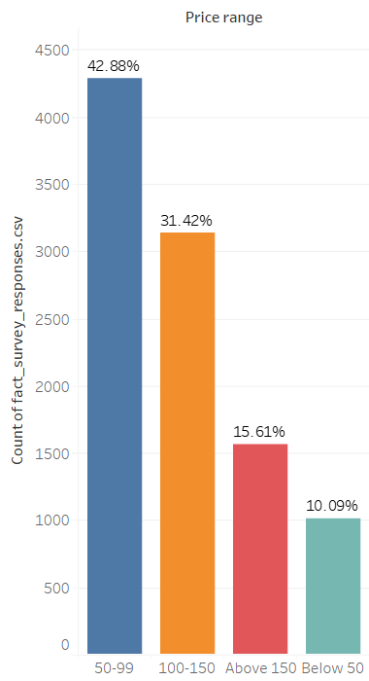
Key action items
What should be the ideal price of our product?
Range of price
As we all know if we lower the price the demand will be high and it will attract the customers.
As 42.8% wants the lower price range

Slide 18
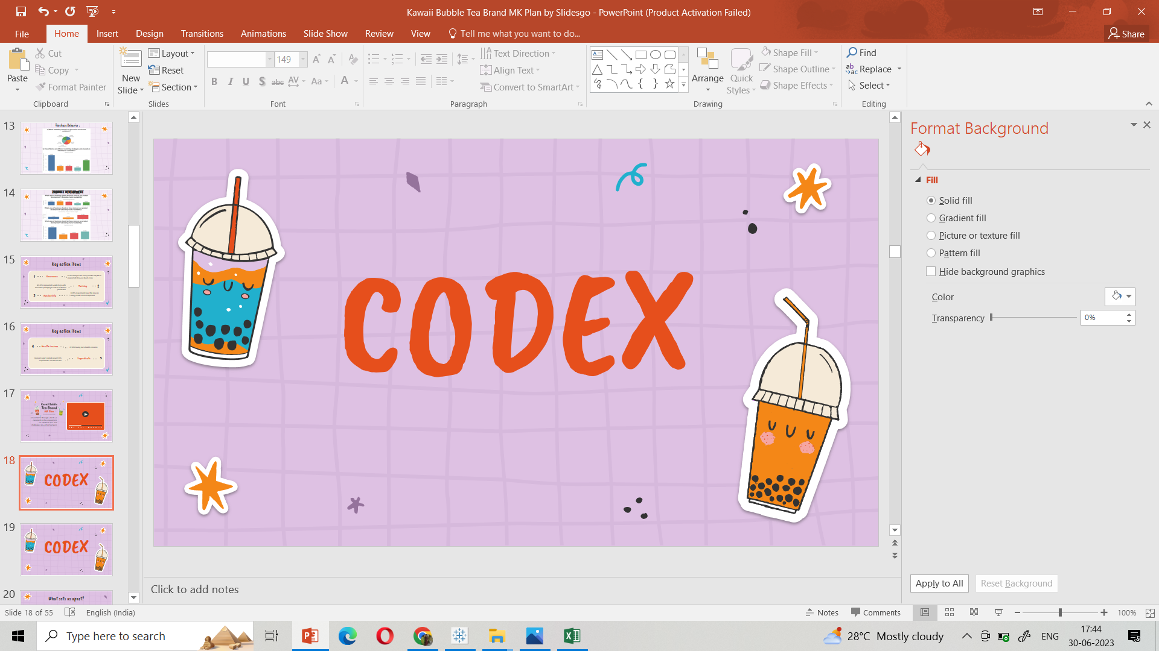
Social media
What kind of marketing campaigns, offers, and discounts we can run?
According to the survey online adds is the major channel around 40% through which we can reach to the consumers.
“SHARE A ENERGY DRINK”
Taglines,hastags
And some special offers to the fitness freaks.

Slide 19
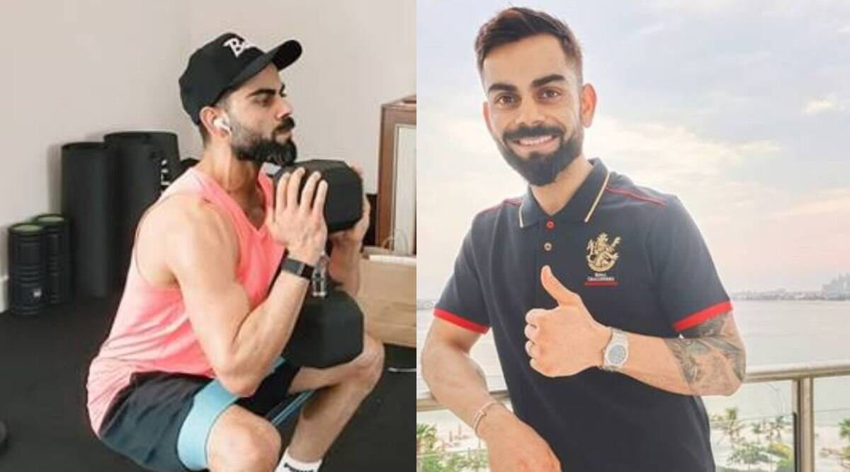
Who can be a brand ambassador, and why?
Stardom
Interest
fitness
80%
All over the globe
Diet
20%

Slide 20
Who should be our target audience, and why?
55.20% respondents prefer the energy drink who all comes under the age of 19-30 years and they all are adult so we should target that audience for more consumption.

Slide 21
Thanks!
Do you have any questions?
kratikajain729@gmail.com
codeX

