Slide 1
Ns3 simulation code
Kratik Gupta 2022252
Shashank Mishra 2022603

Slide 2
SIMULATION
We are asked to analyze the performance of a custom network topology implemented using NS-3. The network consists of 5 servers 0-4 and four routers R1-R4. Point-to-point links are used to connect these components. The objectives of this assignment include the evaluation of end-to-end performance metrics such as average and variance of one-way delays, observation of packet drops, and monitoring of queue lengths at the outgoing links of the routers.

Slide 3
SIMULATION
We will trace the paths of specific packets traveling from source servers 0,1,2,3 to each other through the network, thereby providing a detailed understanding of the routing and transmission process. These observations will be recorded and tabulated in source-destination matrices for better comprehension and presentation of the results. Topology , Routing Table , End-to-end Delay , Queue Lengths and Packet Drops are discussed on subsequent slides.

Slide 4
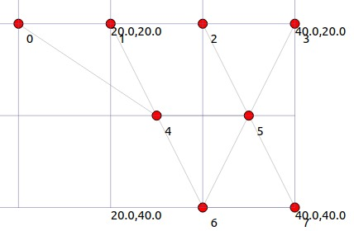
TOPOLOGY
Nodes 0 , 1 , 2 and 3 are workstations , they are end-user devices and are connected to each other through a router for network traffic. Nodes 4, 5 , 6 and 7 are routers , they serve as intermediary devices to route traffic between workstations . They are interconnected , forming a mesh-like structure. The following image illustrates our topology :-

Slide 5
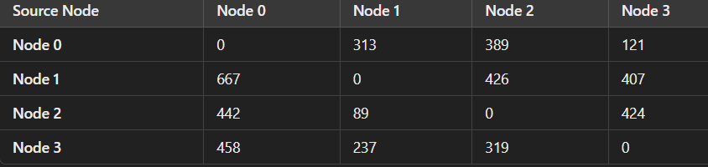
Traffic

Slide 6
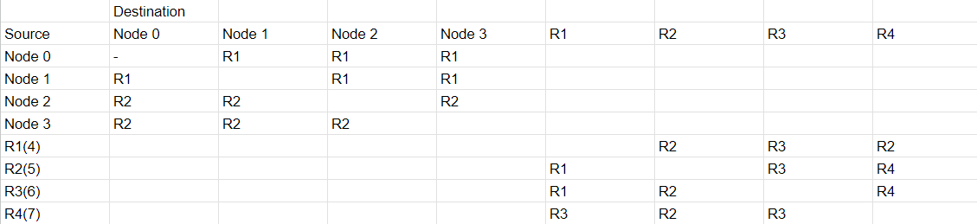
ROUTING TABLE
The routing table demonstrates the network's hierarchical structure, showing paths between workstation nodes (Node 0–Node 3) and routers (R1–R4). Each entry highlights the next hop for packet delivery, emphasizing efficient routing through direct connections or intermediate routers to optimize communication

Slide 7
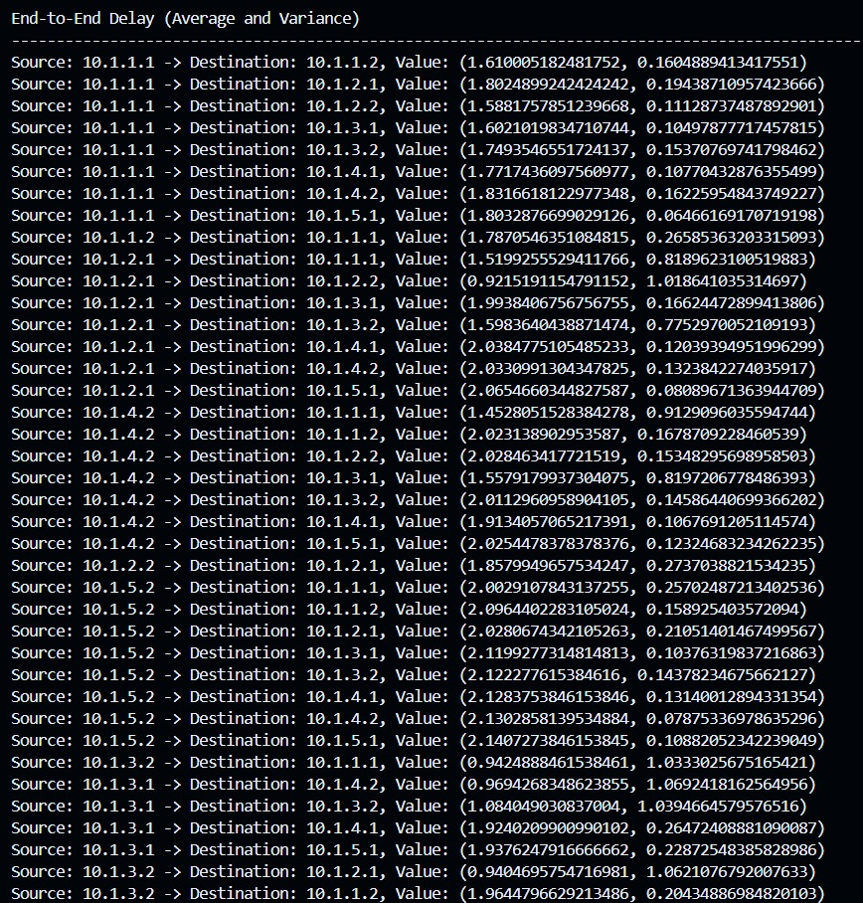
END-TO-END DELAY
The image attached displays end-to-end delays (average and variance) vary significantly across source-destination pairs. Routes like 10.1.5.1 -> 10.1.4.2 show more delay, which may indicate some performance problems, while others, such as 10.1.1.1 -> 10.1.1.2, maintain lower delay values.

Slide 8
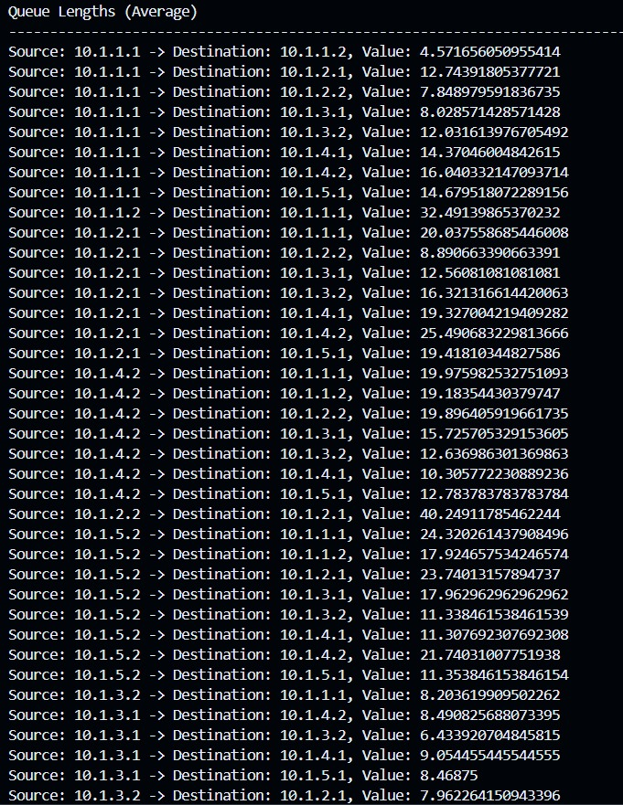
QUEUE LENGTHS
The queue length data suggests that the source-destination pairs have varying levels of congestion. Some links, such as 10.1.1.1 → 10.1.1.2, have very low congestion levels, while others, like 10.1.1.2 → 10.1.1.1, have high queuing levels, which may indicate uneven traffic or capacity.

Slide 9
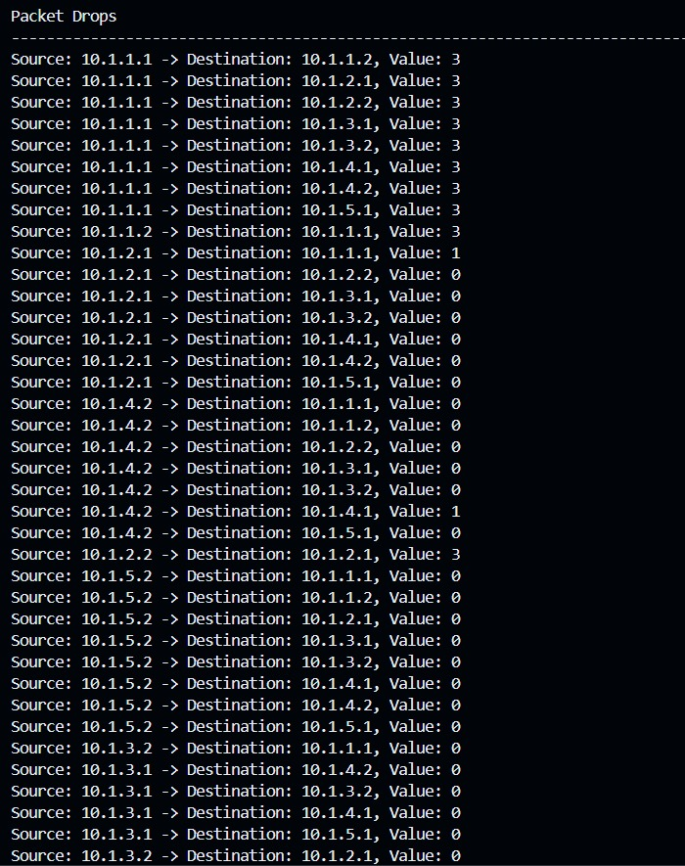
PACKET DROPS
The data in the image depicts packet drops between different IP addresses. Most of the packet drops are between 10.1.1.1 to 10.1.1.2, 10.1.3.2, and 10.1.4.2, with Value = 3. Other connections have 1 or 0 packet drops.

Slide 10
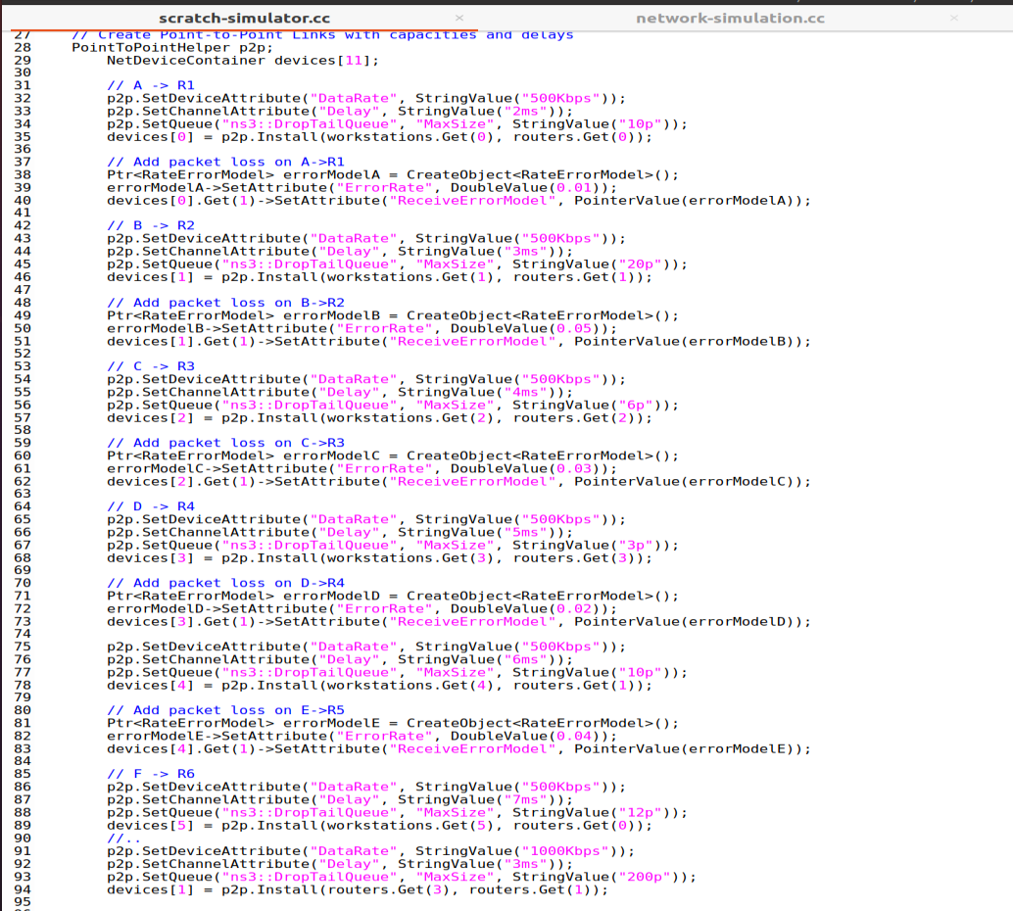
Running at the client end

Slide 11
Thank You!

