Slide 1
Data Deduplication
Amanda Buckley & Jayce Gaines
CMSC 490 Research: Spring 2011

Slide 2
Introduction (1)
What is Data De-Duplication?
– One file with many copies on the disk.
– Redundant information within files which are not necessarily the same
Why is it important?
– Disk space is expensive.
– Multiple copies can diverge over time, creating inconsistencies in the data.

Slide 3
Introduction (2)
What is structured text?
– Stores data items and relationships between them
– Data is stored in plain text, marked up with tags
– Forms a tree structure
– Difficult to de-duplicate

Slide 4
What is XML?
XML - eXtensible Markup Language.
A language to structure, store and transport data.
Human readable.
Schema extendable with namespaces
Used for graphics, news feeds, word documents

Slide 5
Applications of XML
Web pages
Really Simple Syndication (RSS) and Atom Feeds
  Specified Formats
Office Documents
  OpenOffice.org XML
  Microsoft's .docx format
Scalable Vector Graphics (SVG) Files
  Language for 2D drawings in XML
Notes:
SVG not propreitary
Ooff XML not the format used anymore

Slide 6
XML Nodes
Elements
Attributes
Entities
Processing Instructions
Comments
CDATA Sections

Slide 7
XML Data De-Duplication
Goal: create a software library and accompanying application for finding the difference between two XML input files
Output the result as a parseable XML file
Structured text is hard to de-duplicate
Tree structure does not depend on line order
Files contain meta-information as well as data
<hr/> is the same as <hr></hr>

Slide 8
Background (1)
File System De-Duplication
– De-duplicates data on the fly over the network
– Uses hashing or other sophisticated data structure techniques to find duplicate blocks within files
– Does not solve data inconsistency problem

Slide 9
Background (2)
De-duplication Utilities
– Unix “diff” command
– Outputs differences between two files
– Operates line by line
– Not suitable for tree structures
– Not suitable for binary data
– OpenXMLDiff
– Command-line program, pipes output to text file

Slide 10
Background (3)
Diffxml utility
– Doctoral Dissertation by Adrian Mouat
– Outputs diff in “DUL” (Delta Update Language)
– Written in Java
– Open Source, but not available as a library
– Limited to small files
Xmldiff
– Open Source Python script
– Can be used as a library
– Only documentation is a French blog post???

Slide 11
Background (4)
Proprietary Tools
– DiffDog
  Provides diff/merge for text files and ODTs
  “XML-aware” approach to visualization
  Provides different options for customization
– DeltaXML Ltd's “Delta XML”
– “XML Diff and Merge” and “XML Tree Diff”

Slide 12
Background (5)
DiffDog
  Provides diff/merge for text files and ODTs
  “XML-aware” approach to visualization
  Provides different options for customization
  Proprietary
OpenXMLDiff
  Free
  Command-line program, pipe output to text file

Slide 13
FastXMLDiff
Open Source program for finding differences between two XML trees
Outputs the UNION of the two trees with appropriate annotations
This allows it to produce files that can be opened by the application that created the files
Cross-platform GUI app based on Qt
Could easily be made into a library for use in other applications

Slide 14
Example Image

Slide 15
Example Document (XML)
<?xml version="1.0" encoding="UTF-8" standalone="no"?>
<svg width="744.09448819"
height="1052.3622047"
id="svg2"
version="1.1"
inkscape:version="0.48.0 r9654"
sodipodi:docname="testimage1.svg">
<sodipodi:namedview id="base"
pagecolor="#ffffff"
bordercolor="#666666"
borderopacity="1.0"
inkscape:pageopacity="0.0"
inkscape:pageshadow="2"
inkscape:zoom="0.35"
inkscape:cx="375"
inkscape:cy="520"
inkscape:document-units="px"
inkscape:current-layer="layer1"
showgrid="false"
inkscape:window-width="1280"
inkscape:window-height="947"
inkscape:window-x="0"
inkscape:window-y="24"
inkscape:window-maximized="1" />
<g inkscape:label="Layer 1"
inkscape:groupmode="layer"
id="layer1">
<path id="path2985" style="fill:#00ff00;fill- rule:evenodd;stroke:#000000;stroke- width:1px;stroke-linecap:butt;stroke- linejoin:miter;stroke-opacity:1"
d="m 345.71428,215.21933 a 135.71428,97.14286 0 1 1 -271.428559,0 135.71428,97.14286 0 1 1 271.428559,0 z" />
<path style="fill:#800080”
id="path3011"
inkscape:flatsided="true"
inkscape:rounded="0"
inkscape:randomized="0"
d="M 114.28572,720.93363 72.695787,503.89155 266.26307,397.26748 427.48416,548.41226 333.557,748.44893 z"
inkscape:transform-center-x="-11.368332"
inkscape:transform-center-y="-19.471307"
transform="matrix(1.5717694,0,0,1.781037,-41.565228,-310.28061)" />
<rect
style="fill:#ffff00"
id="rect3140"
width="122.85714"
height="868.57141"
x="471.42856"
y="83.790756" />
</g>
</svg>

Slide 16
Example Image (Modified)

Slide 17
Modified Example Document:
<?xml version="1.0" encoding="UTF-8" standalone="no"?>
<svg width="744.09448819"
height="1052.3622047"
id="svg2" version="1.1"
inkscape:version="0.47 r22583" sodipodi:docname="testimage2.svg">
<sodipodi:namedview id="base"
pagecolor="#ffffff"
bordercolor="#666666"
borderopacity="1.0"
inkscape:pageopacity="0.0"
inkscape:pageshadow="2"
inkscape:zoom="0.35"
inkscape:cx="375"
inkscape:cy="514.28571"
inkscape:document-units="px"
inkscape:currentlayer="layer1"
showgrid="false"
inkscape:window-width="1280"
inkscape:window-height="949"
inkscape:window-x="0"
inkscape:window-y="25"
inkscape:window-maximized="1" />
<g inkscape:label="Layer 1"
inkscape:groupmode="layer"id="layer1">
<path style="fill:#00ff00;fill-rule:evenodd;stroke:#000000;stroke-width:1px;stroke-linecap:butt;stroke-linejoin:miter;stroke-opacity:1"
id="path2985" d="m 345.71428,215.21933 a 135.71428,97.14286 0 1 1 -271.428559,0 135.71428,97.14286 0 1 1 271.428559,0 z" transform="translate(2.8571433,602.85714)" />
<rect style="fill:#800080" id="rect3140"
Width="122.85714" Height="868.57141"
X="471.42856" y="83.790756" ry="61.42857" />
<path sodipodi:type="spiral" style="fill:none;stroke:#000000;stroke-width:1px;stroke-linecap:butt;stroke-linejoin:miter;stroke-opacity:1"
id="path3142" d="m 340,166.6479 c -3.16672,3.30861 -6.02228,-2.63632 -5.49912,-5.26329 1.41773,-7.11893 10.46709,-8.45664 16.02571,-5.73495 9.94306,4.86846 11.38412,18.045 5.97078,26.78812 -7.9443,12.83089 -25.72474,14.39569 -37.55054,6.20661 -15.76193,-10.91475 -17.44292,-33.44049 -6.44244,-48.31295 13.84297,-18.71547 41.17339,-20.50856 59.07537,-6.67827 21.68169,16.75032 23.58485,48.91593 6.9141,69.83778 -19.64591,24.65568 -56.66449,26.66784 -80.6002,7.14993 -27.63473,-22.53419 -29.75529,-64.41705 -7.38576,-91.36261 25.41768,-30.617257 72.17244,-32.845862 102.12503,-7.62159 33.60227,28.29782 35.9387,79.92988 7.85742,112.88744 -31.17554,36.58914 -87.68888,39.03324 -123.64986,8.09325 -39.5774,-34.05146 -42.12907,-95.44906 -8.32908,-134.412271 36.926,-42.566747 103.21018,-45.225933 145.17469,-8.564911 45.55695,39.799462 48.32361,110.972072 8.80074,155.937102 -42.67206,48.54786 -118.73457,51.42195 -166.69952,9.03657 -51.53933,-45.54395 -54.52083,-126.49757 -9.2724,-177.461932 48.41528,-54.531269 134.261,-57.620159 188.22435,-9.50823 57.5236,51.286132 60.71987,142.024792 9.74406,198.986762 -54.15659,60.51627 -149.78888,63.81992 -209.74918,9.97989 -63.50922,-57.02669 -66.92023,-157.55323 -10.21572,-220.511592 59.89651,-66.502409 165.31781,-70.020778 231.27401,-10.45155 69.49581,62.766082 73.12154,173.082592 10.68738,242.036422 -65.63543,72.4894 -180.84754,76.22248 -252.79884,10.92321 -6.98202,-6.33651 -13.47185,-13.21429 -19.39508,-20.55012" transform="matrix(1.6895195,0,0,1.6840156,-243.94779,180.82631)" />
</g>
</svg>

Slide 18
Example Output
<root>
<?xml version='1.0' encoding='UTF-8' standalone='no'?>
<svg
width="744.09448819"
version="1.1"
height="1052.3622047"
xmlns:sodipodi="http://sodipodi.sourceforge.net/DTD/sodipodi-0.dtd"
sodipodi:docname="testimage1.svg"
id="svg2"
xmlns:inkscape="http://www.inkscape.org/namespaces/inkscape">
<sodipodi:namedview
inkscape:window-y="25"
inkscape:window-maximized="1"
inkscape:zoom="0.35"
inkscape:document-units="px"
showgrid="false"
pagecolor="#ffffff"
bordercolor="#666666"
inkscape:cx="375"
id="base"
inkscape:cy="520"
inkscape:window-height="949"
inkscape:pageopacity="0.0"
borderopacity="1.0"
inkscape:pageshadow="2"
inkscape:current-layer="layer1"
inkscape:window-width="1280"
inkscape:window-x="0"/>
<g
inkscape:label="Layer 1"
inkscape:groupmode="layer"
id="layer1">
<path
modified="true"
style="fill:#00ff00;fill-rule:evenodd;stroke:#000000;stroke-width:1px;stroke-linecap:butt;stroke-linejoin:miter;stroke-opacity:1"
id="path2985"
d="m 345.71428,215.21933 a 135.71428,97.14286 0 1 1 -271.428559,0 135.71428,97.14286 0 1 1 271.428559,0 z"
transform="translate(2.8571433,602.85714)"/>
<container-node
modified="true">
<path
inkscape:transform-center-x="-11.368332"
inkscape:rounded="0"
inkscape:transform-center-y="-19.471307"
inkscape:flatsided="true"
style="fill:#800080"
id="path3011"
inkscape:randomized="0"
d="M 114.28572,720.93363 72.695787,503.89155 266.26307,397.26748 427.48416,548.41226 333.557,748.44893 z"
transform="matrix(1.5717694,0,0,1.781037,-41.565228,-310.28061)"/>
<rect
width="122.85714"
x="471.42856"
y="83.790756"
height="868.57141"
ry="61.42857"
style="fill:#800080"
added="true"
id="rect3140"/>
</container-node>
<container-node
modified="true">
<rect
width="122.85714"
x="471.42856"
y="83.790756"
height="868.57141"
style="fill:#ffff00"
id="rect3140"/>

Slide 19
Example output (cont.)
<path
sodipodi:type="spiral"
style="fill:none;stroke:#000000;stroke-width:1px;stroke-linecap:butt;stroke-linejoin:miter;stroke-opacity:1"
added="true"
id="path3142"
d="m 340,166.6479 c -3.16672,3.30861 -6.02228,-2.63632 -5.49912,-5.26329 1.41773,-7.11893 10.46709,-8.45664 16.02571,-5.73495 9.94306,4.86846 11.38412,18.045 5.97078,26.78812 -7.9443,12.83089 -25.72474,14.39569 -37.55054,6.20661 -15.76193,-10.91475 -17.44292,-33.44049 -6.44244,-48.31295 13.84297,-18.71547 41.17339,-20.50856 59.07537,-6.67827 21.68169,16.75032 23.58485,48.91593 6.9141,69.83778 -19.64591,24.65568 -56.66449,26.66784 -80.6002,7.14993 -27.63473,-22.53419 -29.75529,-64.41705 -7.38576,-91.36261 25.41768,-30.617257 72.17244,-32.845862 102.12503,-7.62159 33.60227,28.29782 35.9387,79.92988 7.85742,112.88744 -31.17554,36.58914 -87.68888,39.03324 -123.64986,8.09325 -39.5774,-34.05146 -42.12907,-95.44906 -8.32908,-134.412271 36.926,-42.566747 103.21018,-45.225933 145.17469,-8.564911 45.55695,39.799462 48.32361,110.972072 8.80074,155.937102 -42.67206,48.54786 -118.73457,51.42195 -166.69952,9.03657 -51.53933,-45.54395 -54.52083,-126.49757 -9.2724,-177.461932 48.41528,-54.531269 134.261,-57.620159 188.22435,-9.50823 57.5236,51.286132 60.71987,142.024792 9.74406,198.986762 -54.15659,60.51627 -149.78888,63.81992 -209.74918,9.97989 -63.50922,-57.02669 -66.92023,-157.55323 -10.21572,-220.511592 59.89651,-66.502409 165.31781,-70.020778 231.27401,-10.45155 69.49581,62.766082 73.12154,173.082592 10.68738,242.036422 -65.63543,72.4894 -180.84754,76.22248 -252.79884,10.92321 -6.98202,-6.33651 -13.47185,-13.21429 -19.39508,-20.55012"
transform="matrix(1.6895195,0,0,1.6840156,-243.94779,180.82631)"/>
</container-node>
</g>
</svg>
</root>

Slide 20
Algorithm (1)
Creates a new tree representing the union of the two files.
Annotates the new tree by marking nodes as:
  Modified
  Added
  Deleted
Uses a recursive tree-union algorithm.
Comparing two nodes
  Comparing Elements
  Comparing Entities and other non-elements
  Handling attributes

Slide 21
Algorithm (2)
XmlTree CompareXML(XmlTree A, XmlTree B):
root = new_node()
for each child a[i] in A:
if ∃ b[i] in B:
if a[i] ≠ b[i]:
create a container node “c”.
append a[i] and b[i] to c.
mark “c” as modified.
append “c” to root.
else
make a copy “c” of a[i].
mark “c” as deleted.
append “c” to root.
for each child b[i] in B\A:
make a copy “c” of b[i].
mark “c” as added.
append “c” to root.
return root

Slide 22
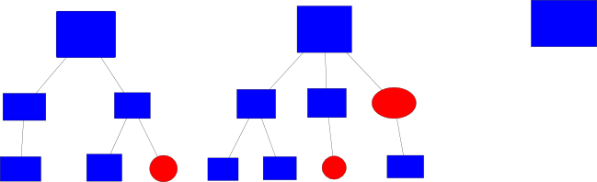
Algorithm (3)
Old New Result

Slide 23
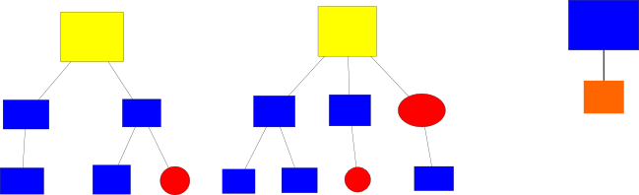
Algorithm (4)

Slide 24
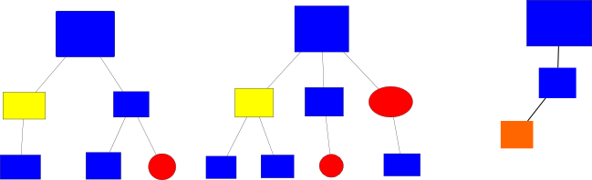
Algorithm (5)

Slide 25
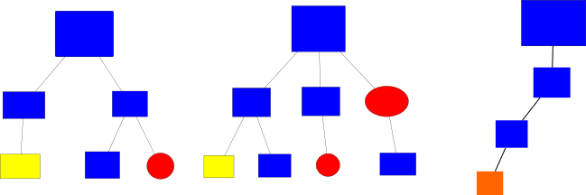
Algorithm (6)

Slide 26
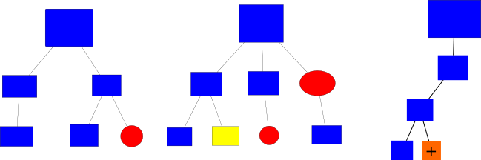
Algorithm (7)

Slide 27
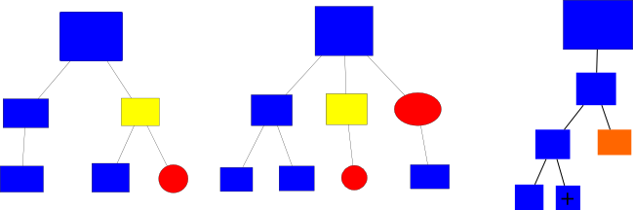
Algorithm (8)

Slide 28
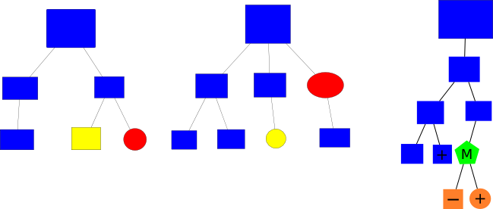
Algorithm (9)

Slide 29
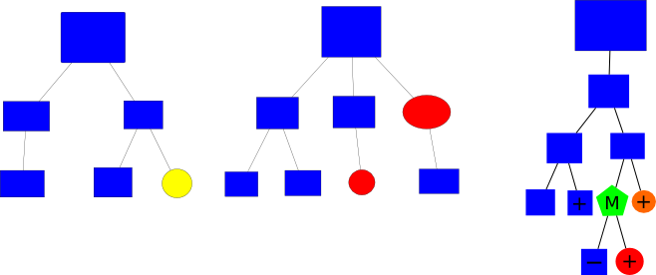
Algorithm (10)

Slide 30
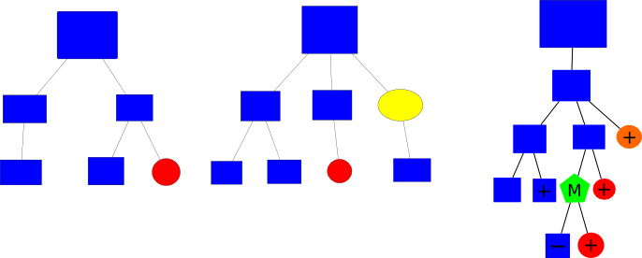
Algorithm (11)

Slide 31
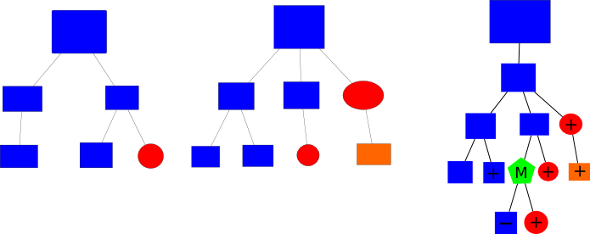
Algorithm (12)

Slide 32
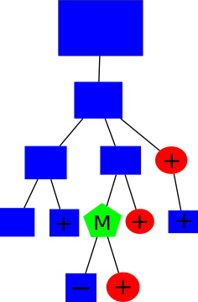
Algorithm (Final Output)

Slide 33
Applications
– Change tracking in office documents
– De-duplication of graphics, office, and news files
– Automation of system tasks
– Finding “new” items in a feed

Slide 34
Testing
Tested on 4 Documents
  2 XML files obtained by decompressing
    OpenOffice.org ODT Files
  2 SVG Image Files
Similar files with slight differences
Our program successfully detected the differences in both file types and returned the output in a tree to the user

Slide 35
Future Work
Use namespaces to distinguish “diff” attributes from application domain attributes
Create library for integrating with applications
Create an XML schema/DTD outlining the format so that diff files can be validated
Integration with XML applications

Slide 36
Questions?

