Slide 1

TRAFFIC SIGN RECOGNITION
DEEP LEARNING LAB Project
Name: Piyush Thakur - 49
Sajal Kamble - 62
Program: B. Tech – Computer Science and Engineering
Semester: VII
Slide 1 of 8

Slide 2

Dataset and Data Split
German Traffic Sign Recognition Benchmark (GTSRB)
43 classes: speed limits, Stop, Yield, No Entry and more
80 / 20 split
39,209 images form the training and validation sets.
12,630 separate images form the test set.
Slide 2 of 8
Notes:
Source: local training notebook. Training 31,367, validation 7,842, test 12,630. Stratification preserves class proportions. Chart uses literal counts from the notebook.

Slide 3
Image Preprocessing
1. Read and convert
OpenCV reads BGR. Convert to RGB.
2. Resize
Standardize every image to 32 × 32 × 3.
3. Normalize
Divide pixels by 255 to get values from 0 to 1.
4. Encode and split
Use one-hot labels and a stratified 80 / 20 split.
The app applies the same RGB, resizing and normalization steps.
Slide 3 of 8

Slide 4
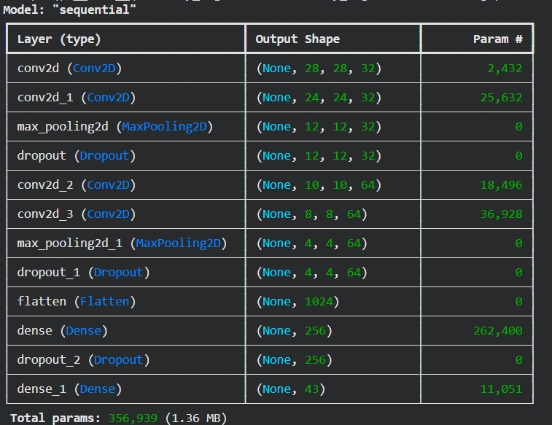
CNN Architecture
Feature extraction
2 Conv2D layers: 32 filters, 5 × 5
Max pooling + 25% dropout
2 Conv2D layers: 64 filters, 3 × 3
Max pooling + 25% dropout
Classification
Flatten: 1,024 values
Dense: 256 + 50% dropout
Softmax: 43 output classes
Slide 4 of 8
Notes:
Source: supplied model summary and notebook. ReLU in convolution and hidden dense layers. Valid padding. Total trainable parameters: 356,939.

Slide 5
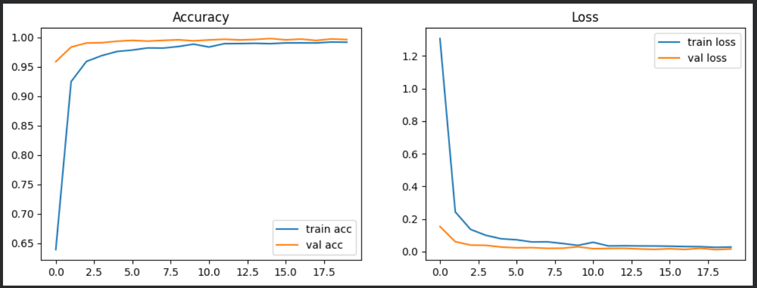
Training and Learning Curves
20 epochs Batch size 64 Optimizer: Adam
Loss: categorical crossentropy. Validation monitors unseen images.
Slide 5 of 8
Notes:
Source: supplied learning curves and notebook. Epoch indexes 0–19 indicate 20 epochs. Dropout runs during training and is disabled for validation.

Slide 6
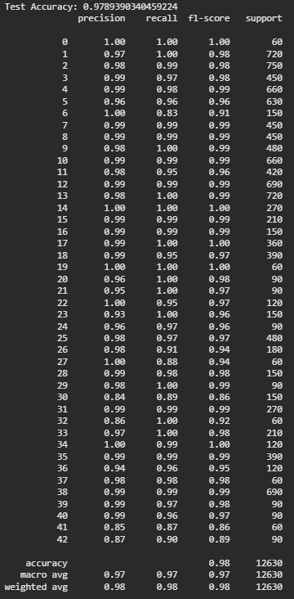
Test Results
97.89%
Test accuracy on 12,630 images
Macro F1-score: 0.97
Weighted F1-score: 0.98
Harder categories include ice / snow
and end of no passing.
Both have an F1-score of 0.86.
Slide 6 of 8
Notes:
Source: supplied latest classification report. Exact accuracy 0.9789390340459224, rounded to 97.89%. Macro F1 0.97 and weighted F1 0.98 are rounded in the source. Class 30 and class 41 each have F1 0.86.

Slide 7
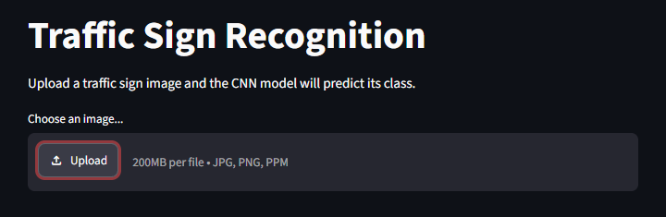
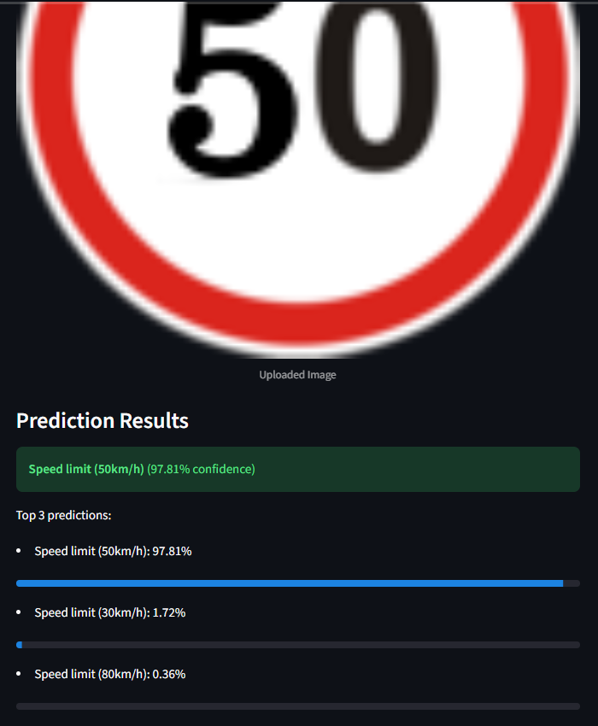
Streamlit Application Demo
1. Upload a traffic sign image
2. Apply the same preprocessing
3. Display the top 3 predictions
Example: 50 km/h, 97.81% confidence
Slide 7 of 8
Notes:
Source: supplied two Streamlit screenshots and app.py. Crops remove browser chrome and blank areas. Screenshot shows 50 km/h 97.81%, 30 km/h 1.72%, 80 km/h 0.36%. Model confidence for one example differs from test accuracy.

Slide 8
Conclusion and Future Scope
Project outcome
A CNN trained from scratch recognizes 43 traffic sign classes.
The supplied test run achieves 97.89% accuracy.
Current scope
Future improvements
Classifies an uploaded sign image.
Unrelated images still receive a class.
Full road scenes need sign localization.
Augment difficult sign classes.
Add an object detector for road scenes.
Explore TensorFlow Lite deployment.
Slide 8 of 8
Notes:
Source: notebook and app. Augmentation, object detection and TensorFlow Lite are proposed extensions, not implemented features.

