Slide 1

Closing the Gap
Benchmarking the Met's Modern Acquisitions
Against MoMA to Inform Tang Wing Strategy
Keagan Krauss - Data Wrangling and Retrieval Project

Slide 2

THE BUSINESS CONTEXT
The Met is opening a 70,000 sq ft wing in 2030, committed to underrepresented artists.
This analysis benchmarks the Met's current Modern Art acquisition composition against MoMA — providing data-driven evidence of where the Met stands on diversity, and whether its strategy is working ahead of the Tang Wing opening.
Met Strategic Acquisition Analysis

Slide 3
THE QUESTION
We expected to
find a gap.
The data told a
different story.
HYPOTHESIS
PROBLEM STATEMENT
The Met's Modern acquisitions were expected to show underrepresentation gaps relative to MoMA — the data revealed the opposite, with MoMA showing higher Western concentration than the Met.
How does the Met's Modern Art acquisition diversity compare to MoMA's — and what does that reveal about the strength of its strategy ahead of the Tang Wing?
Met Strategic Acquisition Analysis

Slide 4
THE DATA
Three sources. One story.
484,956 objects
Filtered to Modern Art department (14,464 objects).
Artist nationality, gender, accession year.
Met CSV
148,580 artworks
MoMA's official open-data Artists & Artworks CSVs. Nationality, gender, acquisition date.
MoMA CSV
Most-visited art museums
Annual visitor data scraped using requests + pd.read_html() to add public engagement context.
Wiki Web Scrape
Met Strategic Acquisition Analysis

Slide 5
DATA WRANGLING AND CLEANING
+
CHALLENGES
Pipe-Separated Fields
`str.split('|').str[0]` to extract first artist when multiple artists shared a work. Clean, reusable pattern.
The API Saga
Met API rate-limited after repeated calls, Cloudflare 403 blocking requests entirely. Pivoted to Met open-access CSV (484k objects, no API needed).
Nationality Standardisation
Regex to collapse "American, born Russia"→ "American". Without this, 274 artists would be miscounted as non-American.
Missing Data
Dropped 67 rows with null Artist Nationality, 170 with null AccessionYear. Culture column dropped entirely - too sparse to support analysis.
Type Conversion
pd.to_numeric(errors='coerce') for AccessionYear, pd.to_datetime().dt.year for MoMA's DateAcquired.
Two different date formats, one consistent analysis variable.
MoMA Format Mismatch
Nationality had malformed duplicates like “American) (American” and blank strings hiding as valid entries. Fixed with .str.strip(), empty string to NaN conversion, and .str.split(“)”)
Met Strategic Acquisition Analysis

Slide 6
PROJECT MANAGEMENT
THE PLAN: Asana Kanban Board
Tasks spanning ideation, data collection, cleaning, EDA, visualisation, and presentation. Followed the Day 1–5 bootcamp brief as the project backbone.
WHAT ADAPTED: Pivots Along the Way
Original plan used the Met API for bulk data. After hitting Cloudflare rate-limiting, pivoted to the open-access CSV — a faster, cleaner, and more complete data source. Better outcome than the original plan.
RISK MANAGEMENT: The API
Primary risk was data access failure — it materialised on Day 2. Mitigation: instructor consultation, pivot to CSV, kept MoMA and Wikipedia scrape on track independently. Project delivered on schedule.
Met Strategic Acquisition Analysis

Slide 7
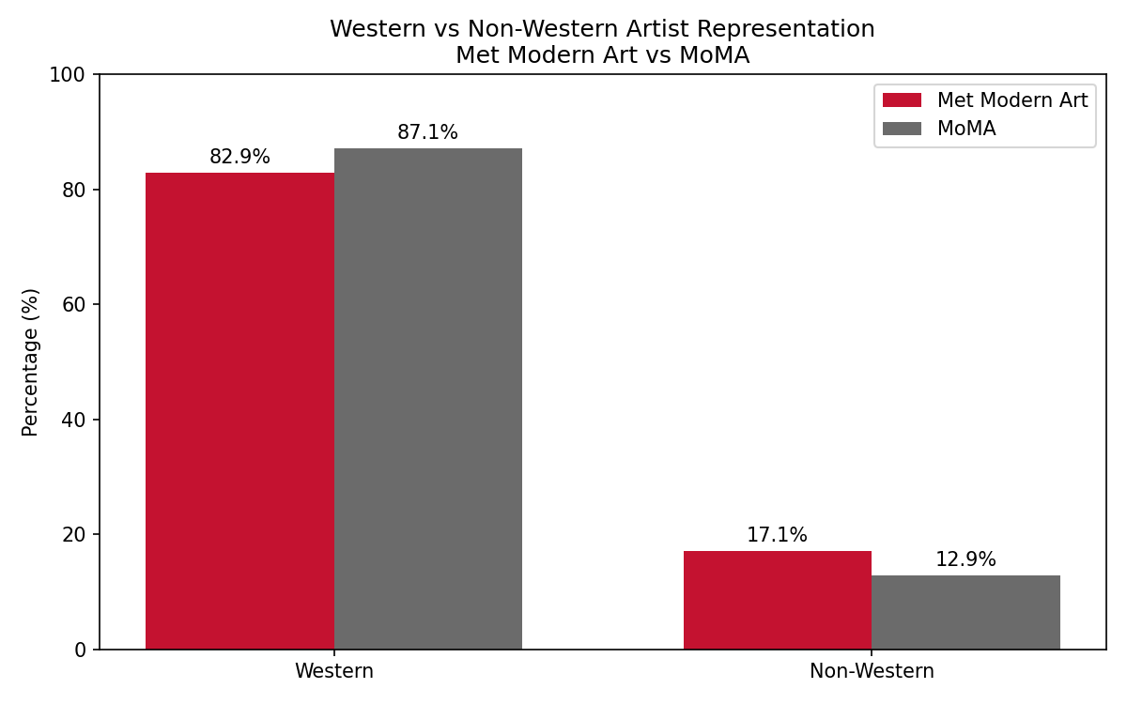
4.2%
FINDING 1
The Met outperforms MoMA on non-Western representation
Higher Non-Western representation
at the Met vs MoMA
Met Strategic Acquisition Analysis

Slide 8
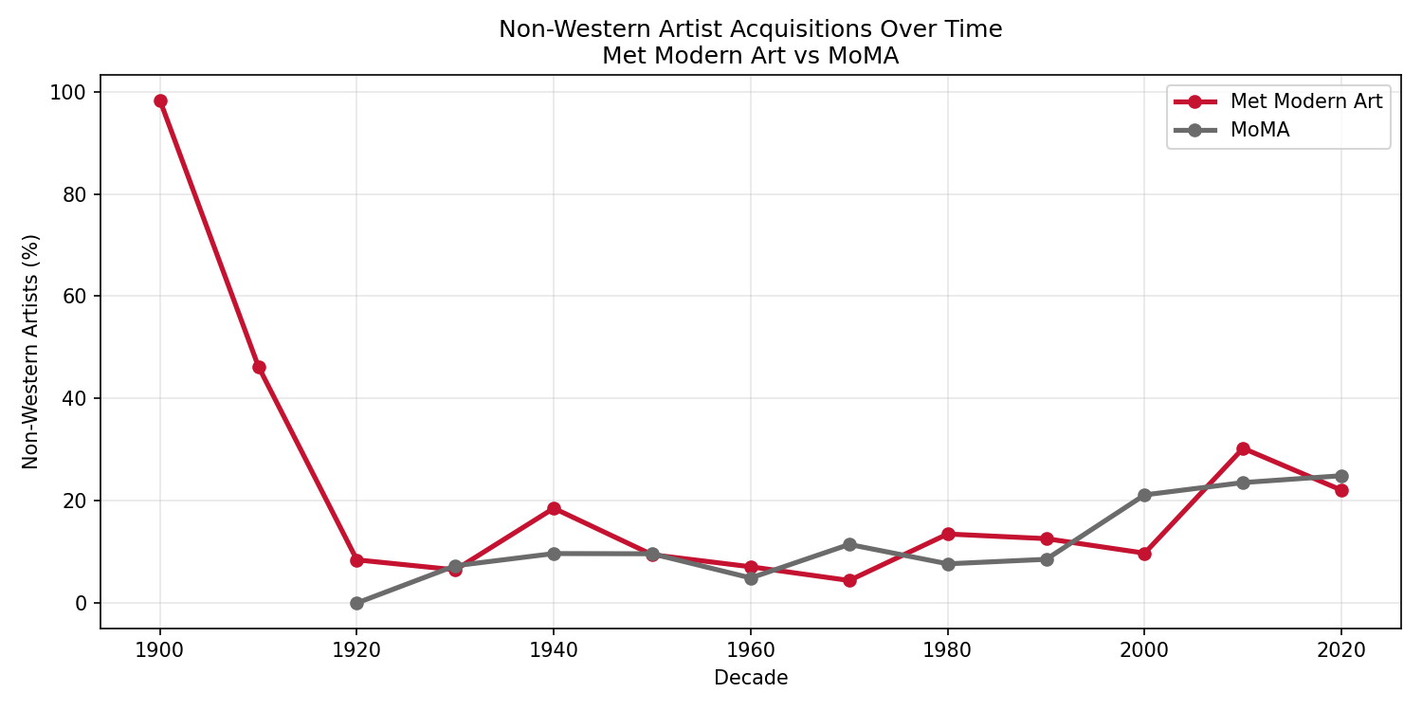
FINDING 2
The Met is accelerating faster — and the Tang Wing is why
↑ Met 2010s: 30.3% Non-Western — highest ever, driven by Tang Wing strategy
Met Strategic Acquisition Analysis

Slide 9
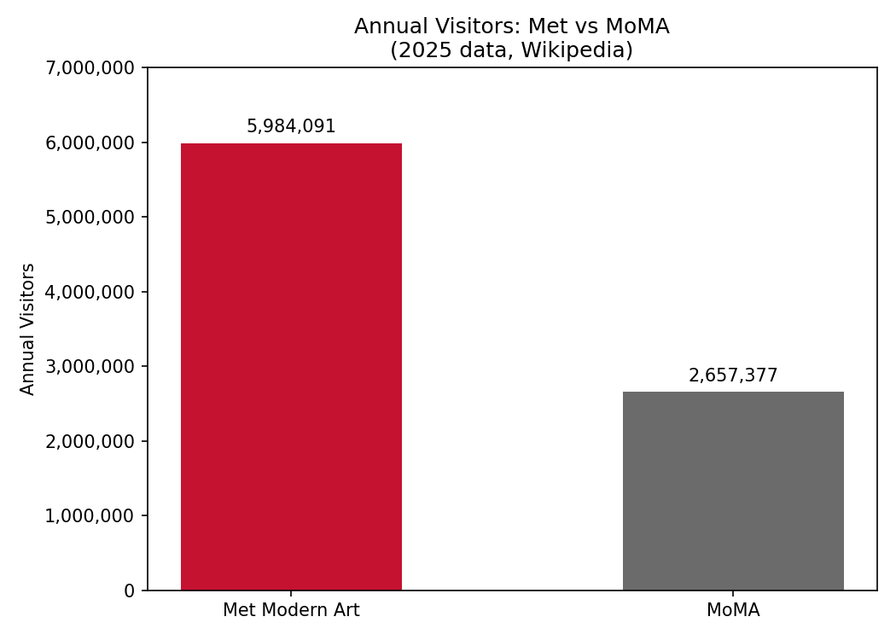
2.25×
FINDING 3
The Met serves 2.25× more visitors than MoMA annually
More visitors reach
the Met each year
Met Strategic Acquisition Analysis

Slide 10
FINDINGS
The Met is already
more diverse than MoMA.
17.1%
12.9%
30.3%
Met non-Western
MoMA non-Western
Met 2010s peak
Met Strategic Acquisition Analysis

Slide 11
INTERPRETATION
Institutional mission shapes collection — not just intention
THE MET
MoMA
Encyclopedic mission spanning 5,000 years of global art history. Collecting globally is embedded in its DNA — non-Western acquisition is a structural feature, not a recent initiative.
The Tang Wing is an amplification of what the Met already does.
Founded to champion Modernism — a movement with Western European origins. MoMA's collection is structurally Western, regardless of its stated diversity ambitions.
Reputation and reality diverge in a measurable, data-backed way.
Met Strategic Acquisition Analysis

Slide 12

CONCLUSION
The data validates the Tang Wing strategy
Hypothesis Refuted:
The Met already outperforms MoMA on non-Western representation (17.1% vs 12.9%)
Accelerating Trend:
Both institutions show growing non-Western acquisitions post-2000 — the Met leads with 30.3% in the 2010s
Higher Stakes:
At 2.25× more annual visitors, the Met's collection choices reach a far larger public than MoMA's
Strategic Validation:
The Tang Wing is not a course correction — it is an institutional commitment to accelerate a shift already underway in the data
Met Strategic Acquisition Analysis

Slide 13
FURTHER QUESTIONS
WHAT TO EXPLORE NEXT
Gender Representation
Does gender diversity follow similar patterns to nationality? Gender data exists in both datasets but was sparse — a dedicated analysis could reveal a complementary story.
Market Value Correlation
Would cross-referencing auction data reveal whether diversity in acquisitions correlates with commercial value? Museums as early indicators of market trends.
Broader Peer Comparison
How do other major encyclopedic museums compare — Smithsonian, British Museum, Rijksmuseum? Is the Met's pattern unique or sector-wide?
Met Strategic Acquisition Analysis

Slide 14

Thank You
Keagan Krauss - Closing the Gap: Met Strategic Acquisition Analysis

