Slide 1

VU Design and Implementation of a Rendering Engine
Content: Rendering engine internals
Challenges
Architectural: how to structure reusable software modules
Technical: how to use hardware efficiently
Dealing with tradeoffs: usability vs performance
Topics
Graphics APIs Insights (OpenGL, Direct3D, Vulkan,..)
Scene representation, domain specific languages
performance optimization and data structures
Systematic performance evaluation
Scene description
Optimization
GPU code
Notes:
all our projects are built using our open-source research platform
It is based on a number of novel approaches, published at major conferences (e.g. high performance graphics)
to the best of our knowledge this is currently the fastest and most concise rendering platform
Goal for 2017: friendly landing page and examples/tutorials for non-experts and first-time users
OpenGL, Vulkan
Windows, Linux
Elm: a delightful language for reliable web-apps (http://elm-lang.org/)

Slide 2
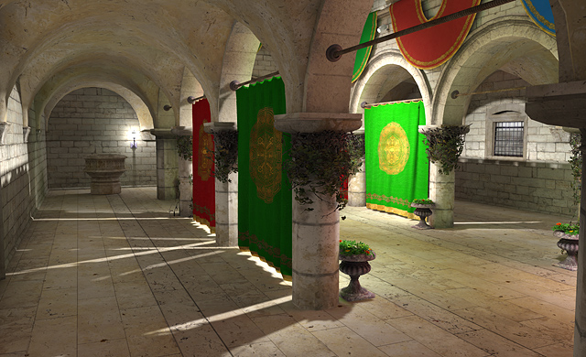
More information
see also:
https://www.cg.tuwien.ac.at/courses/RendEng/
Organization
3 ECTS ~ half lecture, half exercise (see TISS):
rendering engine component, optimization technique,…
Monday, 16:15 (s.t.)-17:45, Seminarraum 186
First lecture: 06.03.2023
Background
Lecturers bring together academic and industry experience
The lecture combines:
State of the art rendering engine architecture and implementation
Years of rendering engine development experience (in research and industry)

