Slide 1
Agenda:
What is XML ?
Why we use XML ?
XML vs. HTML
DOM in XML
XML HttpRequest
Namespace in XML
XML Examples
Summary
Useful links

Slide 2
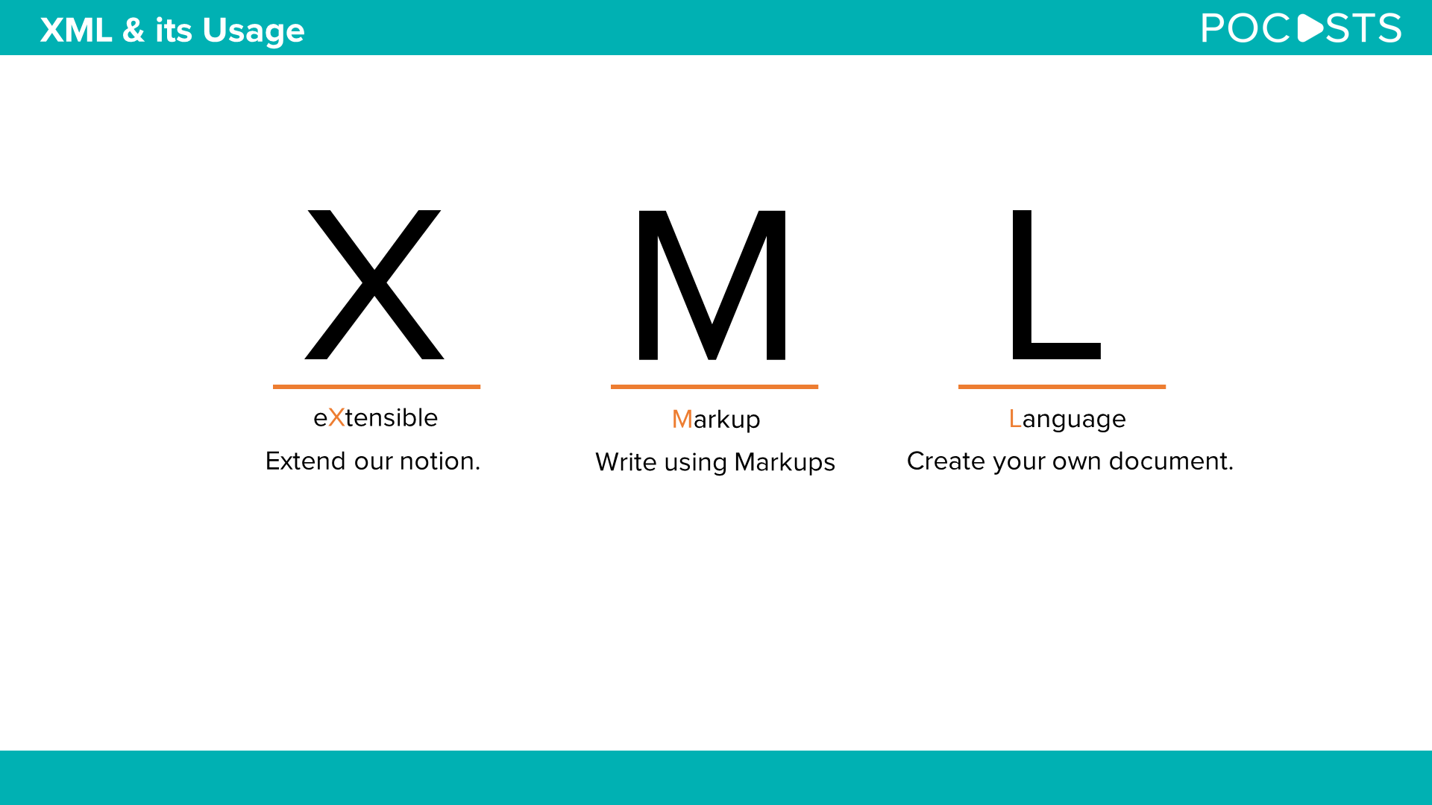
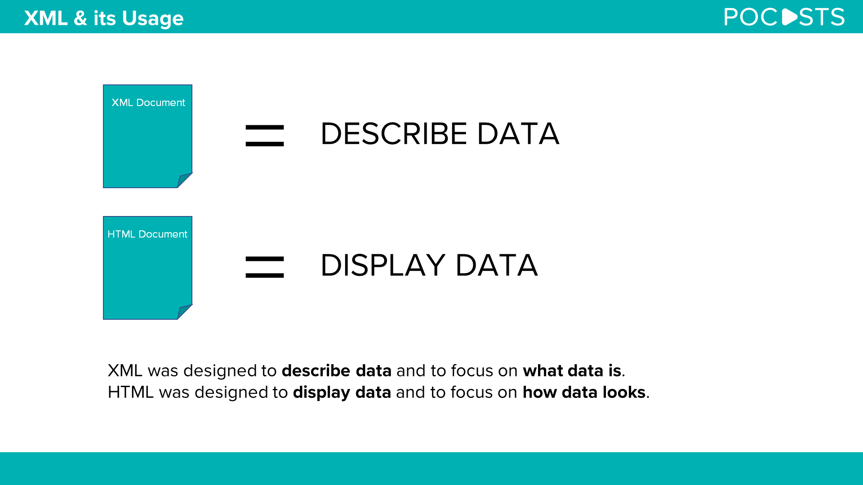
The XML language is intended for storing and transferring data

Slide 3
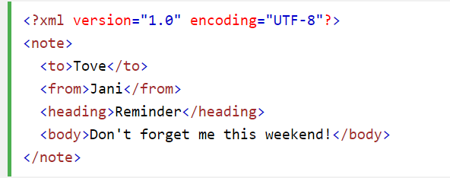
What is XML?
XML is a markup language that resembles HTML;
XML is intended for storing and transferring data;
XML tags aren’t predefined. You must define the tags what you need;
XML is described in such a way as to be self-defined.

Slide 5
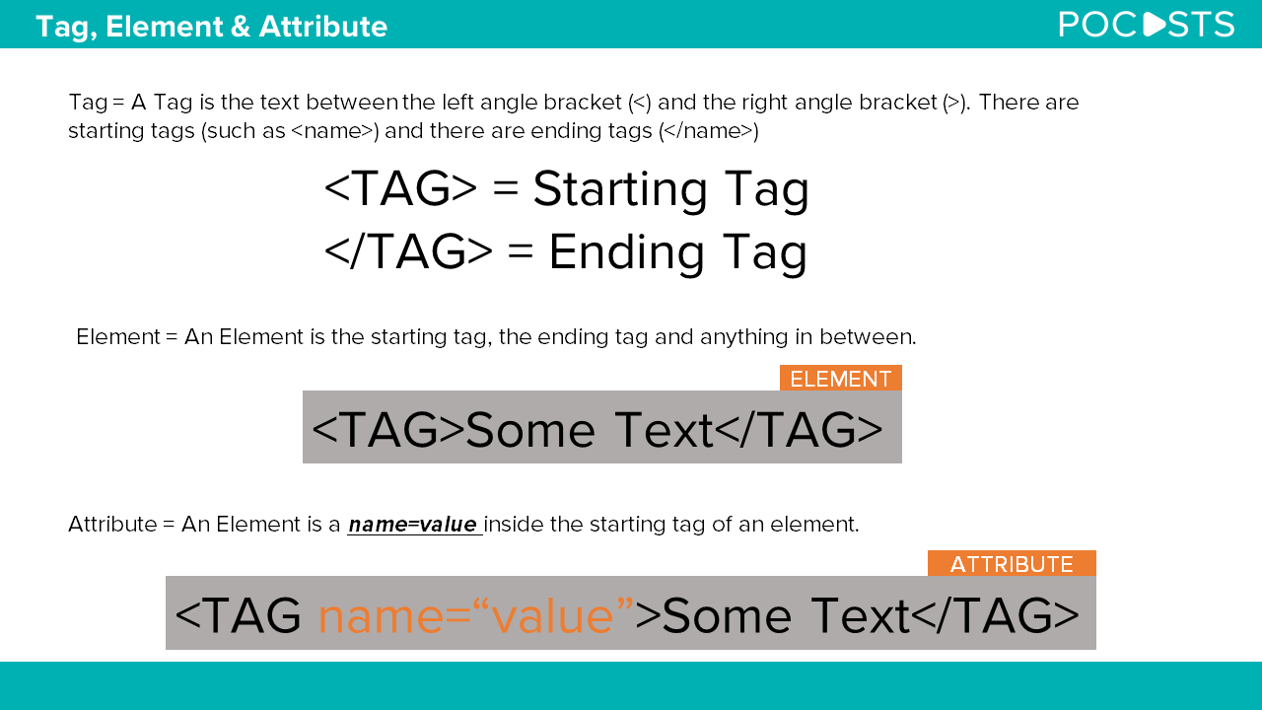

Slide 6
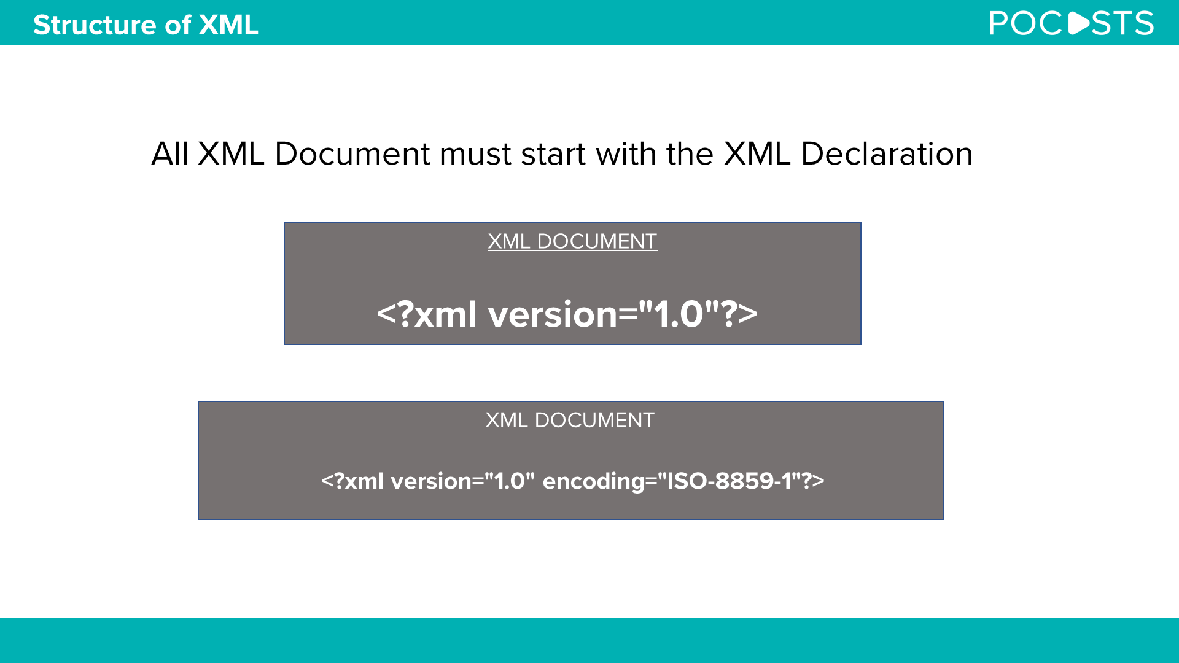

Slide 7
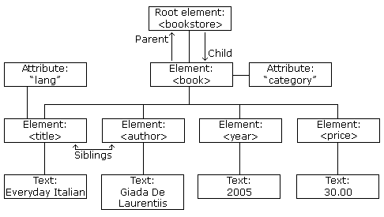
XML DOM
What is the DOM?
The DOM defines a standard for accessing and manipulating documents:
"The W3C Document Object Model (DOM) is a platform and language-neutral interface that allows programs and scripts to dynamically access and update the content, structure, and style of a document."
The HTML DOM defines a standard way for accessing and manipulating HTML documents. It presents an HTML document as a tree-structure.
The XML DOM defines a standard way for accessing and manipulating XML documents. It presents an XML document as a tree-structure.

Slide 8
XML HttpRequest
All modern browsers have a built-in XMLHttpRequest object to request data from a server.
The XMLHttpRequest Object
The XMLHttpRequest object can be used to request data from a web server.
The XMLHttpRequest object is a developers dream, because you can:
Update a web page without reloading the page
Request data from a server - after the page has loaded
Receive data from a server - after the page has loaded
Send data to a server - in the background

Slide 9
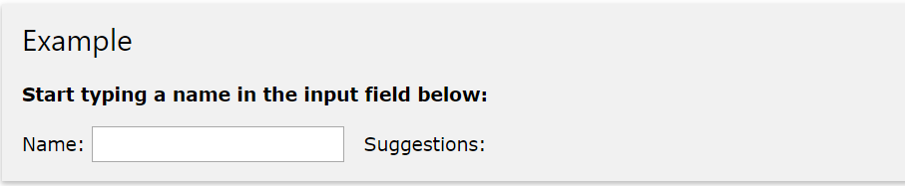
XMLHttpRequest Example
When you type a character in the input field below, an
XMLHttpRequest is sent to the server, and some name
suggestions are returned (from the server):

Slide 10
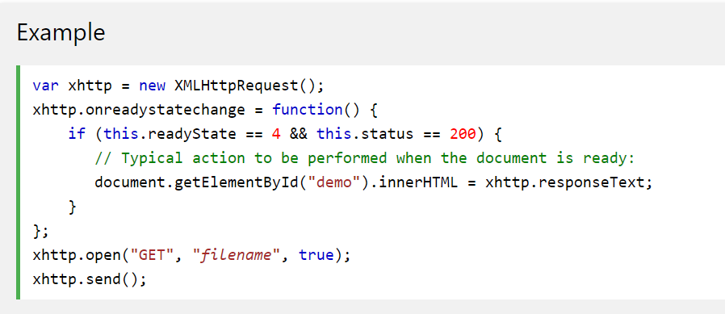
Sending an XMLHttpRequest
A common JavaScript syntax for using the XMLHttpRequest object looks much like this:

Slide 11

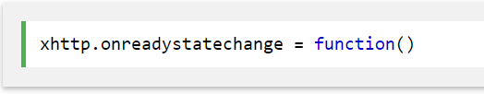

Example Explained
The first line in the example above creates an XMLHttpRequest object:
The onreadystatechange property specifies a function to be executed every time the
status of the XMLHttpRequest object changes:
When readyState property is 4 and the status property is 200, the response is ready:

Slide 12
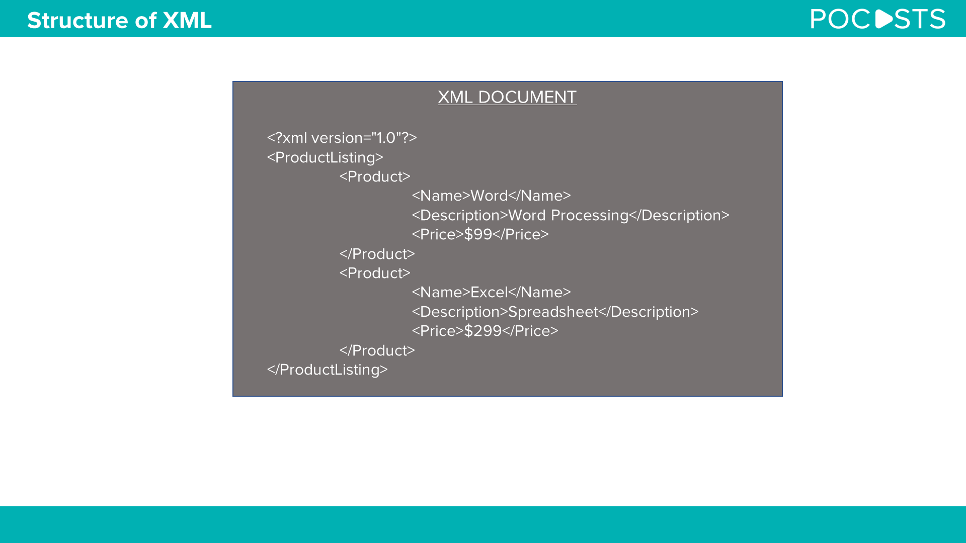

Slide 13
XML Namespaces
Name Conflicts
In XML, element names are defined by the developer. This often results in a conflict when trying to mix XML documents from different XML applications.
This XML carries HTML table information:
<table> <tr> <td>Apples</td> <td>Bananas</td> </tr> </table>
This XML carries information about a table (a piece of furniture):
<table> <name>African Coffee Table</name> <width>80</width> <length>120</length> </table>
If these XML fragments were added together, there would be a name conflict. Both contain a <table> element, but the elements have different content and meaning.
A user or an XML application will not know how to handle these differences.

Slide 14
Solving the Name Conflict Using a Prefix
Name conflicts in XML can easily be avoided using a name prefix.
This XML carries information about an HTML table, and a piece of furniture:
<h:table> <h:tr> <h:td>Apples</h:td> <h:td>Bananas</h:td> </h:tr> </h:table> <f:table> <f:name>African Coffee Table</f:name> <f:width>80</f:width> <f:length>120</f:length> </f:table>
In the example above, there will be no conflict because the two <table> elements have different names.

Slide 15
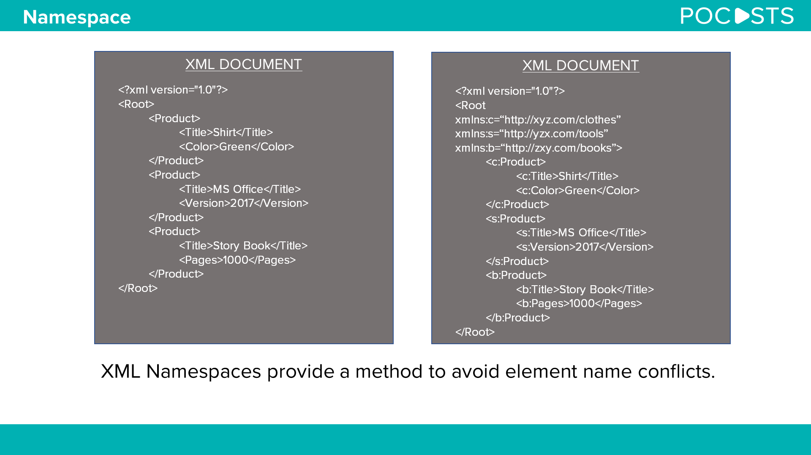

Slide 16
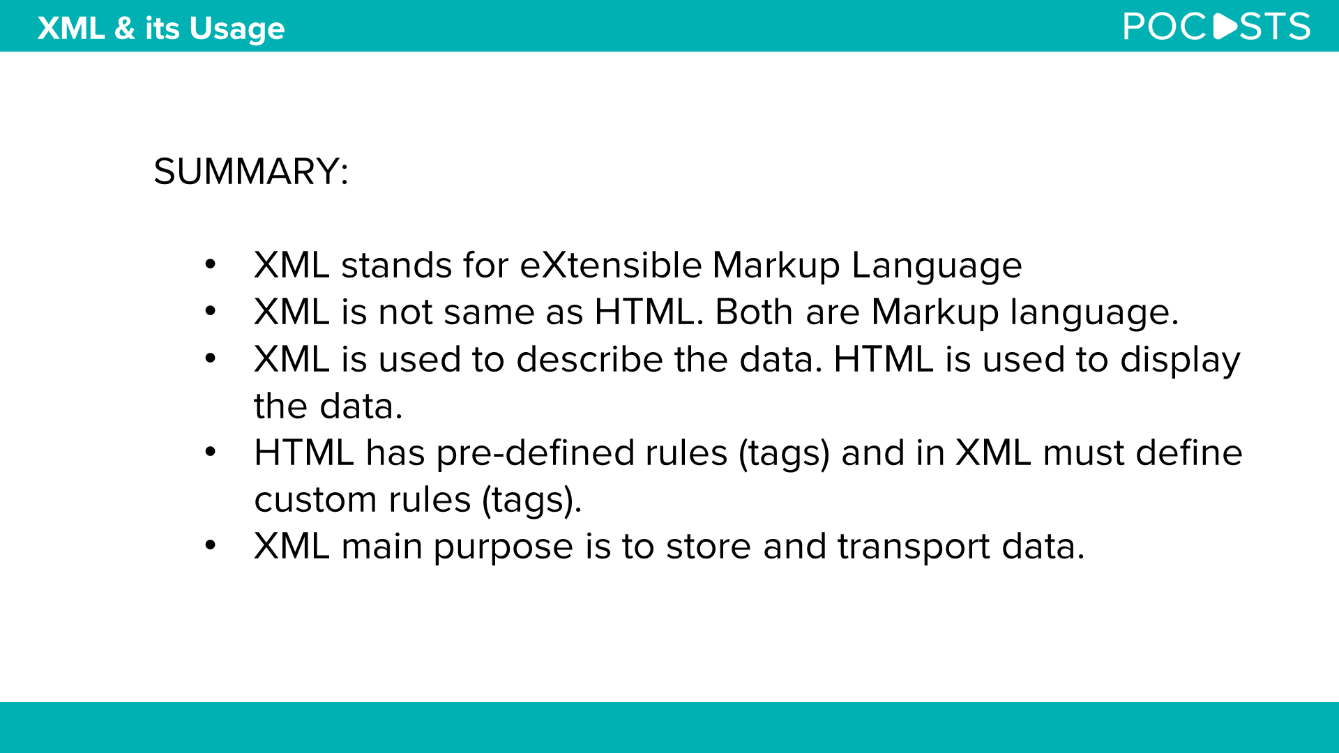

Slide 17


