Slide 1
Taiwanese Credit Card Clients
https://github.com/kravigupta/Taiwanese_Credit_Card_Client_Fraud_detection
Team Members:
Aditya Sarode
Calvin Castelino
Ravi Gupta
Shawn Gomes
Hackathon 1 – Group 4

Slide 2
Agenda
Problem Statement
Data Sources and EDA
Feature Engineering
Machine Learning Model
Conclusion and Recommendations.
Notes:
https://github.com/kravigupta/Taiwanese_Credit_Card_Client_Fraud_detection

Slide 3
Problem Statement
Certain Cases of Customers default on Payments in Taiwan.
From a Risk Management Perspective a Bank/Credit Card Company is more interested in minimizing their losses towards a particular customer.
Goal: To compute the predictive accuracy of probability of default for a Taiwanese Credit Card Client.
Problem Analysis – Classify Probability of default for next month: 1 as “Default” and 0 as “Not Default”.
Notes:
The information that is more valuable to them is estimating the probability of default rather than classifying a customer as credible/not credible.

Slide 4
Data Source
Data available at - https://archive.ics.uci.edu/ml/datasets/default+of+credit+card+clients
Data Consists of -
23 features
30000 records
ID column considered as Index
20 Numeric Features -
LIMIT_BAL, AGE,
PAY_0, PAY_2, PAY_3, PAY_4, PAY_5, PAY_6,
BILL_AMT1, BILL_AMT2, BILL_AMT3, BILL_AMT4, BILL_AMT5, BILL_AMT6,
PAY_AMT1, PAY_AMT2, PAY_AMT3, PAY_AMT4, PAY_AMT5, PAY_AMT6
3 Categorical Features -
SEX, EDUCATION, MARRIAGE
Notes:
ID: ID of each client ● LIMIT_BAL: Amount of given credit in NT dollars (includes individual and family/supplementary credit ● SEX: Gender (1=male, 2=female) ● EDUCATION: (1=graduate school, 2=university, 3=high school, 4=others, 5=unknown, 6=unknown) ● MARRIAGE: Marital status (1=married, 2=single, 3=others) ● AGE: Age in years ● PAY_0: Repayment status in September, 2005 (-1=pay duly, 1=payment delay for one month, 2=payment delay for two months, ... 8=payment delay for eight months, 9=payment delay for nine months and above) 6 CONFIDENTIAL © ● PAY_2: Repayment status in August, 2005 (scale same as above) ● PAY_3: Repayment status in July, 2005 (scale same as above) ● PAY_4: Repayment status in June, 2005 (scale same as above) ● PAY_5: Repayment status in May, 2005 (scale same as above) ● PAY_6: Repayment status in April, 2005 (scale same as above) ● BILL_AMT1: Amount of bill statement in September, 2005 (NT dollar) ● BILL_AMT2: Amount of bill statement in August, 2005 (NT dollar) ● BILL_AMT3: Amount of bill statement in July, 2005 (NT dollar) ● BILL_AMT4: Amount of bill statement in June, 2005 (NT dollar) ● BILL_AMT5: Amount of bill statement in May, 2005 (NT dollar) ● BILL_AMT6: Amount of bill statement in April, 2005 (NT dollar) ● PAY_AMT1: Amount of previous payment in September, 2005 (NT dollar) ● PAY_AMT2: Amount of previous payment in August, 2005 (NT dollar) ● PAY_AMT3: Amount of previous payment in July, 2005 (NT dollar) ● PAY_AMT4: Amount of previous payment in June, 2005 (NT dollar) ● PAY_AMT5: Amount of previous payment in May, 2005 (NT dollar) ● PAY_AMT6: Amount of previous payment in April, 2005 (NT dollar) ● default.payment.next.month: Default payment (1=yes, 0=no)

Slide 5
Numerical Features
BILL_AMT 6, BILL_AMT 5……….BILL_AMT 1
PAY_AMT6, PAY_AMT5……...PAY_AMT1
PAY_2, PAY_3 ………. PAY_6
Represents Amount of Bill Statement in each month from April to Sep 2005
Represents Amount of Previous Payment in each month from April to Sep 2005
Represents Repayment Status in each month from April to Sep 2005

Slide 6
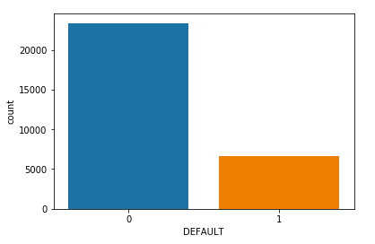
Target Variable
Whether a person is default or not
Not default - 0 - 23364 Default - 1 - 6636

Slide 7
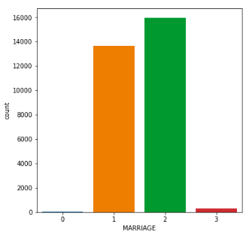
Categorical - Marriage
2 15964 1 13659 3 323 0 54 ← Missing Values

Slide 8
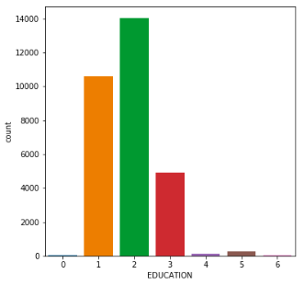
Categorical - Education
2 14030 1 10585 3 4917 5 280 4 123 6 51 0 14 ← Missing Values

Slide 9
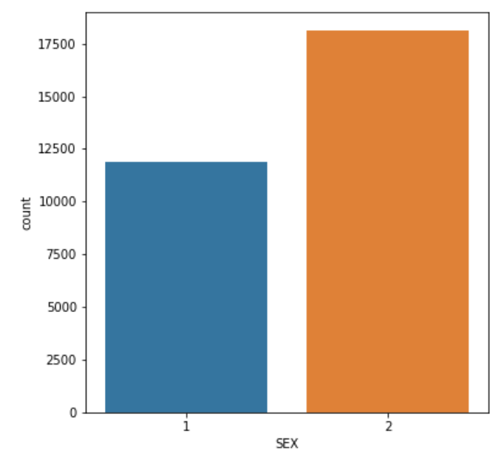
Categorical - Sex
2 18112 1 11888

Slide 10
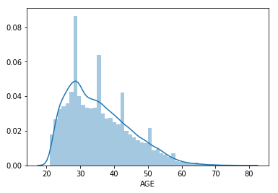
AGE
Range
21 - 79 years
Mean
35.485500
Std
9.217904

Slide 11
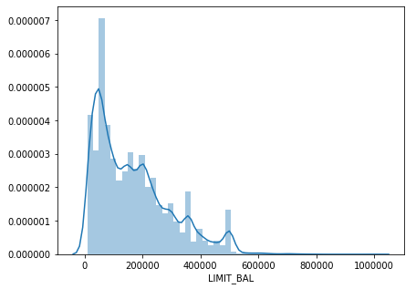
Limit Balance
Range
10000 - 1000000
Mean
167484.322
Std
129747.66

Slide 12
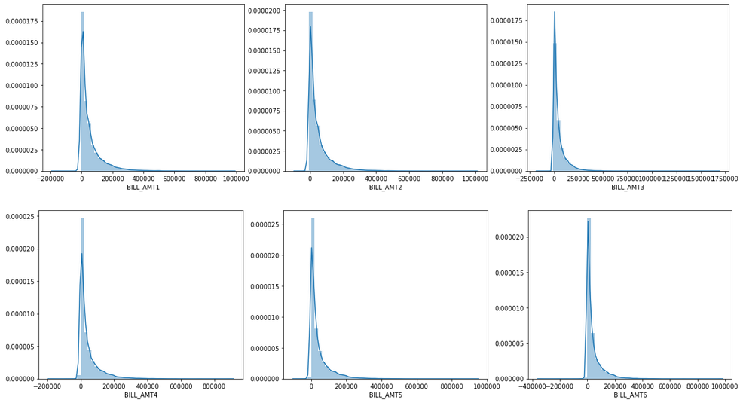
BILL_AMTx
Continuous
Contains both
positive and
negative values

Slide 13
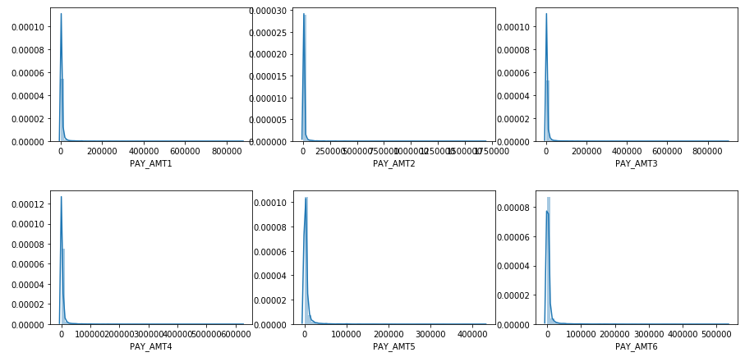
PAY_AMTx
Continuous
Positive values
Min - 0 (zero)

Slide 14
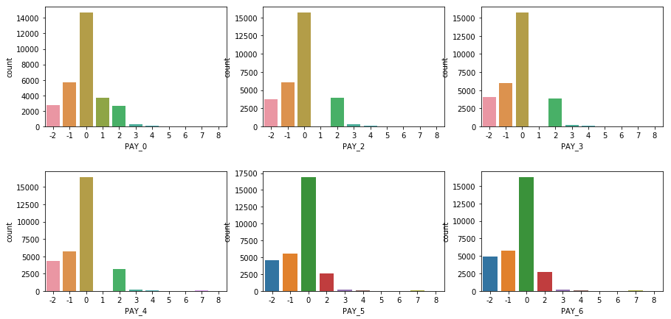
PAY_x
Values from
-2 to 8
Value - 0
(People paid
in same month
after due date)

Slide 15
Findings
No direct Missing Values
Zero NaN, missing values
For Features - Marriage, Education
Missing values are marked as 0 (zero)
Relation between
Bill amounts of previous month <--> Pay amount of current month
If a previous month bill amount was high
Next month can be default

Slide 16
Feature Engineering

Slide 17
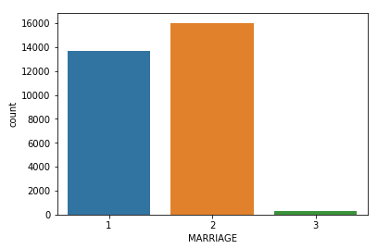
Imputation - MARRIAGE
MARRIAGE
54 values are zero
We can impute this with mode

Slide 18
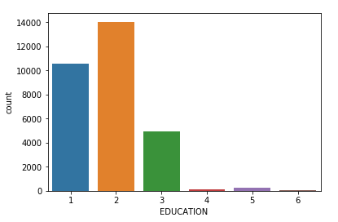
Imputation - EDUCATION
EDUCATION
14 values are zero
We can impute this with mode

Slide 19
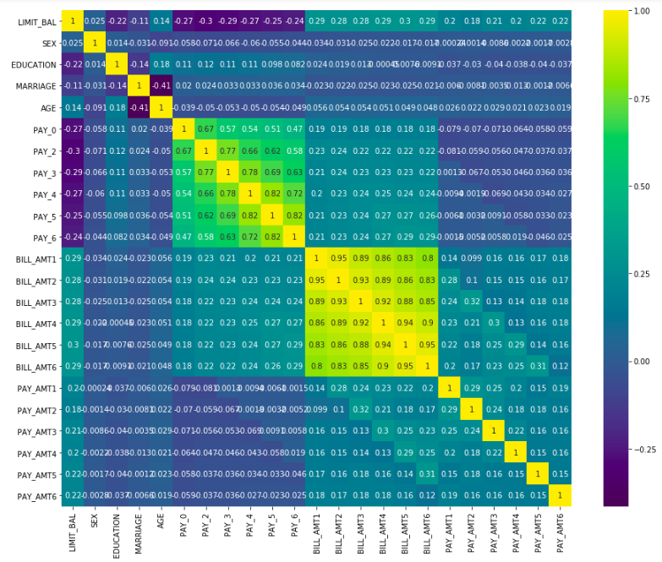
Correlation
High correlation among BILL_AMTx features
High correlation among PAY_x features

Slide 20
One Hot Encoding
MARRIAGE, SEX, and EDUCATION are numeric values but these are really categorical.
These can be one hot encoded.
First converted to category features
Next, pd.get_dummies to encode.

Slide 21
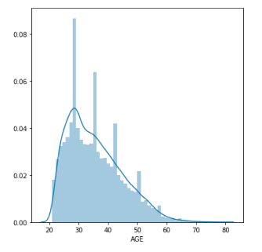
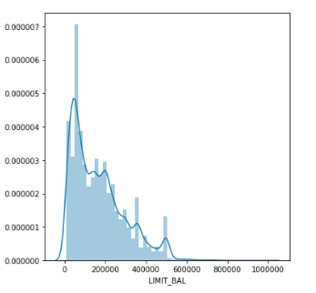
Skewness Handling
For AGE and LIMIT_BAL

Slide 22
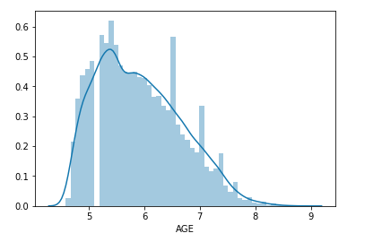
Transformation for AGE
Square Root Transform

Slide 23
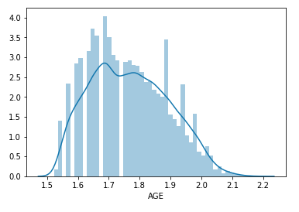
Transformation for AGE
Square Root Transform
Log Transform

Slide 24
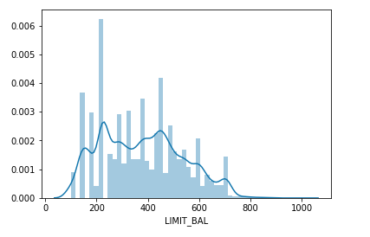
Transformation for LIMIT_BAL
Square Root Transform

Slide 25
New Features - Ratio
Pay Amount
Bill Amount
Ratio
(Higher the ratio, lesser the chance of Default)
Negative/NaN number handling:
If Bill Amount <= 0 : Then convert Ratio to positive
Impute NaN to 1

Slide 26
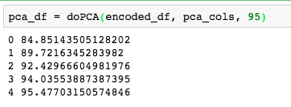
PCA
Apply PCA on highly correlated features:
Pay Amt
Bill Amt
Ratio
Variance Threshold: 95 %

Slide 27
Model

Slide 28
Re-Sampling
The target variable is not balanced.
Possible ways of dealing:
Under Sampling
Over Sampling
No Sampling
Winner: Undersampling

Slide 29
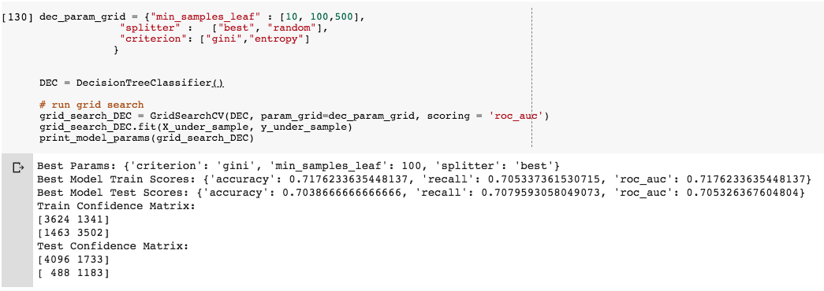
Model - Decision Tree Classifier

Slide 30
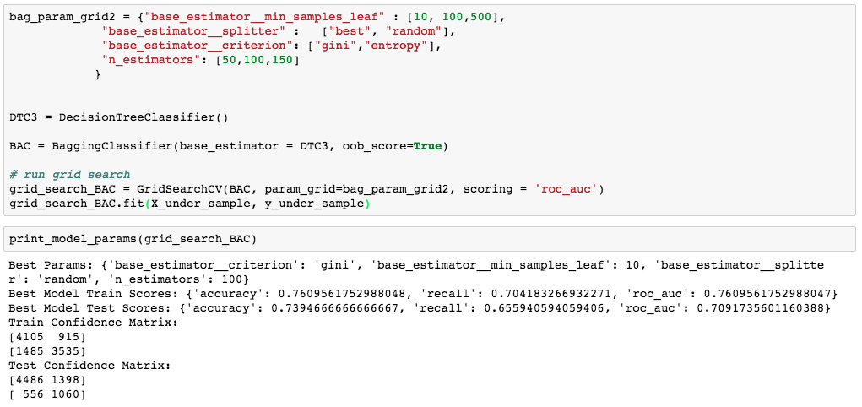
Model - Bagging with DTs

Slide 31
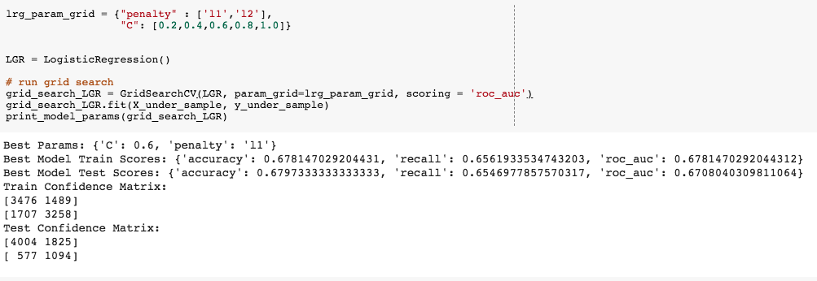
Model - Logistic Regression

Slide 32
Conclusion
Tried without feature engineering - Almost same results
Possible Improvements:
Remove outliers
Extend Grid Search Parameters
Ensembling the three model from previous slides
Github Profile
https://github.com/kravigupta/Taiwanese_Credit_Card_Client_Fraud_detection

