Slide 1
Introduction to Programming with Python

Slide 2

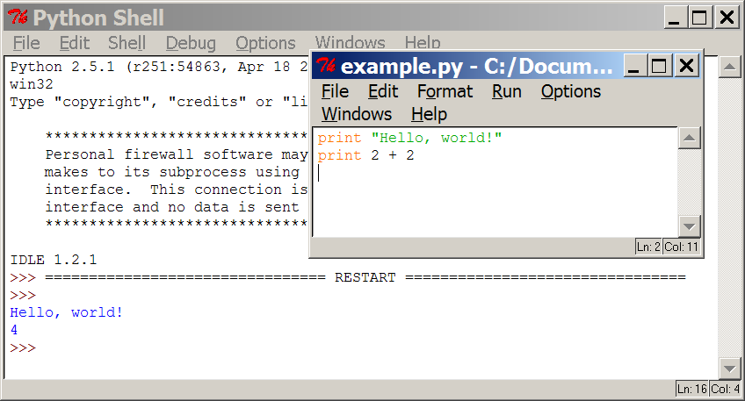
Programming basics
code or source code: The sequence of instructions in a program.
syntax: The set of legal structures and commands that can be used in a particular programming language.
output: The messages printed to the user by a program.
console: The text box onto which output is printed.
  Some source code editors pop up the console as an external window, and others contain their own console window.

Slide 3
What is Python?
Python is a programming language. It was created by Guido van Rossum, and released in 1991.
It is used for:
web development (server-side),
software development,
mathematics,
system scripting.

Slide 4
What can Python Do ?
Python can be used on a server to create web applications.
Python can be used alongside software to create workflows.
Python can connect to database systems. It can also read and modify files.
Python can be used to handle big data and perform complex mathematics.
Python can be used for rapid prototyping, or for production-ready software development.

Slide 5
Why Python?
Python works on different platforms (Windows, Mac, Linux, Raspberry Pi, etc).
Python has a simple syntax similar to the English language.
Python has syntax that allows developers to write programs with fewer lines than some other programming languages.
Python runs on an interpreter system, meaning that code can be executed as soon as it is written. This means that prototyping can be very quick.
Python can be treated in a procedural way, an object-orientated way or a functional way.

Slide 6
Good Know
The most recent major version of Python is Python 3, which we shall be using in this tutorial. However, Python 2, although not being updated with anything other than security updates, is still quite popular.

Slide 7
Python syntax compared to other Languages
Python was designed for readability, and has some similarities to the English language with influence from mathematics.
Python uses new lines to complete a command, as opposed to other programming languages which often use semicolons or parentheses.
Python relies on indentation, using whitespace, to define scope; such as the scope of loops, functions and classes. Other programming languages often use curly-brackets for this purpose.

Slide 8



Compiling and interpreting
Many languages require you to compile (translate) your program into a form that the machine understands.
Python is instead directly interpreted into machine instructions.
compile
execute
source code
Hello.java
byte code
Hello.class
output
interpret
source code
Hello.py
output

Slide 9
Math commands
Python has useful commands for performing calculations.
To use many of these commands, you must write the following at the top of your Python program:
  from math import *
Command name | Description
abs(value) | absolute value
ceil(value) | rounds up
cos(value) | cosine, in radians
floor(value) | rounds down
log(value) | logarithm, base e
log10(value) | logarithm, base 10
max(value1, value2) | larger of two values
min(value1, value2) | smaller of two values
round(value) | nearest whole number
sin(value) | sine, in radians
sqrt(value) | square root
Constant | Description
e | 2.7182818...
pi | 3.1415926...

Slide 10
print
print : Produces text output on the console.
Syntax:
  print "Message"
  print Expression
  Prints the given text message or expression value on the console, and moves the cursor down to the next line.
  print Item1, Item2, ..., ItemN
  Prints several messages and/or expressions on the same line.
Examples:
  print "Hello, world!"
  age = 45
  print "You have", 65 - age, "years until retirement"
  Output:
  Hello, world!
  You have 20 years until retirement

Slide 11
input
input : Reads a number from user input.
  You can assign (store) the result of input into a variable.
  Example:
  age = input("How old are you? ")
  print "Your age is", age
  print "You have", 65 - age, "years until retirement"
  Output:
  How old are you? 53
  Your age is 53
  You have 12 years until retirement

