Slide 1
The greatest powerpoint presentation game you have ever played!!!
Note: to quit DO NOT press “end show”, but instead play past part one and obtain the “quit” button.
Press to load
Press to start

Slide 2
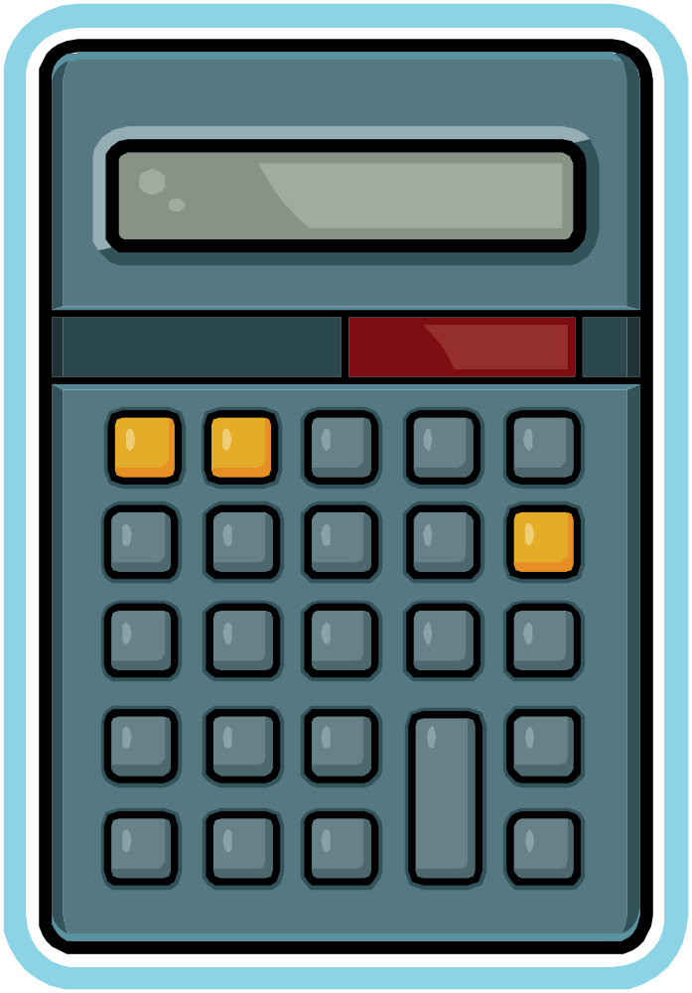
Go back
1
2
3
4
5
6
7
8
9
0

Slide 3
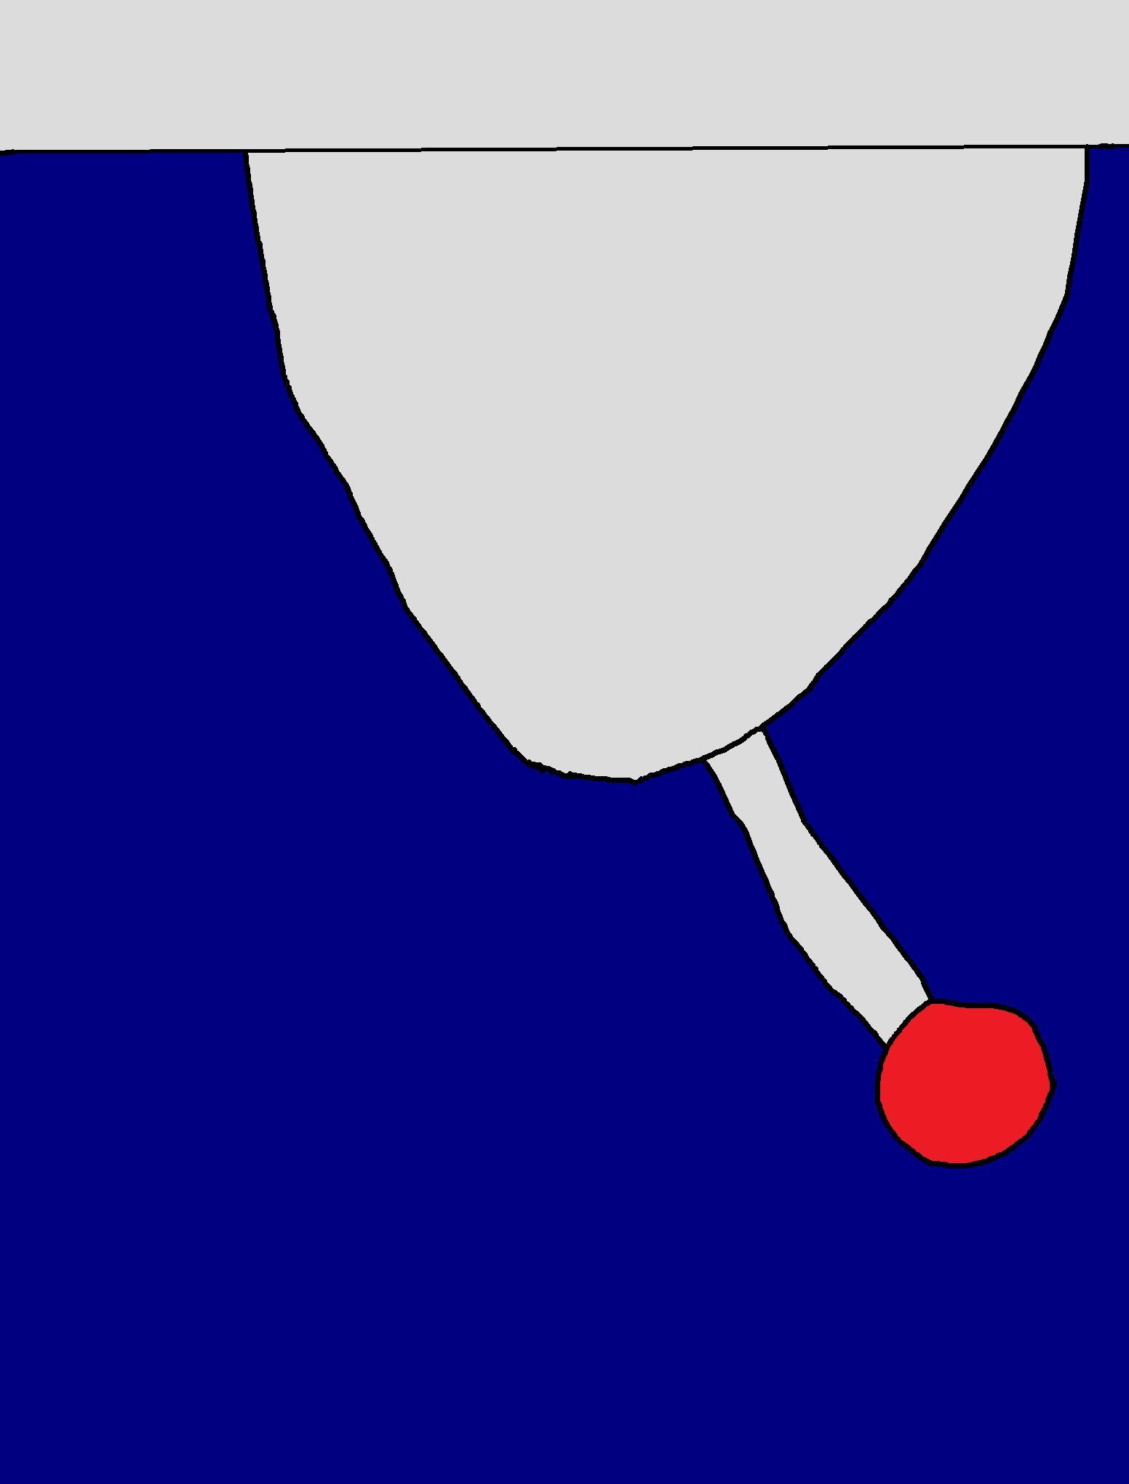
Click this to activate laser (on/off)
Do not click, this is you!
exit
laser

Slide 5
End of tutorial, click here to go back!
Other stuff revealed later.

Slide 6


Why am I here?
Where am I?
Who am I?

Slide 7
Ouch… my thigh hurts…
A laser! Guess I should get out of here first. There is a door behind this…

Slide 10
This one is strange…

Slide 11
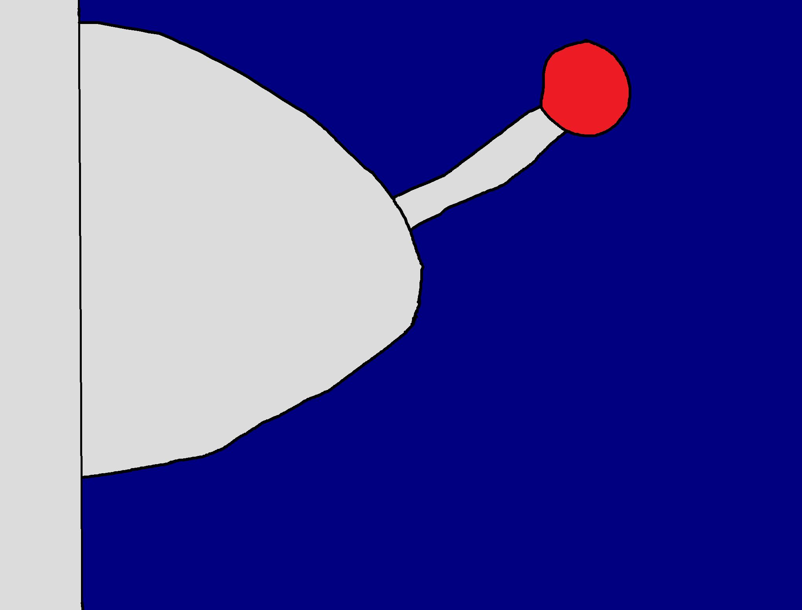

Click this if you do not know what a certain object is

Slide 12
Cut-off laser
(laser that can be cut off)
Click anywhere to go back

Slide 14
Arrgh! Why blue? Why slanted lasers? Why lasers but got levers?

Slide 31
Ahh… much better… no levers?! Although breaking mirrors is unlucky, looks like I will have to…

Slide 32
Mirror
Click this to rotate mirror
Lasers reflect off it.
If you have a hammer, click this to break mirror.
Return

Slide 33


Slide 37



Slide 38
Now there are 3 rooms! By the way, a mysterious magnet sucked my hammer away.

Slide 40
Actually, I would love to do the other room first.

Slide 45


Slide 59
I already went there!

Slide 62
Ahhh, the last level. Those green lasers are sensors which activate the really strong purple lasers which are blocking that normal laser from reaching the other end. Click the sensors or the blue part to control where you walk.
Click here to go back

Slide 69
STOPPED
HERE

Slide 83


