Slide 1

Introduction to Machine Learning Copyright © Michael Mayer

Slide 2
Data Science is 90% data preparation. This lecture is about the remaining 10%.

Slide 3
About Michael
Pricing actuary at Swiss Mobiliar (since 2018)
PhD in statistics (2008)
(M+C)² Blog: lorentzen.ch
github.com/mayer79

Slide 4
What is Machine Learning (ML)?
Collection of statistical algorithms used to
predict things (supervised ML) or to
investigate data structure (unsupervised ML).
This lecture is on supervised ML
Regression
Classification
Statistics
AI
ML

Slide 5
Lecture Overview
Basics and Linear Models
Model Selection and Validation
Trees
Neural Nets
Material: https://github.com/mayer79/ml_lecture
Presentation template: SlidesCarnival

Slide 6
1.
Basics and Linear Models
Basics – Linear Regression – GLMs

Slide 7
Basics

Slide 8
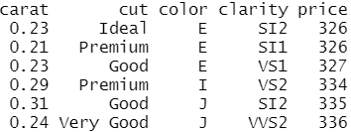

Intro
Organization of data?
Data types?
Descriptive analysis
Structure of diamonds data
Example

Slide 9
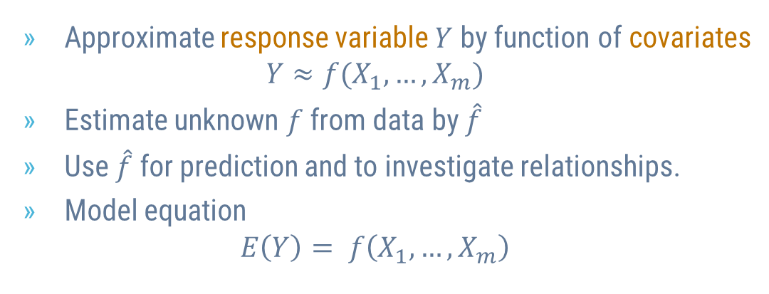
Statistical Models
Other terms?
Approximate response variable $Y$ by function of covariates $Y≈f(X_{1}, …, X_{m})$
Estimate unknown $f$ from data by $\hat{f}$
Use $\hat{f}$ for prediction and to investigate relationships.
Model equation $E\left(Y\right)= f\left(X_{1}, …, X_{m}\right)$
We are often interested in means/expectations

Slide 10
Linear Regression

Slide 11
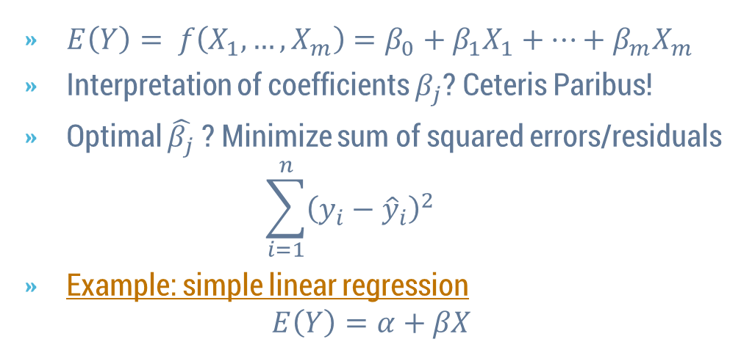

Linear Regression
$E\left(Y\right)= f\left(X_{1}, …, X_{m}\right)=β_{0}+β_{1}X_{1}+⋯+β_{m}X_{m}$
Interpretation of coefficients $β_{j}$? Ceteris Paribus!
Optimal $\hat{β_{j}}$ ? Minimize sum of squared errors/residuals $\sum_{i=1}^{n}{{\left({y_{i}−\hat{y}}_{i}\right)}^{2}}$
Example: simple linear regression $E\left(Y\right)=α+βX$
$\hat{y}=\hat{f}(…)$ are predictions
Residual

Slide 12
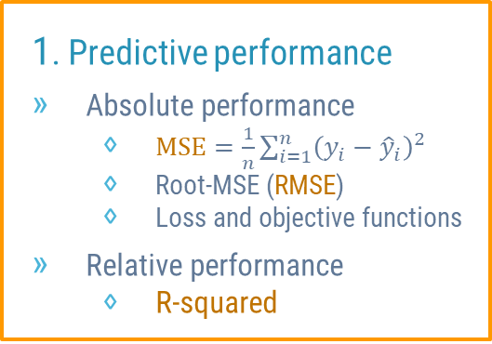
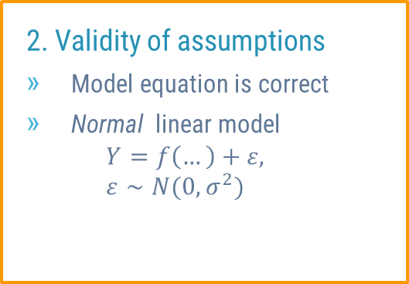
Aspects of Model Quality
1. Predictive performance
Absolute performance
$\text{M}\text{SE}=\frac{1}{n}\sum_{i=1}^{n}{{\left({y_{i}−\hat{y}}_{i}\right)}^{2}}$
Root-MSE (RMSE)
Loss and objective functions
Relative performance
R-squared
2. Validity of assumptions
Model equation is correct
Normal linear model $Y=f\left(…\right)+ε,$ $ε∼N(0, σ^{2})$
Example?

Slide 13
Typical Problems
Missing values
Outliers
Overfitting
Collinearity

Slide 14
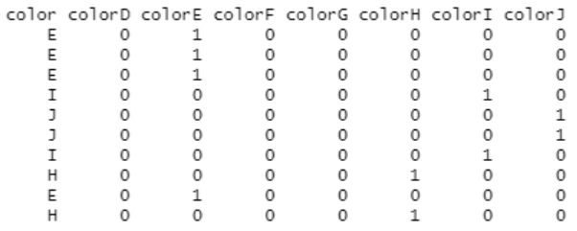
Categorical Covariates
One-Hot-Encoding
Dummy coding
Integer encoding
Interpretation?
Example
Example of One-Hot-Encoding

Slide 15
Linear Regression is Flexible
Non-linear terms
Interactions
Transformations like logarithms
These elements are essential but tricky!

Slide 16
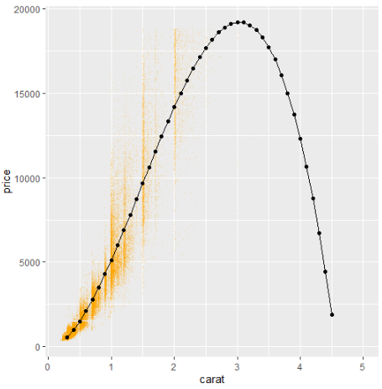
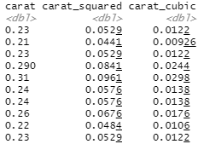
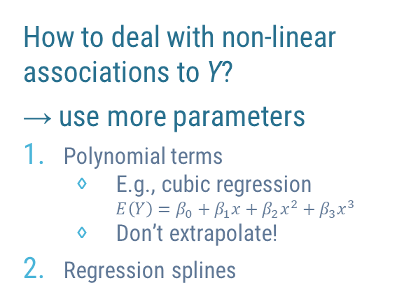
Non-Linear Terms
Example: cubic regression for diamonds
How to deal with non-linear associations to Y?
→ use more parameters
Polynomial terms
E.g., cubic regression
$E\left(Y\right)=β_{0}+β_{1}x+β_{2}x^{2}+β_{3}x^{3}$
Don’t extrapolate!
Regression splines
Systematic predictions

Slide 17
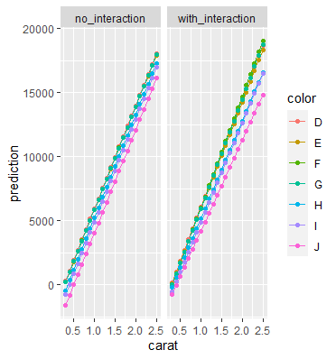
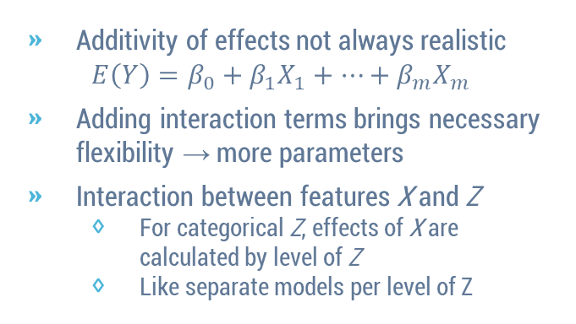
Interactions
Example: diamonds with carat and color
Systematic predictions
Additivity of effects not always realistic
$$E\left(Y\right)=β_{0}+β_{1}X_{1}+⋯+β_{m}X_{m}$$
Adding interaction terms brings necessary flexibility → more parameters
Interaction between features X and Z
For categorical Z, effects of X are calculated by level of Z
Like separate models per level of Z

Slide 18
Transformations of Covariates
Examples
Dummy variables for categoricals
Decorrelation
Logarithms against outliers
Effects are interpreted for transformed covariates

Slide 19
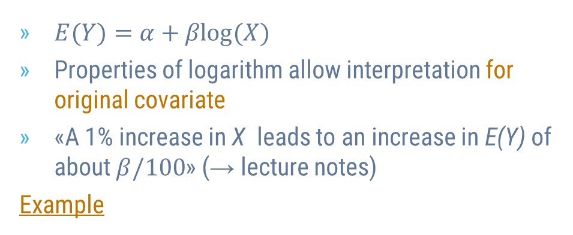
Logarithmic Covariates
$E(Y)=α+βlog(X)$
Properties of logarithm allow interpretation for original covariate
«A 1% increase in X leads to an increase in E(Y) of about $β/100$» (→ lecture notes)
Example

Slide 20
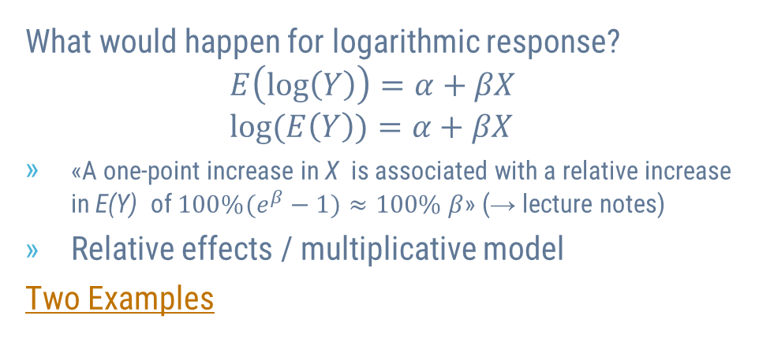
Logarithmic Responses
What would happen for logarithmic response? $$E\left(log\left(Y\right)\right)=α+βX \\ log(E\left(Y\right))=α+βX$$
«A one-point increase in X is associated with a relative increase in E(Y) of ${100\%(e}^{β}−1)≈100\% β$» (→ lecture notes)
Relative effects / multiplicative model
Two Examples
Mathematically wrong (why?)
Biased predictions
Motivation for GLMs

Slide 21

Example: Realistic Model for Diamond Prices
Response: log(price)
Covariates: log(carat), color, cut and clarity

Slide 22
Exercise on Linear Regression
Run last model without any logarithm
Interpret the results
Does model make sense from practical perspective?

Slide 23
Generalized Linear Models

Slide 24
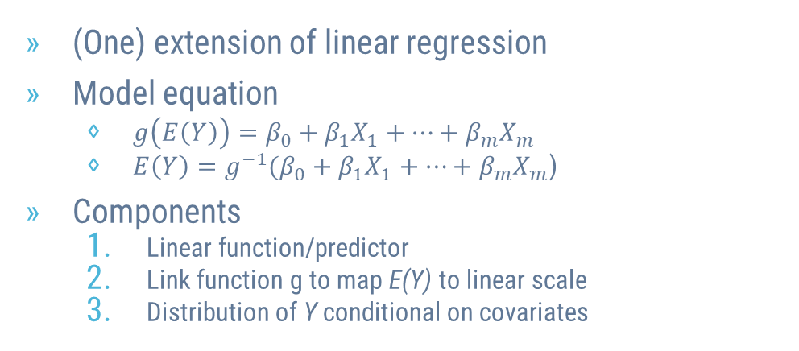
Generalized Linear Model (GLM)
(One) extension of linear regression
Model equation
$g\left(E\left(Y\right)\right)=β_{0}+β_{1}X_{1}+…+β_{m}X_{m}$
$E\left(Y\right)=g^{−1}(β_{0}+β_{1}X_{1}+…+β_{m}X_{m}$)
Components
Linear function/predictor
Link function g to map E(Y) to linear scale
Distribution of Y conditional on covariates

Slide 25
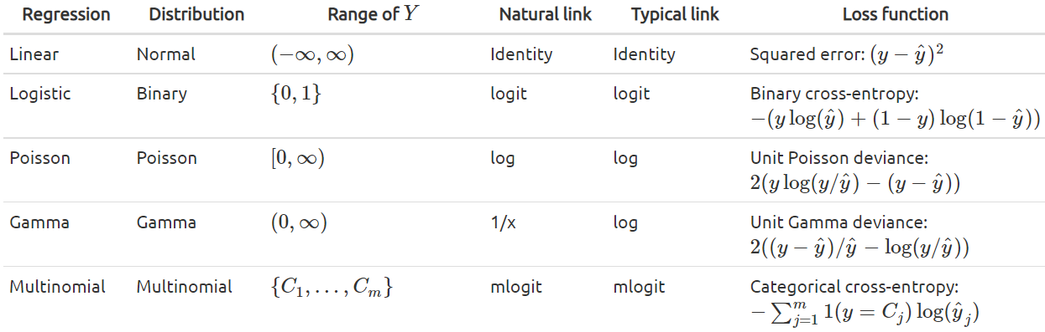
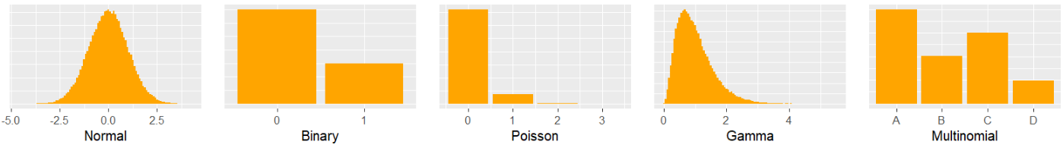
Typical GLMs
Important also for other ML algorithms
Predictions?
Log-Link?
For binary Y E(Y) = P(Y = 1) = p
Tweedie-GLM
MSE → Deviance

Slide 26
Why GLM, not Linear Regression?
Linearity assumption not always realistic
Binary Y: Jump from 0.5 to 0.6 success probability less impressive than from 0.89 to 0.99
Count Y: Jump from E(Y) of 2 to 3 less impressive than from 0.1 to 1.1.
Right-skewed Y: Jump from 1 Mio to 1.1 Mio deemed larger than from 2 Mio to 2.1 Mio.
GLM solves problem by suitable link g
Further advantages?
Log response impossible

Slide 27
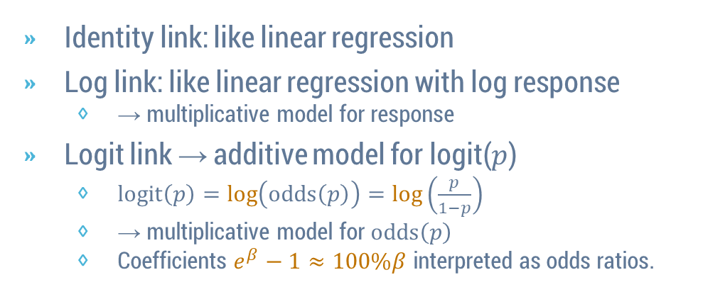

Interpretation of Effects guided by Link
Identity link: like linear regression
Log link: like linear regression with log response
→ multiplicative model for response
Logit link → additive model for logit($p$)
$logit\left(p\right)=log\left(odds\left(p\right)\right)=log\left(\frac{p}{1−p}\right)$
→ multiplicative model for $odds\left(p\right)$
Coefficients $e^{β}−1≈100\%β$ interpreted as odds ratios.
Now in clean way
$$p=P\left(Y=1\right)=E(Y)$$

Slide 28
Examples with Insurance Claim Data
Poisson regression for claim counts
Binary logistic regression for claim (yes/no)

Slide 29
Exercise on GLM
Fit Gamma regression with log-link to explain diamond prices by log(carat), color, cut and clarity.
Compare the coefficients with corresponding linear regression for log(price).
Evaluate the relative prediction bias on USD scale.

Slide 30
2.
Model Selection and Validation

Slide 31
Two Questions
«How good is our model?»
«Which model to choose among alternatives?»
Problem and solution
«Insample» performance is biased
Overfitting should not be rewarded
Use data splitting to get fair results
- Performance measure (evaluation metric) versus loss function?
- Confusion matrix?

Slide 32
Excursion: k-Nearest-Neighbour (k-NN)
Alternative to linear model
How does it work?
Classification & Regression
Standardization?
Example

Slide 33
Simple Validation
Insample, 1-NN would win any comparison!?
Split data into training and validation set, e.g., 80%/20%
Use performance on validation set to make decisions (choose models, choose parameters like k)
Measure amount of overfitting (= optimism)?
Example

Slide 34
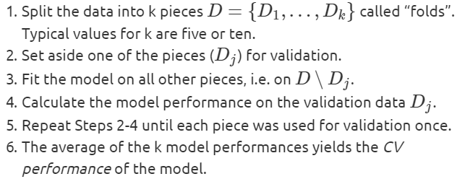
Cross-Validation (CV)
Simple validation is neither economic nor robust, except for large data
Better: k-fold cross-validation
How to choose and fit best/final model? What means «best»?
Repeated CV?
Example

Slide 35
Hyperparameter Tuning
Choosing k in k-NN is example of «hyperparameter tuning»
Algorithms with more than 1 hyperparameter?
Grid Search CV
Randomized Search CV

Slide 36
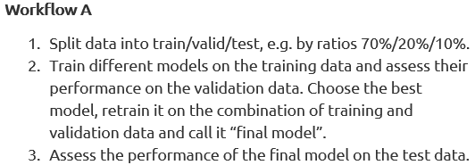
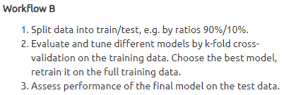
Test Data and Final Workflow
Problematic consequence of model tuning?
Overfitting on validation data or on CV!
Performance of final model? → Test data
Example of Workflow B
When Test = Validation?

Slide 37
Using Independent Partitions is Essential
Random splits
Grouped splits
Time-Series splits
Stratified splits

Slide 38
Exercises with Diamonds
As alternative to grouped splitting, deduplicate (why?) the diamonds data on "price" and all covariates and repeat the last example. Do the results change? Which results do you trust more?
Use CV to select the best polynomial degree of log(carat) in the Gamma GLM with log-link (with additional covariates color, cut, clarity). Evaluate on a test data.

Slide 39
3.
Trees

Slide 40
Decision Trees
Random Forests
Gradient boosting

Slide 41

Decision Trees
Simple
Easy to interpret
Decision trees are like wolves: Weak alone, strong together
Around since 1984 (Breiman, Friedman)
https://images.pexels.com/photos/3732527/pexels-photo-3732527.jpeg

Slide 42
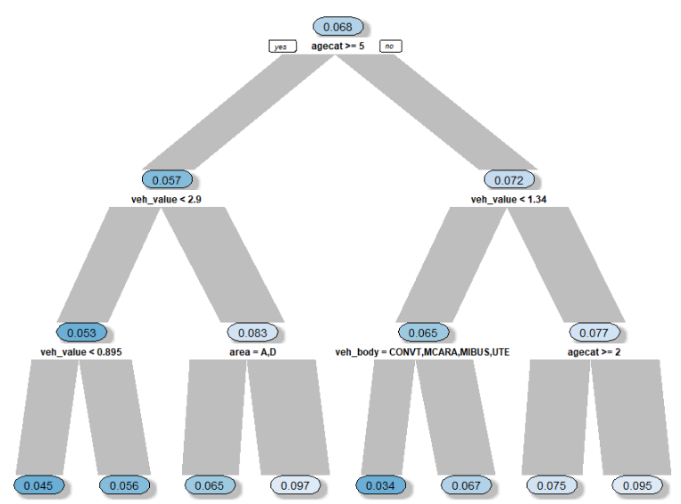
How do Decision Trees Work?
Algorithm
Split: find best «yes/no» question on best feature
Apply Step 1 recursively
Regarding average loss improvement
Example
Typical losses: squared error, log loss/cross-entropy/information or Gini
Predictions?
Leaves

Slide 43
Properties of Decision Trees
Outliers
Greedy
Missing Values
Extrapolation
Categorical covariates
Interactions
Properties are inherited to groups/ensembles of decision trees

Slide 44

Random Forests
Group of many decision trees
Perform very well
“Black Box”
Around since 2001 (Breiman)
https://images.pexels.com/photos/1459534/pexels-photo-1459534.jpeg

Slide 45
How do Random Forests Work?
If we train 500 trees, how can we make sure they are different? → Introduce two sources of randomness
Each split considers random selection of features only.
Each tree is trained on bootstrap sample.
Predictions?

Slide 46
Comments on Random Forests
Number of trees?
Diversification!
Insample performance
Out-of-Bag (OOB)
Parameter tuning
Example

Slide 47
Interpreting a “Black Box” is Important
Minimum interpretation of model?
Performance
Variable importance
Effects → e.g. partial dependence plots
Example

Slide 48
Exercises on Random Forests
In our diamonds random forest, replace carat by log(carat). Do the results change?
Fit a (probability) random forest on the claims data to predict claim probability by veh_value, veh_body, veh_age, gender, area, and agecat.
Choose tree depth by OOB performance or CV.
Evaluate the model on an independent test dataset.
Interpret the results.

Slide 49
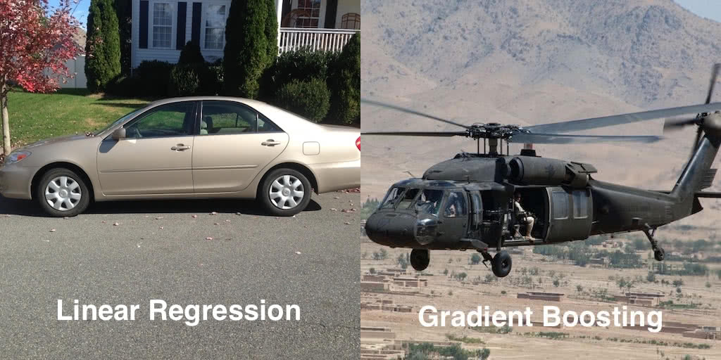
Gradient Boosted Trees
Group of many decision trees
Perform very well
“Black Box”
Around since 2001 (Friedman)
XGBoost, LightGBM, CatBoost
https://www.gormanalysis.com/blog/gradient-boosting-explained/
Like random forests

Slide 50
How does Gradient Boosting Work?
Algorithm
Fit simple model (often a small decision tree).
Add another simple model to correct errors of first model.
Repeat Step 2 until stopping criterion triggers.
Predictions are found by combining predictions of all simple models (like random forest).
Flexible regarding loss function (GLMs…)
Completely different from random forest
Example: XGBoost

Slide 51
Parameter Tuning is Essential
Number of boosting rounds/trees → find by early stopping (validation/CV)
Learning rate → to get reasonable number of rounds
Regularization
Tree depth, number of leaves, loss penalties, …
→ Grid/Randomized search & iterate
Why not one big grid search on all parameters?
Example: XGBoost

Slide 52
Exercises on Gradient Boosting
Study online documentation of XGBoost to make the last model monotonically increasing in carat. Check the resulting partial dependence plot.
Develop a strong XGBoost model on the claims data to predict claim probability by veh_value, veh_body, veh_age, gender, area, and agecat.
Use "binary:logistic" as objective.
Use "logloss" as evaluation metric.
Use a clean CV/test strategy.
Interpret the results.

Slide 53
4.
Neural Nets

Slide 54
Neural Nets
Around since the 1950ies
Underwent different development steps, e.g., use of backpropagation, GPUs
“Black Box”
TensorFlow/Keras, PyTorch

Slide 55
“Swiss Army Knife” among ML Algorithms
Can fit linear models
Fit data larger than RAM
Learn interactions and non-linear terms
Learn «online»
Non-linear dimension reduction
>1 Responses possible
Sequential and spatial in- and output
Flexible and mixed in- and output dimensions
Flexible loss functions

Slide 56
Understanding Neural Nets in three Steps
Linear regression as neural net
Hidden layers
Activation functions
Diamonds data

Slide 57
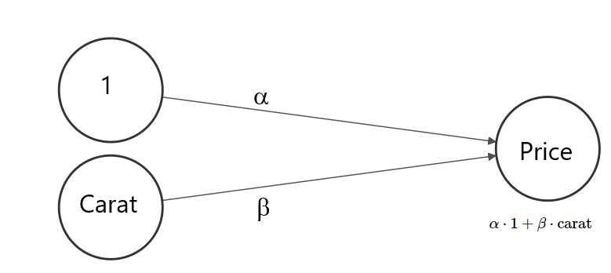
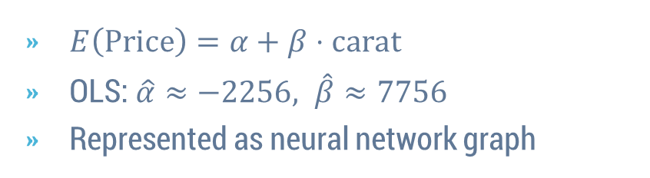
Step 1: Linear Regression as Neural Net
$E\left(Price\right)=α+β⋅carat$
OLS: $\hat{α}≈−2256, \hat{β}≈7756$
Represented as neural network graph
Example
Input layer
Output layer (dense/fully connected)
Bias unit
Weights
Nodes

Slide 58
The Optimization Algorithm
“Mini-batch gradient descent with backpropagation”
Init step: Randomly initiate parameters.
Forward step: Use parameters to calculate predictions of batch.
Backprop step: Evaluate average loss (e.g. MSE) of batch. Change parameters systematically to make it smaller.
Repeat Steps 2 & 3 until one epoch is over.
Repeat Step 4 until some stopping criterion triggers.
SGD?
Gradients?
Local Minima?

Slide 59
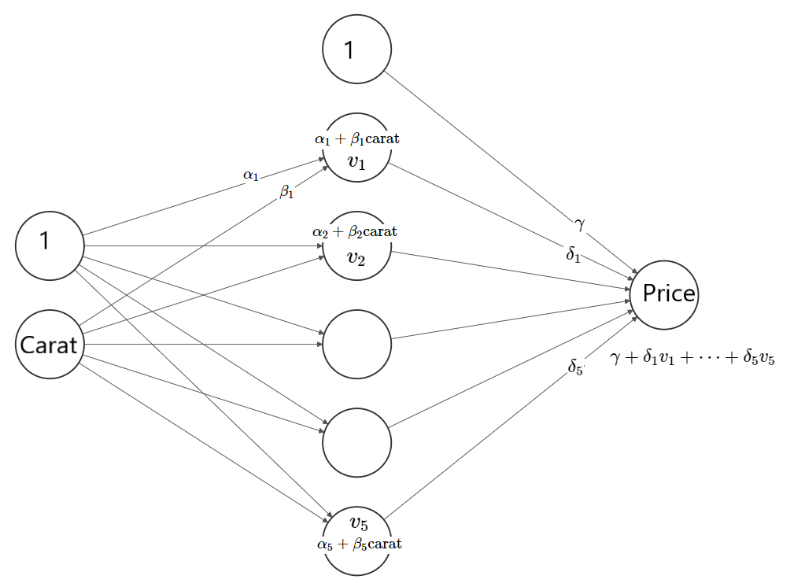
Step 2: Hidden Layers
Add hidden layers for more parameters (= flexibility)
Their nodes are latent/implicit variables
Representational learning
Encoding?
Deep neural net?
Example

Slide 60
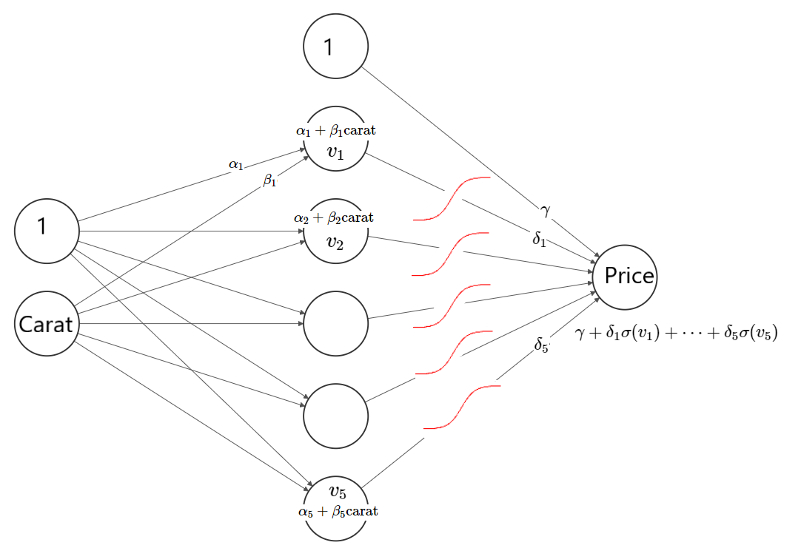
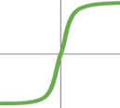
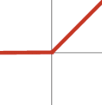

Step 3: Activation Functions
Non-linear transformations $σ$ of node values necessary!
Two purposes
Imply interactions and non-linear terms
Inverse link as in GLMs
Example

Slide 61
Practical Considerations
Input standardization
Validation and tuning of main parameters
Missing values
Categorical input
Callbacks
Types of layers
Interpretation
Optimizer
Overfitting and regularization
Choosing the architecture
Custom losses and evaluation metrics

Slide 62
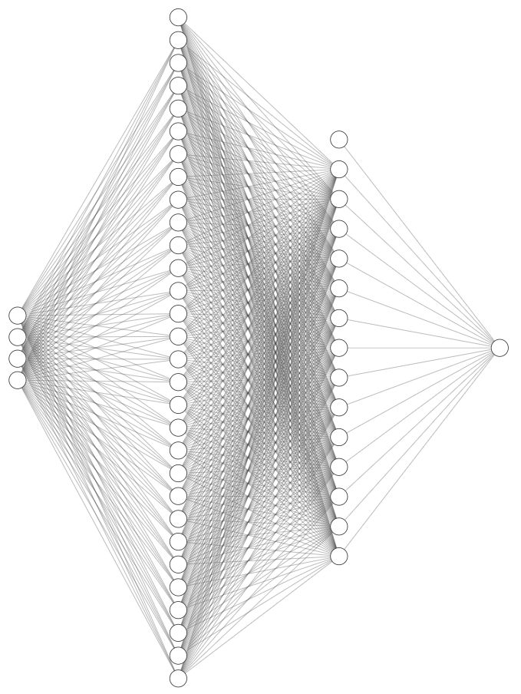
Example: diamonds

Slide 63
Exercises on Neural Nets
Fit diamond prices by minimizing Gamma deviance with log-link (custom loss as in lecture notes; log-link means "exponential" output activation)
Tune model by simple validation.
Evaluate final model (for simplicity) on validation data.
Interpret final model.
Hints: Use smaller learning rate and replace "relu" by "tanh". Furthermore, the response is to be transformed from int to float.
Study either the optional claims data example in the lecture notes or build your own neural net, predicting claim yes/no.

Slide 64
Final Words

Slide 65
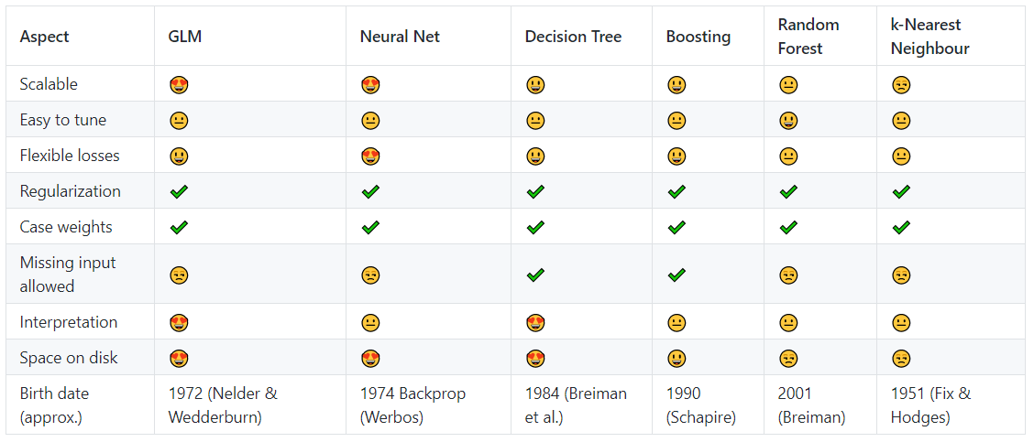
Comparison of ML Algorithms

Slide 66
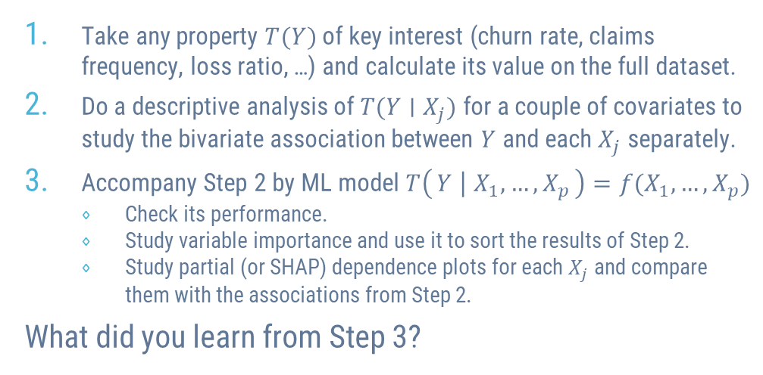
“Michael’s Analysis Scheme X”
Take any property $T(Y)$ of key interest (churn rate, claims frequency, loss ratio, …) and calculate its value on the full dataset.
Do a descriptive analysis of $T(Y∣X_{j})$ for a couple of covariates to study the bivariate association between $Y$ and each $X_{j}$ separately.
Accompany Step 2 by ML model $T\left(Y ∣ X_{1},…, X_{p}\right)=f(X_{1},…, X_{p})$
Check its performance.
Study variable importance and use it to sort the results of Step 2.
Study partial (or SHAP) dependence plots for each $X_{j}$ and compare them with the associations from Step 2.
What did you learn from Step 3?

