Slide 1
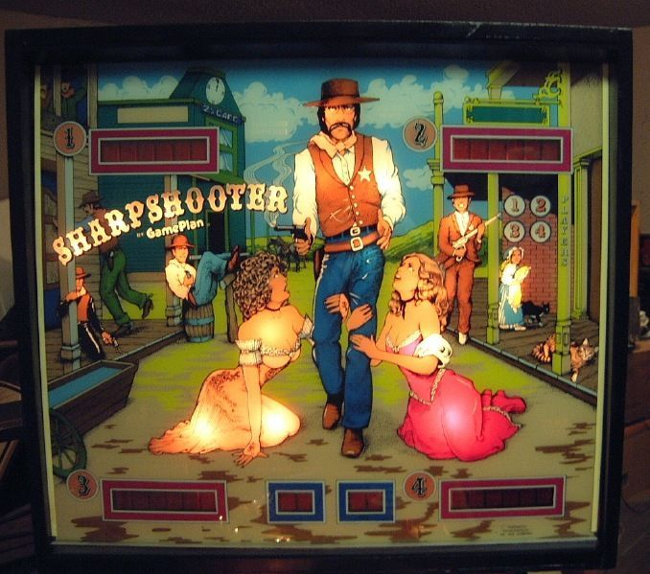
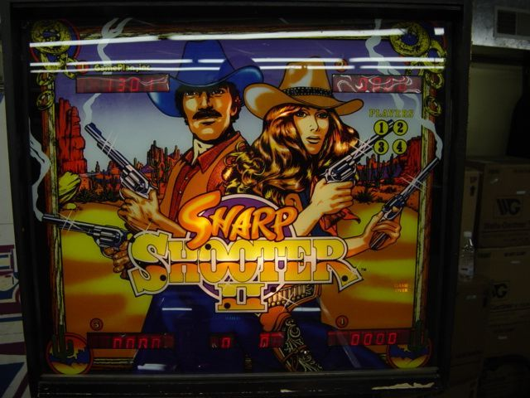
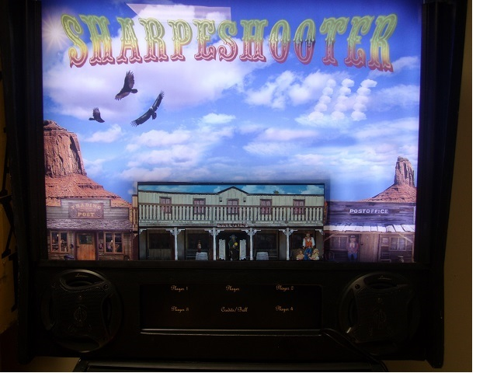

The Making of Sharpe Shooter III
Sharpshooter
1979
Sharp Shooter II
1983
Sharpe Shooter III
2015

Slide 2
Introduction
Talk is centered on SharpeShooter III
Project was created as extension of Open Pinball Project
Forced OPP to a more complete state more quickly
Impossible to discuss SS3 without discussing OPP because it utilizes the hardware, framework, and code generator

Slide 3
Open Pinball Project
Provide complete electronics solution for pinball machine
Completely open source including PCB designs, embedded firmware, and pinball framework
Leverage inexpensive processors for real time control
Does not try to be a drop in replacement for any other board
Targetted? towards homebrew pinball
The one and only truly open source pinball project

Slide 4
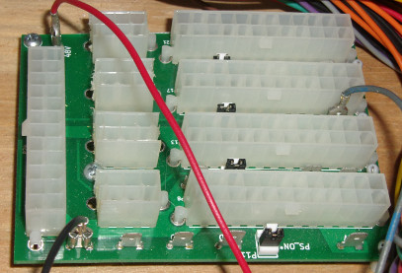
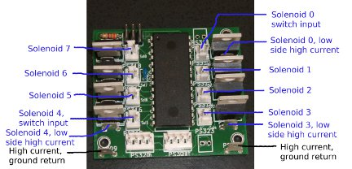
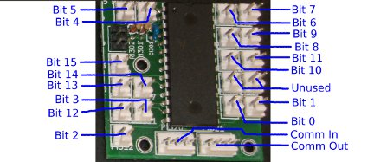
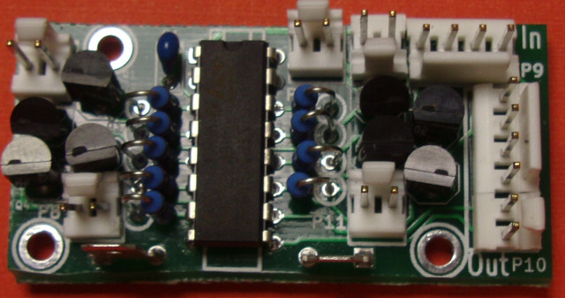
Open Pinball Project (cont.)
Contains four boards
Open source repository contains schematics, layouts and Gerbers in Kicad (PCB layout tool)
MaxPwr
Solenoid Driver
Input Driver
Incandescent
Driver

Slide 5
Open Pinball Project (cont.)
Actively flipping three machines
  SharpeShooter III
    https://openpinballproject.wordpress.com/
    YouTube - openpinballproject
  Blue October – Joe (ToyotaBoy's project)
    http://homebrewpinball.blogspot.com/
  Bulls Eye 301
    YouTube - kerform

Slide 6
What Ever Happened To...
Disaster
  Narrow body machine with tornado at top center
  Created visual pinball layout
  Contained many novel concepts:
    Change slope of playfield depending on mode/difficulty
    Change angle of playfield
    Auto leveling
  Decided custom layout would slow project too much
Backpack pinball
  All mini-pinballs I've seen don't have correct feel

Slide 7
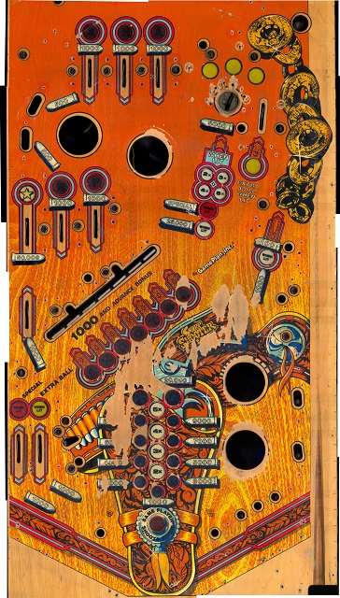
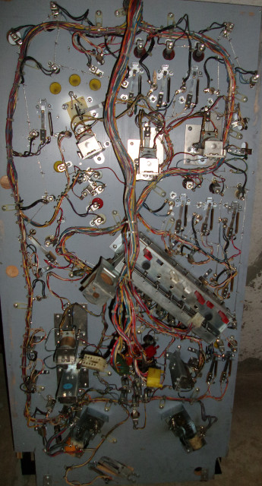
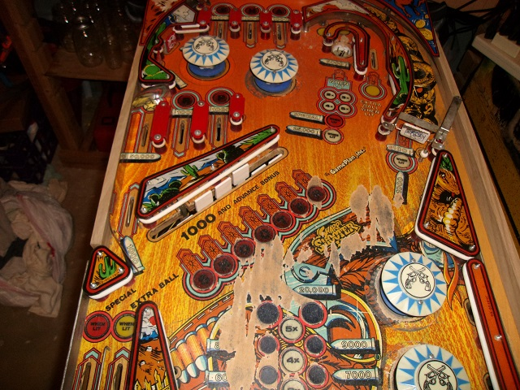
Sharp Shooter II
Purchased playfield 5/8/2014 for $75
  Not a fan layout
  Major wear so not destroying good game
  Designed by Roger Sharpe

Slide 8
Starting Conversion
Strip bottom of playfield of all wires
  Distributed system so wires end beneath playfield
  Locate solenoid cards
  Locate input cards
  Create a route map of wires between cards
Strip top of playfield if re-doing art
  Remove everything that sticks out of playfield
  Playfield divided into six sections and parts kept separate
  Take lots of pictures, so it can be reassembled

Slide 9
Scanning a Playfield
Used HP-4600 flat scanner (inexpensive on Ebay)
  Overlap each scan 30% or more
  Scan playfield in rows
  Directions on website on getting old scanner to work on Windows 8
Use Microsoft ICE (Image Composite Editor)
  Use ICE to make complete rows
  Combine all rows to form complete image
  Reduces amount of twisting/rotation by program

Slide 10
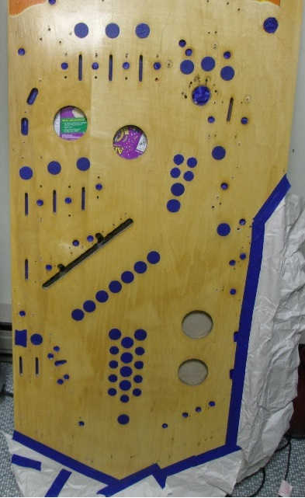
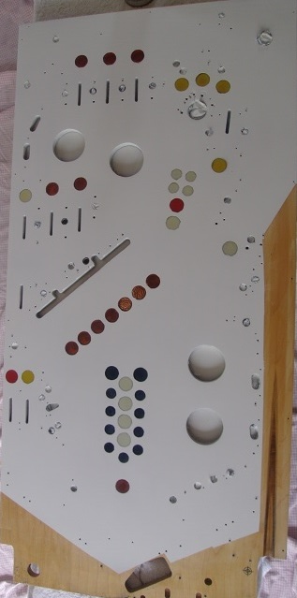
Create Whitewood
Sand down the top of the playfield
  Built pinball rotisserie to hold playfield
  A Random orbital sander is your friend
  Restore any issues with playfield
    Bamboo skewers to fill holes
    Reseat inserts if not flat
Paint playfield white if using clear vinyl overlay
  Required so inserts are brighter
  Mask off inserts and areas of bare wood

Slide 11
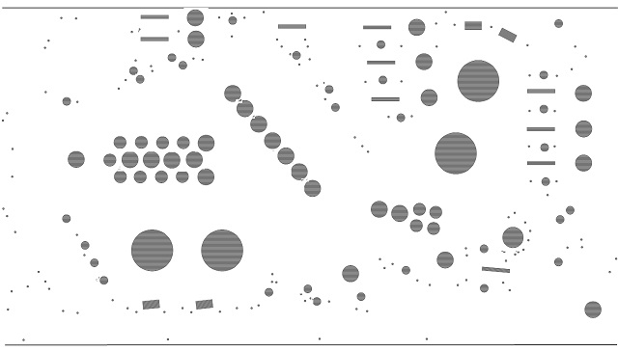
Create Template
Templates are required if creating new art
  Allows art to be positioned appropriately
  Shows locations of all features
  Can be printed inexpensively to verify template
  Verifies overlay matches playfield

Slide 12
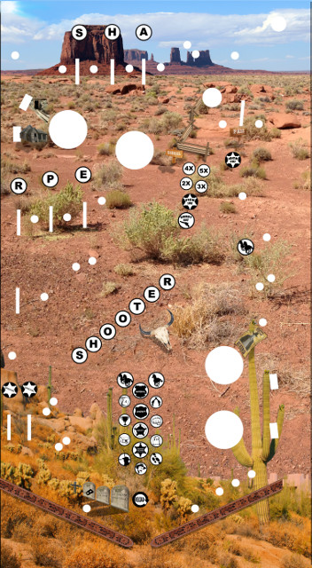


Art and Sounds (it's all Joe)
Started working with Joe as alpha site for hardware
OPP supported his project providing boards
Joe provided:
  Cabinet art
  Backbox art
  Playfield art
  Monitor art
  All game specific callouts

Slide 13
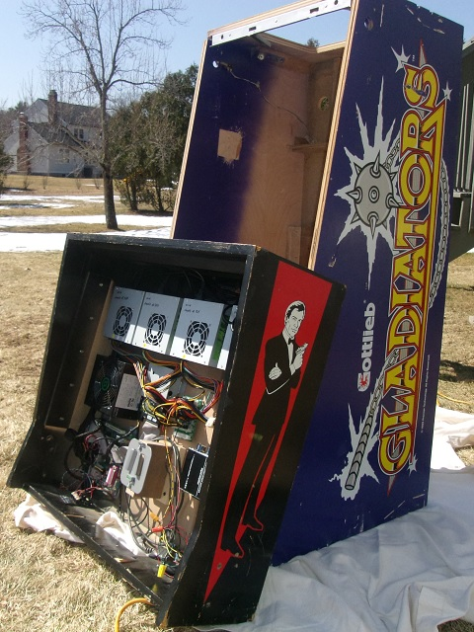
Preparing the Cabinet
Prep the Cabinet
  Sand sides flat
  Fill dings with wood putty
  Use a base coat of paint
    Must be white if using clear overlay
  Sand, sand, sand
    Imperfections are very noticeable
Use wet method to apply overlay
  Spray with water and couple drops of detergent
  Allows overlay to be repositioned

Slide 14
Woe of the Frankenstein Machine
Lockdown bar did not match playfield
Coin door did not fit in cabinet
Backbox did not attach to cabinet
Glass interfered with lockdown bar
Side rails did not match flipper button holes
Cabinet work took much longer than expected
Many parts were fabricated to make things work

Slide 15
Autoclear – Not as bad as you think
Time was running out
  Varathane cure time is about 2 months
Auto clear – start to finish (1.5 weeks)
  Painting, 1 day per coat (5 days)
  Hardening day, 1 day
  Sanding, 2 – 4 days
    Wet sanding keeps sandpaper from clogging (but messy)
    Used 600, 1200, and 2000 grit sandpaper
    Brush worked better than expected (sprayer would be best)
  Repopulated playfield < 2 weeks

Slide 16
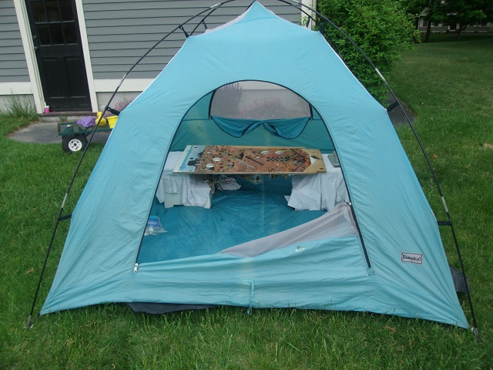
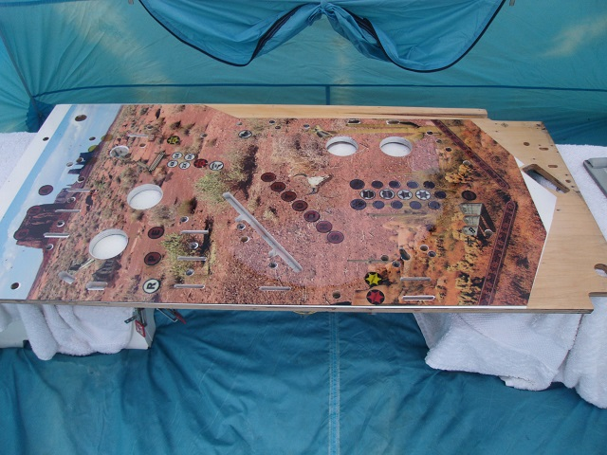
Autoclear – Scary Stuff
Exposure issues include:
  Blindness
  Brain damage
Safety equipment needed:
  Respirator (prevent organic vapors)
  Swim goggles
  Not in the house

Slide 17
Finishing Up
Reassemble playfield
  Remember all those pictures, now they pay off
Clearcoat cabinet with polycrylic (can be done inside)
Start playing machine
  Non-volatile config allows machine's flow to be tested
  PinBrdGui shows output of switches continuously

Slide 18
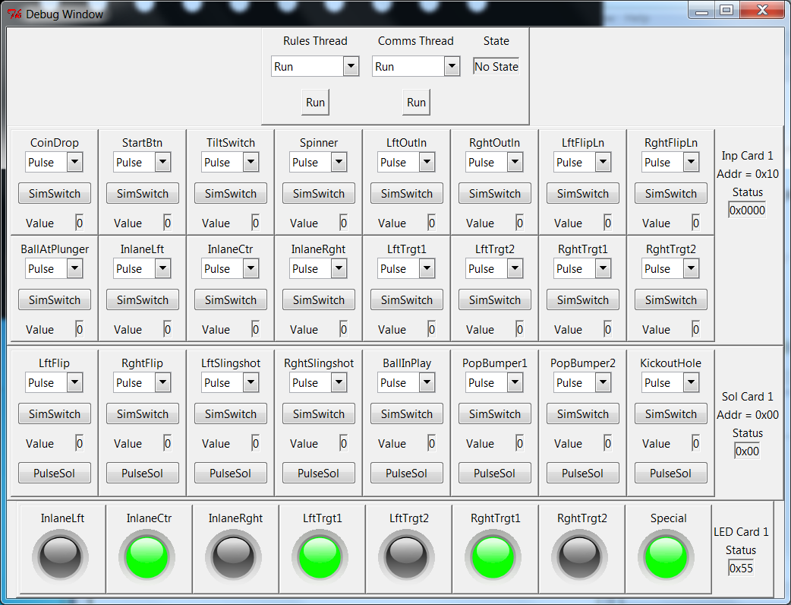
PinballFramework
Python Based framework
Auto creates hardware map using config file
Supports multiple rulesets
Has simulation mode so code can be written in parallel with playfield development

Slide 19
What did it Cost?
Playfield, $75
Cabinet, $50
Backbox, $30
Driver/Input Cards, $50
Power Supplies, $50
Art, $150
LEDs/parts, $130
Monitor, $80
Old PC, free
Total - $615

Slide 20
Restoration Throwdown Contest – Vote for Me
Spirit of the hobby
  Discarded waste, back to playing machine
Restoration – swapping playfields
  What are you restoring when you replace the playfield?
Retheme
  Usually only change art and add sound triggers
  SharpeShooter III has 11 modes and 4 different levels
The playfield has been restored to fully playable machine

Slide 21
RTC – Vote for Me (cont.)
What if SharpeShooter III wins?
  50% cash goes to Joe for all his hard work
  Rest of cash get split amongst:
    Clay – aka PinballNinja
      Without his website much of this would not be possible
      The definitive source of info on pinball restoration
    Pinside – answering the arcane questions
      Providing a search engine to answer most questions
      Telling me where to find pinball when stuck on a business trip
      Forum for people answering any question you have on any machine you need the answers

Slide 22
Questions?

