Slide 1
Assignment 3
User Mode Thread

Slide 2
User Mode Thread
Linux thread – e.g., pthread
  Supported by Linux
  pthread_create(), pthread_join(), pthread_exit(), …
  pthread_mutex_lock/unlock(),…
  Scheduled by Linux
User mode thread – this assignment
  Supported in user level
  uthread_create(), uthread_join(), uthread_exit(), …
  uthread_mutex_lock/unlock(),…
  Scheduled in user level
  Support – priority inheritance and SRP

Slide 3
Scheduling
TCB for a thread
Scheduling – Pick the highest priority ready thread
struct tcb {
int state;
jmp_buf context; //stack and register
int priority;
//some other information continues
};

Slide 4
Scheduling
setjmp(jmp_buf) : save context
longjmp(jmp_buf, non_zero): switch context
int uthread_mutex_lock(uthread_mutex_t *mutex) {
……
if (mutex is not available) {
tcb->state = BLOCKED;
if (setjmp(tcb->context)==0) { //save context
//call scheduler
} else {
When this thread resumes,
it will back to here
}
}
…….
}
void scheduler_func() {
//Select the next thread
//next_tcb = TCB of the selected thread
longjmp(next_tcb->context, some_non_zero); //resume execution for the next thread
}
mutex unlocked by another
void scheduler_func() {
longjmp(…);
…

Slide 5
Timer Signal
sigaction(), sigprocmask(), timer_create()
See the man page of timer_create
int uthread_abstime_nanosleep(…) {
save context
state of current thread -> delayed
set timer
call scheduler
}
Timer expires
Signal_handler() {
save context
change the state to ready
call scheduler
}
…… other threads scheduled ……

Slide 6
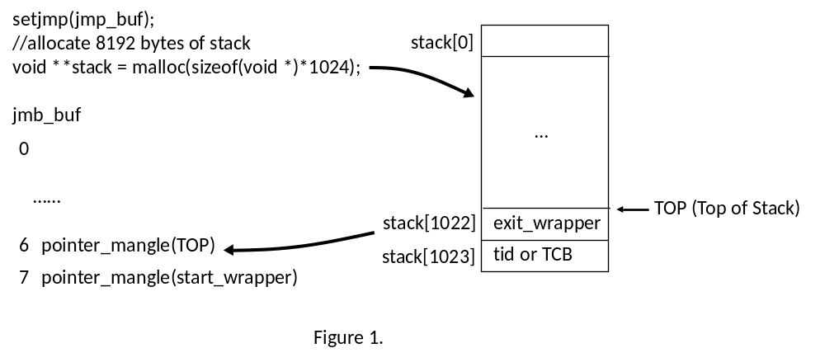
Create and Exit Thread

