Slide 1
VIEWFLIX
Movie & TV Streaming Platform Database System
Database Management Systems Term Project
Prepared by:
Defne Kaya
Göktuğ Karaca
Instructor: Pınar EFE
Date: June 2026

Slide 2
Project Overview
VIEWFLIX is a database system designed for an online movie and TV streaming platform.
The system allows users to:
Subscribe to streaming plans
Browse movies and TV series
Add content to favorites
Rate and review content
Track viewing history
View actors and directors associated with content
Project Goal:
The goal of this project is to design and implement a normalized relational database that efficiently manages users, subscriptions, streaming content, and user interactions.

Slide 3
SYSTEM REQUIREMENTS
The system must be able to:
Store user account information
Manage subscription plans and subscriptions
Store movies and TV series
Categorize content by genres
Store actor, director, writer, and producer information
Track user viewing history
Allow users to add favorites
Allow users to submit ratings and reviews
Maintain data consistency and integrity

Slide 4
ENTITY RELATIONSHIP (ER) DIAGRAM
Relationships:
One User can have one Subscription
One Subscription belongs to one Subscription Plan
One Content can belong to multiple Genres
One Genre can be assigned to multiple Content items
One Content can have multiple People
One Person can participate in multiple Content items
One User can watch multiple Content items
One User can review multiple Content items
One User can add multiple Content items to Favorites
Main Entities:
Users
Subscription_Plans
Subscriptions
Content
Genres
People
Watch_History
Reviews
Favorites
Content_Genres
Content_Cast

Slide 5
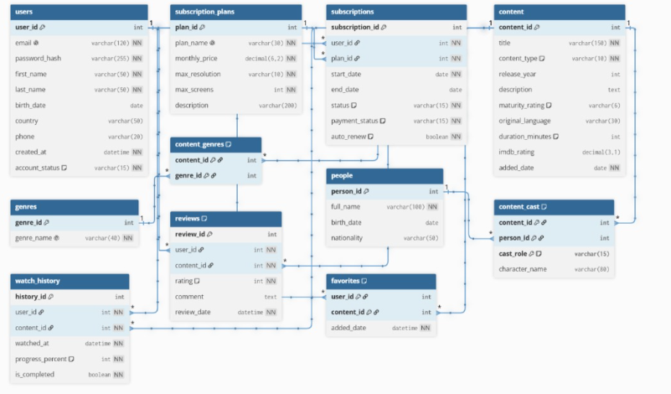
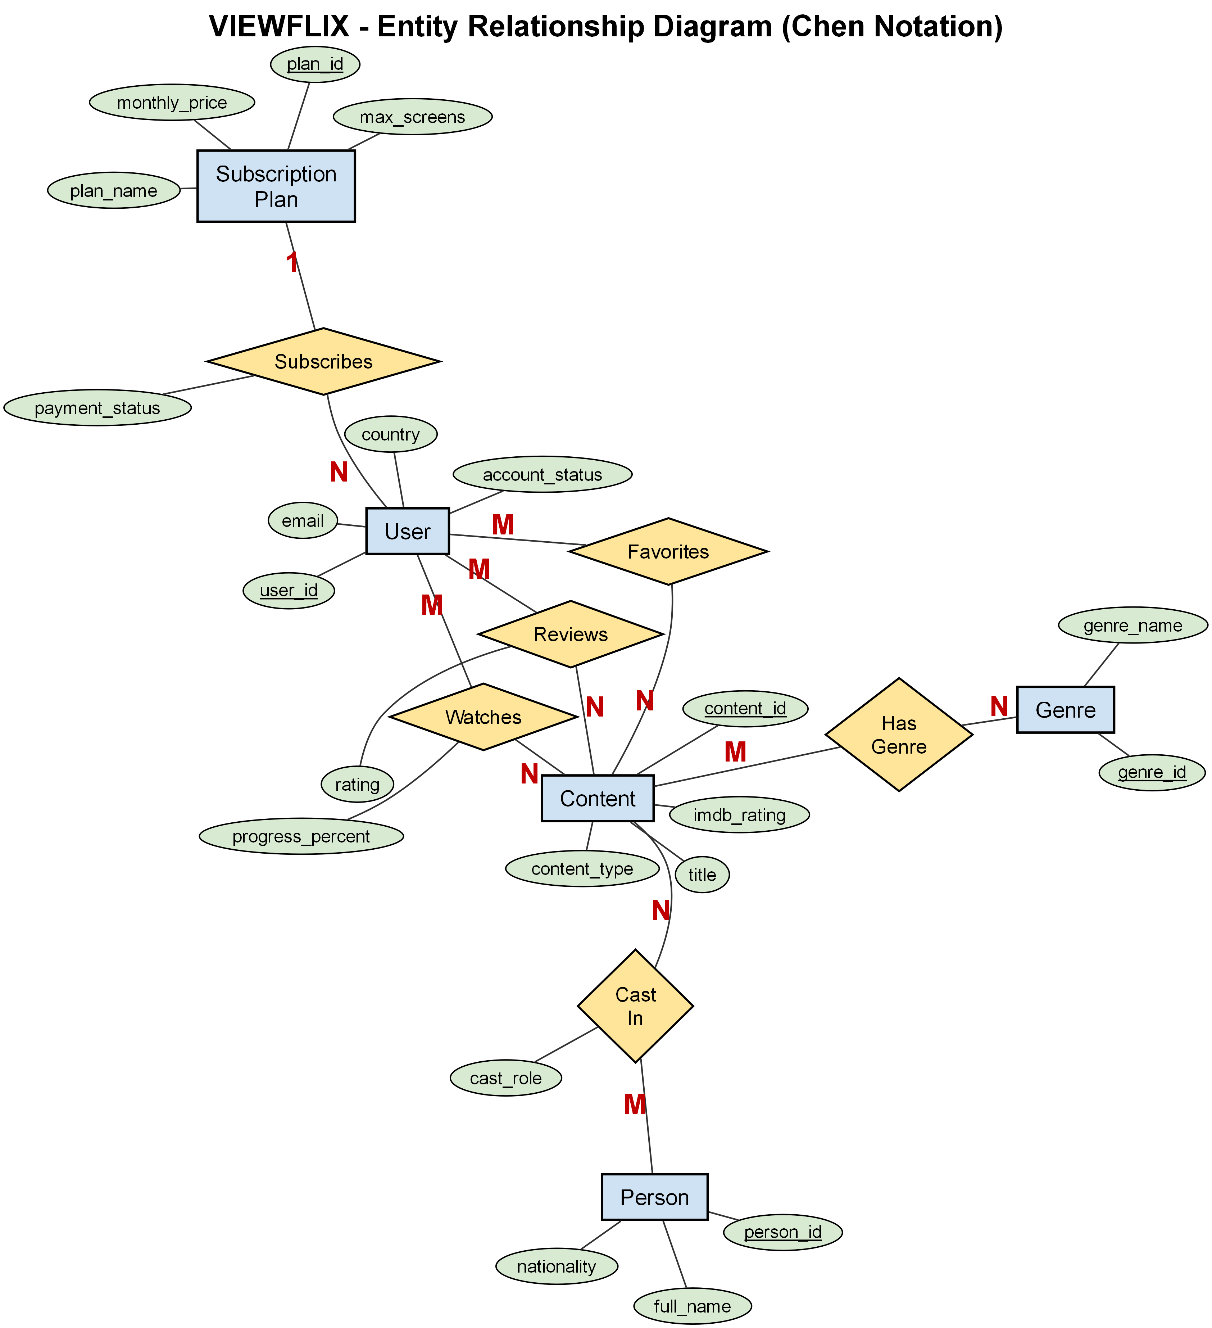
ER Diagram (Chen Notation)

Slide 6
DATABASE DESIGN (3NF)
Normalization:
The database is designed in Third Normal Form (3NF).
First Normal Form (1NF): All attributes contain atomic values. No repeating groups.
Second Normal Form (2NF): No partial dependency on composite keys.
Third Normal Form (3NF): No transitive dependency.
Every non-key attribute depends only on the primary key
Bridge Tables:
Many-to-many relationships are resolved using:
Content_Genres
Content_Cast
Favorites

Slide 7
TABLE STRUCTURE
STRONG ENTITIES Table Primary Key ------------------------------------------------ Users user_id Subscription_Plans plan_id Subscriptions subscription_id Content content_id Genres genre_id People person_id Watch_History history_id Reviews review_id
ASSOCIATIVE (WEAK) ENTITIES Table Composite Primary Key --------------------------------------------------------- Content_Genres (content_id, genre_id) Content_Cast (content_id, person_id, cast_role) Favorites (user_id, content_id)

Slide 8
PRIMARY &FOREIGN KEYS
Table Foreign Key References
------------------------------------------------------------
Subscriptions user_id Users
Subscriptions plan_id Subscription_Plans
Content_Genres content_id Content
Content_Genres genre_id Genres
Content_Cast content_id Content
Content_Cast person_id People
Watch_History user_id Users
Watch_History content_id Content
Reviews user_id Users
Reviews content_id Content
Favorites user_id Users
Favorites content_id Content
Table Primary Key
-------------------------------------------------------------
Users user_id
Subscription_Plans plan_id
Subscriptions subscription_id
Content content_id
Genres genre_id
People person_id
Watch_History history_id
Reviews review_id
Content_Genres (content_id, genre_id)
Content_Cast (content_id, person_id, cast_role)
Favorites (user_id, content_id)

Slide 9
SAMPLE SQL QUERIES
Q1: Which users currently have an active account status?
SELECT * FROM users WHERE account_status = 'Active';
Q2: What ratings have users given to content titles?
SELECT u.first_name, c.title, r.rating FROM reviews r JOIN users u ON r.user_id = u.user_id JOIN content c ON r.content_id = c.content_id;
Q3: Which content items have been added to users' favorites lists?
SELECT u.first_name, c.title FROM favorites f JOIN users u ON f.user_id = u.user_id JOIN content c ON f.content_id = c.content_id;
Q4: What is the average rating received by each content title?
SELECT c.title, AVG(r.rating) AS average_rating FROM reviews r JOIN content c ON r.content_id = c.content_id GROUP BY c.title;

Slide 10
Q5:How can we list all movies ordered by IMDb rating?
SELECT title, release_year, imdb_rating
FROM content
WHERE content_type = 'Movie'
ORDER BY imdb_rating DESC;
Q6: Which active users are located in Turkey?
SELECT first_name, last_name, email
FROM users
WHERE country = 'Turkey' AND account_status = 'Active';
Q7: Which reviews have a rating of 9 or higher?
SELECT user_id, content_id, rating, comment, review_date
FROM reviews
WHERE rating >= 9
ORDER BY review_date DESC;
Q8: Which content items were released after 2015?
SELECT title, content_type, release_year
FROM content
WHERE release_year > 2015
ORDER BY release_year, title;
Q9: Which subscription plans support 4 or more screens?
SELECT plan_name, monthly_price, max_resolution, max_screens
FROM subscription_plans
WHERE max_screens >= 4;

Slide 11
COMPLEX SQL QUERİES
Q3: Which content was directed by Christopher Nolan?
SELECT c.title, c.release_year
FROM content c
WHERE c.content_id IN (
SELECT cc.content_id
FROM content_cast cc
JOIN people p ON cc.person_id = p.person_id
WHERE p.full_name = 'Christopher Nolan'
AND cc.cast_role = 'Director'
);
Q1: Which content has an IMDb rating above the average?
SELECT title, content_type, imdb_rating
FROM content
WHERE imdb_rating > (SELECT AVG(imdb_rating) FROM content)
ORDER BY imdb_rating DESC;
Q2: Which content has never been watched by any user?
SELECT c.title, c.content_type
FROM content c
WHERE NOT EXISTS (
SELECT 1 FROM watch_history wh
WHERE wh.content_id = c.content_id
)
ORDER BY c.title;

Slide 12
Q4: What are all reviews with user names and content titles?
SELECT u.first_name, u.last_name, c.title, r.rating
FROM reviews r
JOIN users u ON r.user_id = u.user_id
JOIN content c ON r.content_id = c.content_id
ORDER BY r.rating DESC, c.title;
Q5: Which actors appear in which content?
SELECT p.full_name AS actor, c.title, cc.character_name
FROM content_cast cc
JOIN people p ON cc.person_id = p.person_id
JOIN content c ON cc.content_id = c.content_id
WHERE cc.cast_role = 'Actor'
ORDER BY p.full_name;
Q6: What is the number of titles per content
type and their average IMDb rating?
SELECT content_type,
COUNT(*) AS title_count,
ROUND(AVG(imdb_rating),2) AS avg_imdb
FROM content
GROUP BY content_type;
Q7: What is the average rating and number of reviews per content?
SELECT c.title,
COUNT(r.review_id) AS review_count,
ROUND(AVG(r.rating),2) AS avg_rating
FROM content c
JOIN reviews r ON c.content_id = r.content_id
GROUP BY c.content_id, c.title
ORDER BY avg_rating DESC, review_count DESC;

Slide 13
Q8: Which genres are associated with more than one content item?
SELECT g.genre_name,
COUNT(cg.content_id) AS title_count
FROM genres g
JOIN content_genres cg ON g.genre_id = cg.genre_id
GROUP BY g.genre_id, g.genre_name
HAVING COUNT(cg.content_id) > 1
ORDER BY title_count DESC;
Q9: What are the top 5 most favorited content items?
SELECT c.title,
COUNT(f.user_id) AS favorite_count
FROM content c
JOIN favorites f ON c.content_id = f.content_id
GROUP BY c.content_id, c.title
ORDER BY favorite_count DESC
LIMIT 5;
Q10: What is the monthly revenue per subscription plan?
SELECT p.plan_name,
COUNT(s.subscription_id) AS active_subs,
SUM(p.monthly_price) AS monthly_revenue
FROM subscription_plans p
JOIN subscriptions s ON p.plan_id = s.plan_id
WHERE s.status = 'Active'
GROUP BY p.plan_id, p.plan_name
ORDER BY monthly_revenue DESC;

Slide 14
Conclusion
VIEWFLIX successfully demonstrates the design of a normalized relational database for a movie and TV streaming platform.
The system manages:
• Users • Subscriptions • Streaming Content • Genres • People (Actors, Directors, Writers, Producers) • Reviews • Favorites • Watch History
The database satisfies Third Normal Form (3NF), ensuring data integrity, consistency, and efficient management.

Slide 15
Thanks...

