Slide 1

Dynamic Work Loads with AWS Batch

Slide 2

Why AWS Batch?
Execute process on-demand or via a schedule
Support long-running tasks
Minimize costs
Define min/max compute
Spin up and tear down compute as needed
Consolidate processes
You define the environment!

Slide 3
Why not AWS Batch?
Setup/teardown of infrastructure takes time!
Required start time precision < 5-10 minutes
Require interval < 5-10 minutes
Alternatives
AWS Batch: except keep at least one computer environment running
Scheduled Lambda: for recurring processes up to 15 minutes in length
AWS CodeBuild: allows for running arbitrary tasks using any Docker image via a variety of triggers
AWS Glue: AWS’ official ETL service

Slide 4
What is AWS Batch?
Abstraction layer to simplify dynamic workloads
Runs on either EC2 (Elastic Cloud Compute) or ECS Fargate (Elastic Container System)
Consists of
Compute Environment: what it runs on
Job Queue: FIFO scheduling
Job Definition: Execution parameters, such as command line and Docker image

Slide 5
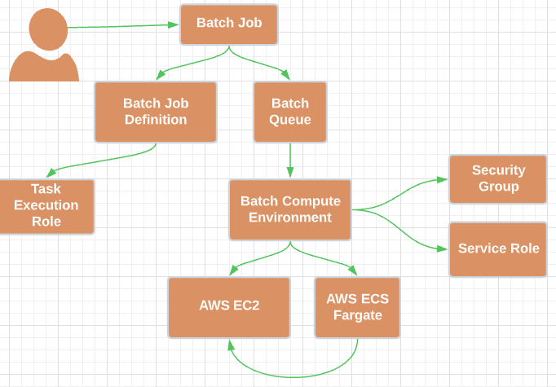
AWS Resource Relationship

Slide 6
Demo
Submit a job
Command
Env vars
Observe Job Status
Review results
Cloudwatch
Bonus: Cloudwatch insights filter

