Slide 1

Dynamic Work Loads with AWS Batch

Slide 2
AWS Batch: What is it?
Abstraction layer to simplify dynamic workloads
Runs on either EC2 (Elastic Cloud Compute) or ECS Fargate (Elastic Container System)
Consists of
Compute Environment: what it runs on
Job Queue: FIFO scheduling
Job Definition: Execution parameters, such as command line and Docker image
Additional Cost: $0.00

Slide 3
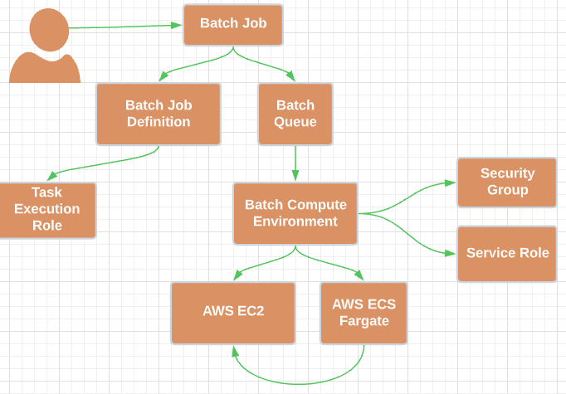
Batch Resource Relationship

Slide 4

AWS Batch: Why?
Execute process on-demand or via a schedule
Support long-running tasks
Minimize costs
Define min/max compute
Spin up and tear down compute as needed
Consolidate processes
You define the environment!
Spot instances supported

Slide 5
AWS Batch: Why NOT?
Setup/teardown of infrastructure takes time!
Required start time precision < 5-10 minutes
Require interval < 5-10 minutes
Alternatives
AWS Batch: except keep at least one compute environment running
Scheduled Lambda: for recurring processes up to 15 minutes in length
AWS CodeBuild: allows for running arbitrary tasks using any Docker image via a variety of triggers
AWS Glue: AWS’ official ETL service

Slide 6
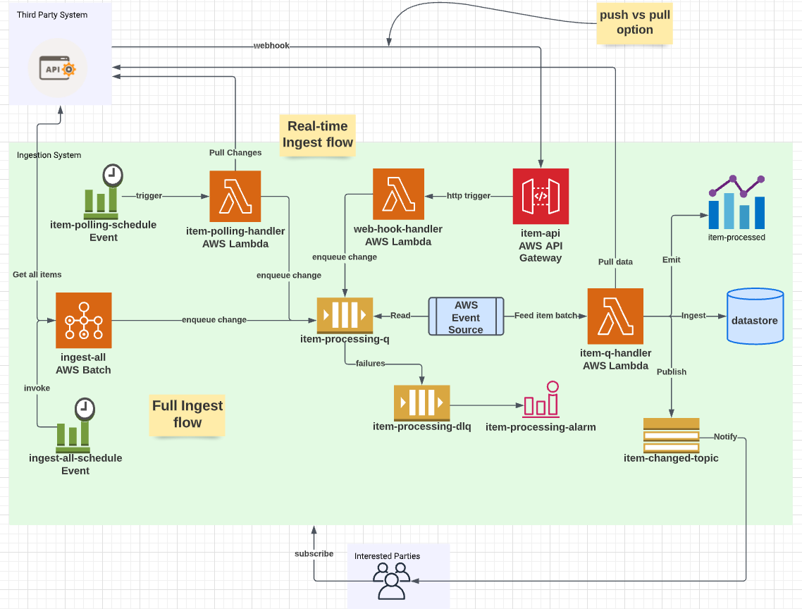
Need More Ingest?

Slide 7
Bonus! Ingest Lessons Learned
CW triggers guaranteed to run “at least once”
Handle duplicate submission gracefully
Does real-time need to pause during full ingest?
What happens if full ingest is interrupted? Durable Queue, such as SQS may help
METRICS! Emit a “per-item” metric and consider other metrics/dimensions
Ensure old items are removed? Enrich with a batch id
Enrich items with version id

Slide 8
AWS Batch Conclusions
Easy to set up and start using.
Saves time for devs.
Avoids use of active web server compute.
Devops can limit the compute environment.
Compute can be resized per job, as needed.
Ideal for long-running, infrequent tasks as well as some short-running, more frequent tasks.
Logical step for those already using ECS Fargate

Slide 9
Demo
Submit a job
Review configuration
Command
Env vars
Observe Job Status
Review results
Cloudwatch
Bonus: Cloudwatch insights filter

