Slide 1

Overview of Simple Multi Person Linear Model
SMPL
Krishna Satish D S
Master’s Degree Program in International Automotive Engineering (IAE)
Technische Hochschule Ingolstadt
krd3855@thi.de

Slide 2
Content
Motivation
Introduction
Related Works
SMPL Model
Training
Model Evaluation
DMPL
Limitations
Future Works
Conclusions

Slide 3

Motivation
Creating a realistic human body models that can represent different body shapes, deform naturally with pose, and exhibit soft-tissue motions like those of real humans and making sure that these models are fast to render, easy to deploy, and compatible with existing rendering engines.
Ex : Fast and Furious synthetic scene creation

Slide 4
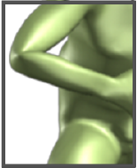
Related Works
Blend Skinning : each vertex in the mesh surface is transformed using a weighted influence of its neighboring bones.
Issue : Bowtie effects
Blend shapes : “Scattered data interpolation”
Issue : Manual sculpting of meshes
Allen et al’s Approach : Only considered torso and arms and rest were interpolated.
Issue : Cannot fully reproduce entire body deformation

Slide 5
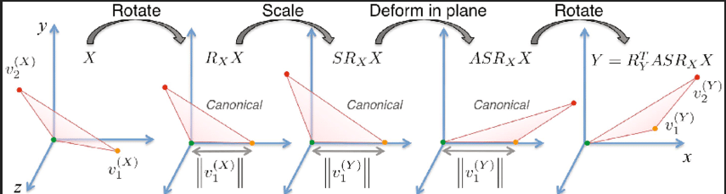
Related Work[2]
SCAPE models : Based on triangle deformation
Very powerful but not compatible with current rendering engines.
The final goal of this work is to derive a vertex-based learnt model which is as powerful as triangular deformation models which are efficient in representing wide range of body poses.

Slide 6
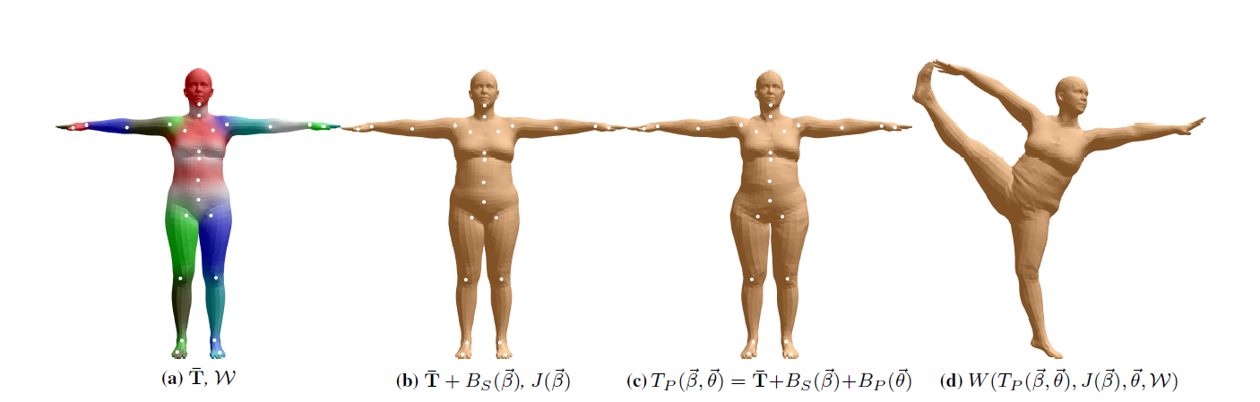
SMPL
In contrast to all the previous works, SMPL model learns blend shapes to correct for the limitations of standard skinning methods.
Different blend shapes for identity, pose, and soft-tissue dynamics are additively combined with a rest template mesh before being transformed by blend skinning.
objective function that penalizes the pervertex disparities between registered meshes and our model.

Slide 7
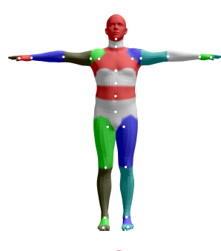

SMPL[2]
A single blend shape is represented as N = 6890 vertices with K = 23 joints.
Template shape T , Rest pose theta(*),
Blend weights( w )
blend shape function B_s(beta)
J(beta)
B_p(teta),
All of the functions are added to rest pose mesh.

Slide 8
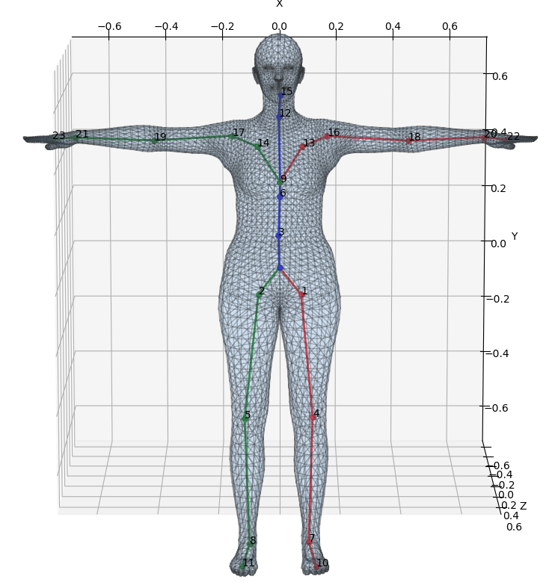
Blend Skinning SMPL
Each joint K is represented by axis angle representation
Shape parameters = 72 (3 + 23*3)
3 parameters for Global co-ordinate transformation,
23*3 parameters for each individual join in [x, y, z] direction

Slide 9
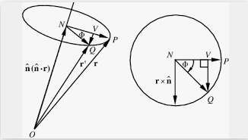
Rodrigues Transformation
Efficient algorithm for rotating a vector in space, given an axis and angle of rotation
Can be used to transform all three basis vectors to compute a rotation matrix.
Each joint’s corresponding axis-angle is transformed into a rotation matrix using Rodrigues formula

Slide 10
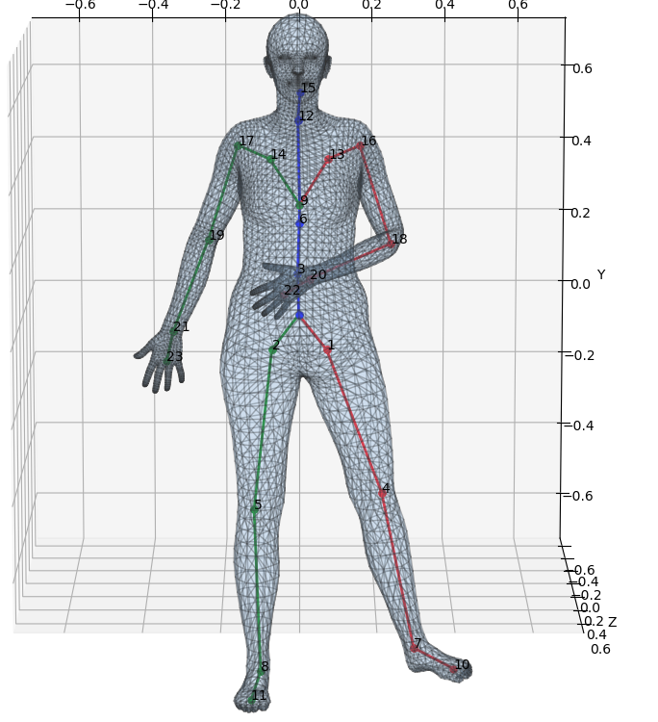




Rodrigues Transformation[2]
Each vertex t_i is transformed into t_i` by
w_k, is an element of the blend weight matrix
Taking all blend shapes and pose dependent weights into consideration,

Slide 11
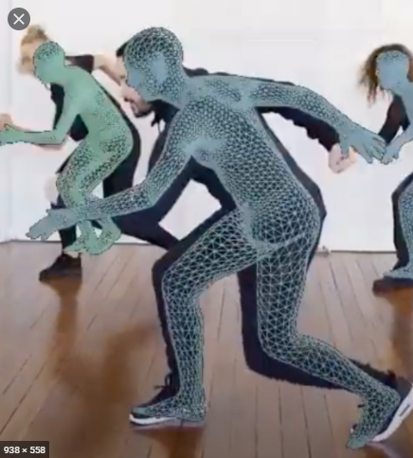
Training SMPL
We train the SMPL on two datasets
Multi-pose
Multi-shape
Aligning these poses and shapes into our template mesh so that our model could accurately represent the 3D scan and hence learn from it, this process is called as “registration”.

Slide 12
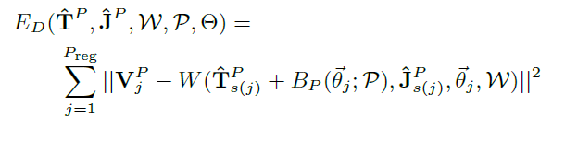



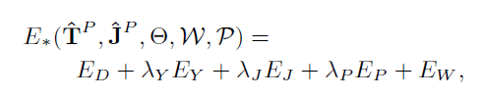
Pose Training
Euclidian distance between the vertices of the registered mesh and 3D model’s mesh
To prevent over-fitting of our model, we use many regularization techniques
Left-Right plane symmetry
Initial prediction regularization
Blend Weights regularization
Total Error is given by →

Slide 13
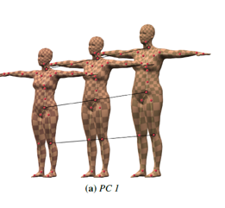

Shape Parameter Training
After pose normalizing the scans from multi-shape database we run a PCA(Principle Component Analysis) to obtain a shape space represented by {T,S},
The pose normalization transforms a raw registration (V_j)^s into registration (T_j)^s in the rest pose theta

Slide 14
SMPL Evaluation
Qualitative and Quantitative evaluation.
Model generalization: it is the ability of the model to fit to meshes of new people and poses; this test both shape and pose blend shapes
We first fit each model to each registered mesh, optimizing over shape beta and pose teta to find the best fit in terms of squared vertex distances.
Pose generalization is the ability to generalize a shape of an individual to new poses of the same person.
we take each individual mesh, select one of the estimated body shapes from the generalization task, and then optimize the pose, theta, for each of the other meshes of that subject, keeping the body shape fixed

Slide 15
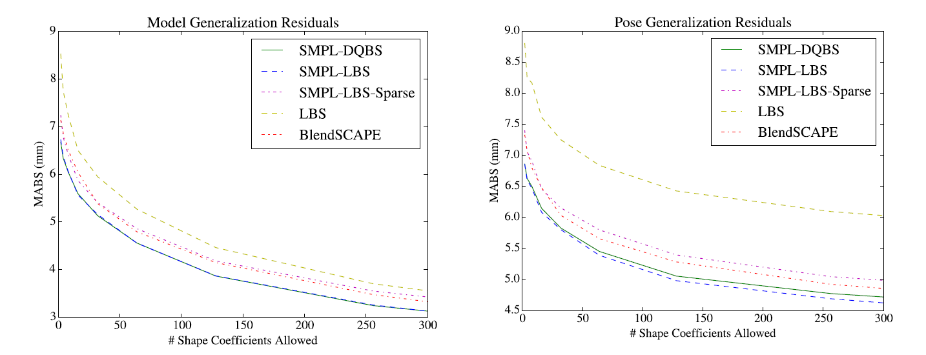
SMPL Evaluation[2]

Slide 16
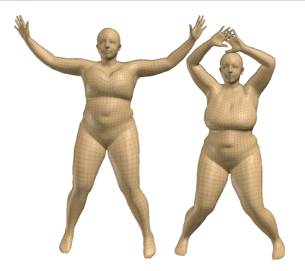

DMPL – Dynamic SMPL
SMPL models static soft-tissue deformations with pose it does not model dynamic deformations.
Displacements between SMPL and the observed meshes correspond to dynamic soft-tissue motions.
Additional displacements are correlated with velocities and accelerations of the body and limbs rather than with pose.

Slide 17

Limitations
SMPL does not model breathing, facial motion, muscle tension and etc.
We manually define the segmentation of the template into parts and rest pose.
The pose-dependent offsets of SMPL are not dependent on body shape.
SMPL is not trained on all human form factors (ex : infants )

Slide 18

Future work
SMPL uses 207 pose blend shapes which can be reduced with PCA.
Reduce the number of multiplications and consequently increase rendering speed

Slide 19
Thank You

