Slide 1
Data Centric AI
Data Knobs

Slide 2
Why Data Centric AI
Data Centric AI focuses on the data used for AI.
Focusing on high quality data that represent the world
Reduce bias in model
More accurate
Easy to debug
Need less data and experience to learn optimal policy

Slide 3
What is Data Centric AI
Data-centric AI is the discipline of systematically engineering the data used to build an AI system.
Reduce bias in model
More accurate
Easy to debug

Slide 4
How to build Data Centric AI
Data-centric AI focus on building high quality datasets.
Accurate Label
Diverse data points
Methods to audit and monitor data quality
Build test data sets
Identify good abstractions from data and process

Slide 5
Knobs - Data centric AI
Knobs are abstract levers
Enable you to augment data in reliable manner
Build gold data set that are compressed, well governed and good quality.
Enable you to handle PI, anonymize dataset
Design abstractions that reduce the data and experience require
Enable experimenting cheaper and faster.
Reduce the data or experience require to make inference

Slide 6
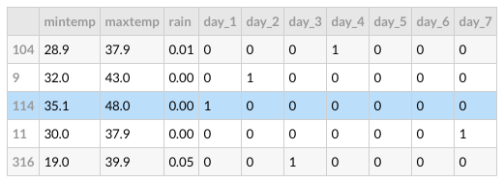





Knobs
α = [α0, α1, α2, …, αn] t
Data pipeline
Feature transformation
Model

